Slide 1
P1 Chapter 2: Quadratics Functions

Slide 2
Function Machines
A function is something which provides a rule on how to map inputs to outputs.
We saw at GCSE that functions were a formal way of describing a ‘number machine’:
Input
Output
$$x$$
$$f$$
$$2x$$
?
Name of the function (often $f$ or $g$)
Input
Output
$$f(x)=2x$$

Slide 3
Function Maps
You’ll cover functions extensively in future chapters, but for now, you need to understand the following concepts:
The domain of a function could potentially be any real number. If so, we’d write:
$$x∈ℝ$$
Inputs
Outputs
-1
1
?
0
0
The input $x$…
the set of real numbers
$$f\left(x\right)=x^{2}$$
2.89
is a member of…
1.7
2
4
We might be interested in what inputs $x$ give an output of 0. These are known as the roots of the function.
3.1
9.61
...
?
...
! The roots/zeroes of a function are the values of $x$ for which $f\left(x\right)=0$.
! The domain of a function is the set of possible inputs.
! The range of a function is the set of possible outputs.

Slide 4
Examples
If $f\left(x\right)=x^{2}−3x$ and $g\left(x\right)=x+5, x∈ℝ$
Find $f(−4)$
Find the values of $x$ for which $f\left(x\right)=g(x)$
Find the roots of $f(x)$.
Find the roots of $g(x)$.
Fro Note: The domain is usually stated for you.
a
?
The roots are the inputs which give an output of 0. So set output expression to 0.
$$x^{2}−3x=0 \\ x\left(x−3\right)=0 \\ x=0 or x=3$$
$$f\left(−4\right)={\left(−4\right)}^{2}−3\left(−4\right) \\ =28$$
c
?
Conceptually, we’re looking for the inputs of the functions which give the same outputs. We can just equate the output expressions.
$$x^{2}−3x=x+5 \\ x^{2}−4x−5=0 \\ \left(x−5\right)\left(x+1\right)=0 \\ x=5 or x=−1$$
b
?
d
$$x+5=0 \\ x=−5$$
?

Slide 5
Examples
Determine the minimum value of the function $f\left(x\right)=x^{2}−6x+2$, and state the value of $x$ for which this minimum occurs.
This means we want to minimise the output of the function.
You might try a (clumsy) approach of trying a few values of $x$ and try to see what makes the output as small as possible…
?
$$f\left(1\right)=1−6+2=−3 \\ f\left(2\right)=4−12+2=−6 \\ f\left(3\right)=9−18+2=−7 \\ f\left(4\right)=16−24+2=−6$$
This looks like the minimum as the value starts going up after.
But the best way to find the minimum/maximum value of a quadratic is to complete the square:
$$f\left(x\right)={\left(x−3\right)}^{2}−7$$
Since anything squared is at least 0, the smallest we can make the bracket is 0, which occurs when $x=3$.
?
$$f\left(1\right)={\left(−2\right)}^{2}−7=−3 \\ f\left(2\right)={\left(−1\right)}^{2}−7=−6 \\ f\left(3\right)=0^{2}−7=−7 \\ f\left(4\right)=1^{2}−7=−6$$
! If $f\left(x\right)={\left(x+a\right)}^{2}+b$, the minimum value of $f(x)$ is $b$, which occurs when $x=−a$.

Slide 6
Quickfire Questions
$$f(x)$$ | Completed square | Min/max value of $f(x)$ | $x$ for which this min/max occurs
$$x^{2}+4x+9$$ | $${\left(x+2\right)}^{2}+5$$ | $$5$$ | $$−2$$
$$x^{2}−10x+21$$ | $${\left(x−5\right)}^{2}−4$$ | $$−4$$ | $$5$$
$$10−x^{2}$$ | Already completed | $$10$$ | $$0$$
$$8−x^{2}+6x$$ | $$17−{\left(x−3\right)}^{2}$$ | $$17$$ | $$3$$
?
?
?
?
?
?
?
?
?
?
?
?

Slide 7
Test Your Understanding
1
Find the minimum value of $f\left(x\right)=2x^{2}+12x−5$ and state the value of $x$ for which this occurs.
2
Find the roots of the function $f\left(x\right)=2x^{2}+3x+1$
?
$$2x^{2}+3x+1=0 \\ \left(2x+1\right)\left(x+1\right)=0 \\ x=−\frac{1}{2} or x=−1$$
?
$$f\left(x\right)=2\left(x^{2}+6x\right)−5 \\ =2\left({\left(x+3\right)}^{2}−9\right)−5 \\ =2{\left(x+3\right)}^{2}−18−5 \\ =2{\left(x+3\right)}^{2}−23$$
Minimum value is -23.
$x$ at which this occurs is -3.
3
Find the roots of the function $f\left(x\right)=x^{4}−x^{2}−6$
?
$$x^{4}−x^{2}−6=0 \\ \left(x^{2}+2\right)\left(x^{2}−3\right)=0 \\ x^{2}=−2 or x^{2}=3 \\ x=±\sqrt{3}$$

Slide 8
Exercise 2.3
Pearson Pure Mathematics Year 1/AS
Page 8

Slide 9
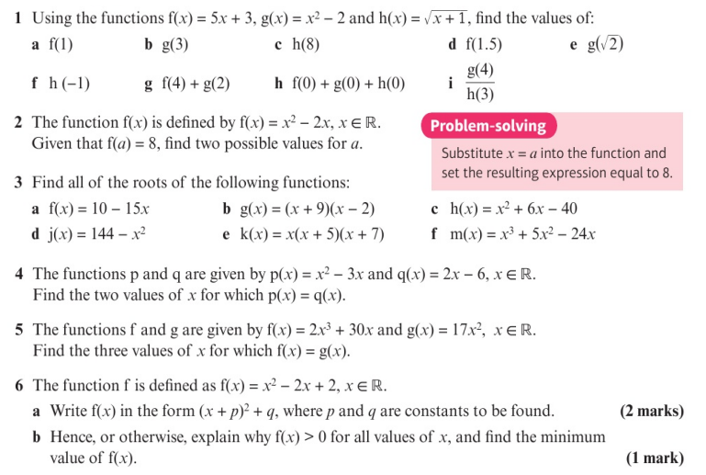
Homework Exercise

Slide 10
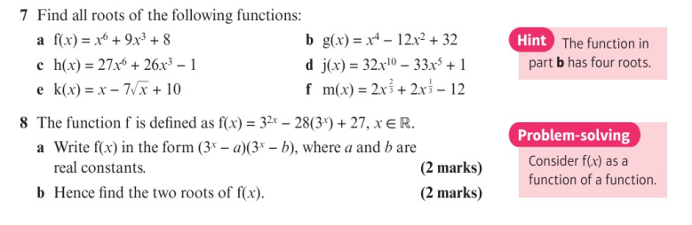
Homework Exercise

Slide 11
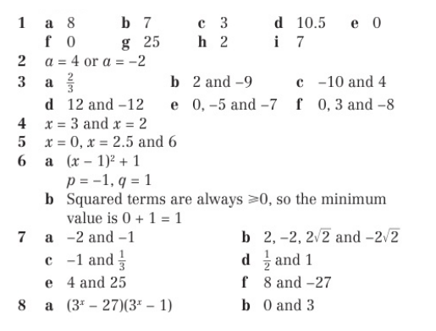
Homework Answers

