Slide 1
M1 Chapter 9: Constant Acceleration Two Base Formulae

Slide 2
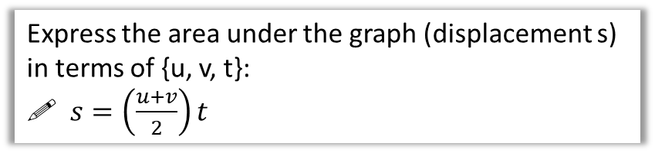

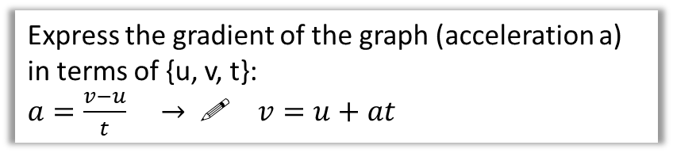
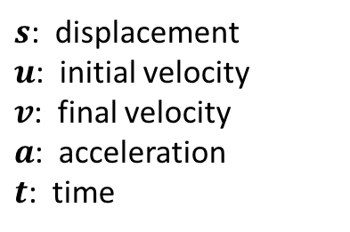
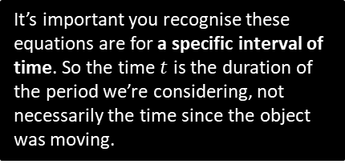


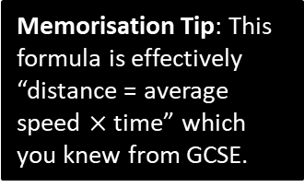
“suvat” Equations (part 1)
When there is constant acceleration, there are a variety of formulae which relate the following 5 quantities:
Velocity
It’s important you recognise these equations are for a specific interval of time. So the time $t$ is the duration of the period we’re considering, not necessarily the time since the object was moving.
$s$: displacement
$u$: initial velocity
$v$: final velocity
$a$: acceleration
$t$: time
$$v$$
$$u$$
Time
$$t$$
Each “suvat” equation we will see involves 4 of the 5 quantities. In a problem we’ll know 3 of the quantities and we wish to find an unknown 4th quantity. We need to select the appropriate equation.
Express the gradient of the graph (acceleration a) in terms of {u, v, t}:
$a=\frac{v−u}{t} →$! $v=u+at$
You are expected to be able to prove each “suvat” question using the above graph.
?
Express the area under the graph (displacement s) in terms of {u, v, t}:
! $s=\left(\frac{u+v}{2}\right)t$
Memorisation Tip: This formula is effectively “distance = average speed $×$ time” which you knew from GCSE.
?

Slide 3

Examples
[Textbook] A cyclist is travelling along a straight road. She accelerates at a constant rate from a velocity of 4 ms⁻¹ to a velocity of 7.5 ms-1 in 40 seconds. Find:
the distance she travels in these 40 seconds
her acceleration in these 40 seconds.
a
$$s=?, u=4, v=7.5, \\ a=?, t=40$$
$$s=\left(\frac{u+v}{2}\right)t=\left(\frac{4+7.5}{2}\right)×40 \\ =230 m$$
$$v=u+at \\ 7.5=4+40a \\ a=0.0875$$
?
Exam Pro: Write a suvat-table indicating the quantity you need to find, and in particular, the quantity you DO NOT need for the given calculation.
b
?

Slide 4

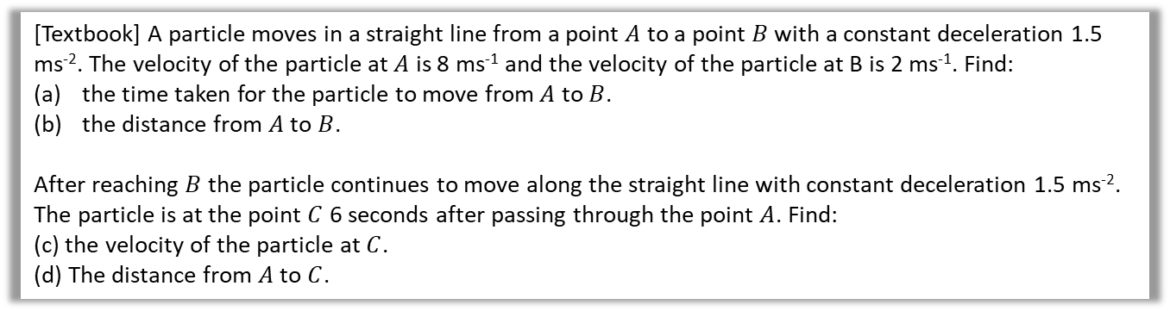

Examples
[Textbook] A particle moves in a straight line from a point $A$ to a point $B$ with a constant deceleration 1.5 ms⁻². The velocity of the particle at $A$ is 8 ms⁻¹ and the velocity of the particle at B is 2 ms⁻¹. Find:
the time taken for the particle to move from $A$ to $B$.
the distance from $A$ to $B$.
After reaching $B$ the particle continues to move along the straight line with constant deceleration 1.5 ms⁻². The particle is at the point $C$ 6 seconds after passing through the point $A$. Find:
(c) the velocity of the particle at $C$.
(d) The distance from $A$ to $C$.
a
$$s=?, u=8, v=2, a=−1.5, t=?$$
$$v=u+at \\ 2=8−1.5t$$ $t=4$ s
$s=\left(\frac{u+v}{2}\right)t=\left(\frac{8+2}{2}\right)×4=20$m
As stated before, think about what period of time we’re considering.
?
$$u=8, a=−1.5, t=6, v=?$$
$$v=u+at \\ =8+\left(−1.5\right)×6=−1$$
$∴$ velocity is 1ms⁻¹ in the direction $\vec{BA}$ (i.e. backwards)
$s=\left(\frac{u+v}{2}\right)t=\left(\frac{8−1}{2}\right)×6=21$m
c
?
b
?
d
?

Slide 5

Test Your Understanding
[Textbook] A car moves from traffic lights along a straight road with constant acceleration. The car starts from rest at the traffic lights and 30 second later the car passes a speed-trap where it is registered as travelling at 45 km h⁻¹. Find:
the acceleration of the car
the distance between the traffic lights and the speed-trap.
Tip: Ensure everything is in SI units first.
a
?
$$45×\frac{1000}{3600}=12.5 ms^{−1}$$
$$u=0, v=12.5, t=30, a=?, s=?$$
$$v=u+at \\ 12.5=0+30a → a=\frac{5}{12} ms^{−2}$$
$s=\left(\frac{u+v}{2}\right)t=\left(\frac{0+12.5}{2}\right)×30=187.5$m
b
?

Slide 6
Exercise 9.3 First two formulae
Pearson Stats/Mechanics Year 1
Pages 60-61

Slide 7
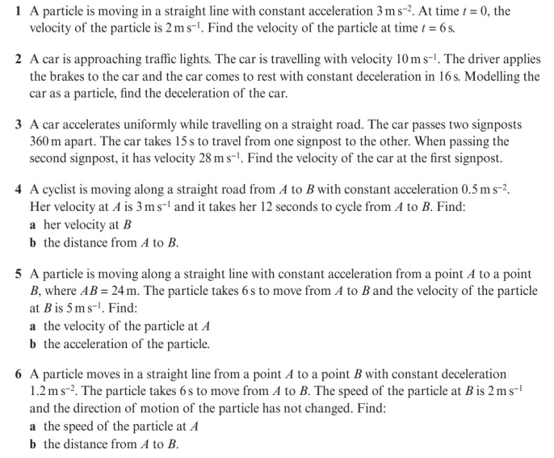
Homework Exercise

Slide 8
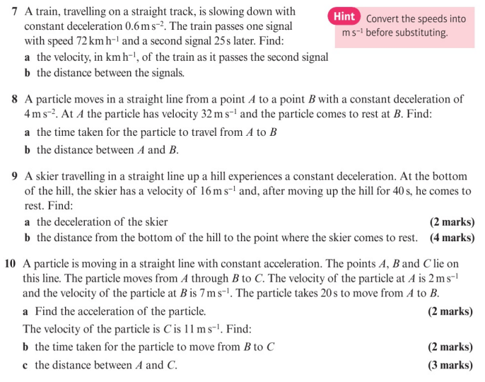
Homework Exercise

Slide 9
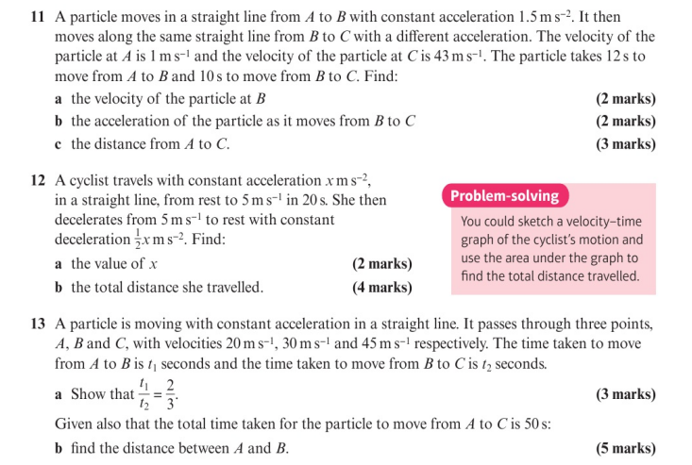
Homework Exercise

Slide 10
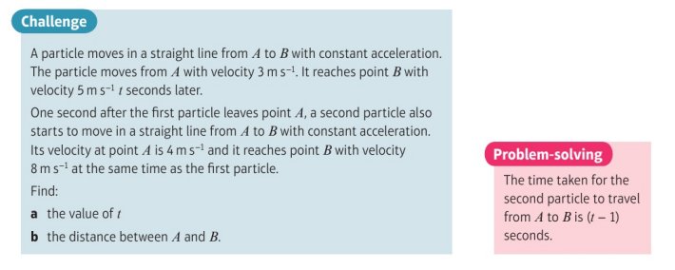
Homework Exercise

Slide 11
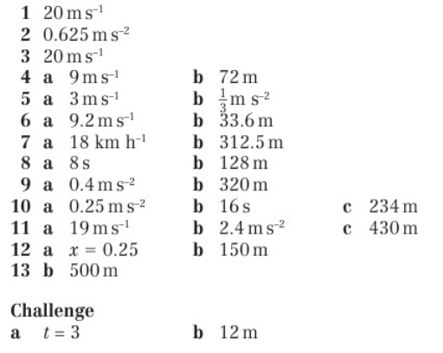
Homework Answers

