Slide 1
M2 Chapter 8: Further Kinematics Vector Projectiles

Slide 2



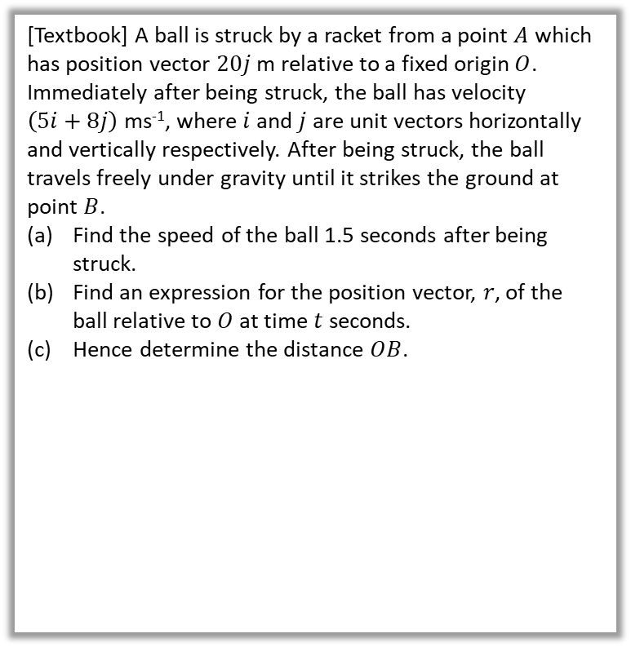



Vector methods for projectiles
Previously we considered the initial speed of the projectile and the angle of projection. But we could also use a velocity vector to represent the initial projection (vectors have both direction and magnitude) and subsequent motion.
[Textbook] A ball is struck by a racket from a point $A$ which has position vector $20j$ m relative to a fixed origin $O$. Immediately after being struck, the ball has velocity $\left(5i+8j\right)$ ms⁻¹, where $i$ and $j$ are unit vectors horizontally and vertically respectively. After being struck, the ball travels freely under gravity until it strikes the ground at point $B$.
Find the speed of the ball 1.5 seconds after being struck.
Find an expression for the position vector, $r$, of the ball relative to $O$ at time $t$ seconds.
Hence determine the distance $OB$.
a
$$v=u+at \\ =\left(\begin{matrix}5 \\ 8\end{matrix}\right)+\left(\begin{matrix}0 \\ −9.8\end{matrix}\right)t=\left(\begin{matrix}5 \\ 8−9.8t\end{matrix}\right)$$
When $t=1.5, v=\left(\begin{matrix}5 \\ −6.7\end{matrix}\right)$
Speed $=\left|v\right|=\sqrt{5^{2}+{6.7}^{2}}=8.4$ms⁻¹
Displacement relative to $A$:
$$r_{A}=ut+\frac{1}{2}at^{2} \\ =\left(\begin{matrix}5 \\ 8\end{matrix}\right)t+\frac{1}{2}\left(\begin{matrix}0 \\ −9.8\end{matrix}\right)t^{2}=\left(\begin{matrix}5t \\ 8t−4.9t^{2}\end{matrix}\right)$$
So position relative to $O$:
$$r_{O}=\left(\begin{matrix}0 \\ 20\end{matrix}\right)+\left(\begin{matrix}5t \\ 8t−4.9t^{2}\end{matrix}\right) \\ =\left(\begin{matrix}5t \\ 8t−4.9t^{2}+20 \end{matrix}\right)$$
When $j$-component is 0:
$$8t−4.9t^{2}+20=0 → t=2.995…$$
$i$-component: $5t=15$ m (2sf)
?
b
?
$$\left(5i+8j\right) ms^{−1}$$
$$A$$
$$20m$$
c
?
$$O$$
$$B$$

Slide 3
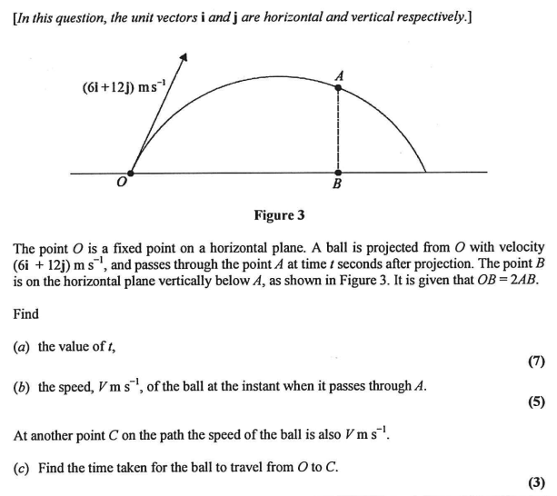
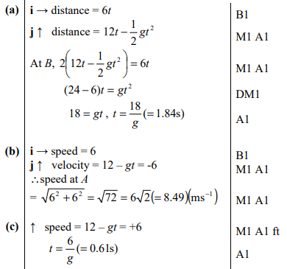
Test Your Understanding
Edexcel M2(Old) Jan 2012 Q7
?
?
?

Slide 4
Exercise 8.2
Pearson Stats/Mechanics Year 2
Pages 69-70

Slide 5
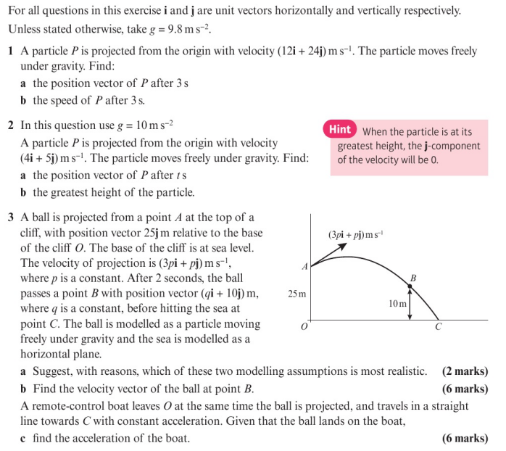
Homework Exercise

Slide 6
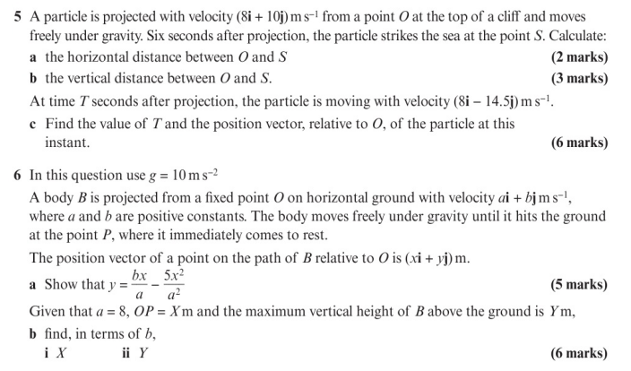
Homework Exercise

Slide 7
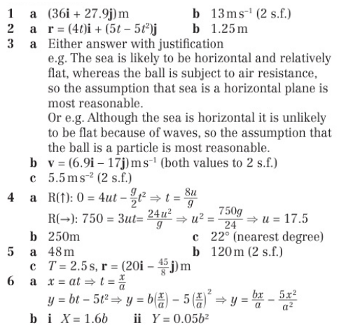
Homework Answers

