Slide 1
P1 Chapter 2: Quadratics Solving Quadratics

Slide 2
Solving Quadratic Equations
$$x^{2}+5x=6$$
There are three ways of solving a quadratic equation.
One is by completing the square, which we’ll do later.
What are the other two ways?
By factorisation
Using the quadratic formula.
?
?
If $ax^{2}+bx+c=0$ then
$$x=\frac{−b±\sqrt{b^{2}−4ac}}{2a}$$
$$x^{2}+5x−6=0 \\ a=1, b=5, c=−6 \\ x=\frac{−5±\sqrt{25+24}}{2} \\ =\frac{−5±7}{2} \\ =1 or −6$$
$$x^{2}+5x−6=0 \\ \left(x+6\right)\left(x−1\right)=0 \\ x=−6, x=1$$
Put in form.
$ax^{2}+bx+c=0$ with 0 on one side
Factorise. If the product of two things is 0, at least one must be 0.

Slide 3
1 :: Solving Quadratic Equations
Solving without factorising
If the subject only appears once however, it might be easier not to expand out/factorise:
$${\left(x−1\right)}^{2}=5 \\ x−1=±\sqrt{5} \\ x=1±\sqrt{5}$$
If you can’t see why the $±$ is required, think about the solutions to: $x^{2}=4$.
$2^{2}=4$, but ${\left(−2\right)}^{2}=4$ as well!
So $x=±2$.
?
Quadratics ‘in disguise’
When we have an expression like say $x^{2}+3x−2$, we say it is “quadratic in $x$”. In trigonometry you will have to solve equations like ${\left(\sin{x}\right)}^{2}+3\sin{x}+2$. We say that the expression is “quadratic in $\sin{x}$”.
Either use a suitable substitution so that you have a ‘normal’ quadratic, or go straight for the factorisation if you’re feeling more confident (recommended!).
Solve $x−6\sqrt{x}+8=0$
Let $y=\sqrt{x}$, then:
$$y^{2}−6y+8=0 \\ \left(y−2\right)\left(y−4\right)=0 \\ y=2, y=4 → \sqrt{x}=2, \sqrt{x}=4 \\ x=4 or x=16$$
?
substitution
?
$$\left(\sqrt{x}−2\right)\left(\sqrt{x}−4\right)=0 \\ \sqrt{x}=2 or \sqrt{x}=4 \\ x=4 or x=16$$
unchanged

Slide 4
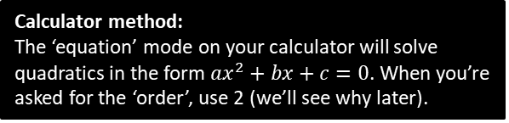
Test Your Understanding
1
Solve ${\left(x+3\right)}^{2}=x+5$ using factorisation.
2
Solve ${\left(2x+1\right)}^{2}=5$
?
$$2x+1=±\sqrt{5} \\ 2x=−1±\sqrt{5} \\ x=−\frac{1}{2}±\frac{1}{2}\sqrt{5}$$
?
$$x^{2}+6x+9=x+5 \\ x^{2}+5x+4=0 \\ \left(x+4\right)\left(x+1\right)=0 \\ x=−4 or x=−1$$
3
Solve $\sqrt{x+3}=x−3$
4
Solve $2x+\sqrt{x}−1=0$
?
?
Squaring both sides:
$$x+3={\left(x−3\right)}^{2} \\ x+3=x^{2}−6x+9 \\ x^{2}−7x+6=0 \\ \left(x−6\right)\left(x−1\right)=0 \\ x=1 or x=6$$
However, squaring both sides of an equation can generate false solutions. e.g. If $x=−2$, squaring gives $x^{2}=4$, which falsely creates the extra solution $x=2$! We therefore need to check by substituting into the original equation, where we find only $x=6$ works.
$$\left(2\sqrt{x}−1\right)\left(\sqrt{x}+1\right)=0 \\ \sqrt{x}=\frac{1}{2} or \sqrt{x}=−1 \\ x=\frac{1}{4}$$
The latter gives no solution because the square root of a number can’t give a negative number.
Calculator method:
The ‘equation’ mode on your calculator will solve quadratics in the form $ax^{2}+bx+c=0$. When you’re asked for the ‘order’, use 2 (we’ll see why later).

Slide 5
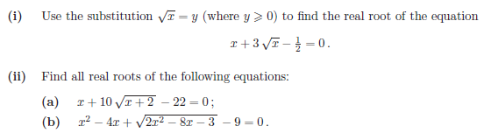
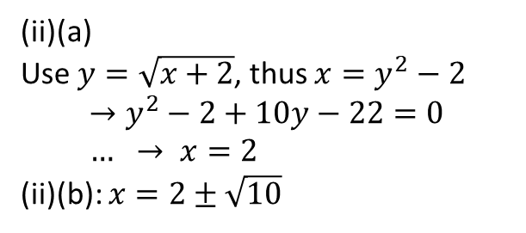

Exercise 2.1
Pearson Pure Mathematics Year 1/AS
Page 7
1
$$y^{2}+3y−\frac{1}{2}=0 \\ 2y^{2}+6y−1=0 \\ y=\frac{−6±\sqrt{36+8}}{4} \\ \sqrt{x}=−\frac{3}{2}±\frac{\sqrt{11}}{2}$$
Since $\sqrt{x}>0$:
$$\sqrt{x}=−\frac{3}{2}+\frac{\sqrt{11}}{2} \\ x=5−\frac{3}{2}\sqrt{11}$$
? i
? ii(a)
(ii)(a)
Use $y=\sqrt{x+2}$, thus $x=y^{2}−2$
$$→y^{2}−2+10y−22=0 \\ … → x=2$$
(ii)(b): $x=2±\sqrt{10}$
? ii(b)

Slide 6
Exercise 1.1
Pearson Pure Mathematics Year 1/AS
Pages 1

Slide 7
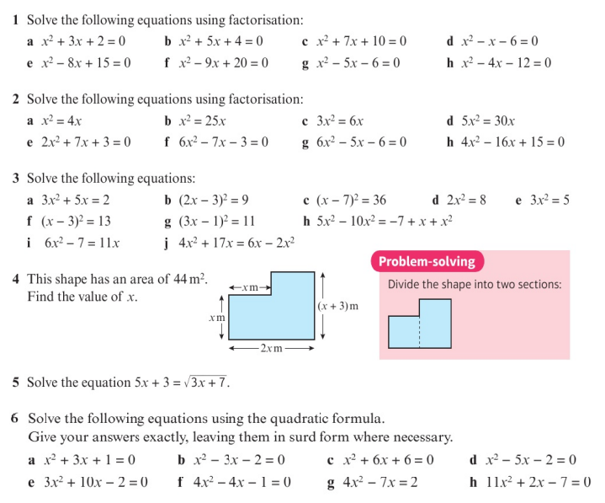
Homework Exercise

Slide 8
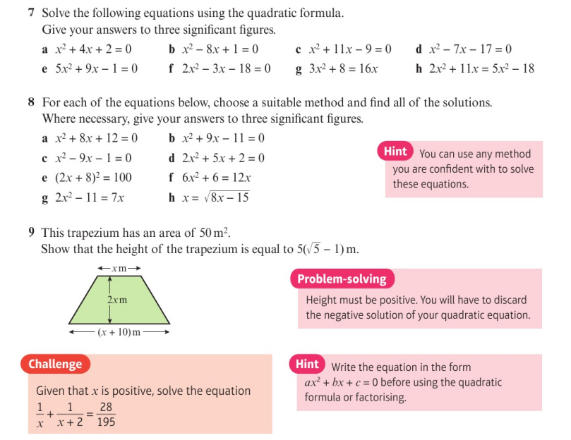
Homework Exercise

Slide 9
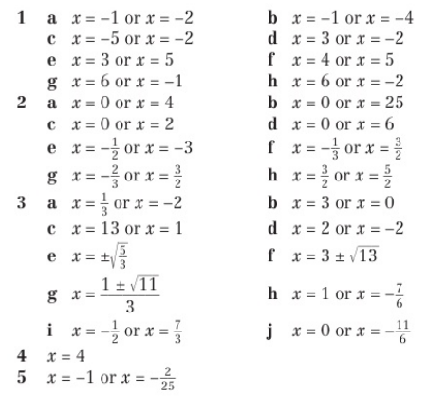
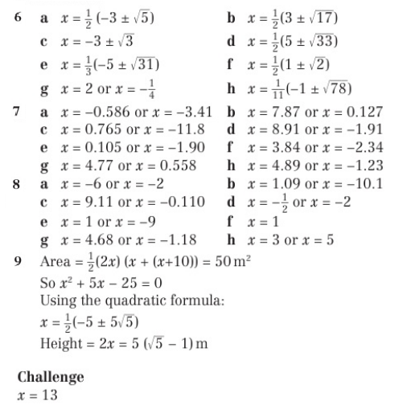
Homework Answers

