Slide 1
P2 Chapter 1: Algebra Techniques
Algebraic Division

Slide 2
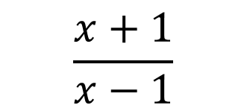
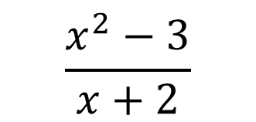
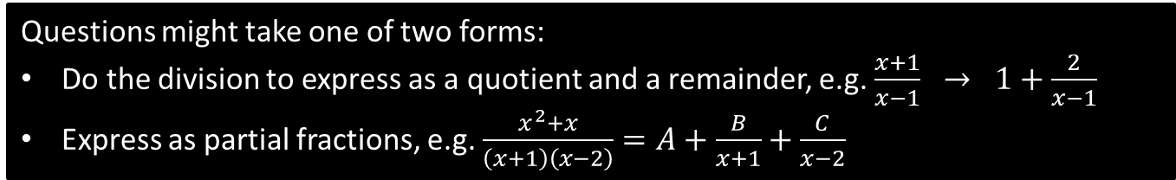
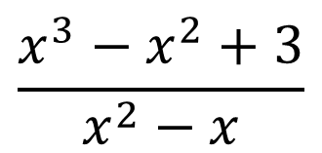
Dealing with Improper Fractions
In Pure Year 1, we saw that the ‘degree’ of a polynomial is the highest power, e.g. a quadratic has degree 2.
An algebraic fraction is improper if the degree of the numerator is at least the degree of the denominator.
$$\frac{x^{3}−x^{2}+3}{x^{2}−x}$$
$$\frac{x^{2}−3}{x+2}$$
$$\frac{x+1}{x−1}$$
A partial fraction is still improper if the degree is the same top and bottom.
Questions might take one of two forms:
Do the division to express as a quotient and a remainder, e.g. $\frac{x+1}{x−1} → 1+\frac{2}{x−1}$
Express as partial fractions, e.g. $\frac{x^{2}+x}{\left(x+1\right)\left(x−2\right)}=A+\frac{B}{x+1}+\frac{C}{x−2}$

Slide 3

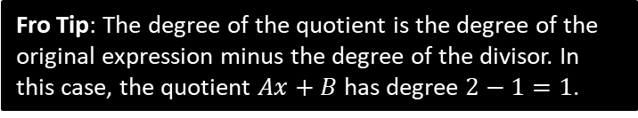

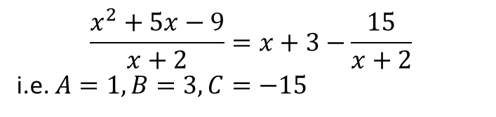
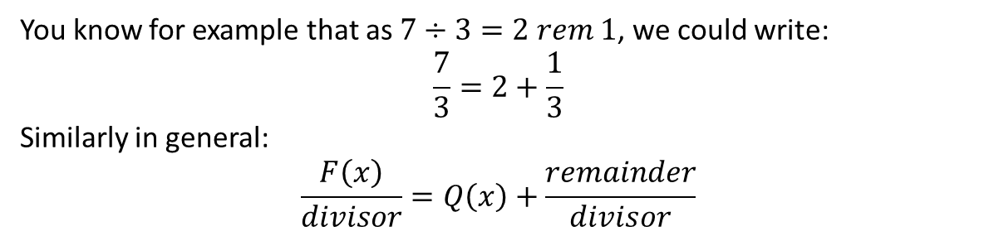




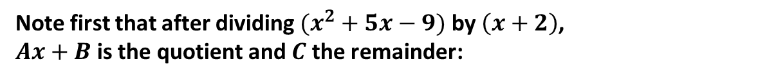

Reducing to Quotient and Remainder
You know for example that as $7÷3=2 rem 1$, we could write:
$$\frac{7}{3}=2+\frac{1}{3}$$
Similarly in general:
$$\frac{F\left(x\right)}{divisor}=Q\left(x\right)+\frac{remainder}{divisor}$$
Quotient
If $\frac{x^{2}+5x−9}{x+2}=Ax+B+\frac{C}{x+2}$, determine the values of $A$, $B$ and $C$.
?
Note first that after dividing $(x^{2}+5x−9)$ by $\left(x+2\right)$,
$Ax+B$ is the quotient and $C$ the remainder:
$$x + 3$$
$$x+2$$
$$x^{2}+5x−9$$
$$\frac{x^{2}+5x−9}{x+2}=x+3−\frac{15}{x+2}$$
i.e. $A=1, B=3, C=−15$
$$x^{2}+2x$$
$$3x−9$$
$$3x+6$$
$$−15$$
Fro Tip: The degree of the quotient is the degree of the original expression minus the degree of the divisor. In this case, the quotient $Ax+B$ has degree $2−1=1$.

Slide 4
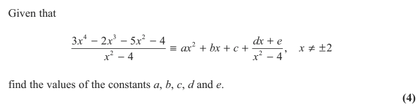
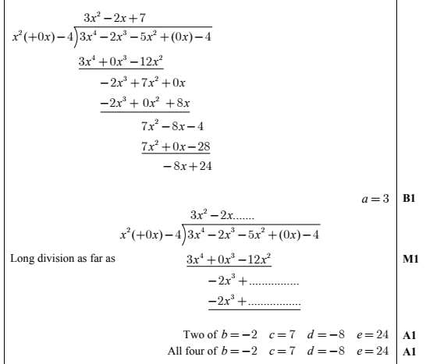
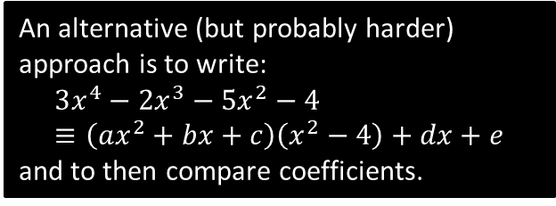
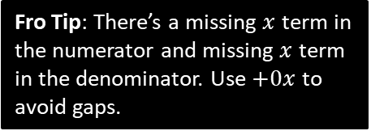
Test Your Understanding
Edexcel C4 June 2013 Q1
Fro Tip: There’s a missing $x$ term in the numerator and missing $x$ term in the denominator. Use $+0x$ to avoid gaps.
?
An alternative (but probably harder) approach is to write:
$$3x^{4}−2x^{3}−5x^{2}−4≡\left(ax^{2}+bx+c\right)\left(x^{2}−4\right)+dx+e$$
and to then compare coefficients.

Slide 5


Dealing with Improper Fractions
Q
Split $\frac{3x^{2}−3x−2}{\left(x−1\right)\left(x−2\right)}$ into partial fractions.
Method 1: Algebraic Division
Method 2: Using One Identity
?
?
$$\frac{3x^{2}−3x−2}{\left(x−1\right)\left(x−2\right)}≡\frac{3x^{2}−3x−2}{x^{2}−3x+2}$$
Dividing algebraically gives:
$$3+\frac{6x−8}{x^{2}−3x+2}$$
Turn numerator back:
$$=3+\frac{6x−8}{\left(x−1\right)\left(x−2\right)}$$
Let $\frac{6x−8}{\left(x−1\right)\left(x−2\right)}≡\frac{A}{x−1}+\frac{B}{x−2}$
$$A=2$$
$$B=4$$
So $\frac{3x^{2}−3x−2}{\left(x−1\right)\left(x−2\right)}≡3+\frac{2}{x−1}+\frac{4}{x−2}$
Let:
$$\frac{3x^{2}−3x−2}{\left(x−1\right)\left(x−2\right)}≡A+\frac{B}{x−1}+\frac{C}{x−2}$$
$$3x^{2}−3x−2≡A\left(x−1\right)\left(x−2\right)+B\left(x−2\right)+C\left(x−1\right)$$
If $x=2$: $4=C$
If $x=1$: $−2=−B → B=2$
Comparing coefficients of $x^{2}$:
$3=A$
Note: Mark-schemes give “using-one-identity” as “Method 1” – implying more standard!

Slide 6

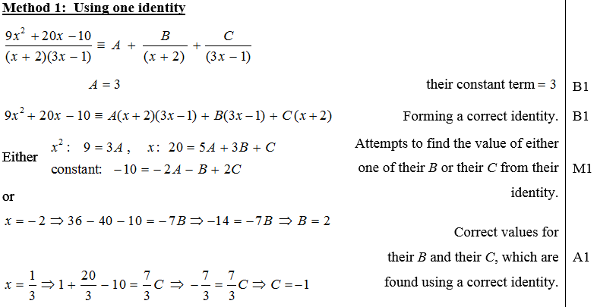
Test Your Understanding
C4 Jan 2013 Q3
?

Slide 7
Exercise 1.5
Pearson Pure Mathematics Year 2/AS
Page 4

Slide 8
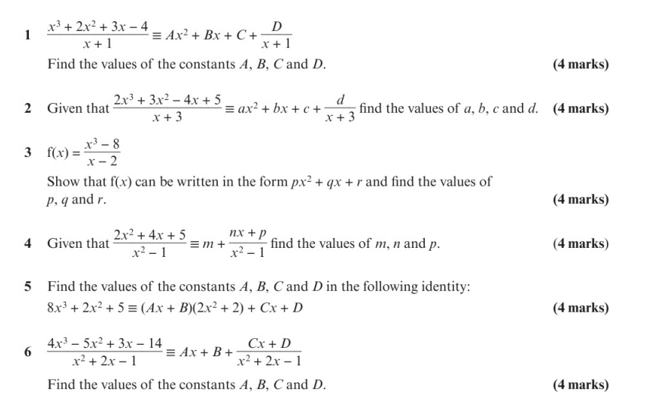
Homework Exercise

Slide 9
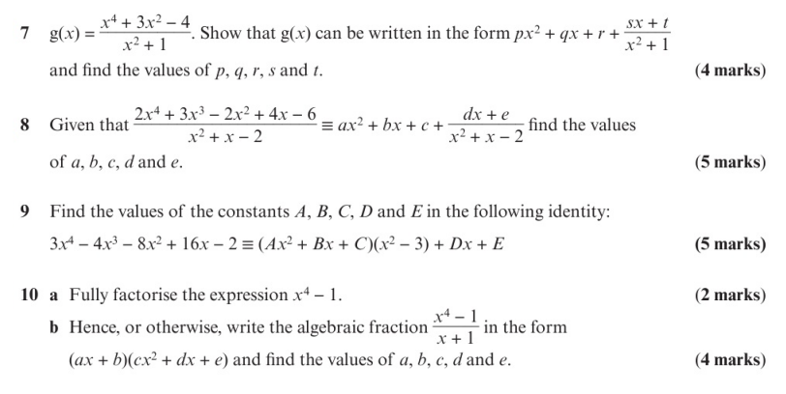
Homework Exercise

Slide 10
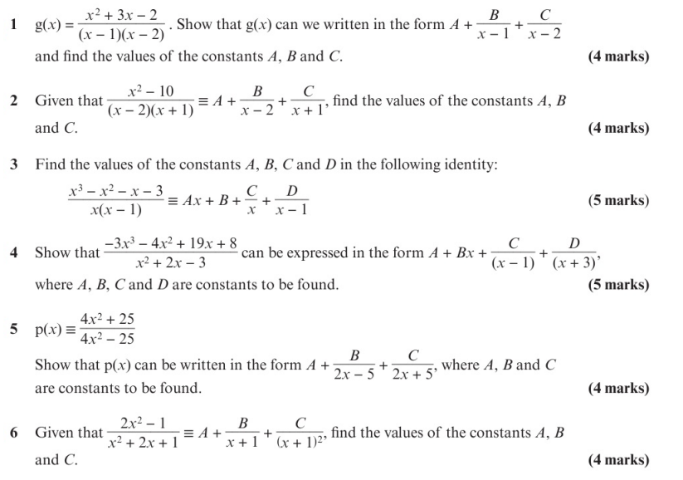
Homework Exercise

Slide 11
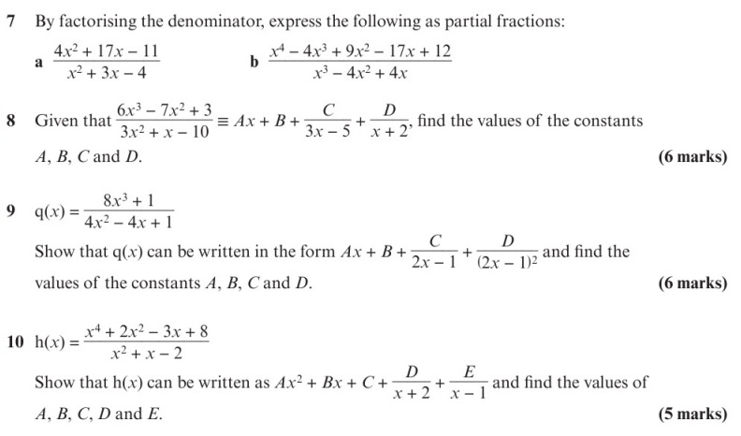
Homework Exercise

Slide 12
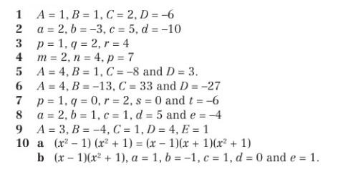
Homework Answers

