Slide 1
M2 Chapter 6: Projectiles Projectile Motion Formulae

Slide 2

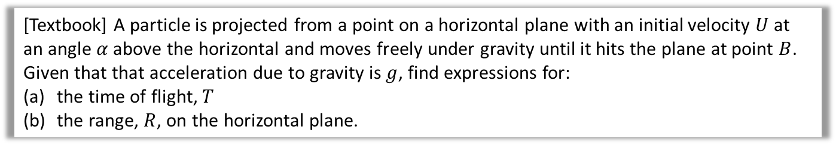

Projectile Formulae
There’s nothing new here, but you may be asked to prove more general results regarding projectile motion.
[Textbook] A particle is projected from a point on a horizontal plane with an initial velocity $U$ at an angle $α$ above the horizontal and moves freely under gravity until it hits the plane at point $B$.
Given that that acceleration due to gravity is $g$, find expressions for:
the time of flight, $T$
the range, $R$, on the horizontal plane.
a
?
$$R\left(↑\right): s=0, u=U\sin{α}, v= ,a=−g,t=? \\ s=ut+\frac{1}{2}at^{2} \\ 0=\left(U\sin{α}\right)t−\frac{1}{2}gt^{2}=t\left(U\sin{α}−\frac{1}{2}gt\right) \\ t=0 (at A) or t=\frac{2U\sin{α}}{g}$$
$$R\left(→\right): R=U\cos{α}×\frac{2U\sin{α}}{g}=\frac{2U^{2}}{g}\sin{α}cos{α} \\ R=\frac{U^{2}\sin{2α}}{g}$$
b
?
Using double-angle formula for $sin$

Slide 3

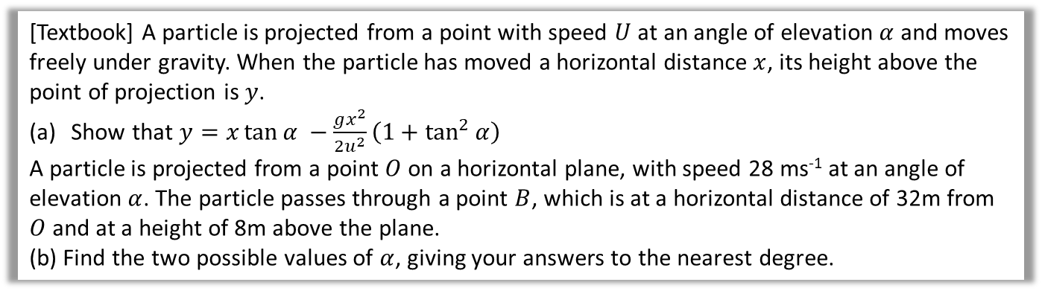
Projectile Formulae
[Textbook] A particle is projected from a point with speed $U$ at an angle of elevation $α$ and moves freely under gravity. When the particle has moved a horizontal distance $x$, its height above the point of projection is $y$.
Show that $y=x\tan{α −\frac{gx^{2}}{2u^{2}}\left(1+\tan^{2}{α}\right)}$
A particle is projected from a point $O$ on a horizontal plane, with speed 28 ms⁻¹ at an angle of elevation $α$. The particle passes through a point $B$, which is at a horizontal distance of 32m from $O$ and at a height of 8m above the plane.
(b) Find the two possible values of $α$, giving your answers to the nearest degree.
a
?
$R\left(→\right): x=U\cos{α}×t (1)$
$$R\left(↑\right): s=ut+\frac{1}{2}at^{2} \\ y=U\sin{α}×t−\frac{1}{2}gt^{2} (2)$$
The target equation doesn’t contain $t$, so much $t$ the subject of $(1)$ and substitute into $(2)$:
$$t=\frac{x}{U\cos{α}} ⇒ y=U\sin{α} \left(\frac{x}{U\cos{α}}\right)−\frac{1}{2}g{\left(\frac{x}{U\cos{α}}\right)}^{2} \\ =x\tan{α}−\frac{gx^{2}}{2U^{2}}\sec^{2}{α} \\ =x\tan{α −\frac{gx^{2}}{2u^{2}}\left(1+\tan^{2}{α}\right)}$$
Don’t be intimidated by the lack of numerical values. Just do what you’d usually do and resolve both vertically and horizontally!

Slide 4




Projectile Formulae
[Textbook] A particle is projected from a point with speed $U$ at an angle of elevation $α$ and moves freely under gravity. When the particle has moved a horizontal distance $x$, its height above the point of projection is $y$.
Show that $y=x\tan{α −\frac{gx^{2}}{2u^{2}}\left(1+\tan^{2}{α}\right)}$
A particle is projected from a point $O$ on a horizontal plane, with speed 28 ms⁻¹ at an angle of elevation $α$. The particle passes through a point $B$, which is at a horizontal distance of 32m from $O$ and at a height of 8m above the plane.
(b) Find the two possible values of $α$, giving your answers to the nearest degree.
b
?
$y =x\tan{α −\frac{gx^{2}}{2u^{2}}\left(1+\tan^{2}{α}\right)}$ $$8=32\tan{α}−6.4\left(1+\tan^{2}{α}\right)$$ This is quadratic in $\tan{α}$:
$$6.4\tan^{2}{α}−32\tan{α+14.4=0} \\ 4\tan^{2}{α}−20\tan{α}+9=0 \\ \left(2\tan{α}−1\right)\left(2\tan{α}−9\right)=0 \\ \tan{α=\frac{1}{2},\frac{9}{2}} \\ α=27°, 77°$$
This is an interesting result, because in general, for a fixed initial speed, there are 2 (and only 2) angles which result in a specified (reachable) point being passed.
$$y$$
$$B$$
$$x$$

Slide 5
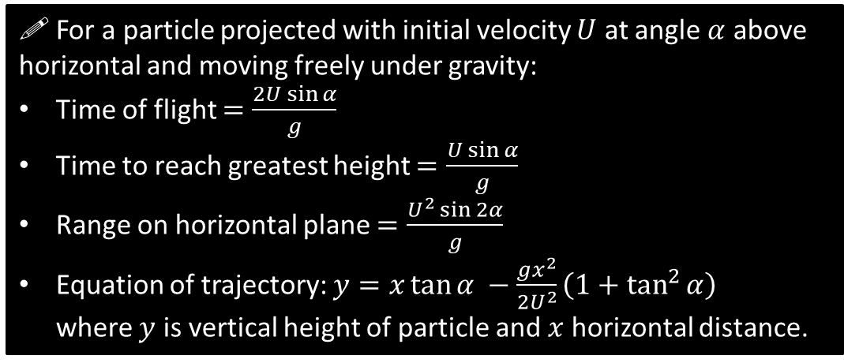
General Results
Exam Note: You may be asked to derive these. But don’t attempt to memorise them or even actually use them to solve exam problems:
– instead, use the techniques used earlier in the chapter.
! For a particle projected with initial velocity $U$ at angle $α$ above horizontal and moving freely under gravity:
Time of flight $=\frac{2U\sin{α}}{g}$
Time to reach greatest height $=\frac{U\sin{α}}{g}$
Range on horizontal plane $=\frac{U^{2}\sin{2α}}{g}$
Equation of trajectory: $y=x\tan{α −\frac{gx^{2}}{2U^{2}}\left(1+\tan^{2}{α}\right)}$ where $y$ is vertical height of particle and $x$ horizontal distance.

Slide 6
Exercise 6.4
Pearson Stats/Mechanics Year 2
Pages 52-53

Slide 7
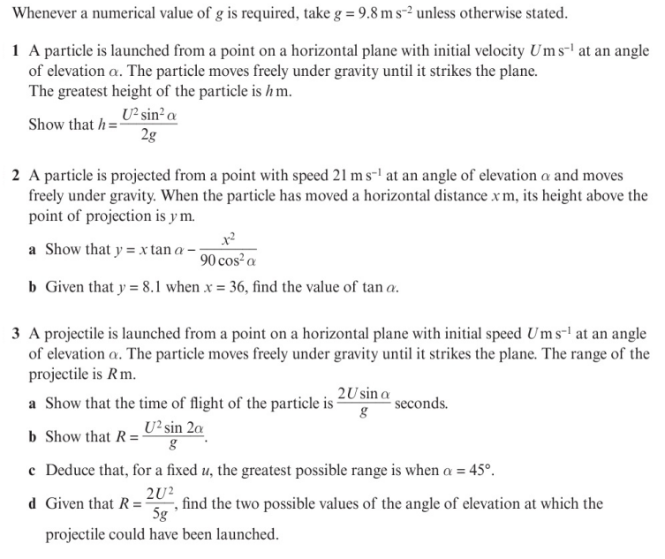
Homework Exercise

Slide 8
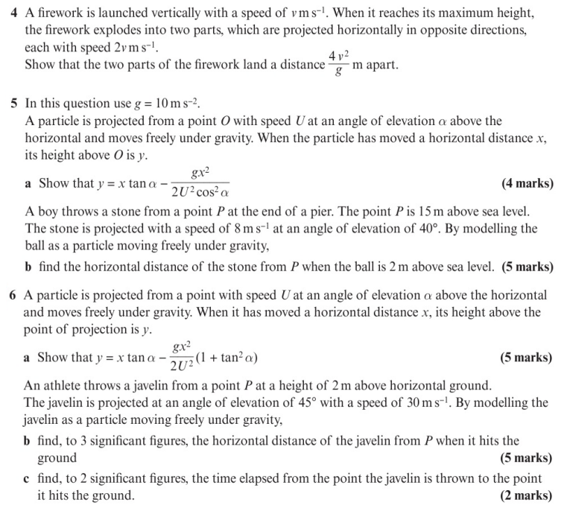
Homework Exercise

Slide 9
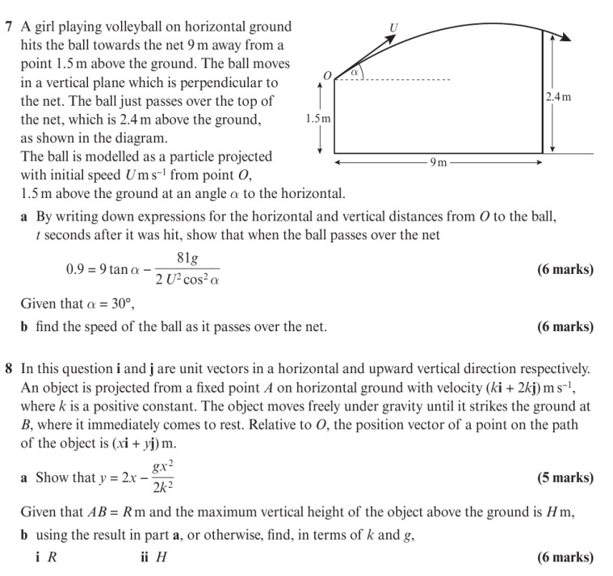
Homework Exercise

Slide 10
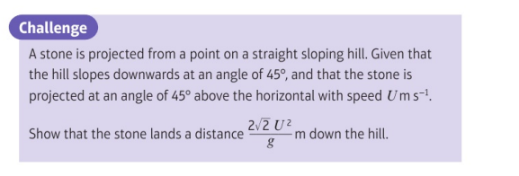
Homework Exercise

Slide 11
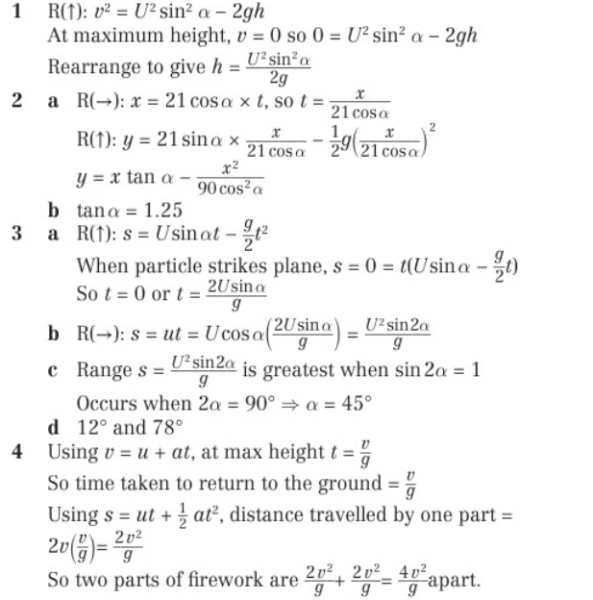
Homework Answers

Slide 12
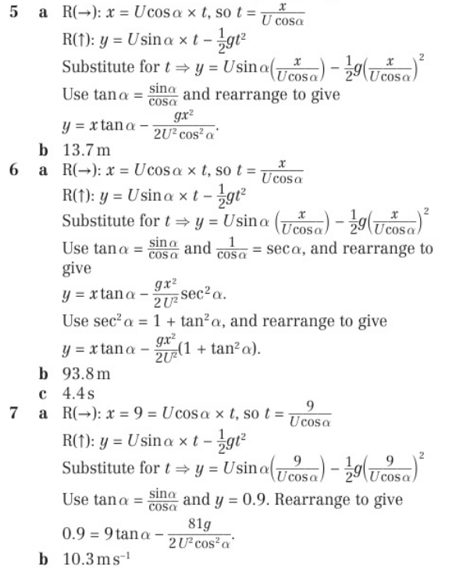
Homework Answers

Slide 13
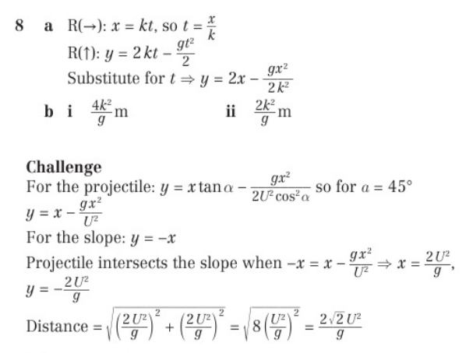
Homework Answers

