Slide 1
P1 Chapter 14: Logarithms Exponential Functions

Slide 2
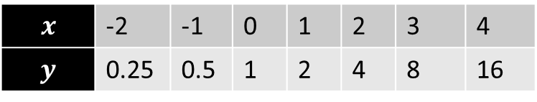

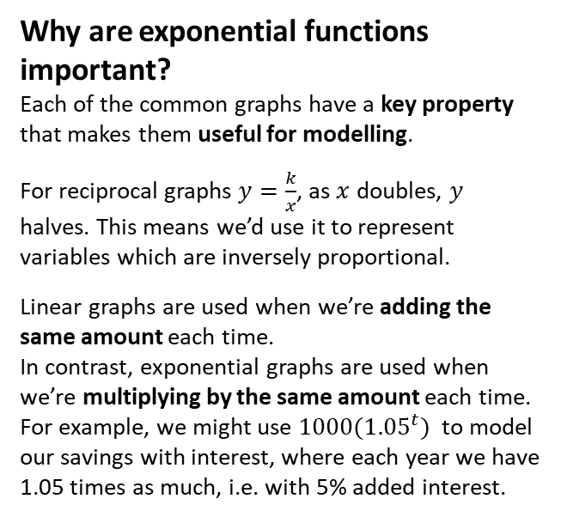

8
20
16
12
8
4
-4
$$y=2^{x}$$
$$x$$ | -2 | -1 | 0 | 1 | 2 | 3 | 4
$$y$$ | 0.25 | 0.5 | 1 | 2 | 4 | 8 | 16
?
?
?
?
?
?
?
Note: Ensure that you can distinguish between a $x^{a}$ (e.g. polynomial) term and an $a^{x}$ exponential term. In the former the variable is in the base, and in the letter the variable is in the power. $2^{x}$ behaves very differently to $x^{2}$, both in its rate of growth (i.e. exponential terms grow much faster!) and how it differentiates.
Why are exponential functions important?
Each of the common graphs have a key property that makes them useful for modelling.
For reciprocal graphs $y=\frac{k}{x}$, as $x$ doubles, $y$ halves. This means we’d use it to represent variables which are inversely proportional.
Linear graphs are used when we’re adding the same amount each time.
In contrast, exponential graphs are used when we’re multiplying by the same amount each time. For example, we might use ${1000(1.05}^{t})$ to model our savings with interest, where each year we have 1.05 times as much, i.e. with 5% added interest.
-2 -1 1 2 3 4 5 6 7
Notes:
Get students to sketch axes and tables in their books.

Slide 3















Contrasting exponential graphs
On the same axes sketch $y=3^{x}, y=2^{x}$, $y={1.5}^{x}$
?
The $y$-intercept is always 1.
$$y$$
$$y=3^{x}$$
If $x<0$, the larger the base, the smaller the $y$ value:
$$3^{x}<2^{x}<{1.5}^{x}$$
$$y=2^{x}$$
If $x>0$, the larger the base, the larger the $y$ value:
$${1.5}^{x}<2^{x}<3^{x}$$
$$y={1.5}^{x}$$
$$1$$
$$x$$
On the same axes sketch $y=2^{x}$ and $y={\left(\frac{1}{2}\right)}^{x}$
?
Three important notes:
$y=2^{x}$ is said to be “exponential growing” whereas $y={\left(\frac{1}{2}\right)}^{x}$ is said to be “exponentially decaying”, because it’s getting smaller (halving) each time $x$ increases by 1.
$y={\left(\frac{1}{2}\right)}^{x}$ is a reflection of $y=2^{x}$ in the line $x=0$. Proof: If $f\left(x\right)=2^{x}$, $f\left(−x\right)=2^{−x}=\frac{1}{2^{x}}={\left(\frac{1}{2}\right)}^{x}$
${\left(\frac{1}{2}\right)}^{x}$ would usually be written $2^{−x}$. You should therefore in general be able to recognise and sketch the graph $y=a^{−x}$.
$$y$$
$$y={\left(\frac{1}{2}\right)}^{x}$$
$$y=2^{x}$$
$$1$$
$$x$$

Slide 4




Graph Transformations
Sketch $y=2^{x+3}$
?
$$y$$
The ‘change’ to $2^{x}$ is ‘inside the function’ (i.e. input $x$ is replaced with $x+3$).
So a translation to the left by 3.
Ensure you work out the new $y$-intercept.
$$y=2^{x+3}$$
$$8$$
$$x$$

Slide 5
Exercise 14.1
Pearson Pure Mathematics Year 1/AS
Page 113

Slide 6
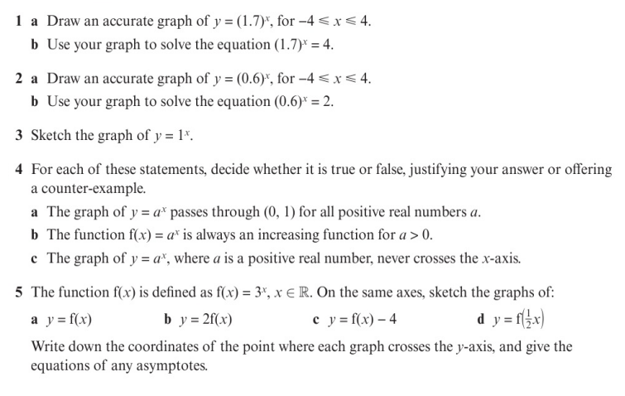
Homework Exercise

Slide 7
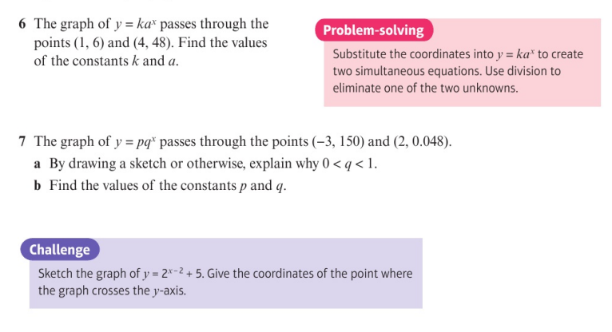
Homework Exercise

Slide 8
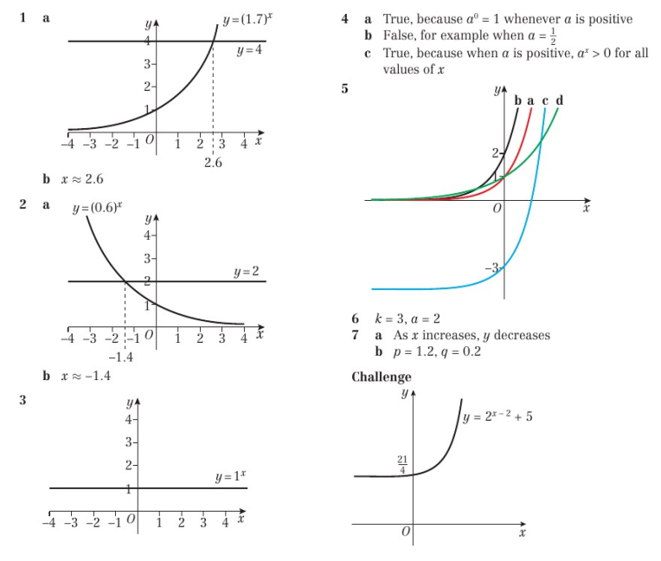
Homework Answers

