Slide 1
P1 Chapter 11: Vectors Vector Algebra

Slide 2







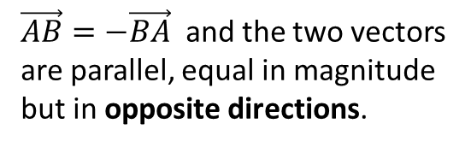
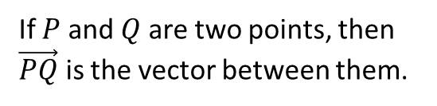




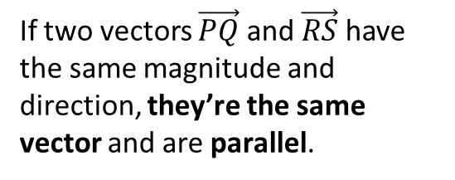


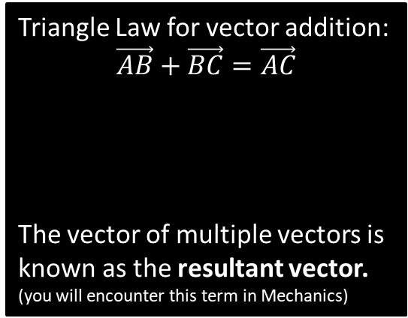





Vector Basics
A coordinate represents a position in space, while a vector represents a change between two positions.
C
$\vec{AB}=−\vec{BA}$ and the two vectors are parallel, equal in magnitude but in opposite directions.
A
$$a$$
$$B$$
$$B$$
A vector has 2 properties:
Direction
Magnitude (i.e. length)
$$A$$
$$−a$$
$$A$$
D
Triangle Law for vector addition:
$$\vec{AB}+\vec{BC}=\vec{AC}$$
The vector of multiple vectors is known as the resultant vector. (you will encounter this term in Mechanics)
If $P$ and $Q$ are two points, then $\vec{PQ}$ is the vector between them.
$$B$$
$$b$$
$$Q$$
$$a$$
$$C$$
$$P$$
$$A$$
$$a+b$$
B
If two vectors $\vec{PQ}$ and $\vec{RS}$ have the same magnitude and direction, they’re the same vector and are parallel.
This might seem obvious, but students sometimes think the vector is different because the movement occurred at a different point in space. Nope!
$$Q$$
$$P$$
$$S$$
$$R$$

Slide 3
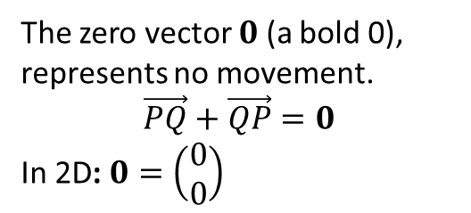



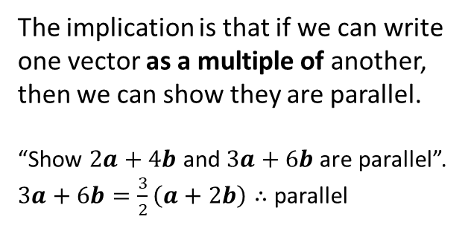
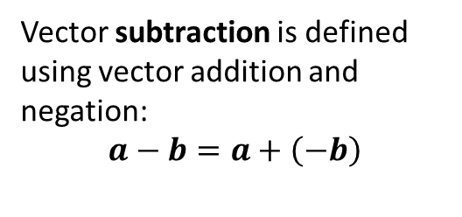






Vector Basics
E
Vector subtraction is defined using vector addition and negation:
$$a−b=a+\left(−b\right)$$
G
A scalar is a numerical factor that doesn’t depend on direction, hence can be used to ‘scale’ a vector.
The direction will be the same.
But the magnitude will be different (unless the scalar is 1).
$$a$$
$$a$$
$$b$$
$$−b$$
$$a$$
$$a−b$$
$$2a$$
If scalar is negative, opposite direction.
F
The zero vector $0$ (a bold 0), represents no movement.
$$\vec{PQ}+\vec{QP}=0$$
In 2D: $0=\left(\begin{matrix}0 \\ 0\end{matrix}\right)$
$$−\frac{1}{2}a$$
H
Any vector parallel to the vector $a$ can be written as $λa$, where $λ$ is a scalar.
The implication is that if we can write one vector as a multiple of another, then we can show they are parallel.
“Show $2a+4b$ and $3a+6b$ are parallel”.
$3a+6b=\frac{3}{2}\left(a+2b\right)∴$parallel

Slide 4
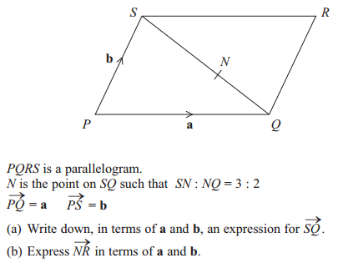

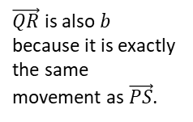


Example
Edexcel GCSE June 2013 1H Q27
Tip: This ratio wasn’t in the original diagram. It was added as a visual aid.
$$\vec{SQ}=−b+a$$
a
?
For (b), there’s two possible paths to get from $N$ to $R$: via $S$ or via $Q$. But which is best?
In (a) we found $S$ to $Q$ rather than $Q$ to $S$, so it makes sense to go in this direction so that we can use our result in (a).
3 : 2
?
$$\vec{NR}=\frac{2}{5}\vec{SQ}+b \\ =\frac{2}{5}\left(−b+a\right)+b \\ =\frac{2}{5}a+\frac{3}{5}b$$
$\vec{QR}$ is also $b$ because it is exactly the same movement as $\vec{PS}$.
b
?
Workings Tip: While you’re welcome to start your working with the second line, I recommend the first line so that your chosen route is clearer.

Slide 5
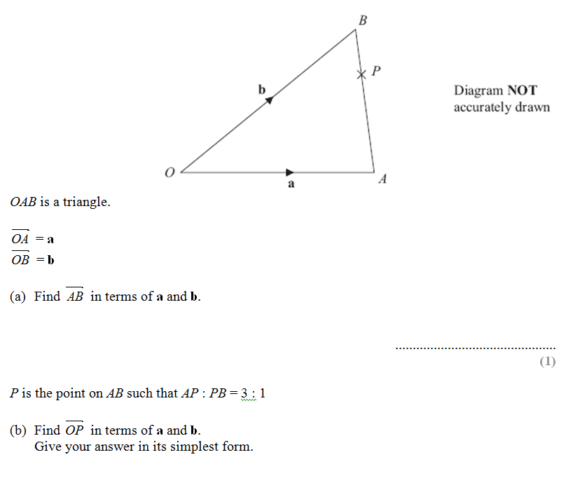
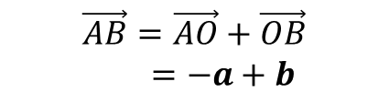

Test Your Understanding
Edexcel GCSE June 2012
$$\vec{AB}=\vec{AO}+\vec{OB}$$
$=−a+b$
?
$$\vec{OP}=a+\frac{3}{4}\vec{AB}$$
$=a+\frac{3}{4}\left(−a+b\right)$
$=\frac{1}{4}a+\frac{3}{4}b$
?

Slide 6



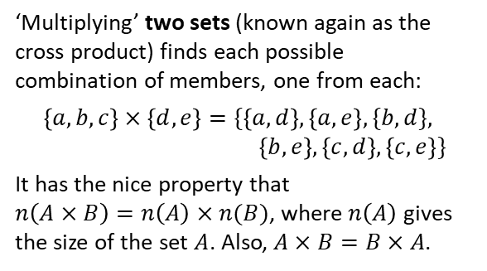
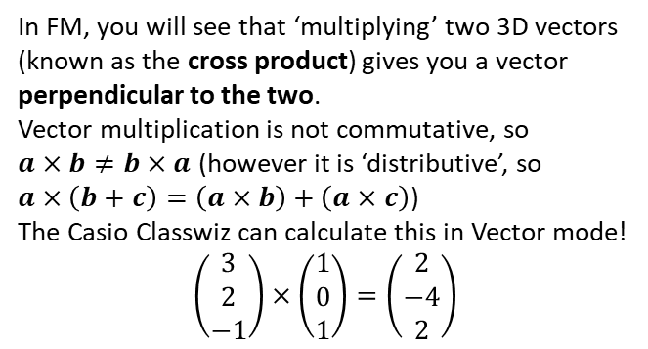
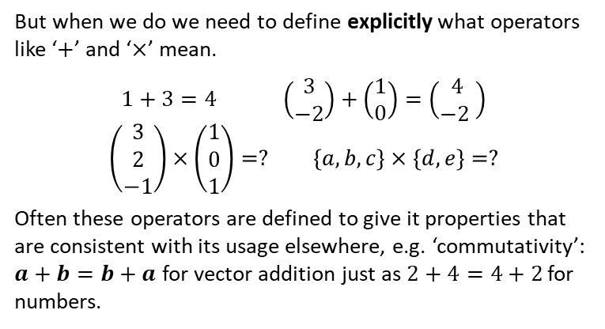
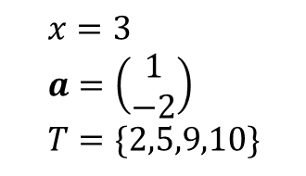


Just for your interest…
Have you ever wondered what happens if you ‘multiply’ two vectors or two sets?
Erm…
In KS2/3 you probably only experienced variables holding numerical values. You since saw that variables can represent other mathematical types, such as sets or vectors:
But when we do we need to define explicitly what operators like ‘$+$’ and ‘$×$’ mean.
$$1+3=4 \left(\begin{matrix}3 \\ −2\end{matrix}\right)+\left(\begin{matrix}1 \\ 0\end{matrix}\right)=\left(\begin{matrix}4 \\ −2 \end{matrix}\right)$$
$$\left(\begin{matrix}3 \\ 2 \\ −1\end{matrix}\right)×\left(\begin{matrix}1 \\ 0 \\ 1\end{matrix}\right)=? \left\{a,b,c\right\}×\left\{d,e\right\}=?$$
Often these operators are defined to give it properties that are consistent with its usage elsewhere, e.g. ‘commutativity’: $a+b=b+a$ for vector addition just as $2+4=4+2$ for numbers.
$$x=3 \\ a=\left(\begin{matrix}1 \\ −2\end{matrix}\right) \\ T=\{2,5,9,10\}$$
‘Multiplying’ two sets (known again as the cross product) finds each possible combination of members, one from each:
$$\left\{a,b,c\right\}×\left\{d,e\right\}=\{\left\{a,d\right\},\left\{a,e\right\},\{b,d\}, \\ \left\{b,e\right\},\left\{c,d\right\},\left\{c,e\right\}\}$$
It has the nice property that $n\left(A×B\right)=n\left(A\right)×n(B)$, where $n\left(A\right)$ gives the size of the set $A$. Also, $A×B=B×A$.
In FM, you will see that ‘multiplying’ two 3D vectors (known as the cross product) gives you a vector perpendicular to the two.
Vector multiplication is not commutative, so $a×b≠b×a$ (however it is ‘distributive’, so $a×\left(b+c\right)=\left(a×b\right)+\left(a×c\right)$)
The Casio Classwiz can calculate this in Vector mode!
$$\left(\begin{matrix}3 \\ 2 \\ −1\end{matrix}\right)×\left(\begin{matrix}1 \\ 0 \\ 1\end{matrix}\right)=\left(\begin{matrix}2 \\ −4 \\ 2\end{matrix}\right)$$
$$a×b$$
$$b$$
ME-WOW!
$$a$$

Slide 7
Exercise 11.1
Pearson Pure Mathematics Year 1/AS
Pages 86-87

Slide 8
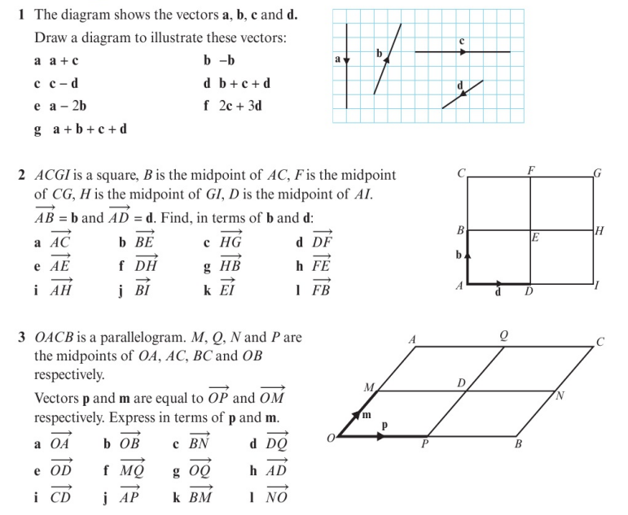
Homework Exercise

Slide 9
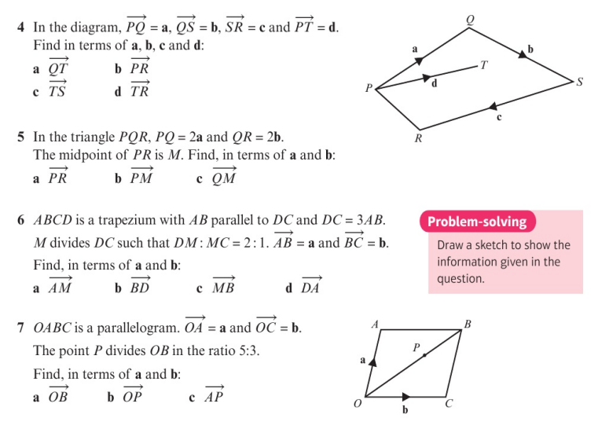
Homework Exercise

Slide 10
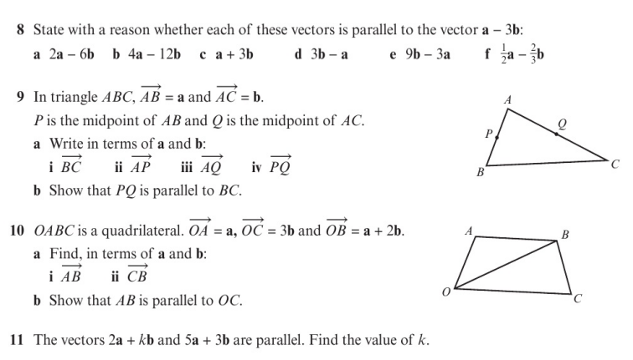
Homework Exercise

Slide 11
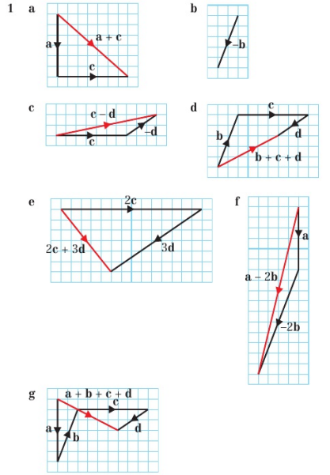
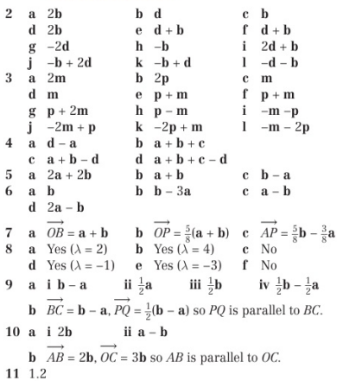
Homework Answers

