Slide 1
M2 Chapter 4: Moments Equilibrium

Slide 2


This whole chapter in a nutshell…
10m
8m
7kg
! If a rigid body is in equilibrium then:
The resultant force in any direction is 0.
The resultant moment about any point is 0.
i.e. Forces up = forces down, as per Year 1
a
b
In other words, clockwise moments = anticlockwise moments
You will typically use both these properties to solve exam questions.

Slide 3




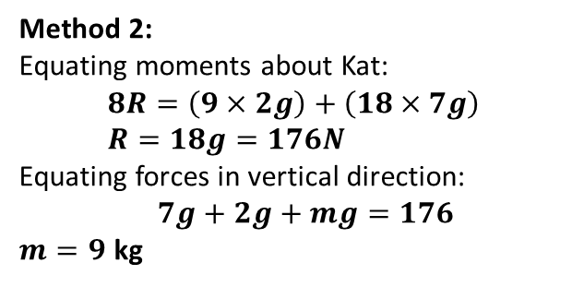


Example
Buggs and Kat are having fun on a uniform seesaw of mass 2kg. Buggs has a mass of 7kg and is 10m from the pivot. Tom is 8m from the pivot. The seesaw remains horizontal.
a) Determine the reaction force at the pivot of the seesaw.
b) Determine Tom’s mass.
If a rod is uniform its centre of mass is at its centre, so we model its weight as acting at that point.
10m
8m
$m$ = ?
Buggs
9m
$$R$$
Kat
7kg
$$7g$$
$$2g$$
$$mg$$
Tip: First draw on forces.
Hint: Choose a suitable point to take moments about.
Click to sketch
Method 1:
Equating moments about pivot:
$$\left(2g×1\right)+\left(7g×10\right)=\left(mg×8\right)$$ $72g=8mg → m=\frac{72g}{8g}=9$ kg
Equating forces in vertical direction, $$R=7g+2g+mg=176N$$
Method 2:
Equating moments about Kat:
$$8R=\left(9×2g\right)+\left(18×7g\right) \\ R=18g=176N$$
Equating forces in vertical direction:
$7g+2g+mg=176$
$m=9$ kg
?
?

Slide 4





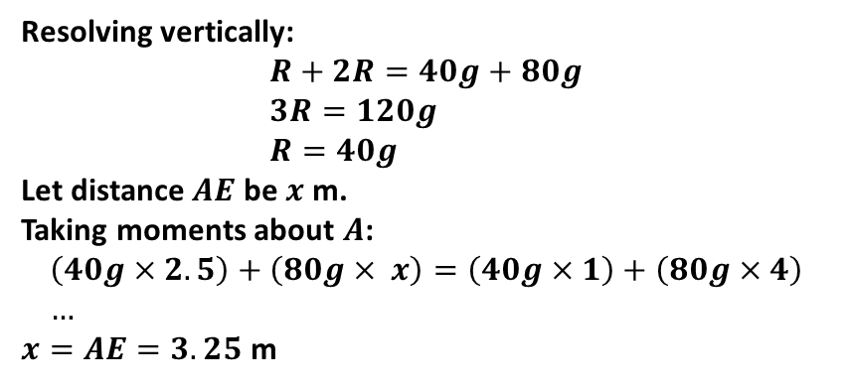
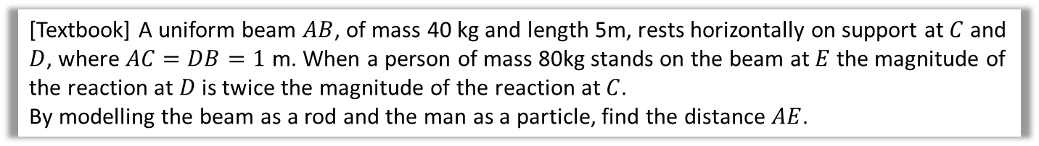








Two Pivots
[Textbook] A uniform beam $AB$, of mass 40 kg and length 5m, rests horizontally on support at $C$ and $D$, where $AC=DB=1$ m. When a person of mass 80kg stands on the beam at $E$ the magnitude of the reaction at $D$ is twice the magnitude of the reaction at $C$.
By modelling the beam as a rod and the man as a particle, find the distance $AE$.
$x$m
$$R$$
Note: A rod has no mass, so there is no reaction force of the rod on the man, only reaction forces from the pivots.
$$2R$$
$$A$$
$$C$$
$$D$$
$$B$$
$1$m
$1.5$m
$$E$$
$1$m
$$40g$$
$$80g$$
?
Resolving vertically:
$$R+2R=40g+80g \\ 3R=120g \\ R=40g$$
Let distance $AE$ be $x$ m.
Taking moments about $A$:
$$\left(40g×2.5\right)+\left(80g× x\right)=\left(40g×1\right)+\left(80g×4\right) \\ …$$ $x=AE=3.25$ m

Slide 5
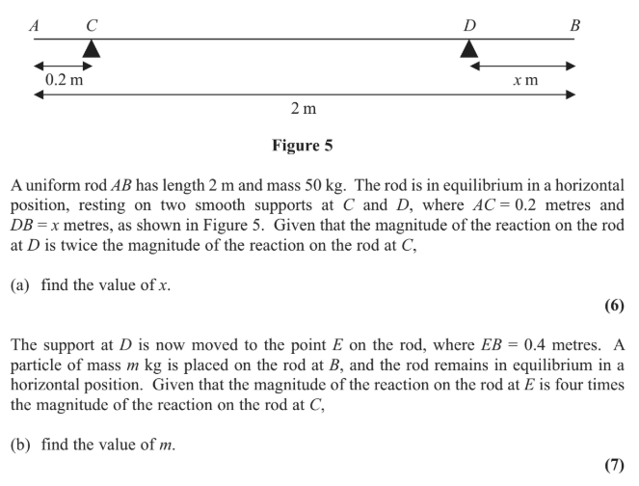
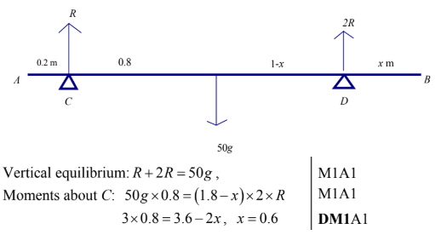
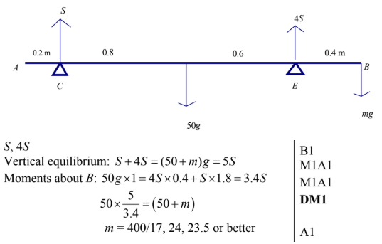
Test Your Understanding
Edexcel M1(Old) May 2013(R) Q8
a
?
b
?

Slide 6
Exercise 4.3
Pearson Stats/Mechanics Year 2
Page 36-37

Slide 7
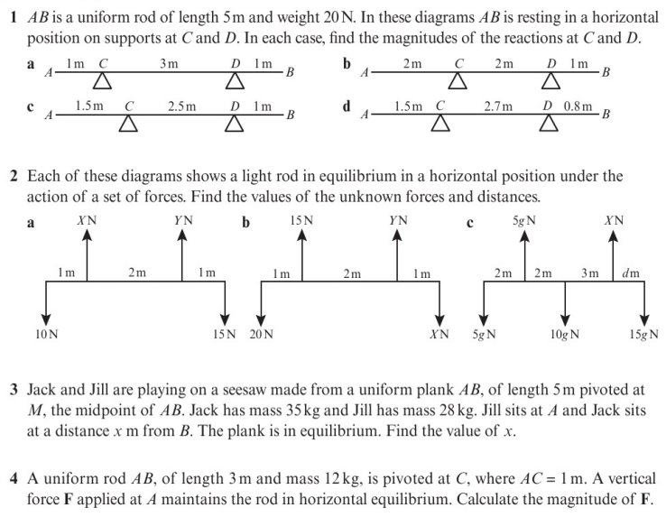
Homework Exercise

Slide 8
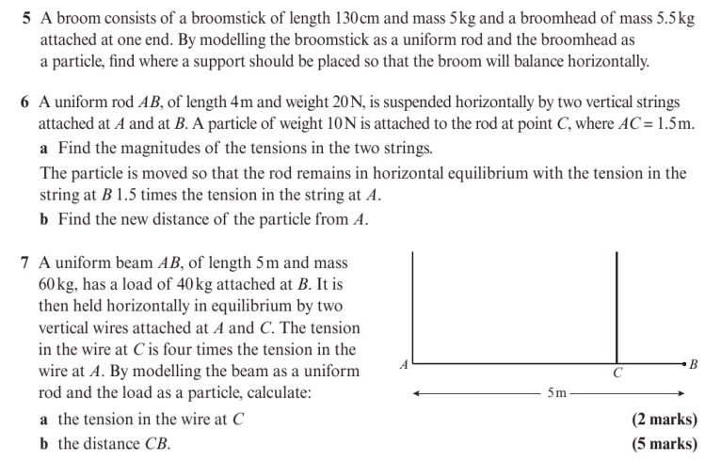
Homework Exercise

Slide 9
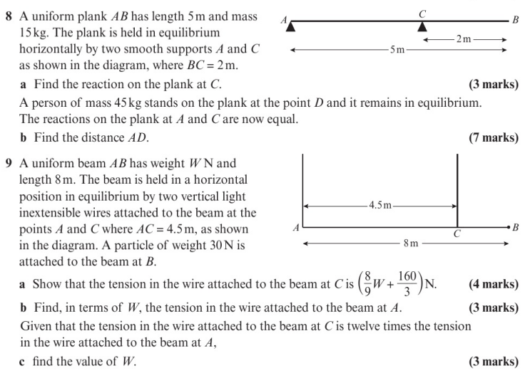
Homework Exercise

Slide 10
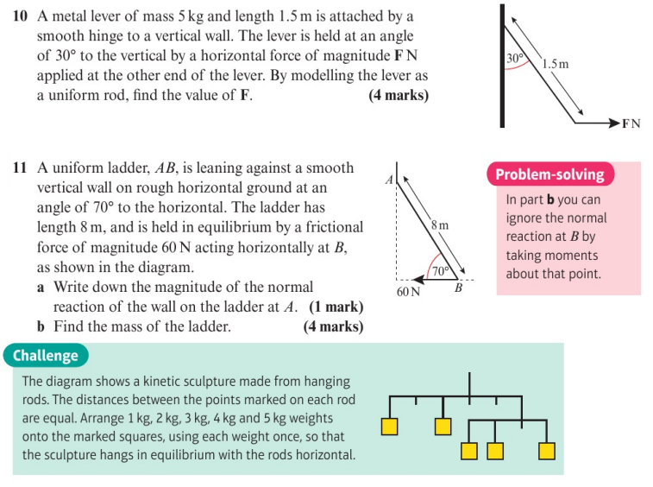
Homework Exercise

Slide 11
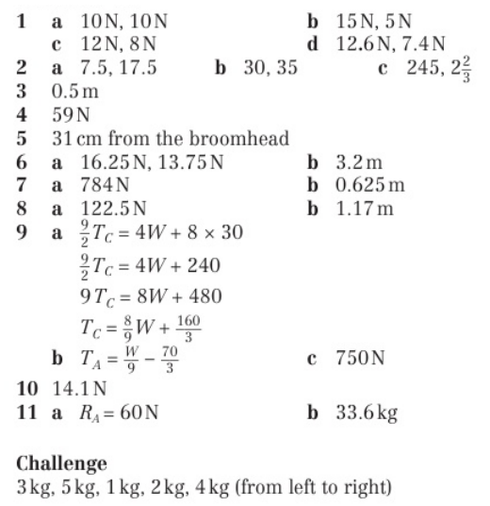
Homework Answers

