Slide 1
P2 Chapter 6: CoAngle Trigonometry
Secant Identities

Slide 2


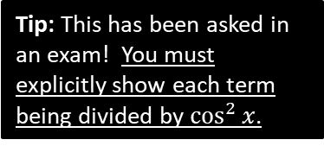

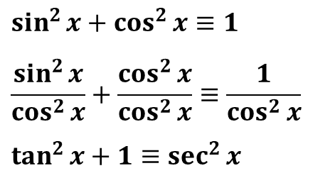



New Identities
In Pure-1 we had the Pythagorean Trig Identity:
$$\sin^{2}{x}+\cos^{2}{x}=1$$
There are two tangent identities to know:
Dividing by $\cos^{2}{x}$:
$$1+\tan^{2}{x}=\sec^{2}{x}$$
?
$$1+\cot^{2}{x}={cosec}^{2}{x}$$
Dividing by $\sin^{2}{x}$:
?
“Prove that $1+\tan^{2}{x}≡\sec^{2}{x}$.”
Tip: remember this one by starting with the above then putting ‘co-’ on front of each trig function.
$$\sin^{2}{x}+\cos^{2}{x}≡1$$
$$\frac{\sin^{2}{x}}{\cos^{2}{x}}+\frac{\cos^{2}{x}}{\cos^{2}{x}}≡\frac{1}{\cos^{2}{x}}$$
$$\tan^{2}{x}+1≡\sec^{2}{x}$$
Tip: This has been asked in an exam! You must explicitly show each term being divided by $\cos^{2}{x}$.

Slide 3

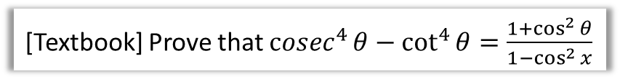
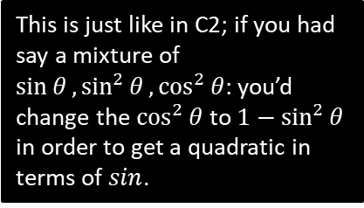

Examples
[Textbook] Prove that ${cosec}^{4}{θ}−\cot^{4}{θ}=\frac{1+\cos^{2}{θ}}{1−\cos^{2}{x}}$
?
$$LHS= \left({cosec}^{2}{θ}{+\cot^{2}{θ}}\right)\left({cosec}^{2}{θ}−\cot^{2}{θ}\right) \\ ={cosec}^{2}{θ}{+\cot^{2}{θ}} \\ =\frac{1}{\sin^{2}{θ}}+\frac{\cos^{2}{θ}}{\sin^{2}{θ}} \\ =\frac{1+\cos^{2}{θ}}{1−\cos^{2}{x}}=RHS$$
Solve the equation $4 cosec^{2}θ−9=\cot{θ}$ in the interval $0≤θ≤360°$
?
$$4\left(1+\cot^{2}{θ}\right)−9=\cot{θ} \\ 4\cot^{2}{θ}−\cot{θ}−5=0 \\ \left(4\cot{θ}−5\right)\left(\cot{θ}+1\right)=0 \\ ∴\cot{θ}=\frac{5}{4} or\cot{θ}=−1 \\ \tan{θ}=\frac{4}{5} or\tan{θ}=−1 \\ θ=135°, 315°$$
This is just like in C2; if you had say a mixture of $\sin{θ},\sin^{2}{θ},\cos^{2}{θ}$: you’d change the $\cos^{2}{θ}$ to $1−\sin^{2}{θ}$ in order to get a quadratic in terms of $sin$.

Slide 4
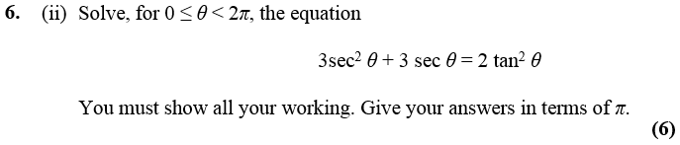
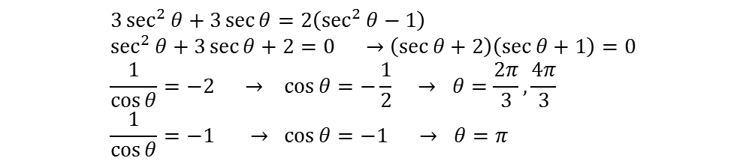

Test Your Understanding
Edexcel C3 June 2013 (R)
$$3\sec^{2}{θ}+3\sec{θ}=2\left(\sec^{2}{θ}−1\right) \\ \sec^{2}{θ}+3\sec{θ}+2=0 →\left(\sec{θ}+2\right)\left(\sec{θ}+1\right)=0 \\ \frac{1}{\cos{θ}}=−2 → \cos{θ}=−\frac{1}{2} → θ=\frac{2π}{3},\frac{4π}{3} \\ \frac{1}{\cos{θ}}=−1 → \cos{θ}=−1 → θ=π$$
?
Q
Solve, for $0≤x<2π$, the equation
$$2cosec^{2}x+\cot{x}=5$$
giving your solutions to 3sf.
$$2\left(1+\cot^{2}{x}\right)+\cot{x}−5=0 \\ 2+2\cot^{2}{x}+\cot{x}−5=0 \\ 2\cot^{2}{x}+\cot{x}−3=0 \\ \left(2\cot{x}+3\right)\left(\cot{x}−1\right)=0 \\ \cot{x}=−\frac{3}{2} or \cot{x}=1 \\ \tan{x}=−\frac{2}{3} or \tan{x}=1 \\ x=2.55, 5.70, 0.785, 3.93$$
?

Slide 5
Exercise 6.4
Pearson Pure Mathematics Year 2/AS
Page 45

Slide 6
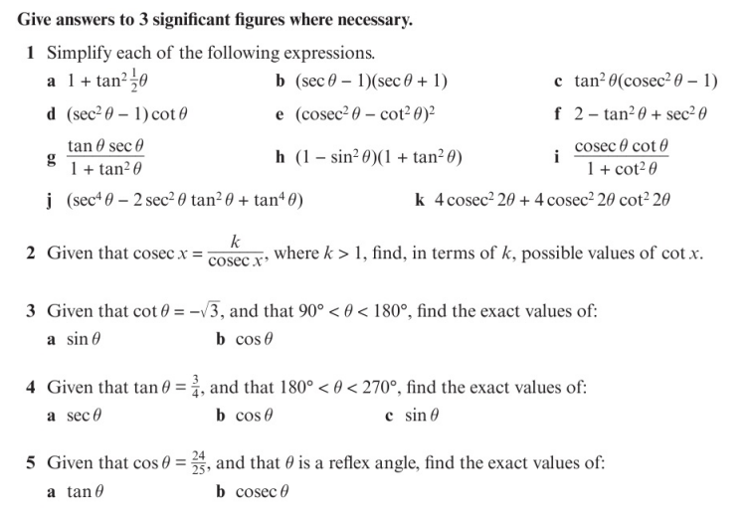
Homework Exercise

Slide 7
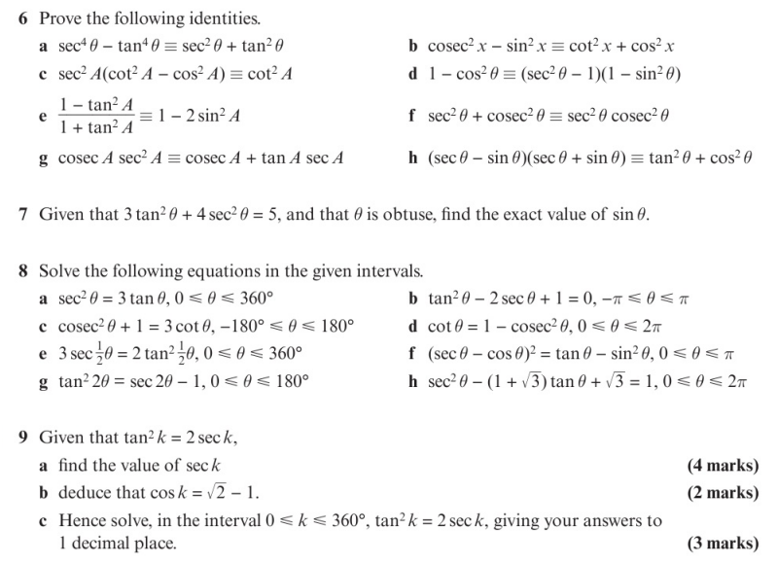
Homework Exercise

Slide 8
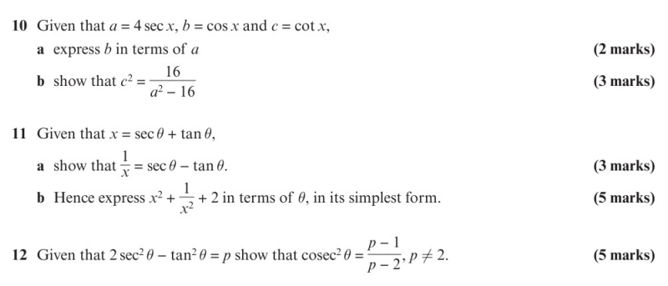
Homework Exercise

Slide 9
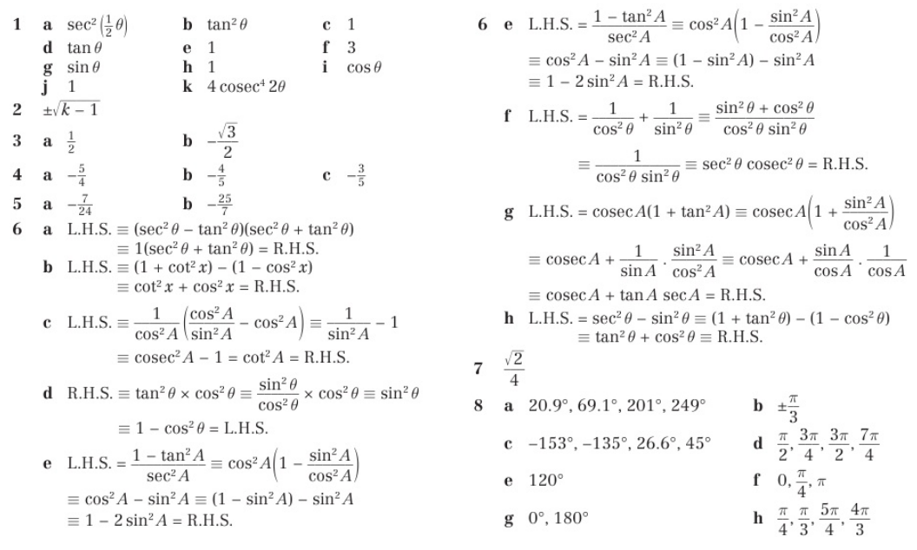
Homework Answers

Slide 10
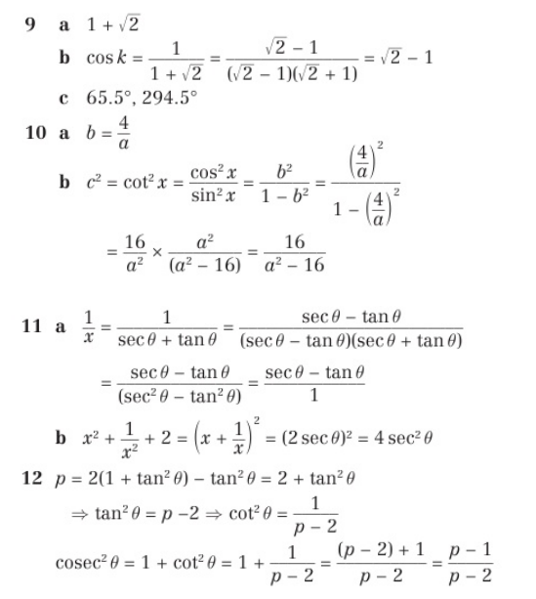
Homework Answers

