Slide 1
P2 Chapter 2: Graphing Functions
Sketching Modulus Functions

Slide 2
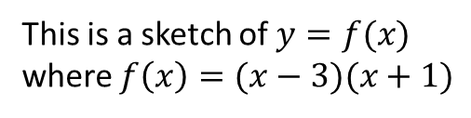



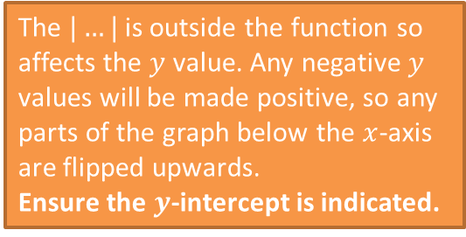







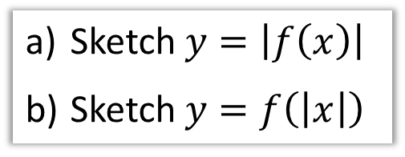
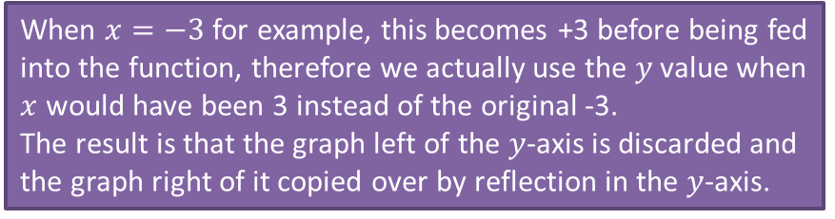
Sketching $y=|f\left(x\right)|$ and $y=f\left(\left|x\right|\right)$
$$y$$
This is a sketch of $y=f(x)$ where $f\left(x\right)=(x−3)(x+1)$
$$y=f(x)$$
Sketch $y=\left|f\left(x\right)\right|$
Sketch $y=f\left(\left|x\right|\right)$
Sketch >
$$y=|f\left(x\right)|$$
Sketch >
$$3$$
$$x$$
$$−3$$
$$−1$$
$$3$$
$$y=f\left(\left|x\right|\right)$$
$$−3$$
The $|…|$ is outside the function so affects the $y$ value. Any negative $y$ values will be made positive, so any parts of the graph below the $x$-axis are flipped upwards.
Ensure the $y$-intercept is indicated.
When $x=−3$ for example, this becomes +3 before being fed into the function, therefore we actually use the $y$ value when $x$ would have been 3 instead of the original -3.
The result is that the graph left of the $y$-axis is discarded and the graph right of it copied over by reflection in the $y$-axis.

Slide 3
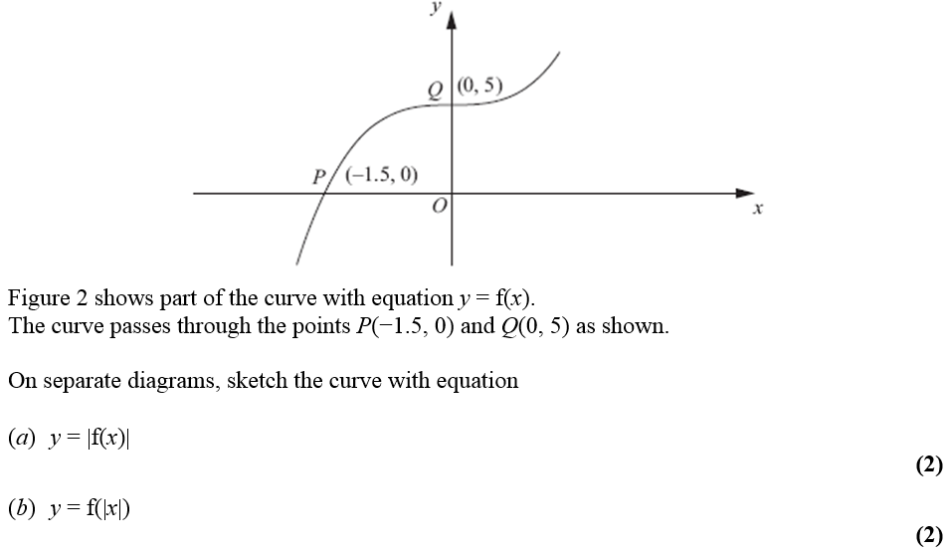
Test Your Understanding
Edexcel C4 June 2012 Q4
Sketch >
Sketch >

Slide 4





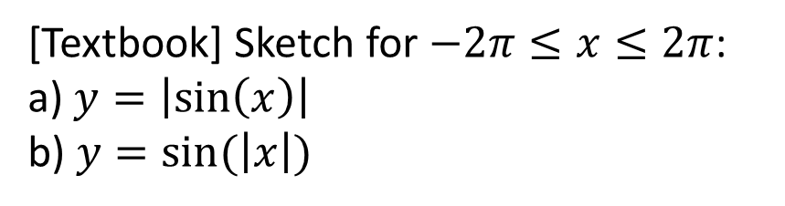







Further Test Your Understanding
[Textbook] Sketch for $−2π≤x≤2π$:
a) $y=\left|\sin\left(x\right)\right|$
b) $y=sin⁡(\left|x\right|)$
b
a
?
$$y$$
$$y$$
?
$$x$$
$$x$$
$$−360°$$
$$−180°$$
$$180°$$
$$360°$$
$$−360°$$
$$−180°$$
$$180°$$
$$360°$$

Slide 5
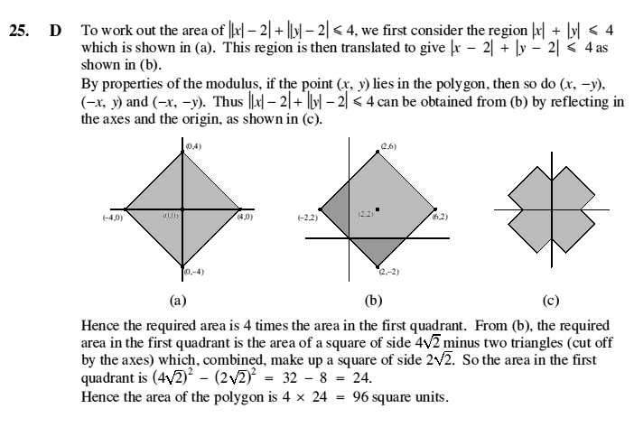
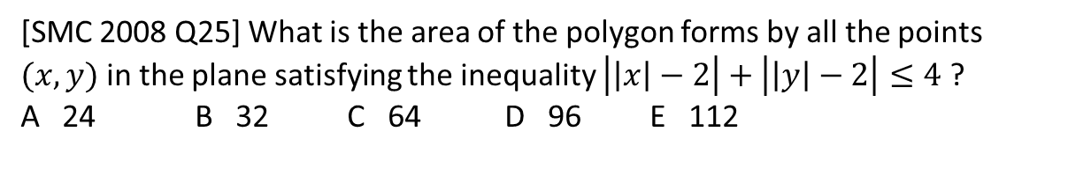
Exercise 2E
Pearson Pure Mathematics Year 2/AS
Pages 42-44
Extension
1
[SMC 2008 Q25] What is the area of the polygon forms by all the points $(x,y)$ in the plane satisfying the inequality $\left|\left|x\right|−2\right|+\left|\left|y\right|−2\right|≤4$ ?
A 24 B 32 C 64 D 96 E 112
?

Slide 6
Exercise 2.5
Pearson Pure Mathematics Year 2/AS
Page 10
Extension
1
[SMC 2008 Q25] What is the area of the polygon forms by all the points $(x,y)$ in the plane satisfying the inequality $\left|\left|x\right|−2\right|+\left|\left|y\right|−2\right|≤4$ ?
A 24 B 32 C 64 D 96 E 112
?

Slide 7
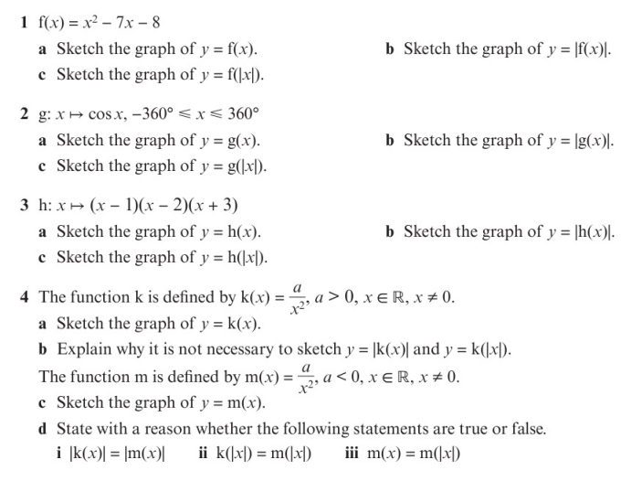
Homework Exercise

Slide 8
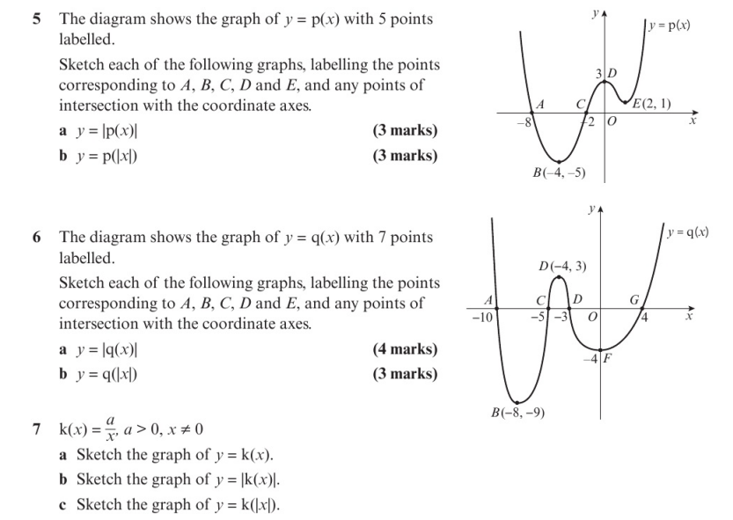
Homework Exercise

Slide 9
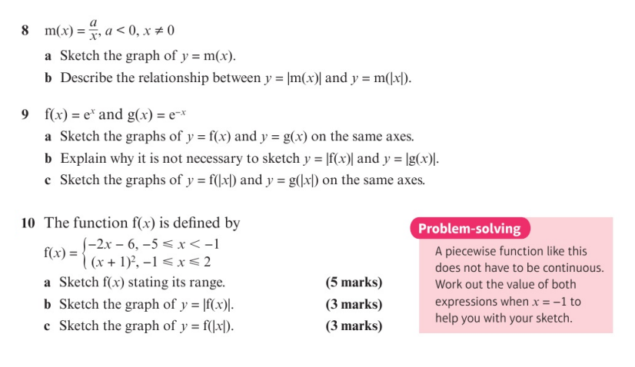
Homework Exercise

Slide 10
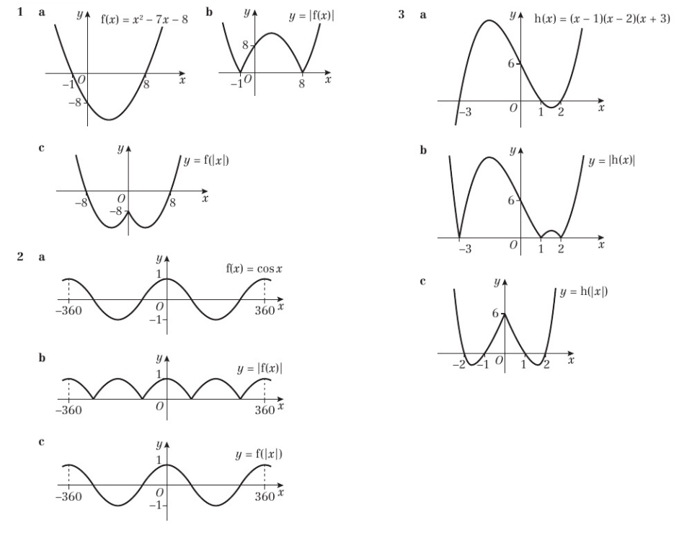
Homework Answers

Slide 11
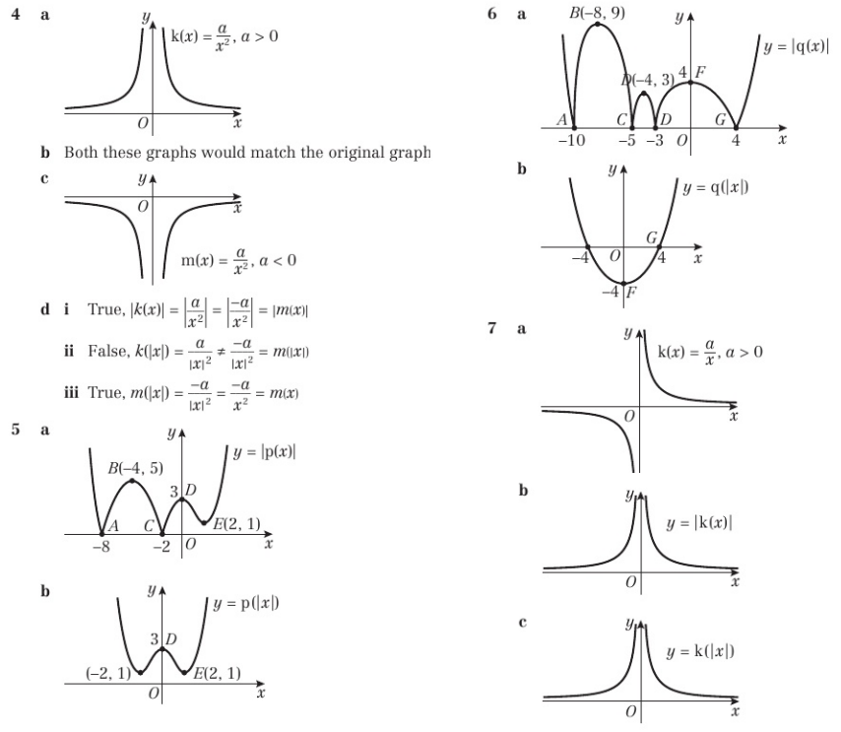
Homework Answers

Slide 12
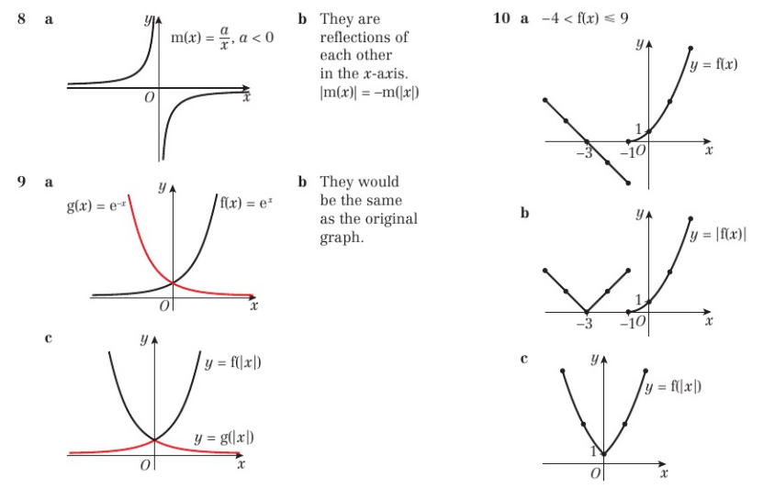
Homework Answers

