Slide 1
P1 Chapter 4: Transforming Graphs Transforming Functions

Slide 2
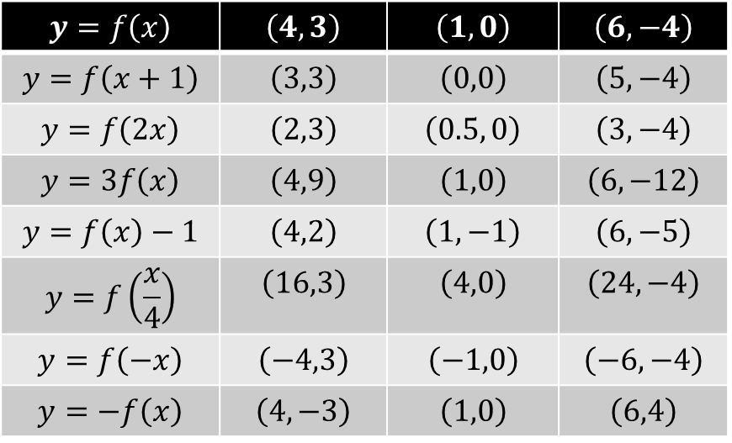
Effect of transformation on specific points
Sometimes you will not be given the original function, but will be given a sketch with specific points and features you need to transform.
Where would each of these points end up?
$$y=f\left(x\right)$$ | $$\left(4,3\right)$$ | $$\left(1,0\right)$$ | $$\left(6,−4\right)$$
$$y=f\left(x+1\right)$$ | $$\left(3,3\right)$$ | $$\left(0,0\right)$$ | $$\left(5,−4\right)$$
$$y=f\left(2x\right)$$ | $$\left(2,3\right)$$ | $$\left(0.5, 0\right)$$ | $$\left(3, −4\right)$$
$$y=3f\left(x\right)$$ | $$\left(4,9\right)$$ | $$\left(1,0\right)$$ | $$\left(6,−12\right)$$
$$y=f\left(x\right)−1$$ | $$\left(4,2\right)$$ | $$\left(1,−1\right)$$ | $$\left(6,−5\right)$$
$$y=f\left(\frac{x}{4}\right)$$ | $$\left(16,3\right)$$ | $$\left(4,0\right)$$ | $$\left(24,−4\right)$$
$$y=f\left(−x\right)$$ | $$\left(−4,3\right)$$ | $$\left(−1,0\right)$$ | $$\left(−6,−4\right)$$
$$y=−f\left(x\right)$$ | $$\left(4,−3\right)$$ | $$\left(1,0\right)$$ | $$\left(6,4\right)$$
?
?
?
?
?
?
?
?
?
?
?
?
?
?
?
?
?
?
?
?
?

Slide 3
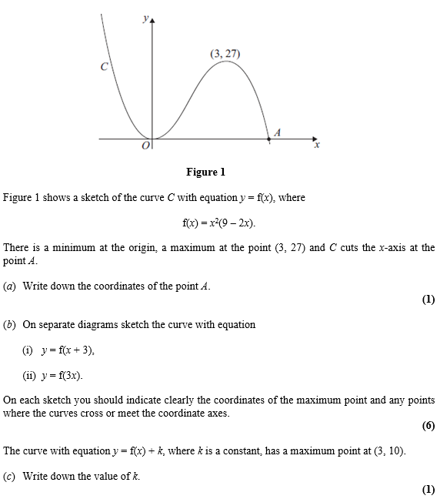
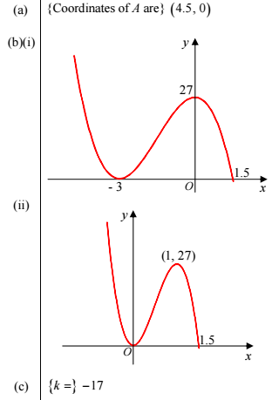
Test Your Understanding
Edexcel C1 May 2012 Q10
?
?
?
?

Slide 4
Exercise 4.7
Pearson Pure Mathematics Year 1/AS
Page 33

Slide 5
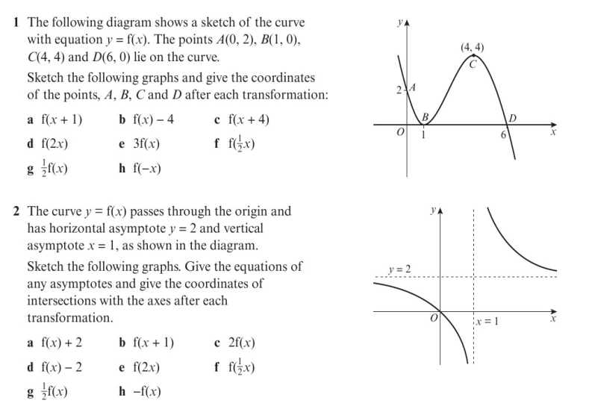
Homework Exercise

Slide 6
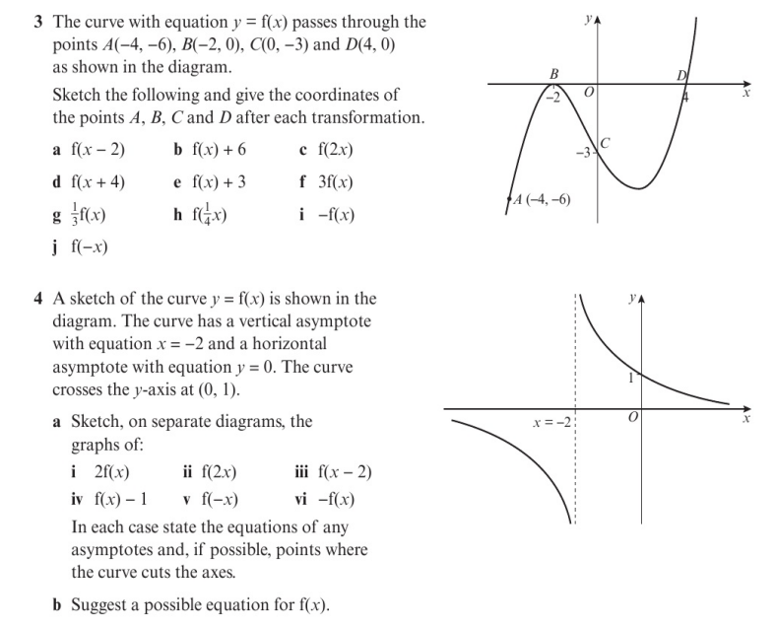
Homework Exercise

Slide 7
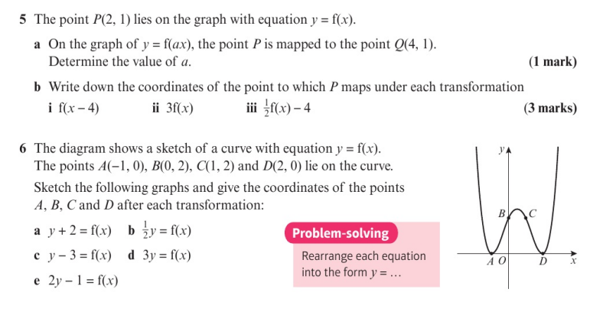
Homework Exercise

Slide 8
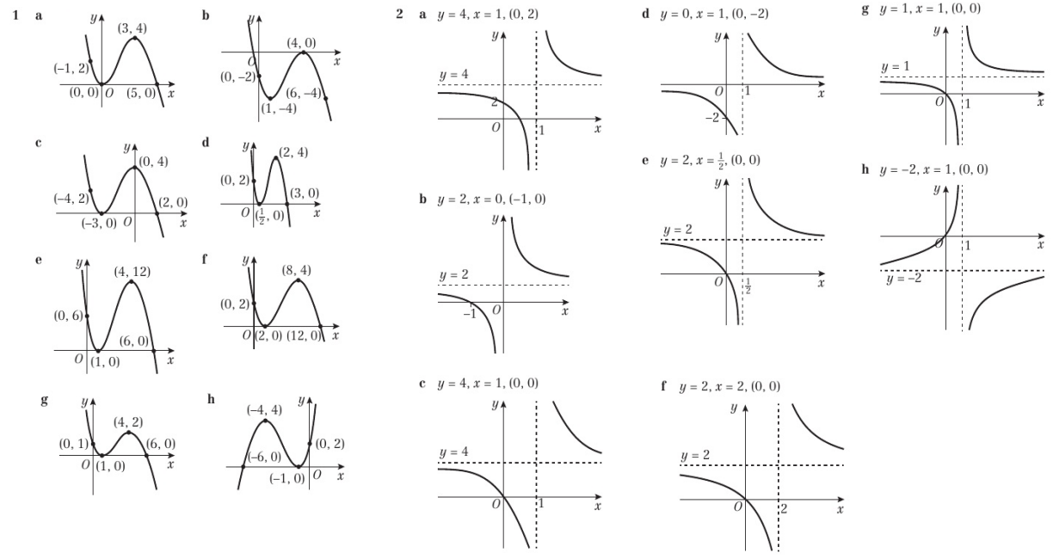
Homework Answers

Slide 9
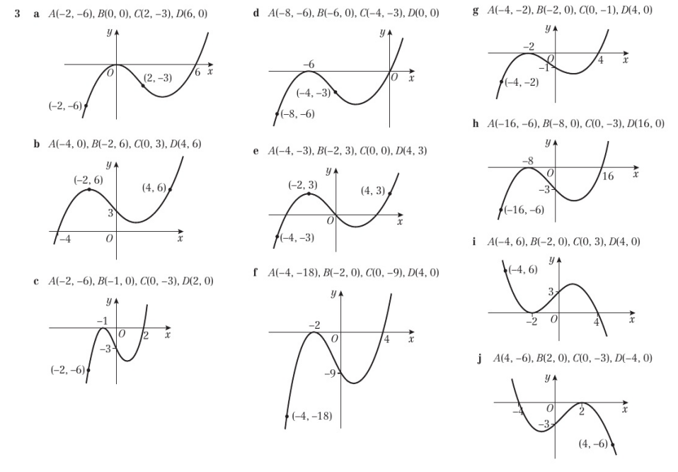
Homework Answers

Slide 10
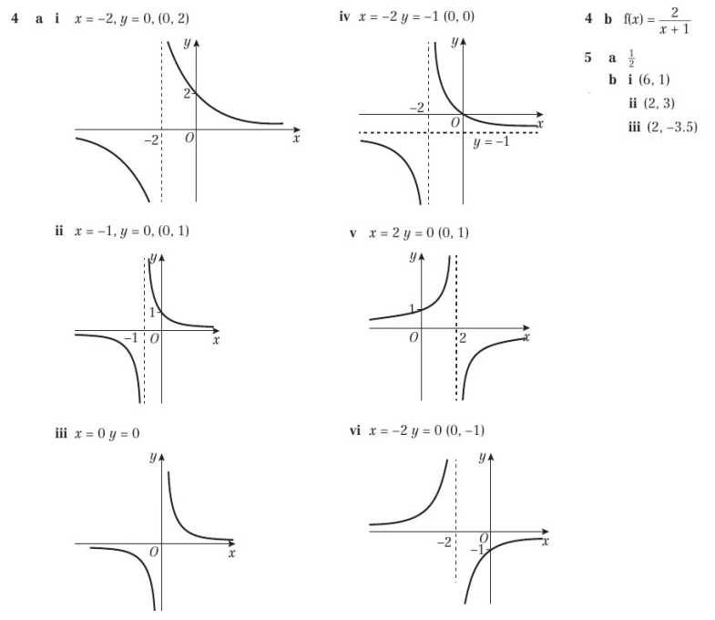
Homework Answers

Slide 11
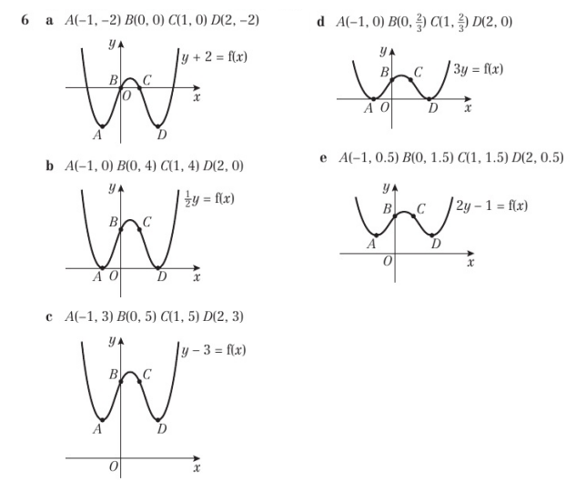
Homework Answers

