Slide 1
P1 Chapter 5: Linear Graphs Linear Modelling

Slide 2

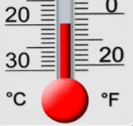
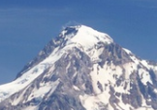
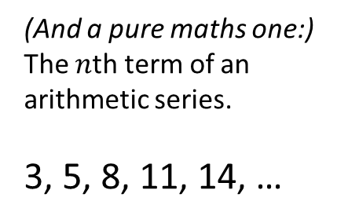
What’s the point of straight line equations?
We saw in Chapter 2 that lots of things in real life have a ‘quadratic’ relationship, e.g. vertical height with time. Lots of real life variables have a ‘linear’ relationship, i.e. there is a fixed increase/decrease in one variable each time the other variable goes up by 1 unit.
Examples
The relationship between Celsius and Fahrenheit.
Car sales made and take home pay.
Temperature and altitude (in a particular location)
(And a pure maths one:)
The $n$th term of an arithmetic series.
3, 5, 8, 11, 14, …

Slide 3


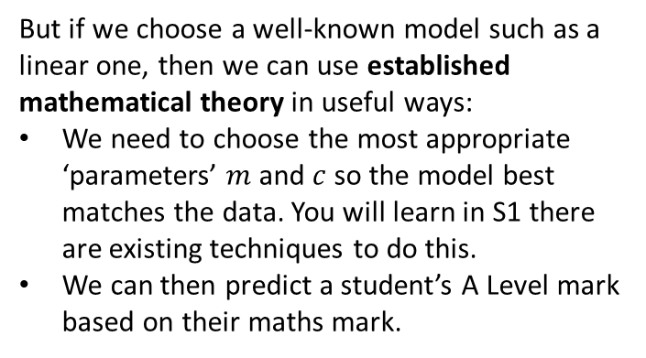
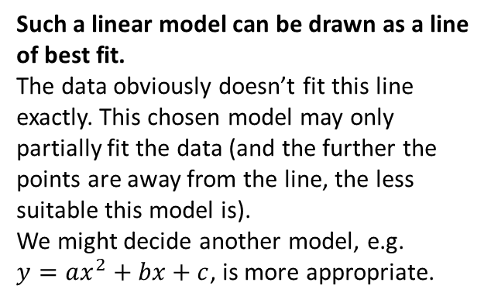
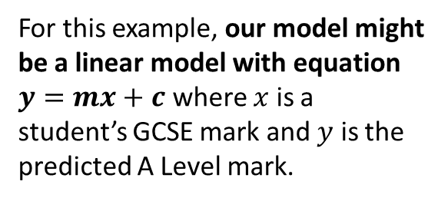
Modelling
$$y$$
100
80
60
40
20
A mathematical model is an attempt to model a real-life situation based on mathematical concepts.
A Level Maths Mark
For this example, our model might be a linear model with equation $y=mx+c$ where $x$ is a student’s GCSE mark and $y$ is the predicted A Level mark.
$$x$$
20 40 60 80 100
GCSE Maths mark
Such a linear model can be drawn as a line of best fit.
The data obviously doesn’t fit this line exactly. This chosen model may only partially fit the data (and the further the points are away from the line, the less suitable this model is).
We might decide another model, e.g.
$y=ax^{2}+bx+c$, is more appropriate.
But if we choose a well-known model such as a linear one, then we can use established mathematical theory in useful ways:
We need to choose the most appropriate ‘parameters’ $m$ and $c$ so the model best matches the data. You will learn in S1 there are existing techniques to do this.
We can then predict a student’s A Level mark based on their maths mark.

Slide 4


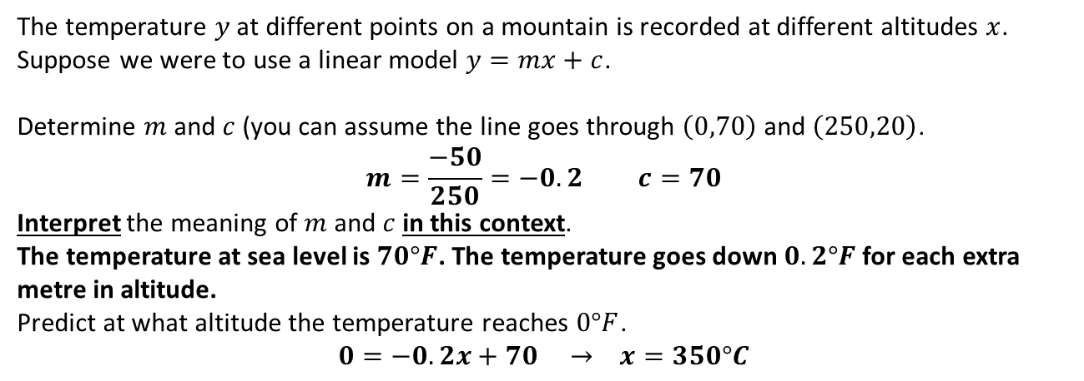

Example
$$y$$
100
80
60
40
20
Temperature $°F$
$$x$$
50 100 150 200 250
Altitude (m)
The temperature $y$ at different points on a mountain is recorded at different altitudes $x$.
Suppose we were to use a linear model $y=mx+c$.
Determine $m$ and $c$ (you can assume the line goes through $\left(0,70\right)$ and $\left(250,20\right)$.
$$m=\frac{−50}{250}=−0.2 c=70$$
Interpret the meaning of $m$ and $c$ in this context.
The temperature at sea level is $70°F$. The temperature goes down $0.2°F$ for each extra metre in altitude.
Predict at what altitude the temperature reaches $0°F$.
$$0=−0.2x+70 → x=350°C$$
a
?
b
?
c
?

Slide 5
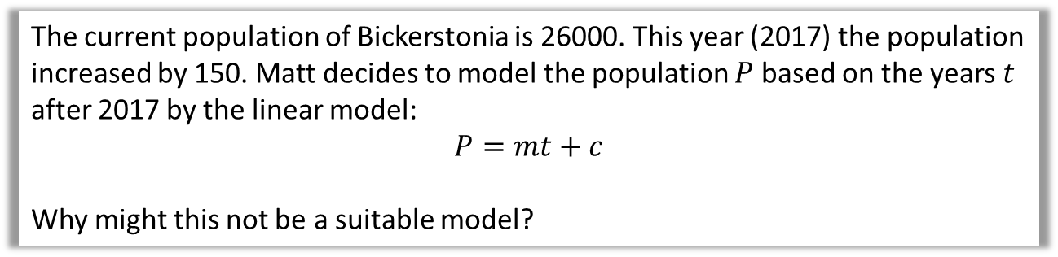
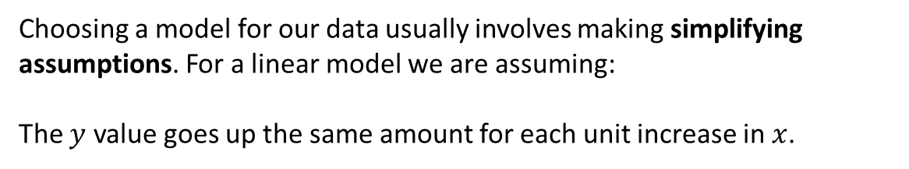
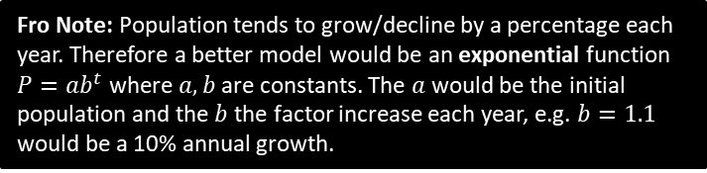
Evaluating if a linear model is most suitable
Choosing a model for our data usually involves making simplifying assumptions. For a linear model we are assuming:
The $y$ value goes up the same amount for each unit increase in $x$.
The current population of Bickerstonia is 26000. This year (2017) the population increased by 150. Matt decides to model the population $P$ based on the years $t$ after 2017 by the linear model:
$$P=mt+c$$
Why might this not be a suitable model?
?
The population is unlikely to increase by the same amount each year.
i.e. the assumption of a linear model is violated.
Fro Note: Population tends to grow/decline by a percentage each year. Therefore a better model would be an exponential function $P=ab^{t}$ where $a,b$ are constants. The $a$ would be the initial population and the $b$ the factor increase each year, e.g. $b=1.1$ would be a 10% annual growth.

Slide 6
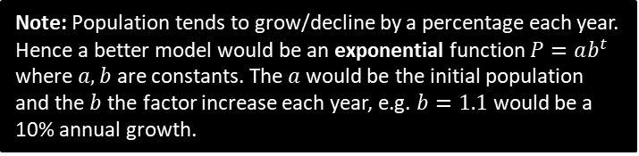
Evaluating if a linear model is most suitable
Choosing a model for our data usually involves making simplifying assumptions. For a linear model we are assuming:
The $y$ value goes up the same amount for each unit increase in $x$.
The current population of Bickerstonia is 26000. This year (2017) the population increased by 150. Matt decides to model the population $P$ based on the years $t$ after 2017 by the linear model:
$$P=mt+c$$
Why might this not be a suitable model?
?
The population is unlikely to increase by the same amount each year.
i.e. the assumption of a linear model is violated.
Note: Population tends to grow/decline by a percentage each year. Hence a better model would be an exponential function $P=ab^{t}$ where $a,b$ are constants. The $a$ would be the initial population and the $b$ the factor increase each year, e.g. $b=1.1$ would be a 10% annual growth.

Slide 7
Exercise 5.5
Pearson Pure Mathematics Year 1/AS
Page 42

Slide 8
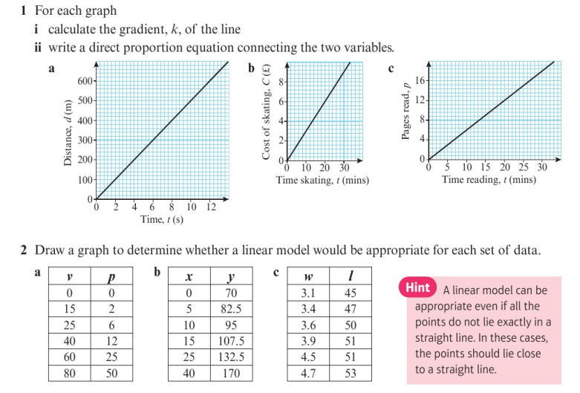
Homework Exercise

Slide 9
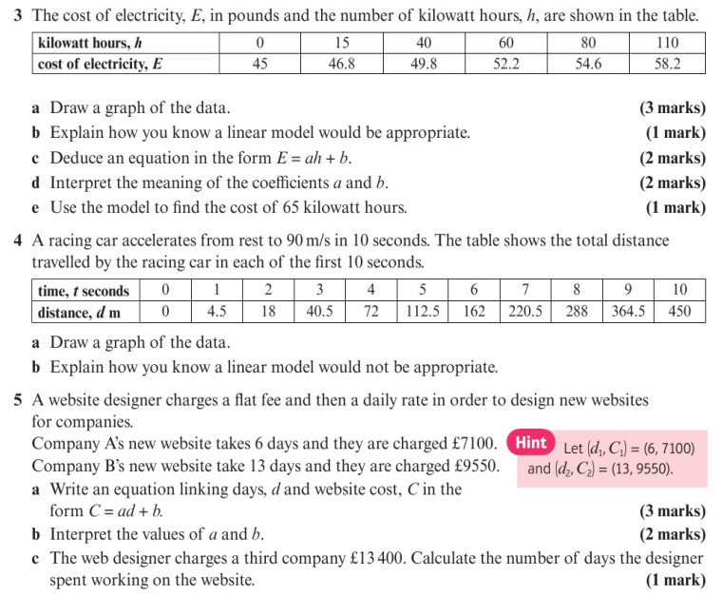
Homework Exercise

Slide 10
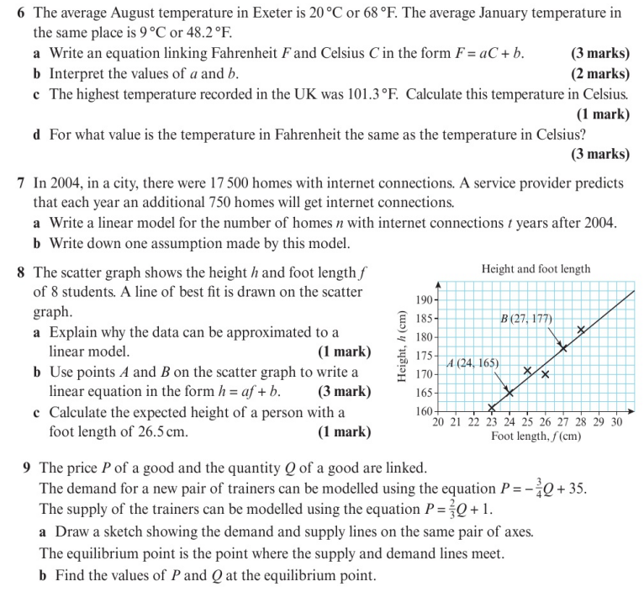
Homework Exercise

Slide 11
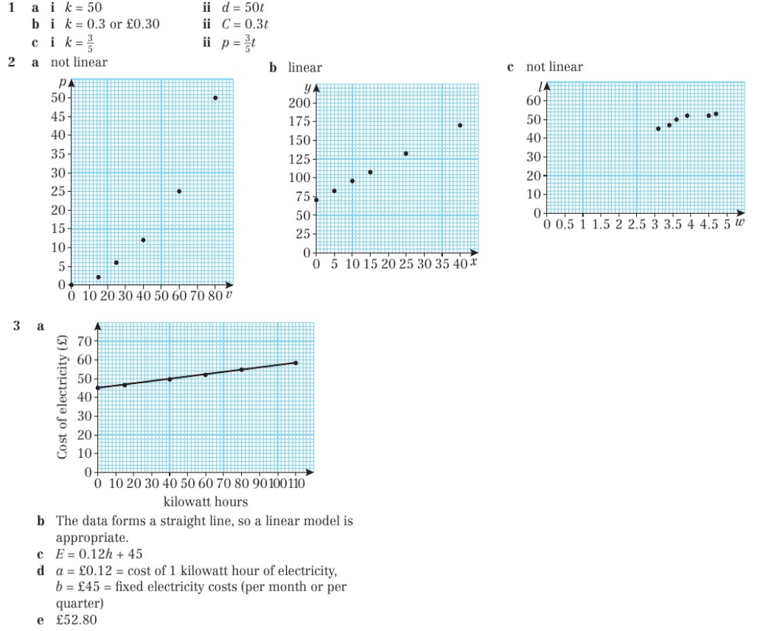
Homework Answers

Slide 12
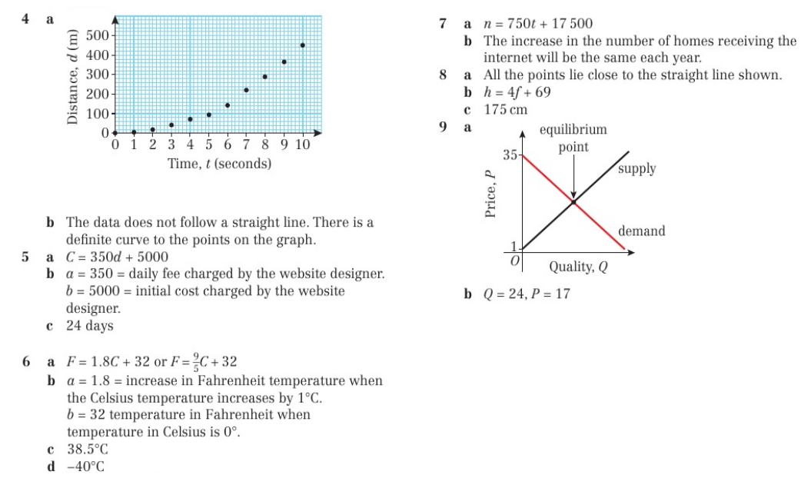
Homework Answers

