Slide 1
P1 Chapter 14: Logarithms Exponential Modelling

Slide 2

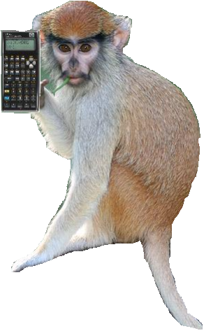


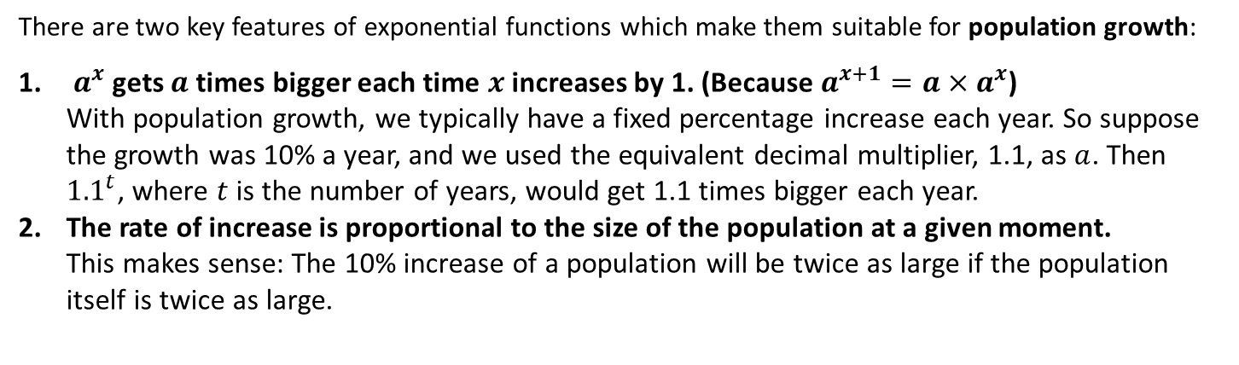
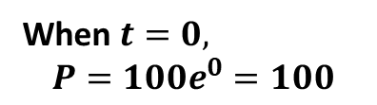


Exponential Modelling
There are two key features of exponential functions which make them suitable for population growth:
$a^{x}$ gets $a$ times bigger each time $x$ increases by 1. (Because $a^{x+1}=a×a^{x}$) With population growth, we typically have a fixed percentage increase each year. So suppose the growth was 10% a year, and we used the equivalent decimal multiplier, 1.1, as $a$. Then ${1.1}^{t}$, where $t$ is the number of years, would get 1.1 times bigger each year.
The rate of increase is proportional to the size of the population at a given moment. This makes sense: The 10% increase of a population will be twice as large if the population itself is twice as large.
Suppose the population $P$ in The Republic of Dave is modelled by $P=100e^{3t}$ where $t$ is the numbers years since The Republic was established.
$$P$$
What is the initial population?
?
When $t=0,$ $$P=100e^{0}=100$$
What is the initial rate of population growth?
?
$$\frac{dP}{dt}=300e^{3t}$$
When $t=0,\frac{dP}{dt}=300$
$$t$$
“Use of Technology” Monkey says:
When I’m not busy eating ticks off other monkeys, I use the $e^{□}$ key. I can also use [ALPHA] [$e$] to get $e$ without a power.

Slide 3


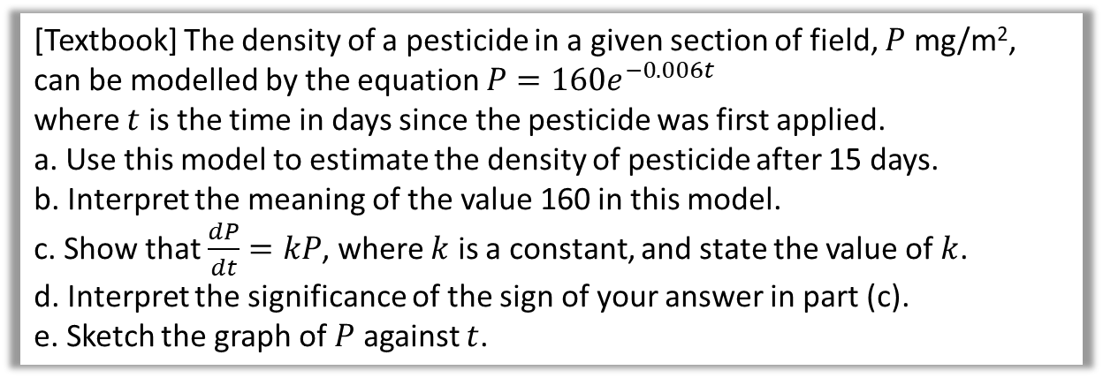


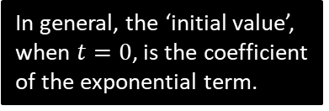
Another Example
[Textbook] The density of a pesticide in a given section of field, $P$ mg/m², can be modelled by the equation $P=160e^{−0.006t}$
where $t$ is the time in days since the pesticide was first applied.
a. Use this model to estimate the density of pesticide after 15 days.
b. Interpret the meaning of the value 160 in this model.
c. Show that $\frac{dP}{dt}=kP$, where $k$ is a constant, and state the value of $k$.
d. Interpret the significance of the sign of your answer in part (c).
e. Sketch the graph of $P$ against $t$.
When $t=15, P=160e^{−0.006(15)}$ $$=145.2 mg/m^{2}$$
When $t=0$, then $P=160$. Thus 160 is the initial density of pesticide in the field.
$$\frac{dP}{dt}=\left(160×−0.006\right)e^{−0.006t} \\ =−0.96e^{−0.006t} ∴k=−0.96$$
The rate is negative, thus the density of pesticide is decreasing.
a
?
In general, the ‘initial value’, when $t=0$, is the coefficient of the exponential term.
b
?
$$P$$
Recall that if the power in the exponential term is negative, we have an exponential decay graph, which gradually decreases towards 0.
If in doubt, just try a large value of $t$.
Don’t forget to put in the 160!
?
c
?
160
d
?
$$t$$

Slide 4
Exercise 14.3
Pearson Pure Mathematics Year 1/AS
Page 115

Slide 5


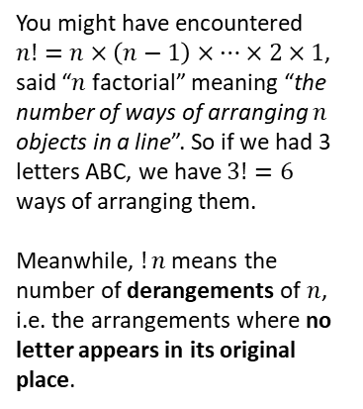

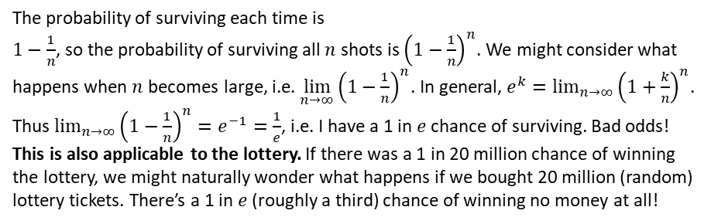

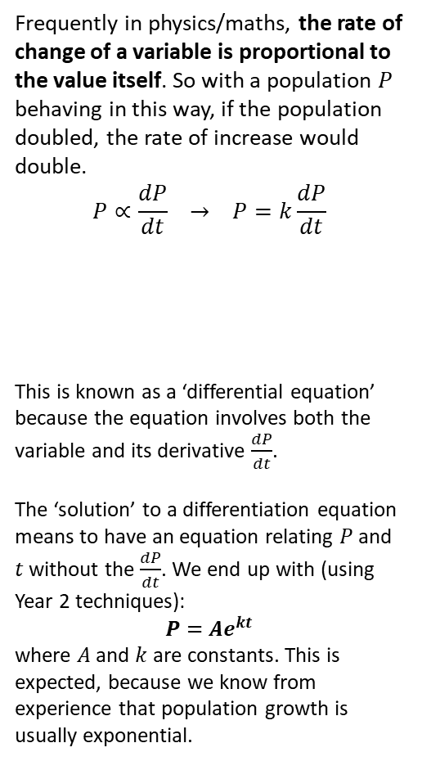

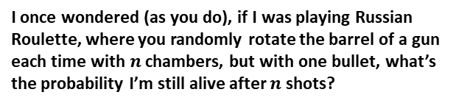
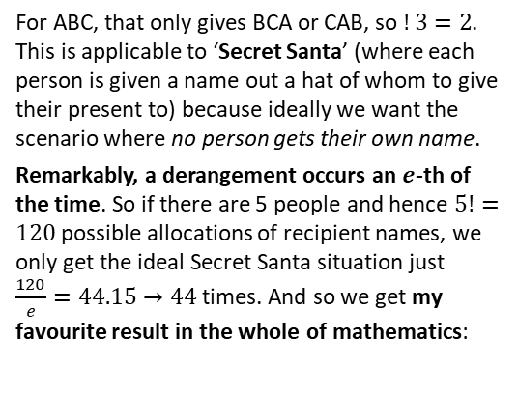

Application 2: Russian Roulette
A scene from one of Dr Frost’s favourite films, The Deer Hunter.
Application 1: Solutions to many ‘differential equations’.
I once wondered (as you do), if I was playing Russian Roulette, where you randomly rotate the barrel of a gun each time with $n$ chambers, but with one bullet, what’s the probability I’m still alive after $n$ shots?
Frequently in physics/maths, the rate of change of a variable is proportional to the value itself. So with a population $P$ behaving in this way, if the population doubled, the rate of increase would double.
$$P∝\frac{dP}{dt} → P=k\frac{dP}{dt}$$
This is known as a ‘differential equation’ because the equation involves both the variable and its derivative $\frac{dP}{dt}$.
The ‘solution’ to a differentiation equation means to have an equation relating $P$ and $t$ without the $\frac{dP}{dt}$. We end up with (using Year 2 techniques):
$$P=Ae^{kt}$$
where $A$ and $k$ are constants. This is expected, because we know from experience that population growth is usually exponential.
The probability of surviving each time is $1−\frac{1}{n}$, so the probability of surviving all $n$ shots is ${\left(1−\frac{1}{n}\right)}^{n}$. We might consider what happens when $n$ becomes large, i.e. $\lim_{n→∞}{{\left(1−\frac{1}{n}\right)}^{n}}$. In general, $e^{k}=\lim_{n→∞}{{\left(1+\frac{k}{n}\right)}^{n}}$. Thus $\lim_{n→∞}{{\left(1−\frac{1}{n}\right)}^{n}}=e^{−1}=\frac{1}{e}$, i.e. I have a 1 in $e$ chance of surviving. Bad odds!
This is also applicable to the lottery. If there was a 1 in 20 million chance of winning the lottery, we might naturally wonder what happens if we bought 20 million (random) lottery tickets. There’s a 1 in $e$ (roughly a third) chance of winning no money at all!
$$P$$
Application 3: Secret Santa
$$t$$
You might have encountered $n!=n×\left(n−1\right)×…×2×1$, said “$n$ factorial” meaning “the number of ways of arranging $n$ objects in a line”. So if we had 3 letters ABC, we have $3!=6$ ways of arranging them.
Meanwhile, $!n$ means the number of derangements of $n$, i.e. the arrangements where no letter appears in its original place.
For ABC, that only gives BCA or CAB, so $!3=2$. This is applicable to ‘Secret Santa’ (where each person is given a name out a hat of whom to give their present to) because ideally we want the scenario where no person gets their own name.
Remarkably, a derangement occurs an $e$-th of the time. So if there are 5 people and hence $5!=120$ possible allocations of recipient names, we only get the ideal Secret Santa situation just $\frac{120}{e}=44.15→44$ times. And so we get my favourite result in the whole of mathematics:
ABC,
ACB,
BAC,
BCA,
CAB,
CBA
$$!n=\left[\frac{n!}{e}\right]$$
(where $[…]$ means round)

Slide 6
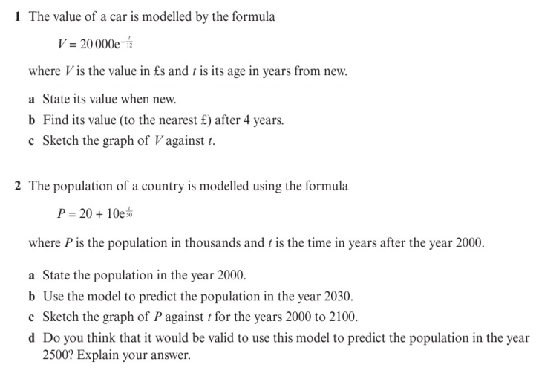
Homework Exercise

Slide 7
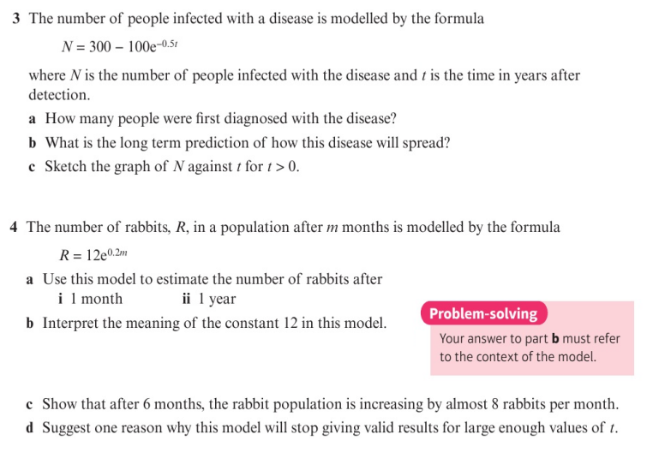
Homework Exercise

Slide 8
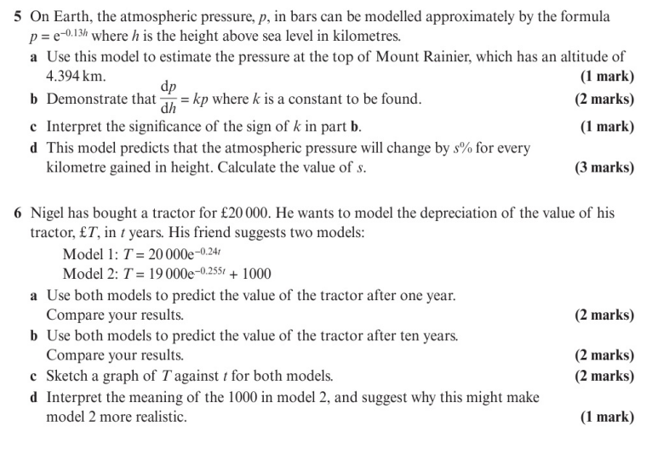
Homework Exercise

Slide 9
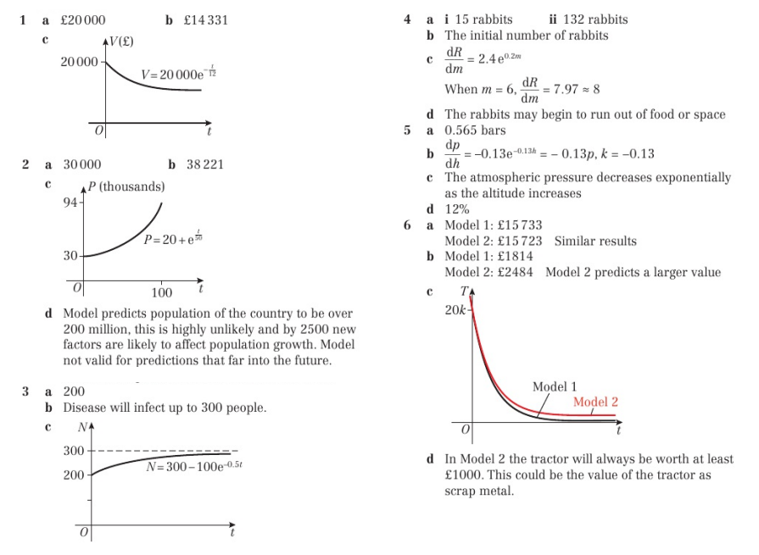
Homework Answers

