Slide 1
P2 Chapter 11: 3D Vectors Gibbs Notation in 3D

Slide 2

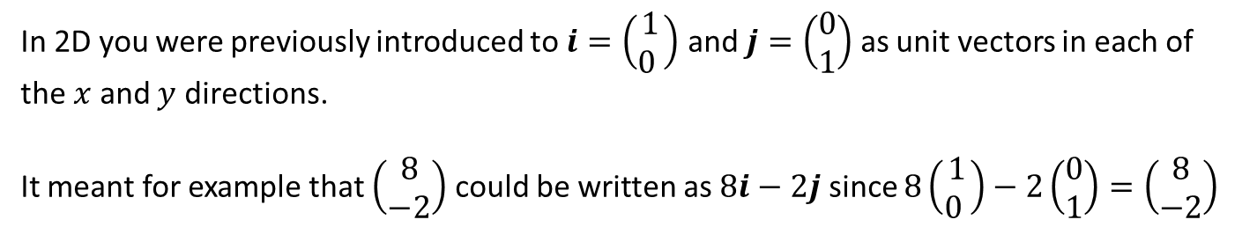

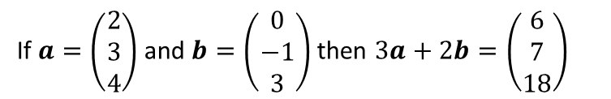

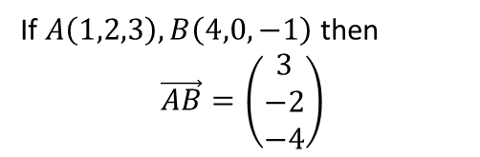




$i$, $j$ and $k$ notation
In 2D you were previously introduced to $i=\left(\begin{matrix}1 \\ 0 \end{matrix}\right)$ and $j=\left(\begin{matrix}0 \\ 1\end{matrix}\right)$ as unit vectors in each of the $x$ and $y$ directions.
It meant for example that $\left(\begin{matrix}8 \\ −2\end{matrix}\right)$ could be written as $8i−2j$ since $8\left(\begin{matrix}1 \\ 0 \end{matrix}\right)−2\left(\begin{matrix}0 \\ 1\end{matrix}\right)=\left(\begin{matrix}8 \\ −2\end{matrix}\right)$
Unsurprisingly, in 3D:
$$i=\left(\begin{matrix}1 \\ 0 \\ 0\end{matrix}\right), j=\left(\begin{matrix}0 \\ 1 \\ 0\end{matrix}\right), k=\left(\begin{matrix}0 \\ 0 \\ 1\end{matrix}\right)$$
Quickfire Questions
2
Write as a column vector:
?
$$i−j=\left(\begin{matrix}1 \\ −1 \\ 0\end{matrix}\right)$$
$$4j+k=\left(\begin{matrix}0 \\ 4 \\ 1\end{matrix}\right)$$
?
1
Put in $i,j,k$ notation:
$$\left(\begin{matrix}1 \\ 2 \\ 3\end{matrix}\right)=i+2j+3k$$
?
3
If $A\left(1,2,3\right), B\left(4,0,−1\right)$ then
$$\vec{AB}=\left(\begin{matrix}3 \\ −2 \\ −4\end{matrix}\right)$$
$$\left(\begin{matrix}−7 \\ 3 \\ 0\end{matrix}\right)=−7i+3j$$
?
?
$$\left(\begin{matrix}3 \\ 0 \\ −1\end{matrix}\right)=3i−k$$
?
If $a=\left(\begin{matrix}2 \\ 3 \\ 4\end{matrix}\right)$ and $b=\left(\begin{matrix}0 \\ −1 \\ 3\end{matrix}\right)$ then $3a+2b=\left(\begin{matrix}6 \\ 7 \\ 18\end{matrix}\right)$
?
4

Slide 3
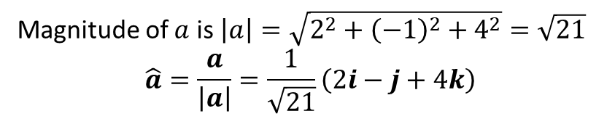
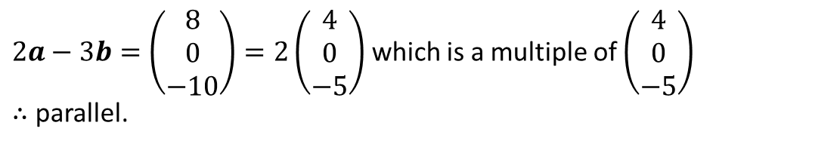
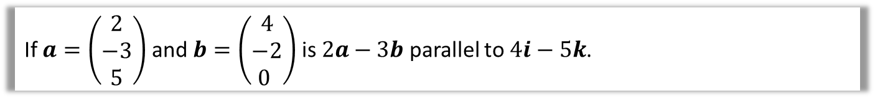
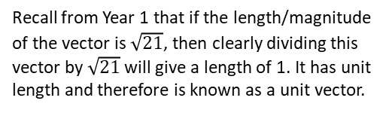
Examples
Find the magnitude of $a=2i−j+4k$ and hence find $\hat{a}$, the unit vector in the direction of $a$.
?
Magnitude of $a$ is $\left|a\right|=\sqrt{2^{2}+{\left(−1\right)}^{2}+4^{2}}=\sqrt{21}$
$$\hat{a}=\frac{a}{\left|a\right|}=\frac{1}{\sqrt{21}}\left(2i−j+4k\right)$$
Recall from Year 1 that if the length/magnitude of the vector is $\sqrt{21}$, then clearly dividing this vector by $\sqrt{21}$ will give a length of 1. It has unit length and therefore is known as a unit vector.
If $a=\left(\begin{matrix}2 \\ −3 \\ 5\end{matrix}\right)$ and $b=\left(\begin{matrix}4 \\ −2 \\ 0 \end{matrix}\right)$ is $2a−3b$ parallel to $4i−5k$.
?
$2a−3b=\left(\begin{matrix}8 \\ 0 \\ −10\end{matrix}\right)=2\left(\begin{matrix}4 \\ 0 \\ −5\end{matrix}\right)$ which is a multiple of $\left(\begin{matrix}4 \\ 0 \\ −5\end{matrix}\right)$
$∴$ parallel.

Slide 4
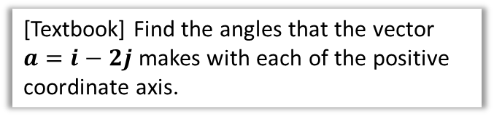

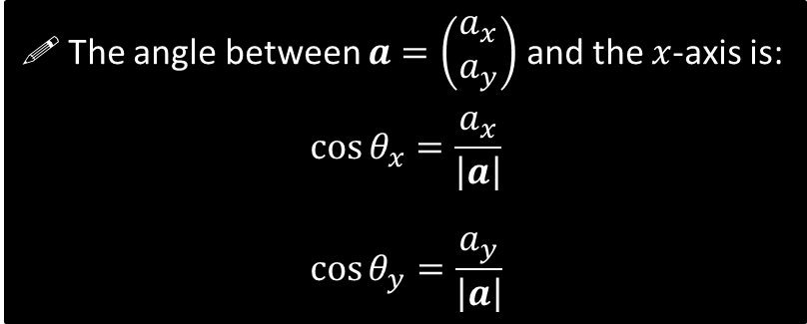

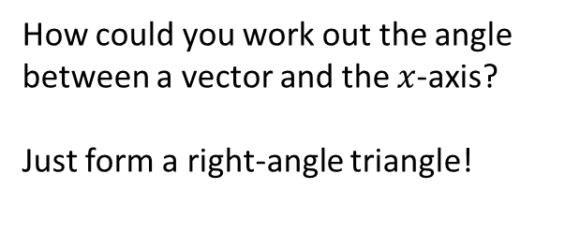





Angles between vectors and an axis: 2D
$$y$$
How could you work out the angle between a vector and the $x$-axis?
Just form a right-angle triangle!
$$a$$
?
$$a_{y}$$
$$θ_{x}$$
The angle between $a=\left(\begin{matrix}a_{x} \\ a_{y}\end{matrix}\right)$ and the $x$-axis is:
$$\cos{θ_{x}}=\frac{a_{x}}{\left|a\right|}$$
$$\cos{θ_{y}}=\frac{a_{y}}{\left|a\right|}$$
$$a_{x}$$
$$x$$
[Textbook] Find the angles that the vector $a=i−2j$ makes with each of the positive coordinate axis.
?
$$\left|a\right|=\sqrt{1^{2}+{\left(−2\right)}^{2}}=\sqrt{5} \\ \cos{θ_{x}}=\frac{1}{\sqrt{5}} → θ_{x}=63.4° \\ \cos{θ_{y}}=\frac{−2}{\sqrt{5}} → θ_{y}=153°$$

Slide 5
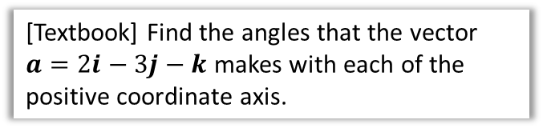





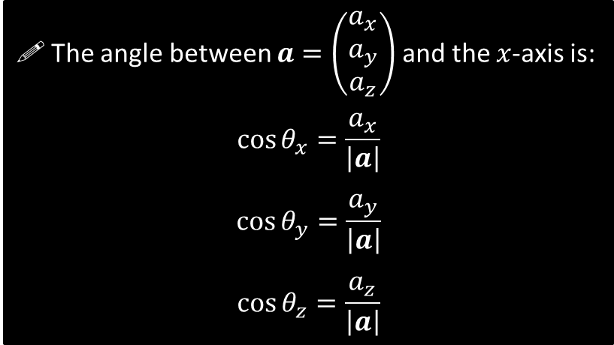

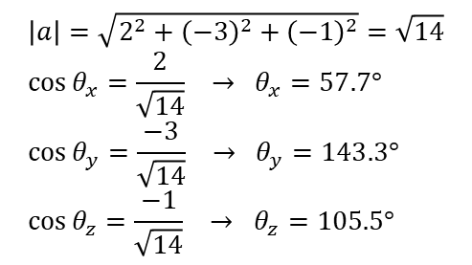
Angles between vectors and an axis: 3D
How could you work out the angles in 3D?
It’s still right-angle triangles! But now tilted into z.
$$z$$
?
$$y$$
The angle between $a=\left(\begin{matrix}a_{x} \\ a_{y} \\ a_{z}\end{matrix}\right)$ and the $x$-axis is:
$$\cos{θ_{x}}=\frac{a_{x}}{\left|a\right|}$$
$$\cos{θ_{y}}=\frac{a_{y}}{\left|a\right|}$$
$$\cos{θ_{z}}=\frac{a_{z}}{\left|a\right|}$$
$$a$$
$$θ_{x}$$
$$x$$
$$x$$
?
[Textbook] Find the angles that the vector $a=2i−3j−k$ makes with each of the positive coordinate axis.
$$\left|a\right|=\sqrt{2^{2}+{\left(−3\right)}^{2}+{\left(−1\right)}^{2}}=\sqrt{14} \\ \cos{θ_{x}}=\frac{2}{\sqrt{14}} → θ_{x}=57.7° \\ \cos{θ_{y}}=\frac{−3}{\sqrt{14}} → θ_{y}=143.3° \\ \cos{θ_{z}}=\frac{−1}{\sqrt{14}} → θ_{z}=105.5°$$

Slide 6

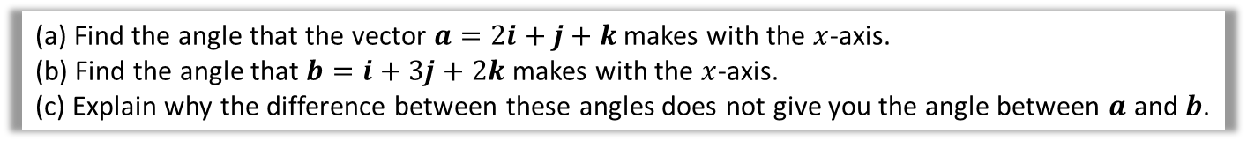
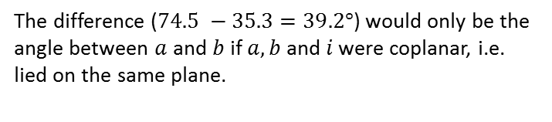



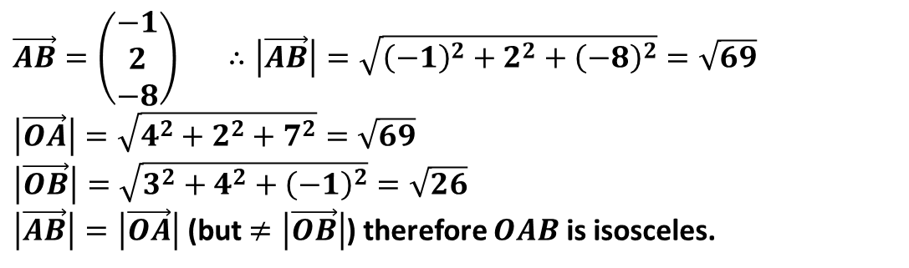
Test Your Understanding
[Textbook] The points $A$ and $B$ have position vectors $4i+2j+7k$ and $3i+4j−k$ relative to a fixed origin, $O$. Find $\vec{AB}$ and show that $ΔOAB$ is isosceles.
?
We can find $\vec{AB}$ by simply looking at the change from 4 to 3, and so on. The textbook has a longwinded way of writing $\vec{OA} =\left(\begin{matrix}4 \\ 2 \\ 7\end{matrix}\right)$ and $\vec{OB} =\left(\begin{matrix}3 \\ 4 \\ −1\end{matrix}\right)$, then finding $\vec{AB}=\vec{OB}−\vec{OA}$. Overkill!
$$\vec{AB}=\left(\begin{matrix}−1 \\ 2 \\ −8\end{matrix}\right) ∴\left|\vec{AB}\right|=\sqrt{{\left(−1\right)}^{2}+2^{2}+{\left(−8\right)}^{2}}=\sqrt{69} \\ \left|\vec{OA}\right|=\sqrt{4^{2}+2^{2}+7^{2}}=\sqrt{69} \\ \left|\vec{OB}\right|=\sqrt{3^{2}+4^{2}+{\left(−1\right)}^{2}}=\sqrt{26}$$ $\left|\vec{AB}\right|=\left|\vec{OA}\right|$ (but $≠\left|\vec{OB}\right|$) therefore $OAB$ is isosceles.
(a) Find the angle that the vector $a=2i+j+k$ makes with the $x$-axis.
(b) Find the angle that $b=i+3j+2k$ makes with the $x$-axis. (c) Explain why the difference between these angles does not give you the angle between $a$ and $b$.
$$\left|a\right|=\sqrt{2^{2}+1^{2}+1^{2}}=\sqrt{6} \\ \cos{θ_{x}}=\frac{2}{\sqrt{6}} θ_{x}=35.264°$$
$$\left|b\right|=\sqrt{1^{2}+3^{2}+2^{2}}=\sqrt{14} \\ \cos{θ_{x}}=\frac{1}{\sqrt{14}} θ_{x}=74.499°$$
c
The difference ($74.5 −35.3=39.2°$) would only be the angle between $a$ and $b$ if $a,b$ and $i$ were coplanar, i.e. lied on the same plane.
a
?
?
b
?
$$74.499°$$
$$x$$

Slide 7
Exercise 12.2
Pearson Pure Mathematics Year 2/AS
Pages 106-107

Slide 8
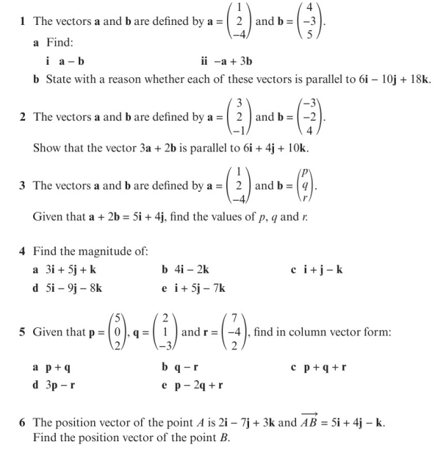
Homework Exercise

Slide 9
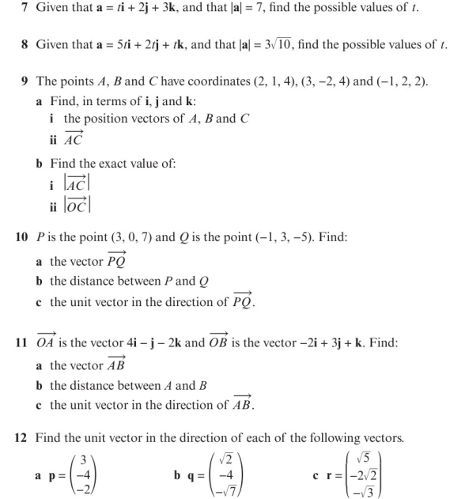
Homework Exercise

Slide 10
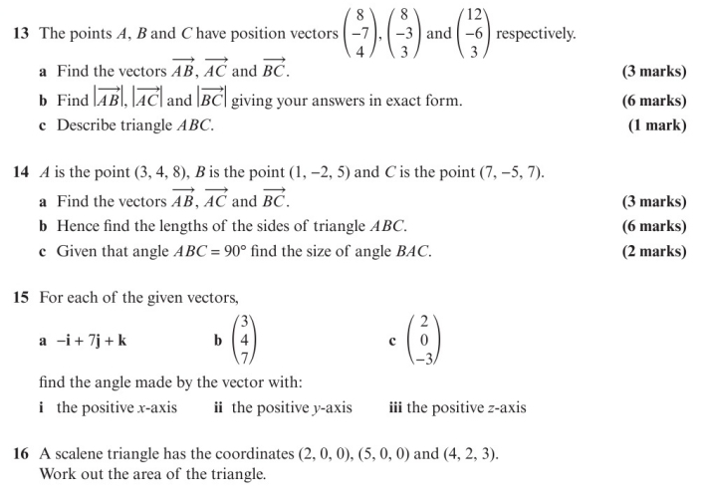
Homework Exercise

Slide 11
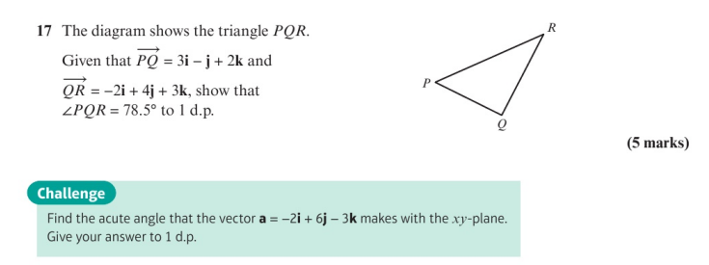
Homework Exercise

Slide 12
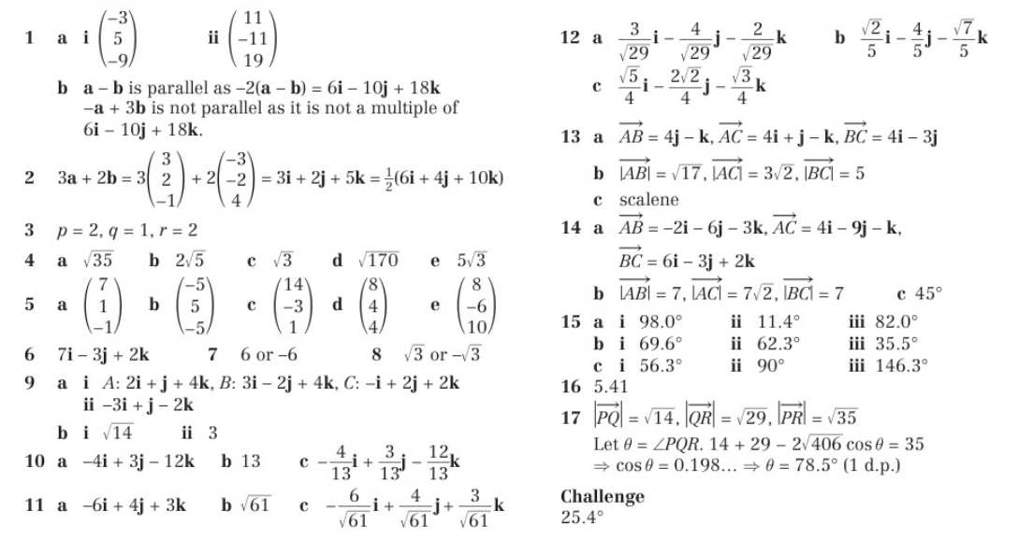
Homework Answers

