Slide 1
M1 Chapter 9: Constant Acceleration Vertical Motion Under Gravity

Slide 2
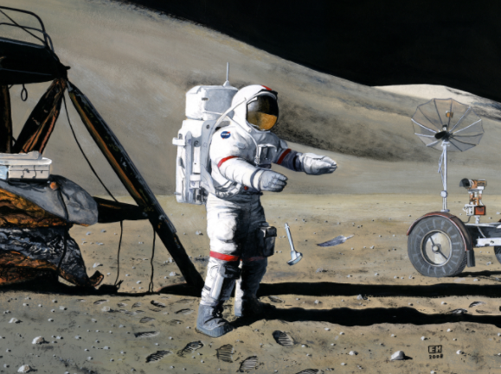
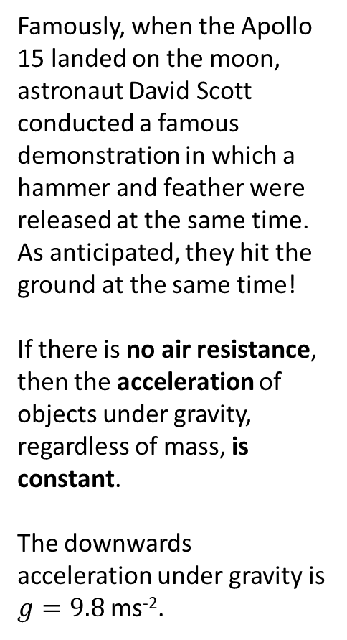
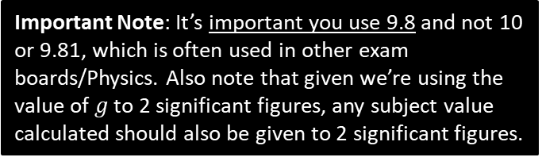
Vertical Motion Under Gravity
Famously, when the Apollo 15 landed on the moon, astronaut David Scott conducted a famous demonstration in which a hammer and feather were released at the same time. As anticipated, they hit the ground at the same time!
If there is no air resistance, then the acceleration of objects under gravity, regardless of mass, is constant.
The downwards acceleration under gravity is $g=9.8$ms⁻².
Important Note: It’s important you use 9.8 and not 10 or 9.81, which is often used in other exam boards/Physics. Also note that given we’re using the value of $g$ to 2 significant figures, any subject value calculated should also be given to 2 significant figures.

Slide 3
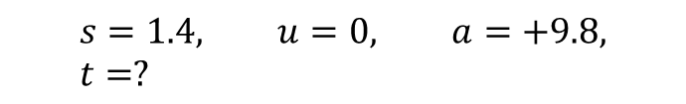
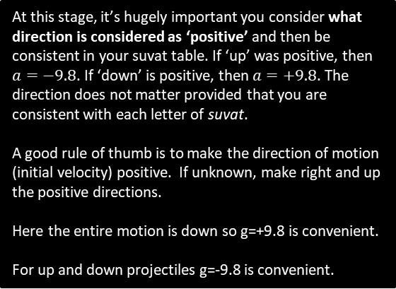
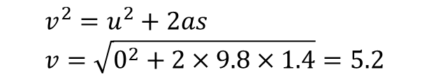

Example
[Textbook] A book falls off the top shelf of a bookcase. The shelf is 1.4 m above a wooden floor. Find:
the time the book takes to reach the floor,
the speed with which the book strikes the floor.
At this stage, it’s hugely important you consider what direction is considered as ‘positive’ and then be consistent in your suvat table. If ‘up’ was positive, then $a=−9.8$. If ‘down’ is positive, then $a=+9.8$. The direction does not matter provided that you are consistent with each letter of suvat.
A good rule of thumb is to make the direction of motion (initial velocity) positive. If unknown, make right and up the positive directions.
Here the entire motion is down so g=+9.8 is convenient.
For up and down projectiles g=-9.8 is convenient.
?
$$s=1.4, u=0, a=+9.8, t=?$$
a
?
?
?
$$s=ut+\frac{1}{2}at^{2} \\ 1.4=0+\frac{1}{2}×9.8×t^{2} \\ t=0.53$$
b
?
$$v^{2}=u^{2}+2as \\ v=\sqrt{0^{2}+2×9.8×1.4}=5.2$$
As per previous slides, quote only to 2 or 3 significant figures. You may be penalised if you quote more!

Slide 4
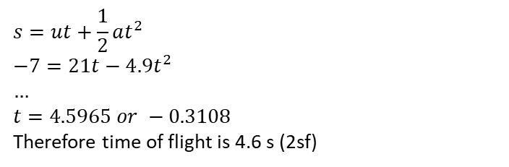
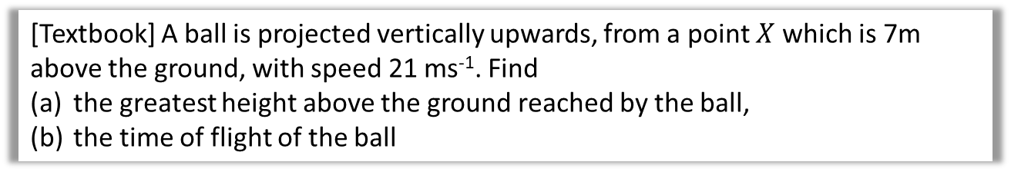


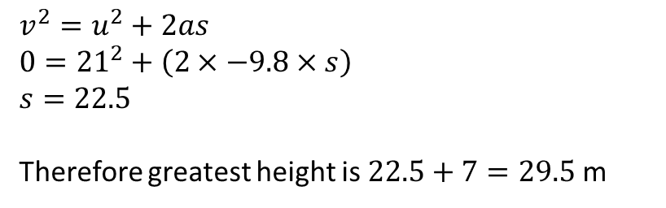
Further Example
[Textbook] A ball is projected vertically upwards, from a point $X$ which is 7m above the ground, with speed 21 ms⁻¹. Find
the greatest height above the ground reached by the ball,
the time of flight of the ball
?
?
?
$$s$$
a
?
$$s=?, u=21, v=0, a=−9.8,$$
?
$$v^{2}=u^{2}+2as \\ 0={21}^{2}+\left(2×−9.8×s\right) \\ s=22.5$$
Therefore greatest height is $22.5+7=29.5$ m
$$7$$
b
?
?
?
$$s=−7, u=21, a=−9.8, t=?$$
$$s=ut+\frac{1}{2}at^{2} \\ −7=21t−4.9t^{2} \\ … \\ t=4.5965 or −0.3108$$
Therefore time of flight is 4.6 s (2sf)
?

Slide 5
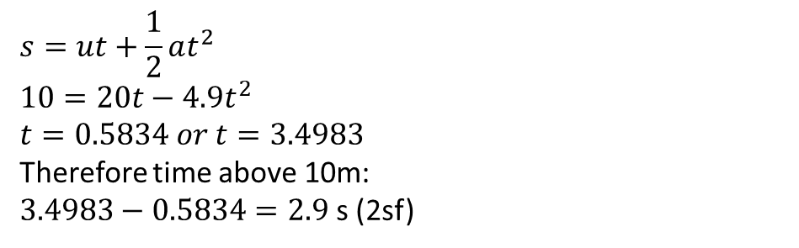
A further common type of question…
A ball is projected vertically upwards from ground level at a speed of 20 ms⁻¹.
Determine the amount of time the ball is at least 10m above ground level.
?
$$s=10, u=20, a=−9.8, t=?$$
a
?
?
?
10m
$$s=ut+\frac{1}{2}at^{2} \\ 10=20t−4.9t^{2} \\ t=0.5834 or t=3.4983$$
Therefore time above 10m:
$3.4983−0.5834=2.9$ s (2sf)
?
Froculator Tip: Be sure to use the quadratic solver on your calculator (within ‘Equation’ mode on the ClassWiz).

Slide 6
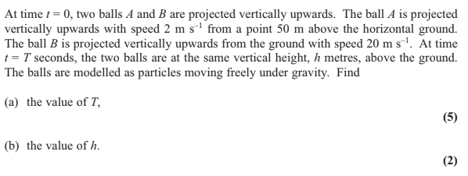
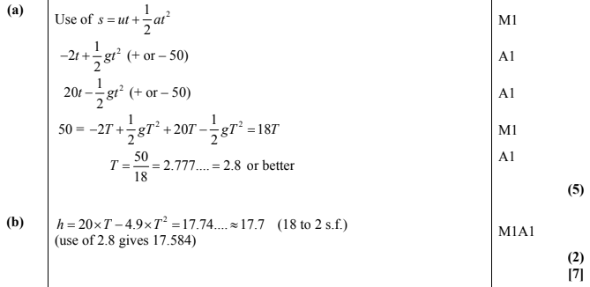
Test Your Understanding
Edexcel M1 May 2013(R) Q4
?
?

Slide 7
Exercise 9.5 Vertical projectiles
Pearson Stats/Mechanics Year 1
Pages 64-65

Slide 8
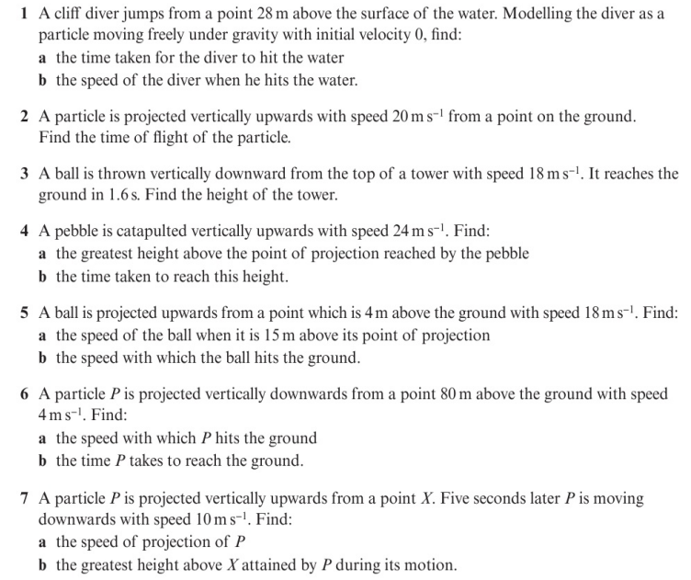
Homework Exercise

Slide 9
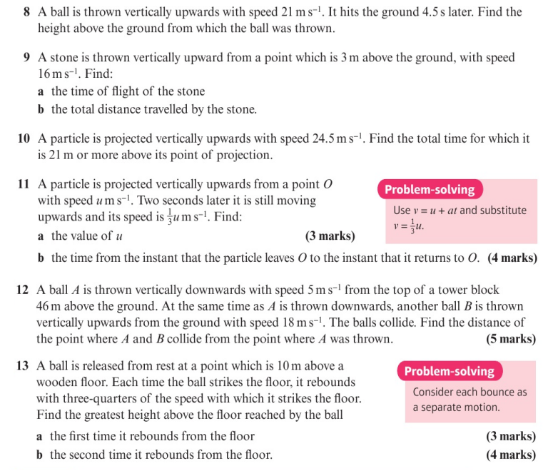
Homework Exercise

Slide 10
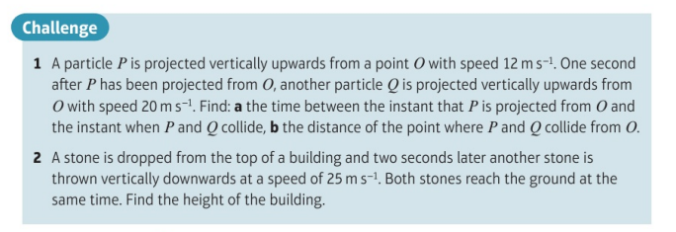
Homework Exercise

Slide 11
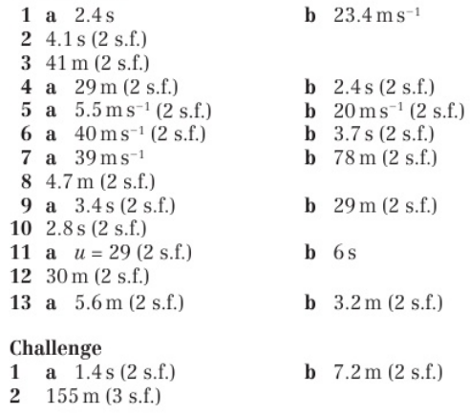
Homework Answers

