Slide 1
P1 Chapter 12: Differentiation
Sketching Gradient Functions

Slide 2


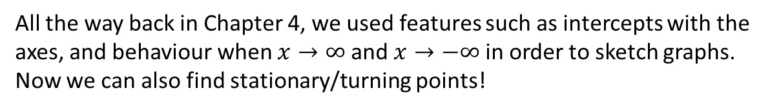






Sketching Graphs
All the way back in Chapter 4, we used features such as intercepts with the axes, and behaviour when $x→∞$ and $x→−∞$ in order to sketch graphs.
Now we can also find stationary/turning points!
[Textbook] By first finding the stationary points, sketch the graph of $y=\frac{1}{x}+27x^{3}$
? Turning Points
$$y$$
$$y=x^{−1}+27x^{3} \\ \frac{dy}{dx}=−x^{−2}+81x^{2}=0 \\ −\frac{1}{x^{2}}+81x^{2}=0 → 81x^{2}=\frac{1}{x^{2}} \\ 81x^{4}=1 → x=\frac{1}{3} or −\frac{1}{3} \\ \left(\frac{1}{3},4\right), \left(−\frac{1}{3},−4\right)$$
As $x→∞, y→∞$
As $x→−∞, y→−∞$
$x$ not defined at 0 (due to $\frac{1}{x}$ term)
? Graph
$$4$$
$$x$$
$$−\frac{1}{3}$$
$$\frac{1}{3}$$
? As $x→∞$, $x→−∞$
$$−4$$
? Vertical Asymptotes

Slide 3
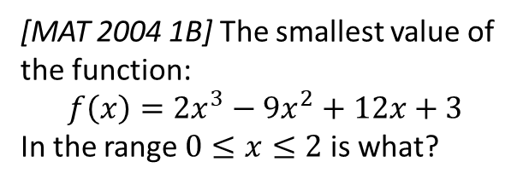
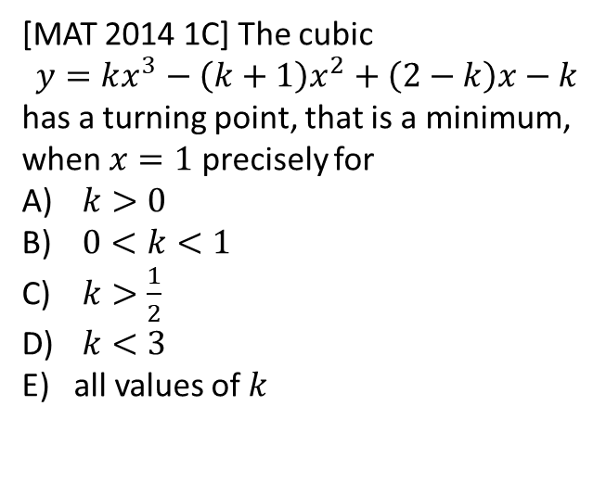
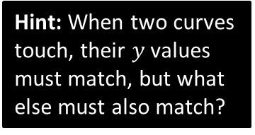
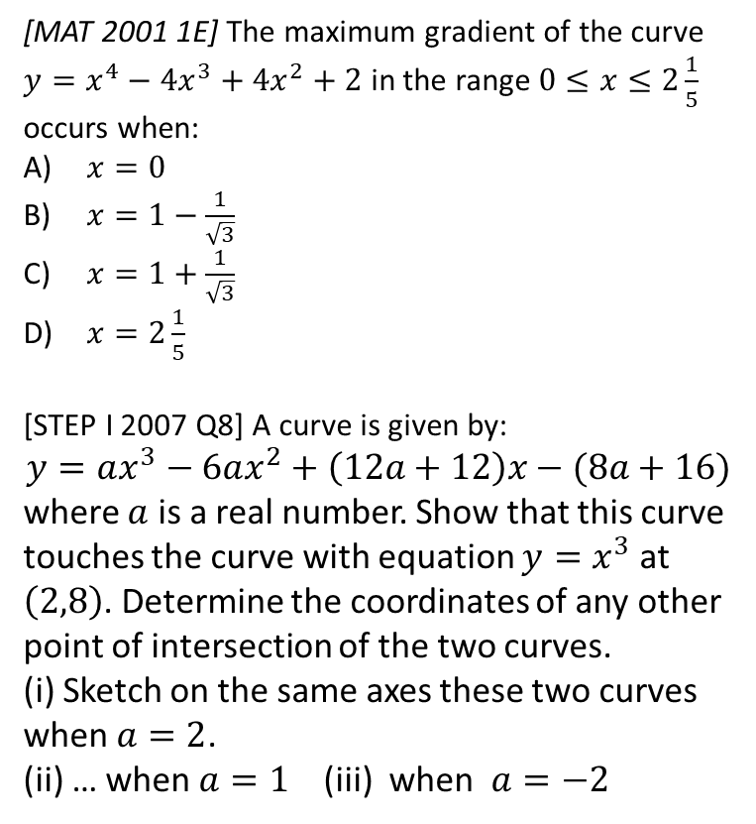
Exercise
Extension
3
[MAT 2001 1E] The maximum gradient of the curve $y=x^{4}−4x^{3}+4x^{2}+2$ in the range $0≤x≤2\frac{1}{5}$ occurs when:
$x=0$
$x=1−\frac{1}{\sqrt{3}}$
$x=1+\frac{1}{\sqrt{3}}$
$x=2\frac{1}{5}$
[STEP I 2007 Q8] A curve is given by:
$$y=ax^{3}−6ax^{2}+\left(12a+12\right)x−(8a+16)$$
where $a$ is a real number. Show that this curve touches the curve with equation $y=x^{3}$ at $\left(2,8\right)$. Determine the coordinates of any other point of intersection of the two curves.
(i) Sketch on the same axes these two curves when $a=2$.
(ii) … when $a=1$ (iii) when $a=−2$
1
[MAT 2014 1C] The cubic
$$y=kx^{3}−\left(k+1\right)x^{2}+\left(2−k\right)x−k$$
has a turning point, that is a minimum, when $x=1$ precisely for
$k>0$
$0<k<1$
$k>\frac{1}{2}$
$k<3$
all values of $k$
Hint: When two curves touch, their $y$ values must match, but what else must also match?
4
2
[MAT 2004 1B] The smallest value of the function:
$$f\left(x\right)=2x^{3}−9x^{2}+12x+3$$
In the range $0≤x≤2$ is what?

Slide 4
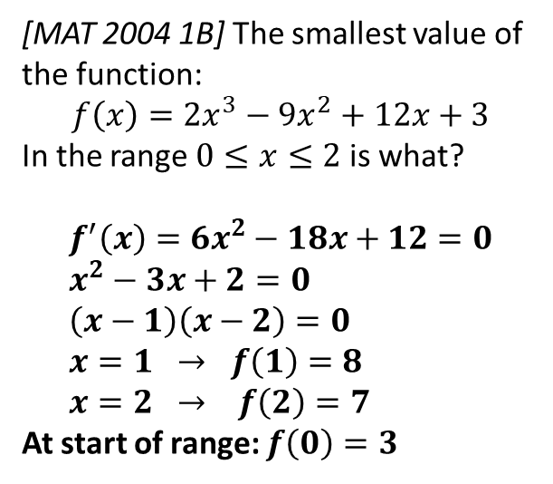
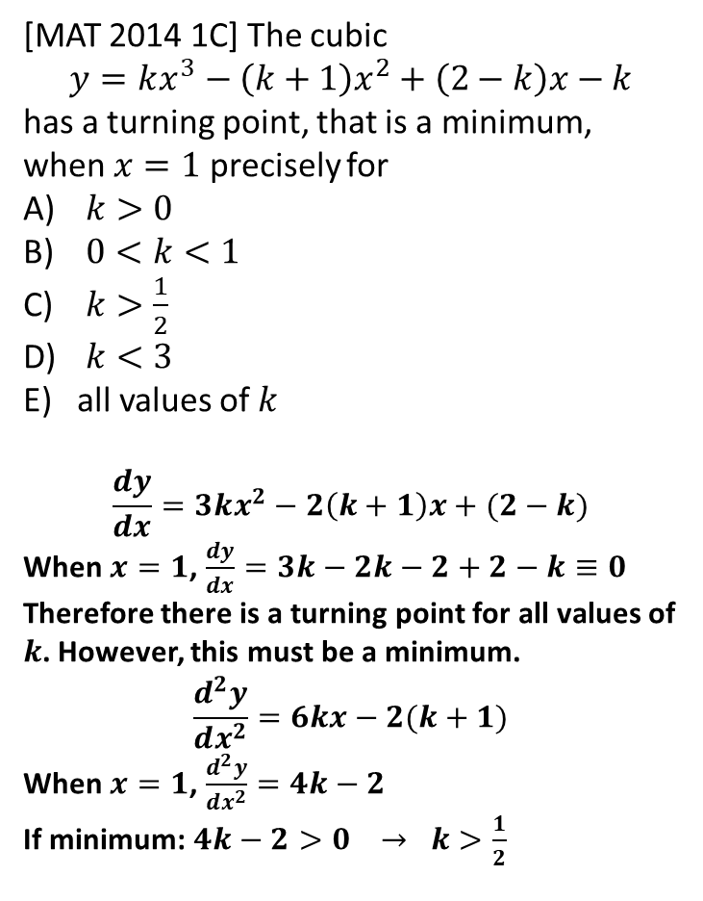



Solutions to Extension Questions
1
[MAT 2014 1C] The cubic
$$y=kx^{3}−\left(k+1\right)x^{2}+\left(2−k\right)x−k$$
has a turning point, that is a minimum, when $x=1$ precisely for
$k>0$
$0<k<1$
$k>\frac{1}{2}$
$k<3$
all values of $k$
$$\frac{dy}{dx}=3kx^{2}−2\left(k+1\right)x+(2−k)$$
When $x=1$, $\frac{dy}{dx}=3k−2k−2+2−k≡0$
Therefore there is a turning point for all values of $k$. However, this must be a minimum.
$$\frac{d^{2}y}{dx^{2}}=6kx−2(k+1)$$
When $x=1$, $\frac{d^{2}y}{dx^{2}}=4k−2$
If minimum: $4k−2>0 → k>\frac{1}{2}$
2
[MAT 2004 1B] The smallest value of the function:
$$f\left(x\right)=2x^{3}−9x^{2}+12x+3$$
In the range $0≤x≤2$ is what?
$$f^{′}\left(x\right)=6x^{2}−18x+12=0 \\ x^{2}−3x+2=0 \\ \left(x−1\right)\left(x−2\right)=0 \\ x=1 → f\left(1\right)=8 \\ x=2 → f\left(2\right)=7$$
At start of range: $f\left(0\right)=3$
$$(1,8)$$
$$(2,7)$$
$$(0,3)$$
Therefore answer is 3.

Slide 5
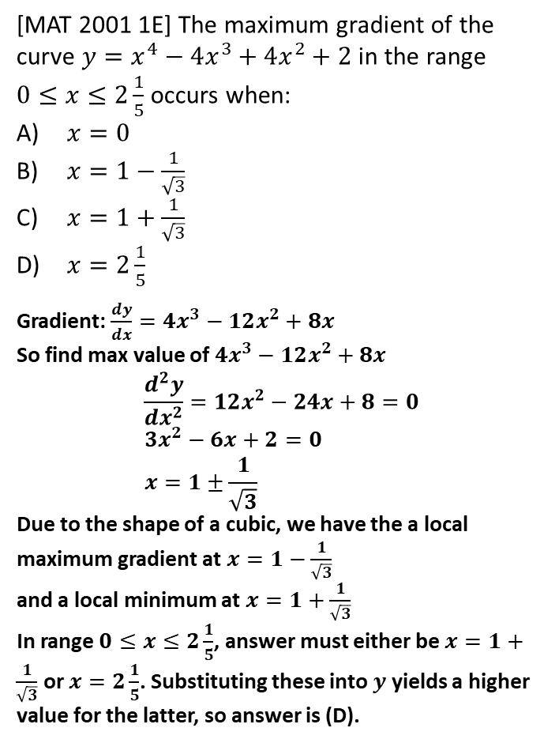
Solutions to Extension Questions
3
[MAT 2001 1E] The maximum gradient of the curve $y=x^{4}−4x^{3}+4x^{2}+2$ in the range
$0≤x≤2\frac{1}{5}$ occurs when:
$x=0$
$x=1−\frac{1}{\sqrt{3}}$
$x=1+\frac{1}{\sqrt{3}}$
$x=2\frac{1}{5}$
Gradient: $\frac{dy}{dx}=4x^{3}−12x^{2}+8x$
So find max value of $4x^{3}−12x^{2}+8x$
$$\frac{d^{2}y}{dx^{2}}=12x^{2}−24x+8=0 \\ 3x^{2}−6x+2=0 \\ x=1±\frac{1}{\sqrt{3}}$$
Due to the shape of a cubic, we have the a local maximum gradient at $x=1−\frac{1}{\sqrt{3}}$
and a local minimum at $x=1+\frac{1}{\sqrt{3}}$
In range $0≤x≤2\frac{1}{5}$, answer must either be $x=1+\frac{1}{\sqrt{3}}$ or $x=2\frac{1}{5}$. Substituting these into $y$ yields a higher value for the latter, so answer is (D).

Slide 6
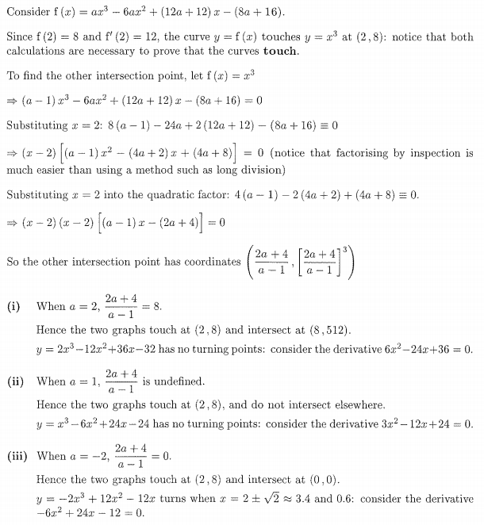
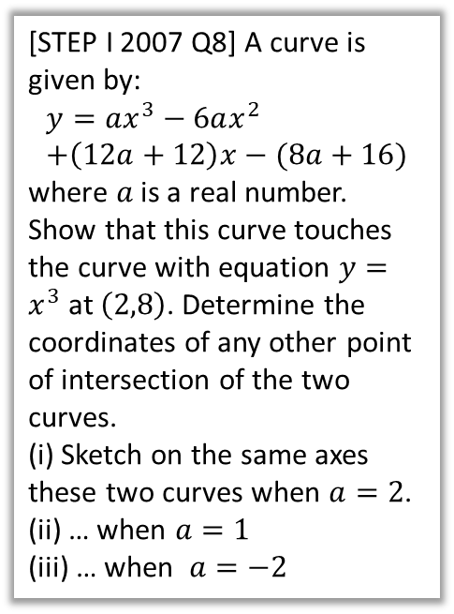
Solutions to Extension Questions
4
[STEP I 2007 Q8] A curve is given by:
$$y=ax^{3}−6ax^{2} \\ +\left(12a+12\right)x−(8a+16)$$
where $a$ is a real number. Show that this curve touches the curve with equation $y=x^{3}$ at $\left(2,8\right)$. Determine the coordinates of any other point of intersection of the two curves.
(i) Sketch on the same axes these two curves when $a=2$.
(ii) … when $a=1$
(iii) … when $a=−2$

Slide 7
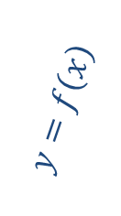

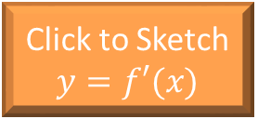
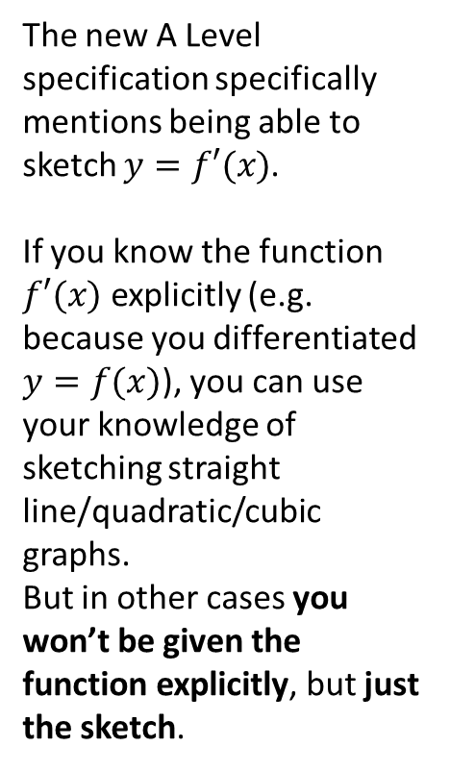

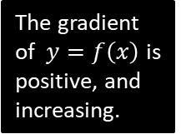

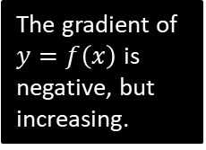

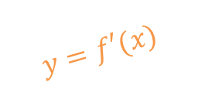
Sketching Gradient Functions
The new A Level specification specifically mentions being able to sketch $y=f′(x)$.
If you know the function $f′(x)$ explicitly (e.g. because you differentiated $y=f(x)$), you can use your knowledge of sketching straight line/quadratic/cubic graphs.
But in other cases you won’t be given the function explicitly, but just the sketch.
$$y$$
The gradient of $y=f\left(x\right)$ is negative, but increasing.
$$y=f\left(x\right)$$
The gradient at the turning point is 0.
The gradient of $y=f\left(x\right)$ is positive, and increasing.
$$x$$
$$y=f′(x)$$
Click to Sketch $y=f′(x)$
Click to Sketch $y=f′(x)$
Click to Sketch $y=f′(x)$

Slide 8

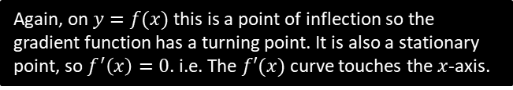




A Harder One
Gradient is positive: initially increases but then decreases.
Fro Tip: Mentally describe the gradient of each section of the curve, starting your mental sentence with “The gradient is…” and using terms like “positive”, “but increasing”, “but not changing”, etc.
Gradient is negative, but increasing.
$$y$$
Gradient is positive: initially increases but then decreases.
Gradient is 0.
Gradient is 0.
Gradient is 0, but positive before and after.
Gradient is negative. Initially decreases but then tends towards 0.
$$y=f\left(x\right)$$
$$x$$
$$y=f′(x)$$
>
>
>
>
>
>
>
Fro Pro Tip: The gradient is momentarily not changing so the gradient of the gradient is 0. We get a turning point in $y=f^{′}\left(x\right)$ whenever the curve has a point of inflection.
Again, on $y=f(x)$ this is a point of inflection so the gradient function has a turning point. It is also a stationary point, so $f^{′}\left(x\right)=0$. i.e. The $f′(x)$ curve touches the $x$-axis.

Slide 9



Test Your Understanding
$$y$$
Gradient is negative, but increasing.
Gradient is positive; initially increases but then decreases.
$$y=f\left(x\right)$$
Gradient is 0.
$$y=f′(x)$$
$$x$$
Gradient is positive, but tending towards 0.
Solution >

Slide 10

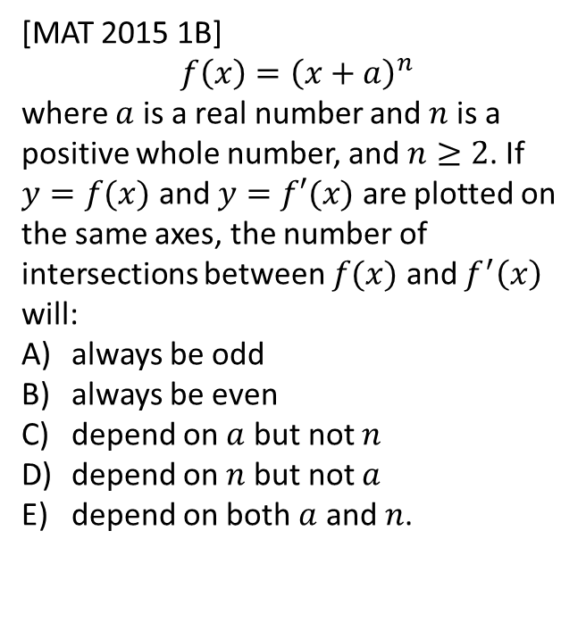
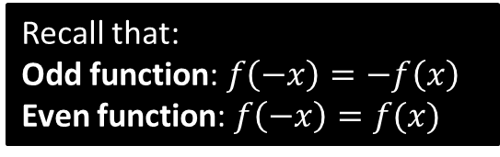
Exercise 12.10
Pearson Pure Mathematics Year 1/AS
Page 99
Extension
?
(Official solution)
If $f(x)$ is an even function then $f^{′}\left(x\right)$ will be an odd function, and vice versa. $f(x)$ and $f^{′}\left(x\right)$ will cross the $x$-axis at $\left(−a,0\right)$ and will have one further intersection when $y$ and $x$ are greater than 0.
The answer is (b).
1
[MAT 2015 1B]
$$f\left(x\right)={\left(x+a\right)}^{n}$$
where $a$ is a real number and $n$ is a positive whole number, and $n≥2$. If $y=f(x)$ and $y=f′(x)$ are plotted on the same axes, the number of intersections between $f(x)$ and $f^{′}\left(x\right)$ will:
always be odd
always be even
depend on $a$ but not $n$
depend on $n$ but not $a$
depend on both $a$ and $n$.
Recall that:
Odd function: $f\left(−x\right)=−f\left(x\right)$
Even function: $f\left(−x\right)=f(x)$

Slide 11
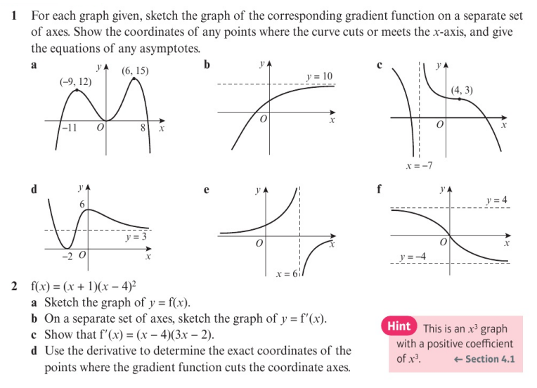
Homework Exercise

Slide 12
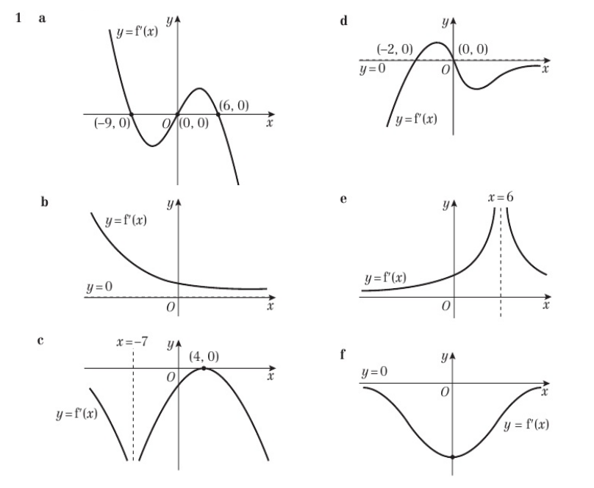
Homework Answers

Slide 13
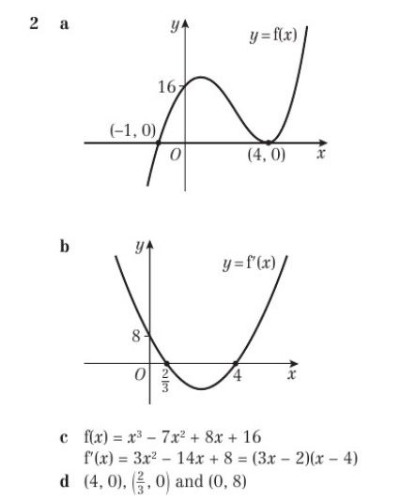
Homework Answers

