Slide 1
P2 Chapter 11: Integration Using Standard Functions

Slide 2
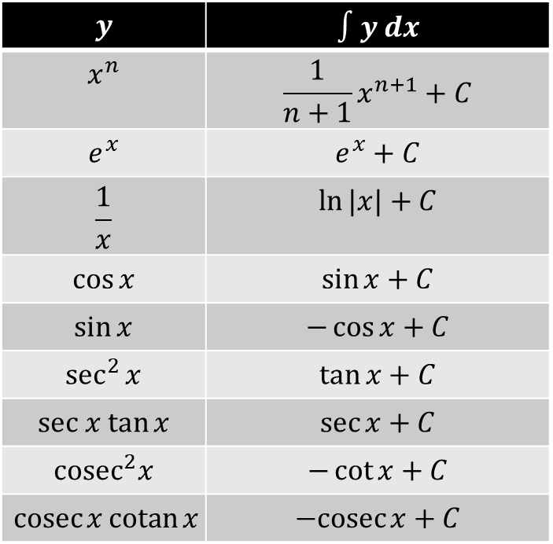
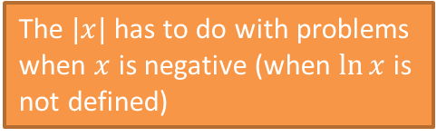
SKILL #1: Integrating Standard Functions
There’s certain results you should be able to integrate straight off, by just thinking about the opposite of differentiation.
$$y$$ | $$∫y dx$$
$$x^{n}$$ | $$\frac{1}{n+1}x^{n+1}+C$$
$$e^{x}$$ | $$e^{x}+C$$
$$\frac{1}{x}$$ | $$\ln{|x|}+C$$
$$\cos{x}$$ | $$\sin{x}+C$$
$$\sin{x}$$ | $$−\cos{x}+C$$
$$\sec^{2}{x}$$ | $$\tan{x}+C$$
$$sec x tan{x}$$ | $$\sec{x}+C$$
$${cosec}^{2}x$$ | $$−\cot{x}+C$$
$$\operatorname{cosec}{x}\operatorname{cotan}{x}$$ | $$−cosec{x}+C$$
?
?
The $|x|$ has to do with problems when $x$ is negative (when $\ln{x}$ is not defined)
?
?
Remember the memorisation trick of picturing sin above cos from C3, so that ‘going down’ is differentiating and ‘going up’ is integrating, and we change the sign if the wrong way round.
?
?
?
?
It’s vital you remember this one.
?
Have a good stare at this slide before turning your paper over – let’s see how many you remember…

Slide 3
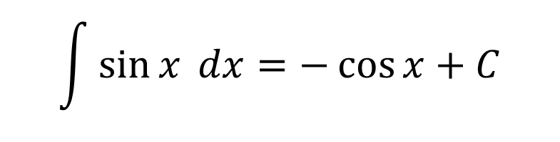
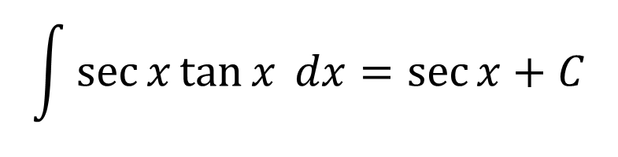
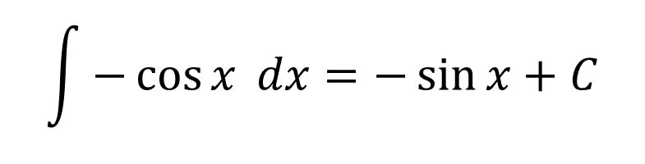
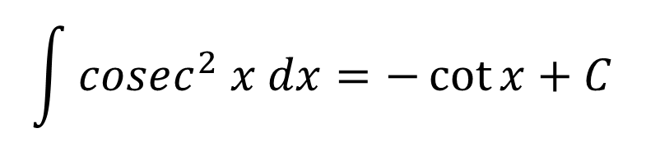
Quickfire Questions (without cheating!)
$$\int{\sec{x}\tan{x} dx}=\sec{x}+C$$
?
$$\int{\sin{x} dx}=−\cos{x}+C$$
?
$$\int{cosec^{2} x dx}=−\cot{x}+C$$
?
$$\int{−\cos{x} dx}=−\sin{x}+C$$
?

Slide 4
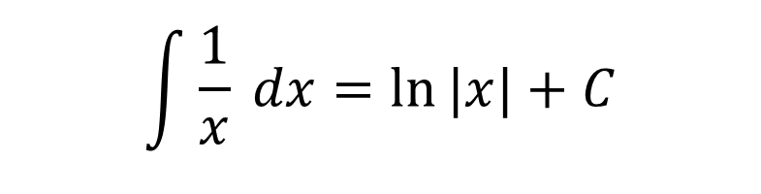
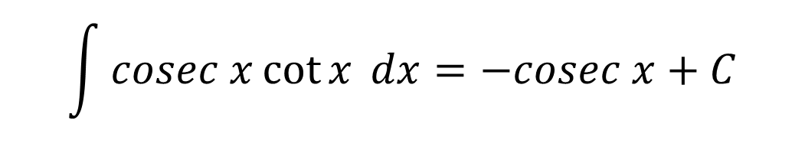
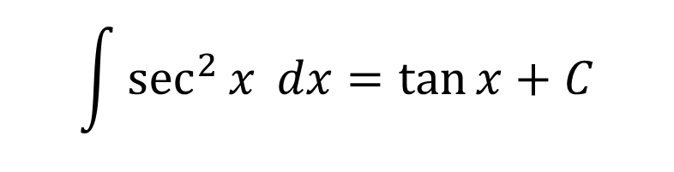
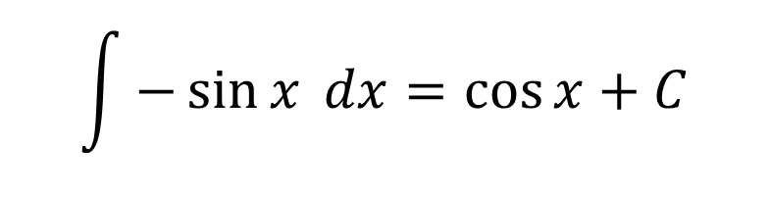
Quickfire Questions (without cheating!)
$$\int{\sec^{2}{x} dx}=\tan{x}+C$$
?
$$\int{cosec x\cot{x} dx}=−cosec x+C$$
?
$$\int{\frac{1}{x} dx}=\ln{|x|}+C$$
?
$$\int{−\sin{x} dx}=\cos{x}+C$$
?

Slide 5
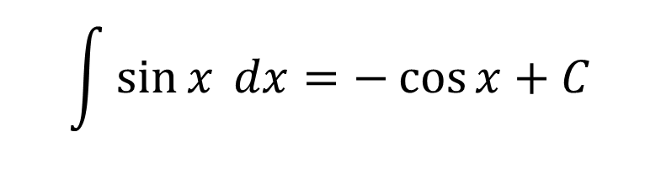
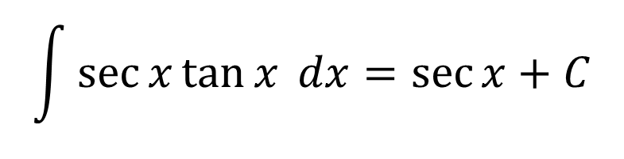
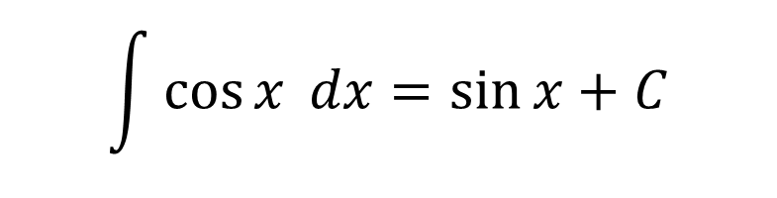
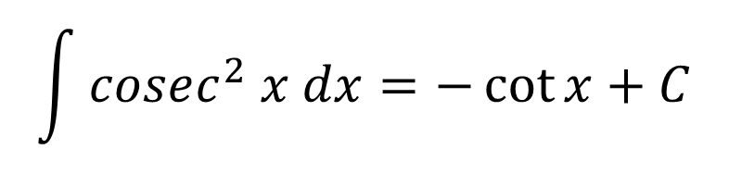
Quickfire Questions (without cheating!)
$$\int{cosec^{2} x dx}=−\cot{x}+C$$
?
$$\int{\sin{x} dx}=−\cos{x}+C$$
?
$$\int{\sec{x}\tan{x} dx}=\sec{x}+C$$
?
$$\int{\cos{x} dx}=\sin{x}+C$$
?

Slide 6
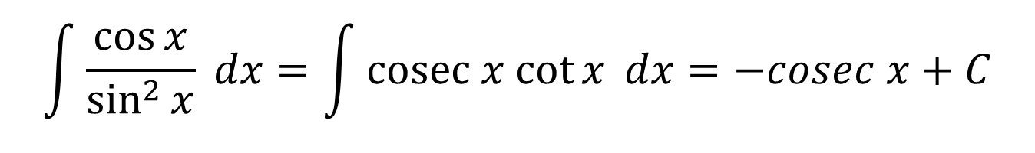
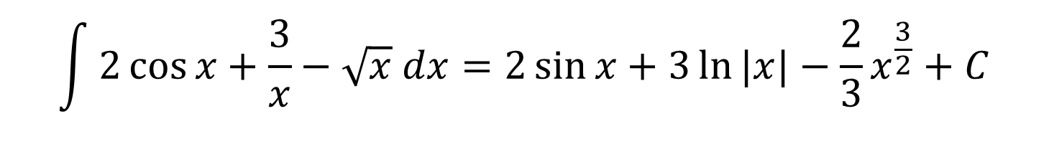
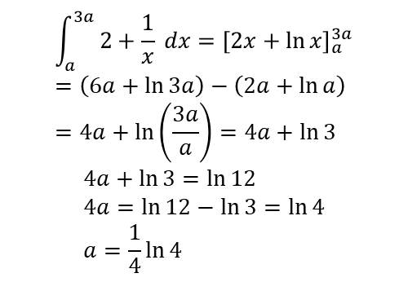
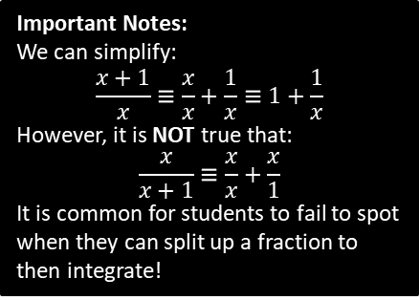
Test Your Understanding
$$\int{2\cos{x}+\frac{3}{x}−\sqrt{x} dx}=2\sin{x}+3\ln{|x|}−\frac{2}{3}x^{\frac{3}{2}}+C$$
?
$$\int{\frac{\cos{x}}{\sin^{2}{x}} dx}=\int{cosec x cot{x} dx}=−cosec x+C$$
?
Hint: What ‘reciprocal’ trig functions does this simplify to?
[Textbook] Given that $\int_{a}^{3a}{ \frac{2x+1}{x} dx}=\ln{12}$, find the exact value of $a$.
$$\int_{a}^{3a}{2+\frac{1}{x} dx}={\left[2x+\ln{x}\right]}_{a}^{3a} \\ =\left(6a+\ln{3a}\right)−\left(2a+\ln{a}\right) \\ =4a+\ln\left(\frac{3a}{a}\right)=4a+\ln{3}$$
$$4a+\ln{3}=\ln{12} \\ 4a=\ln{12}−\ln{3}=\ln{4} \\ a=\frac{1}{4}\ln{4}$$
?
Important Notes:
We can simplify:
$$\frac{x+1}{x}≡\frac{x}{x}+\frac{1}{x}≡1+\frac{1}{x}$$
However, it is NOT true that:
$$\frac{x}{x+1}≡\frac{x}{x}+\frac{x}{1}$$
It is common for students to fail to spot when they can split up a fraction to then integrate!

Slide 7
Exercise 11.1
Pearson Pure Year 2
Page 90

Slide 8
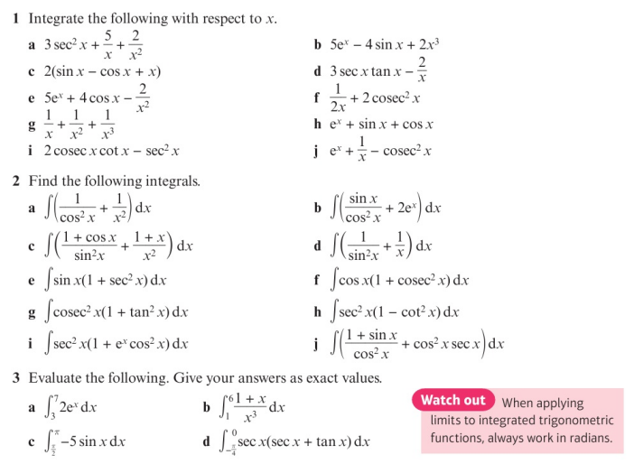
Homework Exercise

Slide 9
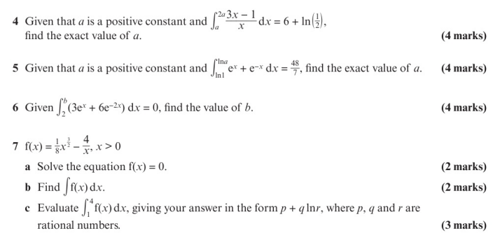
Homework Exercise

Slide 10
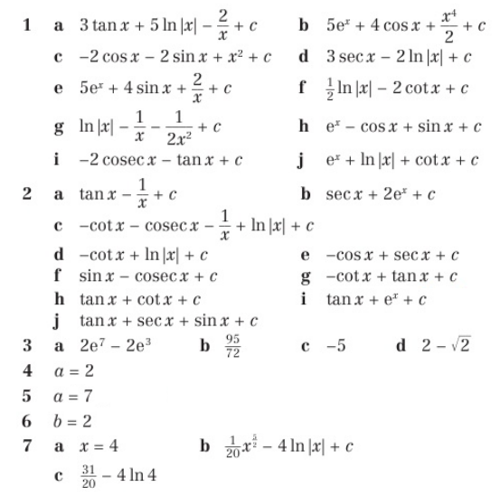
Homework Answers

