Slide 1
P1 Chapter 3: Inequalities Linear Inequalities

Slide 2




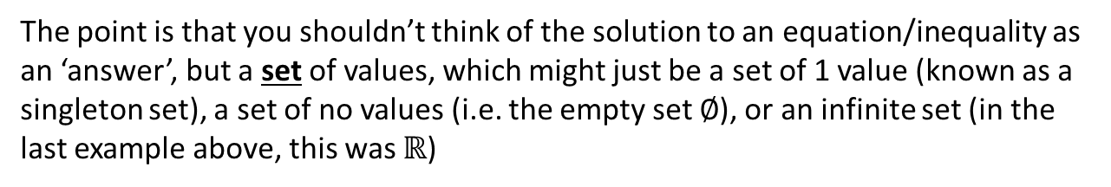

Solutions sets
The solution(s) to an equation may be:
A single value:
$$2x+1=5$$
Multiple values:
$$x^{2}+3x+2=0$$
An infinitely large set of values:
$$x>3$$
No (real) values!
$$x^{2}=−1$$
Every value!
$$x^{2}+x=x\left(x+1\right)$$
The point is that you shouldn’t think of the solution to an equation/inequality as an ‘answer’, but a set of values, which might just be a set of 1 value (known as a singleton set), a set of no values (i.e. the empty set $∅$), or an infinite set (in the last example above, this was $ℝ$)
! The solutions to an equation are known as the solution set.

Slide 3

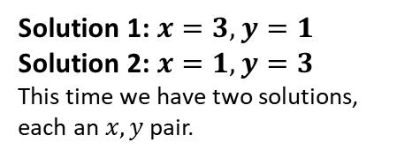


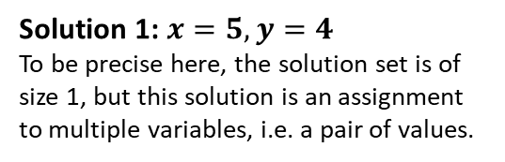
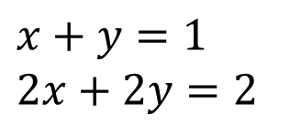
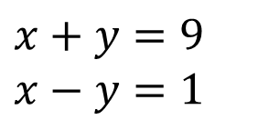
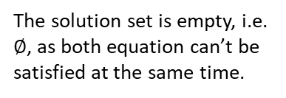
Solutions sets
For simultaneous equations, the same is true, except each ‘solution’ in the solution set is an assignment to multiple variables.
All equations have to be satisfied at the same time, i.e. ‘simultaneously’.
Scenario
Example
Solution Set
?
?
A single solution:
$$x+y=9 \\ x−y=1$$
Solution 1: $x=5, y=4$
To be precise here, the solution set is of size 1, but this solution is an assignment to multiple variables, i.e. a pair of values.
?
?
$$x^{2}+y^{2}=10 \\ x+y=4$$
Solution 1: $x=3, y=1$
Solution 2: $x=1, y=3$
This time we have two solutions, each an $x,y$ pair.
Two solutions:
?
?
$$x+y=1 \\ x+y=3$$
The solution set is empty, i.e. $∅$, as both equation can’t be satisfied at the same time.
Textbook Error Pg39: “Linear simultaneous equations in two unknowns have one set of values that will make a pair of equations true at the same time.”
There are two separate errors in this statement – I’ll let you work out what! (Hint: underlined)
No solutions:
?
?
Infinitely large set of solutions:
$$x+y=1 \\ 2x+2y=2$$
Solution 1: $x=0, y=1$
Solution 2: $x=1, y=0$
Solution 3: $x=2, y=−1$
Solution 4: $x=0.5, y=0.5$
… Infinite possibilities!

Slide 4
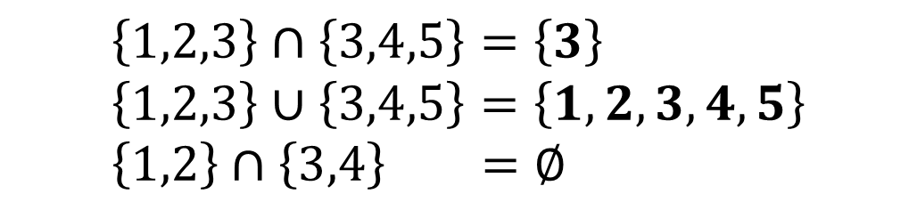
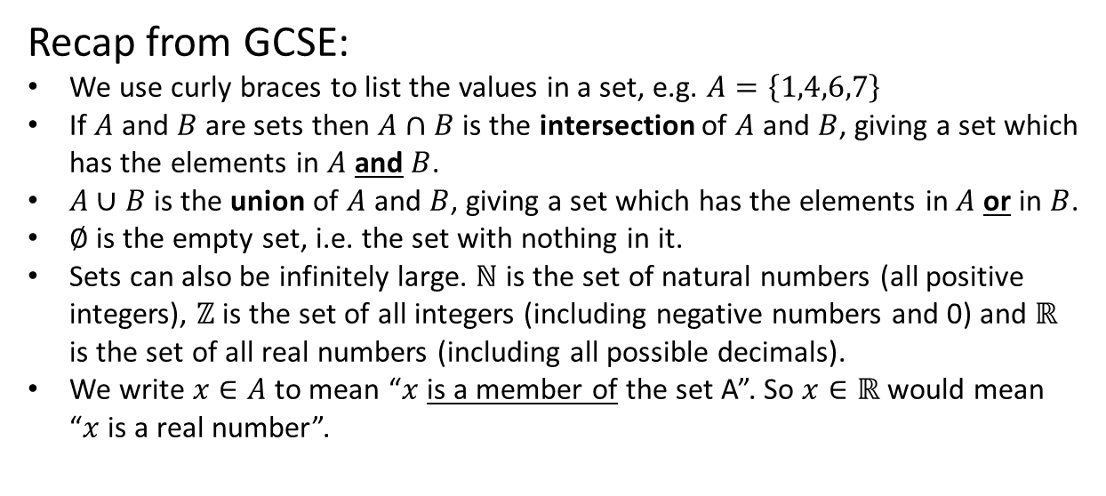
Set Builder Notation
Recall that a set is a collection of values such that:
The order of values does not matter.
There are no duplicates.
Remark: Sets seem sensible for listing solutions to an equation, as the order doesn’t matter.
Recap from GCSE:
We use curly braces to list the values in a set, e.g. $A=\left\{1,4,6,7\right\}$
If $A$ and $B$ are sets then $A∩B$ is the intersection of $A$ and $B$, giving a set which has the elements in $A$ and $B$.
$A∪B$ is the union of $A$ and $B$, giving a set which has the elements in $A$ or in $B$.
$∅$ is the empty set, i.e. the set with nothing in it.
Sets can also be infinitely large. $ℕ$ is the set of natural numbers (all positive integers), $ℤ$ is the set of all integers (including negative numbers and 0) and $ℝ$ is the set of all real numbers (including all possible decimals).
We write $x∈A$ to mean “$x$ is a member of the set A”. So $x∈ℝ$ would mean “$x$ is a real number”.
?
$$\left\{1,2,3\right\}∩\left\{3,4,5\right\}=\left\{3\right\} \\ \left\{1,2,3\right\}∪\left\{3,4,5\right\}=\left\{1,2,3,4,5\right\} \\ \left\{1,2\right\}∩\left\{3,4\right\} =∅$$
?
?

Slide 5

Set Builder Notation
It is possible to construct sets without having to explicitly list its values. We use:
The | or : means “such that”.
$$\left\{expr \right| condition \}$$
or $\{expr : condition \}$
Can you guess what sets the following give?
(In words “All numbers $2x$ such that $x$ is an integer)
?
$$\left\{2x :x∈ℤ\right\}=\{0,2,−2,4,−4,6,−6,…\}$$
i.e. The set of all even numbers!
?
$$\left\{2^{x} :x∈ℕ\right\}=\{2,4,8,16,32,…\}$$
?
$$\left\{xy: x,y are prime\right\}=\{4,6,10,14,15,…\}$$
i.e. All possible products of two primes.
We previously talked about ‘solutions sets’, so set builder notation is very useful for specifying the set of solutions!

Slide 6

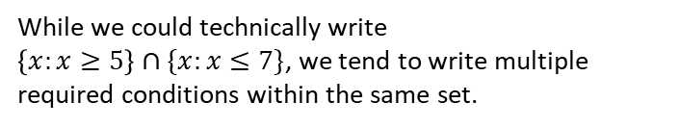



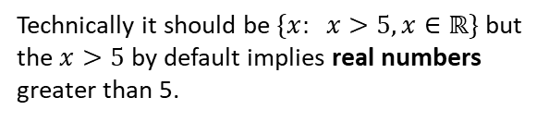
Set Builder Notation
Can you use set builder notation to specify the following sets?
?
All odd numbers.
$$\{2x+1 : x∈ℤ\}$$
All (real) numbers greater than 5.
$$\{x: x>5\}$$
?
Technically it should be $\{x: x>5,x∈ℝ\}$ but the $x>5$ by default implies real numbers greater than 5.
All (real) numbers less than 5 or greater than 7.
$$\left\{x: x<5\right\}∪\{x:x>7\}$$
?
We combine the two sets together.
All (real) numbers between 5 and 7 inclusive.
$$\left\{x: 5≤x≤7\right\}$$
?
While we could technically write
$\left\{x:x≥5\right\}∩\{x:x≤7\}$, we tend to write multiple required conditions within the same set.

Slide 7







Recap of linear inequalities
Inequality
Solution Set
?
$$2x+1>5$$
$$\{x :x>2\}$$
?
$$3\left(x−5\right)≥5−2(x−8)$$
$$\{x :x≥7.2\}$$
?
Fro Note: Multiplying or both sides of an inequality by a negative number reverses the direction.
$$−x≥2$$
$$\{x :x≤−2\}$$
Combining Inequalities:
If $x<3$ and $2≤x<4$, what is the combined solution set?
? Fro Hint
? Solution
2
3
4
$$2≤x<3$$
If both inequalities have to be satisfied, we have to be on both lines. Place your finger vertically and scan across.

Slide 8
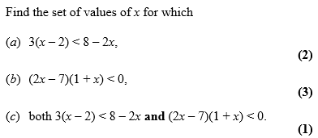
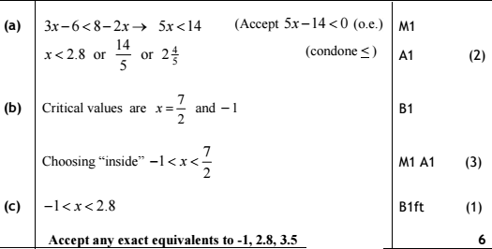
Test Your Understanding
Edexcel C1 May 2010 Q3
?
?
?

Slide 9

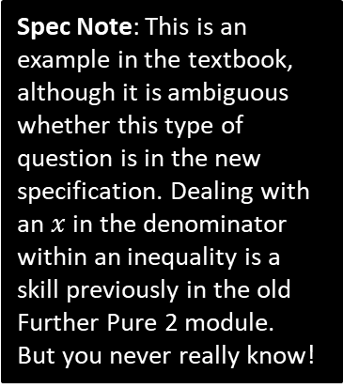







Deal with inequalities with a division by $x$
Find the set of values for which $\frac{6}{x}>2, x≠0$
Spec Note: This is an example in the textbook, although it is ambiguous whether this type of question is in the new specification. Dealing with an $x$ in the denominator within an inequality is a skill previously in the old Further Pure 2 module.
But you never really know!
Why can’t we just multiply both sides by $x$?
We earlier saw that multiplying by a negative number would flip the inequality, but multiplying by a positive number would not. Since we don’t know $x$, we don’t know whether the inequality would flip or not!
Once solution is to sketch $y=\frac{6}{x}$ and $y=2$, find the points of intersection and reason about the graph (see next section, “Inequalities on Graphs”), but an easier way is to multiply both sides by $x^{2}$, because it is guaranteed to be positive:
?
$$y$$
? Solution
$$6x>2x^{2} \\ 2x^{2}−6x<0 \\ x^{2}−3x<0 \\ x\left(x−3\right)<0 \\ 0<x<3$$
$$y=x(x−3)$$
$$3$$
$$x$$
$$0$$

Slide 10
Exercise 3.4
Pearson Pure Mathematics Year 1/AS
Page 19

Slide 11
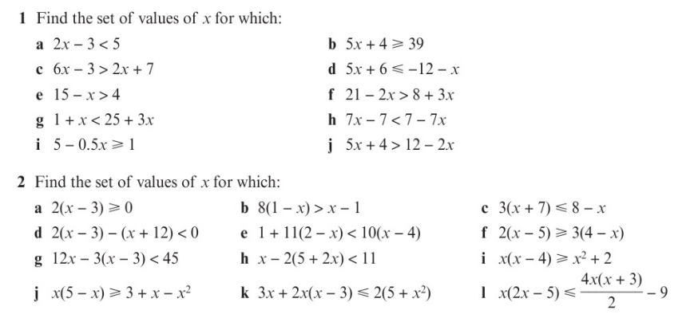
Homework Exercise

Slide 12
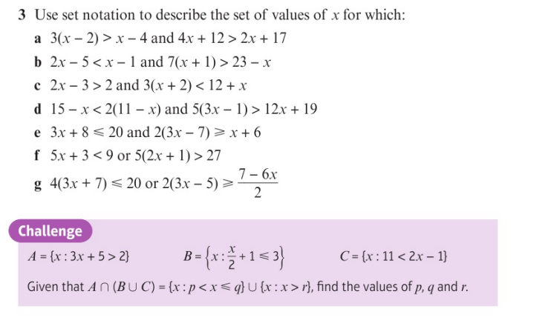
Homework Exercise

Slide 13
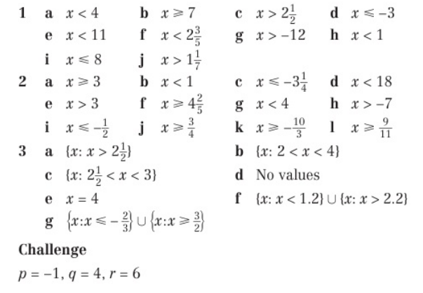
Homework Answers

