Slide 1
Stats1 Chapter 7: Hypothesis Testing Chapter Practice

Slide 2
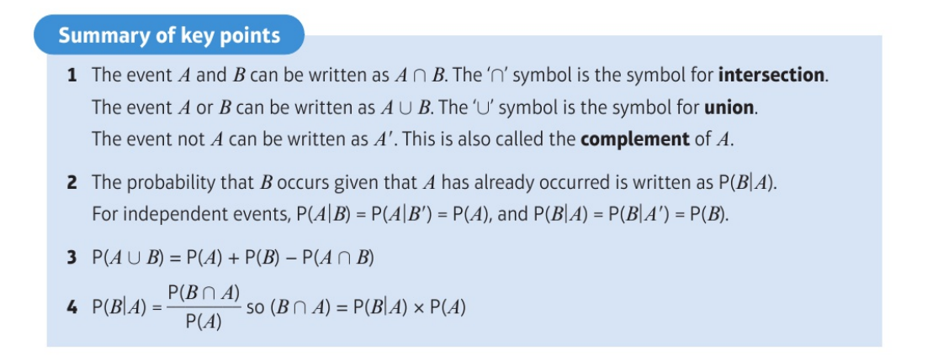
Key Points

Slide 3
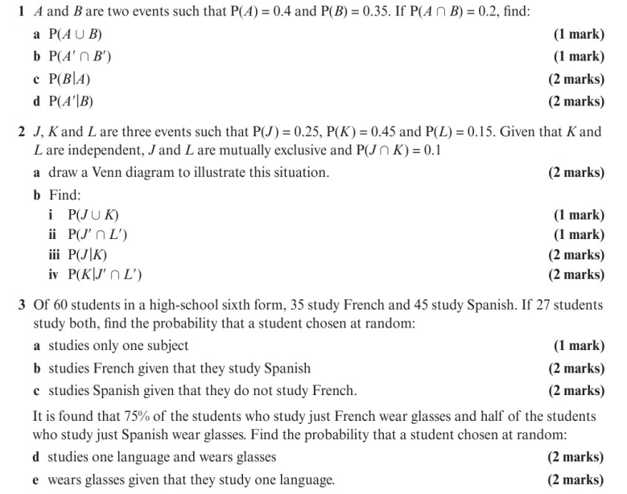
Chapter Exercises

Slide 4
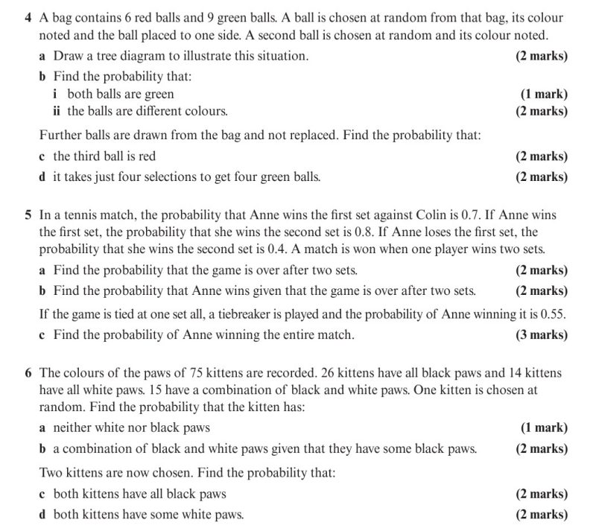
Chapter Exercises

Slide 5
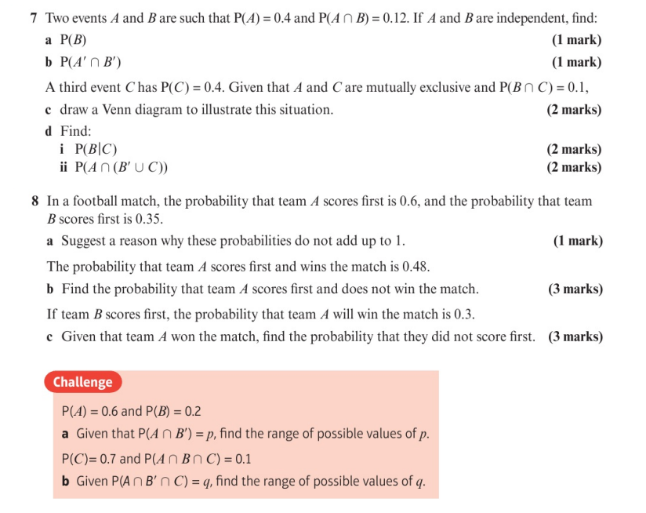
Chapter Exercises

Slide 6
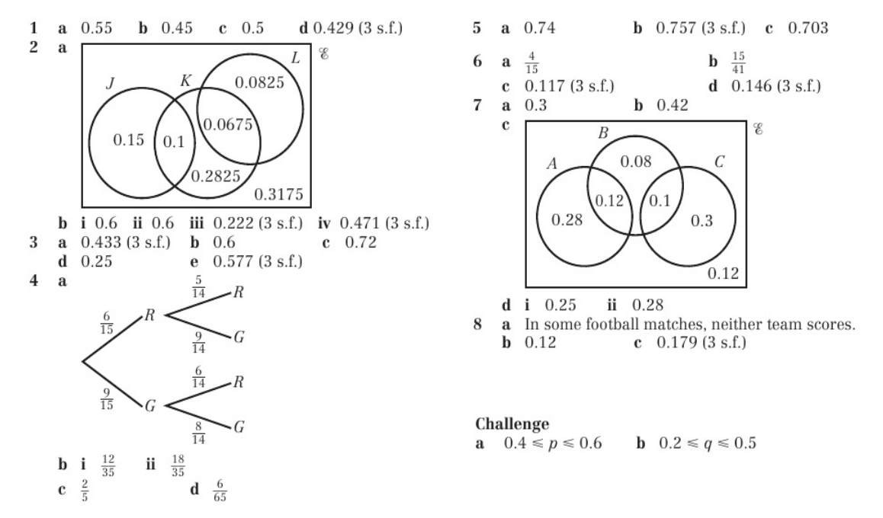
Chapter Answers

