Slide 1
P1 Chapter 3: Inequalities Linear Simultaneous Equations

Slide 2
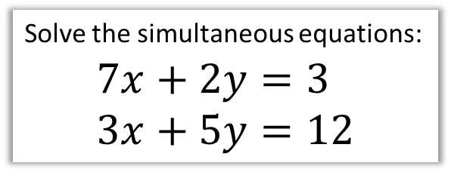

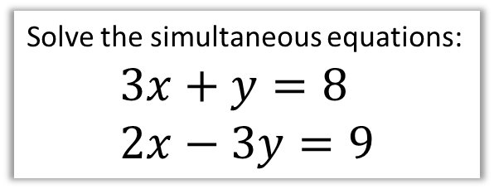
Simultaneous Equations
Recap!
Solve the simultaneous equations:
$$3x+y=8 \\ 2x−3y=9$$
Solve the simultaneous equations:
$$7x+2y=3 \\ 3x+5y=12$$
We can either use substitution (i.e. making $x$ or $y$ the subject of one equation, and substituting it into the other) or elimination, but the latter is easier for linear equations.
$$9x+3y=24 \\ 2x−3y=9$$
Adding the two equations to ‘eliminate’ $y$:
$$11x=33 → x=3$$
Substituting into first equation:
$$27+3y=24 → y=−1$$
?

Slide 3


Test Your Understanding
Solve the simultaneous equations:
$$3x+9=21 \\ y=x+1$$
$$3x^{2}+{\left(x+1\right)}^{2}=21$$

Slide 4




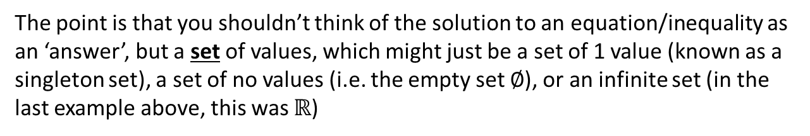

Solutions sets
The solution(s) to an equation may be:
A single value:
$$2x+1=5$$
Multiple values:
$$x^{2}+3x+2=0$$
An infinitely large set of values:
$$x>3$$
No (real) values!
$$x^{2}=−1$$
Every value!
$$x^{2}+x=x\left(x+1\right)$$
The point is that you shouldn’t think of the solution to an equation/inequality as an ‘answer’, but a set of values, which might just be a set of 1 value (known as a singleton set), a set of no values (i.e. the empty set $∅$), or an infinite set (in the last example above, this was $ℝ$)
! The solutions to an equation are known as the solution set.

Slide 5

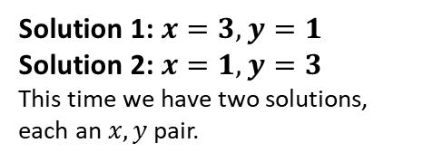


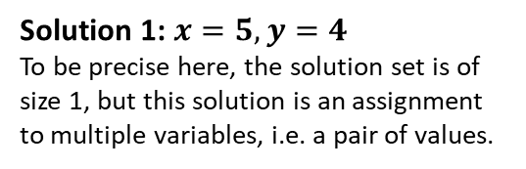
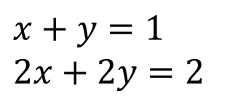
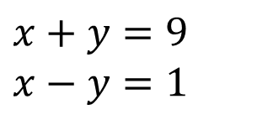
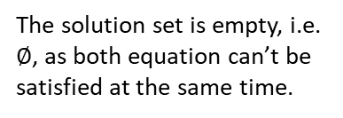
Solutions sets
For simultaneous equations, the same is true, except each ‘solution’ in the solution set is an assignment to multiple variables.
All equations have to be satisfied at the same time, i.e. ‘simultaneously’.
Scenario
Example
Solution Set
?
?
A single solution:
$$x+y=9 \\ x−y=1$$
Solution 1: $x=5, y=4$
To be precise here, the solution set is of size 1, but this solution is an assignment to multiple variables, i.e. a pair of values.
?
?
$$x^{2}+y^{2}=10 \\ x+y=4$$
Solution 1: $x=3, y=1$
Solution 2: $x=1, y=3$
This time we have two solutions, each an $x,y$ pair.
Two solutions:
?
?
$$x+y=1 \\ x+y=3$$
The solution set is empty, i.e. $∅$, as both equation can’t be satisfied at the same time.
No solutions:
?
?
Infinitely large set of solutions:
$$x+y=1 \\ 2x+2y=2$$
Solution 1: $x=0, y=1$
Solution 2: $x=1, y=0$
Solution 3: $x=2, y=−1$
Solution 4: $x=0.5, y=0.5$
… Infinite possibilities!

Slide 6

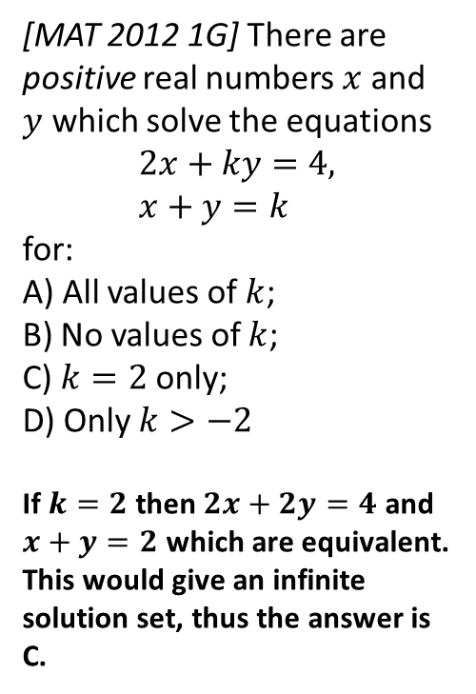
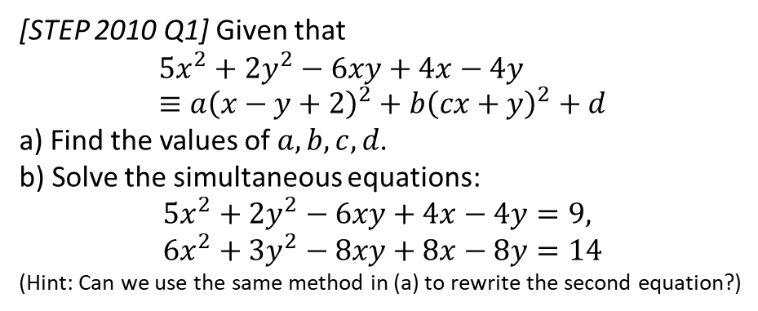
Exercise 3.1
Pearson Pure Mathematics Year 1/AS
Page 16
Extension
2
[STEP 2010 Q1] Given that
$$5x^{2}+2y^{2}−6xy+4x−4y≡a{\left(x−y+2\right)}^{2}+b{\left(cx+y\right)}^{2}+d$$
a) Find the values of $a,b,c,d$.
b) Solve the simultaneous equations:
$$5x^{2}+2y^{2}−6xy+4x−4y=9, \\ 6x^{2}+3y^{2}−8xy+8x−8y=14$$ (Hint: Can we use the same method in (a) to rewrite the second equation?)
1
[MAT 2012 1G] There are positive real numbers $x$ and $y$ which solve the equations
$$2x+ky=4, \\ x+y=k$$
for:
A) All values of $k$;
B) No values of $k$;
C) $k=2$ only;
D) Only $k>−2$
If $k=2$ then $2x+2y=4$ and $x+y=2$ which are equivalent. This would give an infinite solution set, thus the answer is C.
a) Expanding RHS:
$$\left(a+bc^{2}\right)x^{2}+\left(a+b\right)y^{2}+\left(−2a+2bc\right)xy+4ax−4ay+(4a+d)$$
Comparing coefficients: $a=1, b=1, c=−2, d=−4$
b) ${\left(x−y+2\right)}^{2}+{\left(−2x+y\right)}^{2}−4=9$ Using method in (a): $2{\left(x−y+2\right)}^{2}+{\left(−2x+y\right)}^{2}−8=14$
Subtracting yields $y−2x=±2$ and $x−y+2=±3$
We have to consider each of 4 possibilities.
Final solution set: $x=−3, y=−4 or x=1, y=0$
or $x=3, y=8 or x=7,y=12$
? a
?
? b

Slide 7
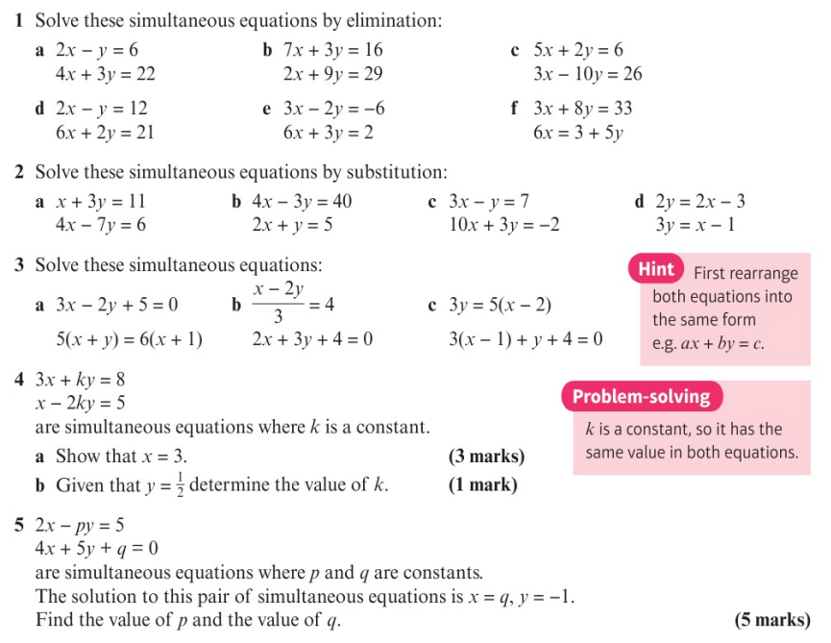
Homework Exercise

Slide 8
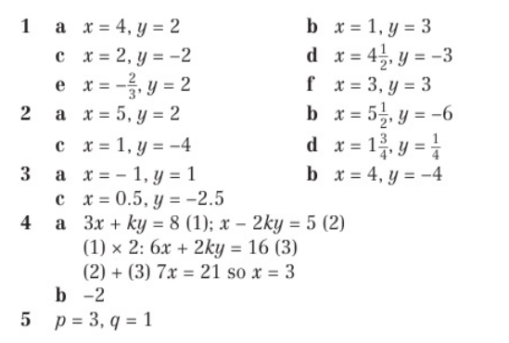
Homework Answers

