Slide 1
M2 Chapter 7: Application of Forces Friction and Static Particles

Slide 2



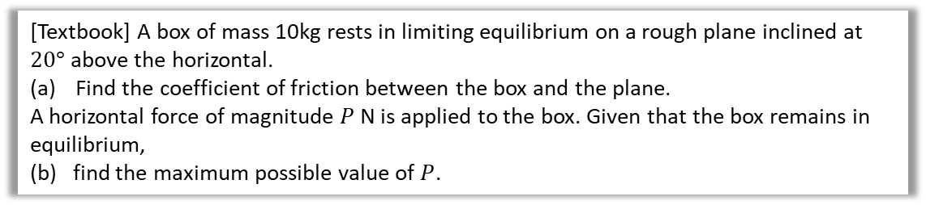




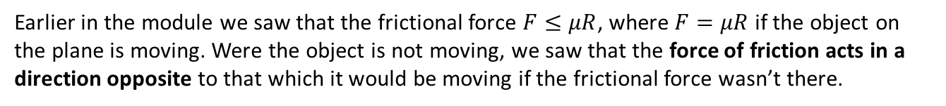







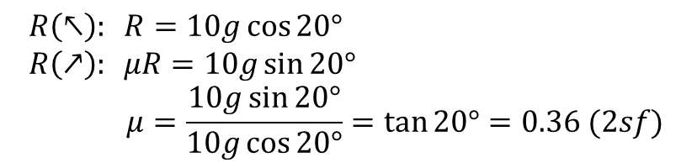




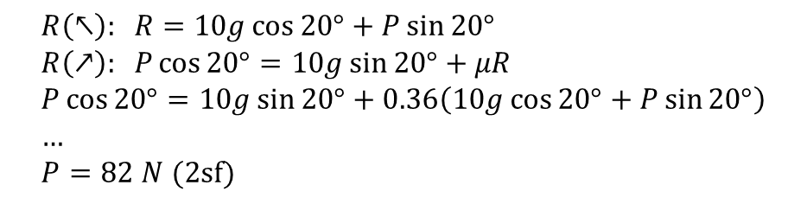
Friction
Earlier in the module we saw that the frictional force $F≤μR$, where $F=μR$ if the object on the plane is moving. Were the object is not moving, we saw that the force of friction acts in a direction opposite to that which it would be moving if the frictional force wasn’t there.
[Textbook] A box of mass 10kg rests in limiting equilibrium on a rough plane inclined at $20°$ above the horizontal.
Find the coefficient of friction between the box and the plane.
A horizontal force of magnitude $P$ N is applied to the box. Given that the box remains in equilibrium,
(b) find the maximum possible value of $P$.
a
? Force Diagram
? Working
$$R$$
$$R\left(↖\right): R=10g\cos{20°} \\ R\left(↗\right): μR=10g\sin{20°} \\ μ=\frac{10g\sin{20°}}{10g\cos{20°}}=\tan{20°}=0.36 (2sf)$$
$$μR$$
$$10g\cos{20}$$
$$10g$$
$$20°$$
$$20°$$
$$10g\sin{20}$$
b
? Force Diagram
? Working
$$R$$
$$R\left(↖\right): R=10g\cos{20°}+P\sin{20°} \\ R\left(↗\right): P\cos{20°}=10g\sin{20°}+μR \\ P\cos{20°}=10g\sin{20°}+0.36\left(10g\cos{20°}+P\sin{20°}\right) \\ … \\ P=82 N (2sf)$$
Important: If we increase $P$ to its maximum, the particle is on the verge of moving UP the plane. Thus friction acts downwards to oppose.
$$P$$
$$20°$$
$$10g\cos{20}$$
$$P\sin{20}$$
$$P\cos{20}$$
$$20°$$
$$μR$$
$$10g$$
$$20°$$
$$10g\sin{20}$$

Slide 3
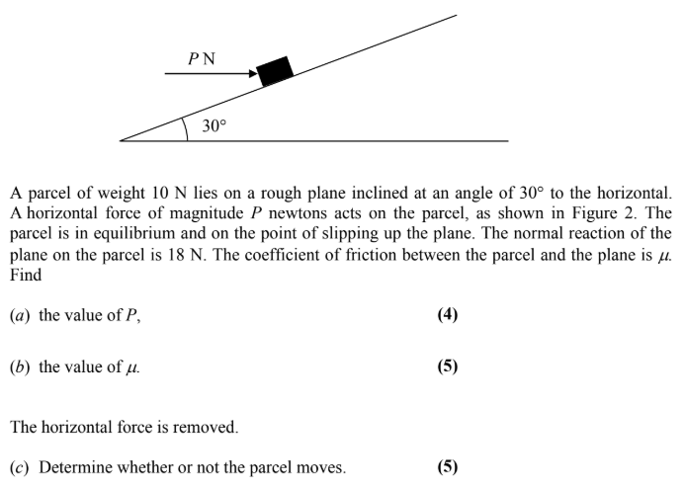
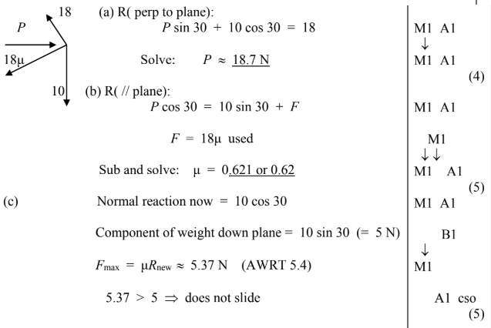
Test Your Understanding
Edexcel M1(Old) Jan 2006 Q5
? a
? b
? c

Slide 4
Exercise 7.3
Pearson Stats/Mechanics Year 2
Pages 58-59

Slide 5
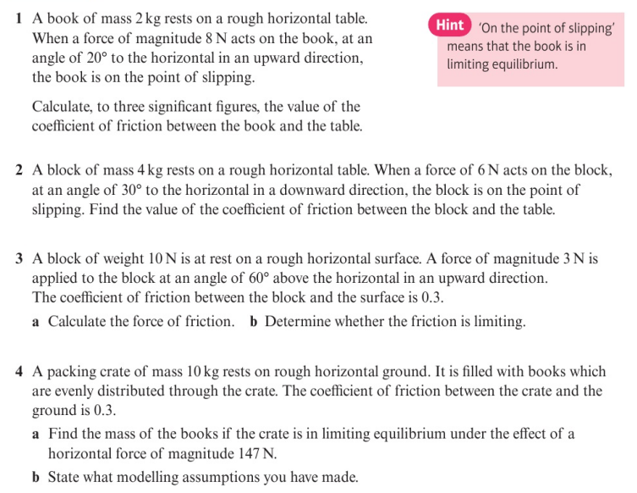
Homework Exercise

Slide 6
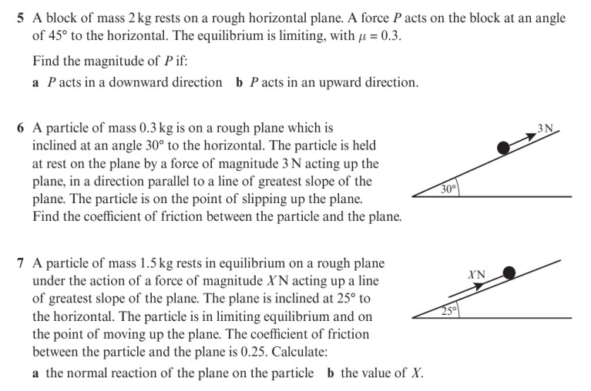
Homework Exercise

Slide 7
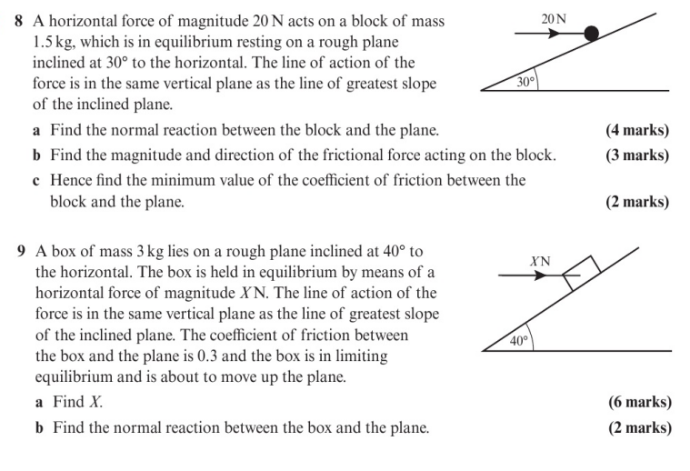
Homework Exercise

Slide 8
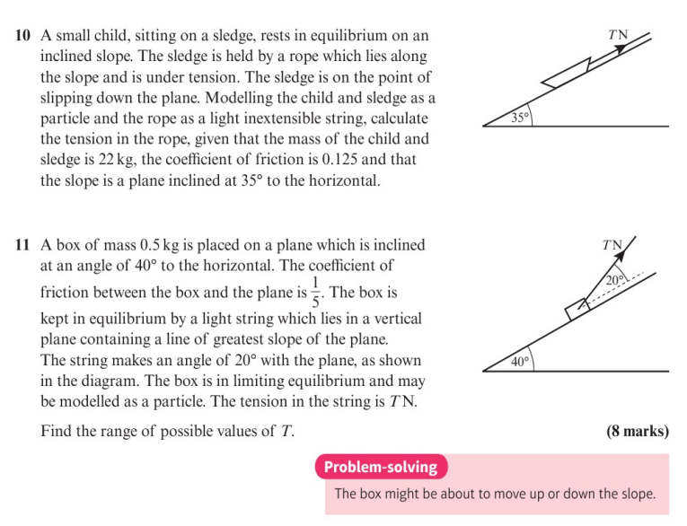
Homework Exercise

Slide 9
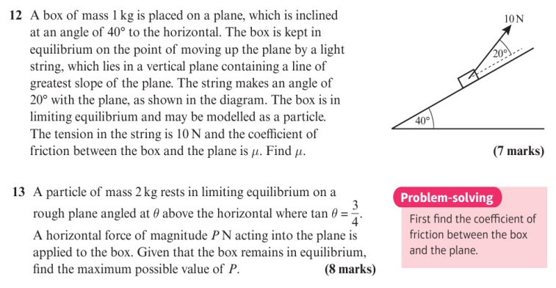
Homework Exercise

Slide 10
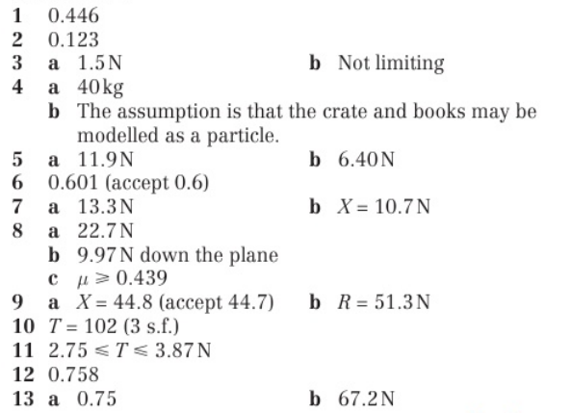
Homework Answers

