Slide 1
M1 Chapter 10: Forces and Motion Forces Causing Acceleration

Slide 2



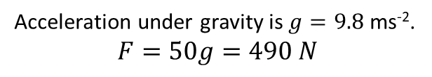
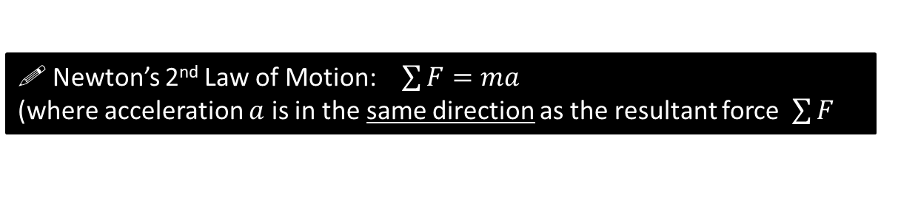
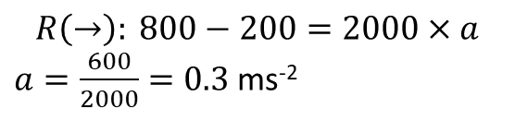
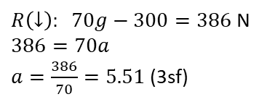




Forces causing Acceleration
! Newton’s 2nd Law of Motion: $\sum{F}=ma$ (where acceleration $a$ is in the same direction as the resultant force $\sum{F}$
If we doubled the force, we double its acceleration.
If we have twice the mass the same force causes half the acceleration.
A child has a mass of 50kg. What is the gravitational force acting on the child? (i.e. its weight)
A car of 2000kg has a driving force of 800N and forces of 200N resisting its motion. Determine its acceleration.
?
Acceleration under gravity is $g=9.8$ ms⁻².
$$F=50g=490 N$$
$$a$$
Fro Preference: Use double arrow to indicate direction (and value if known) of acceleration.
?
$$200$$
2000kg
$$800$$
! Weight $W=mg$
Fro Preference: Put mass of particle inside circle/square.
A falling sheep of mass 70kg experiences air resistance of 300 N. Determine the sheep’s acceleration as it plummets towards the ground.
$$R\left(→\right): 800−200=2000×a$$ $a=\frac{600}{2000}=0.3$ms⁻²
$$300$$
?
$R\left(↓\right): 70g−300=386$ N
$$386=70a$$ $a=\frac{386}{70}=5.51$(3sf)
70kg
$$70g$$

Slide 3
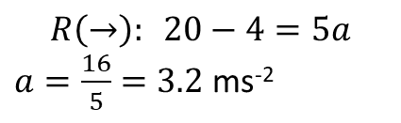



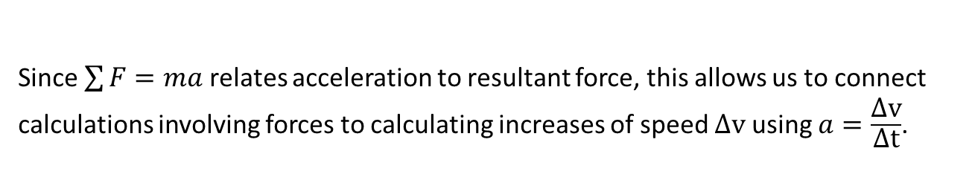


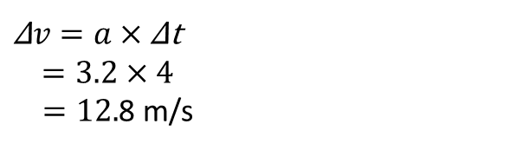
Using $\sum{F}=ma$ to find speed changes
Since $\sum{F}=ma$ relates acceleration to resultant force, this allows us to connect calculations involving forces to calculating increases of speed $\text{Δ}\text{v}$ using $a=\frac{\text{Δ}\text{v}}{\text{Δ}\text{t}}$.
[Textbook] A body of mass 5kg is pulled along a rough horizontal table by a horizontal force of magnitude 20N against a constant friction force of magnitude 4N.
the acceleration of the body
the increase in speed of the body after 4 seconds
does starting speed affect the calculation in part (b) ?
$$a$$
$$R\left(→\right): 20−4=5a$$ $a=\frac{16}{5}=3.2$ ms⁻²
? Diagram
a
?
$$N$$
?
$$4$$
5 kg
$$20$$
b
$\text{Δ}v=a×$Δt
$$=3.2×4$$
$=12.$8 m/s
$$5g$$
No! The change in velocity just adds on to whatever the starting velocity was.
c
?

Slide 4
Classwork Exercise 10.3
Pearson Stats/Mechanics Year 1 Exercise Book
Pages 69-70
Questions 1 to 10.
(question 4: part a only.)

Slide 5
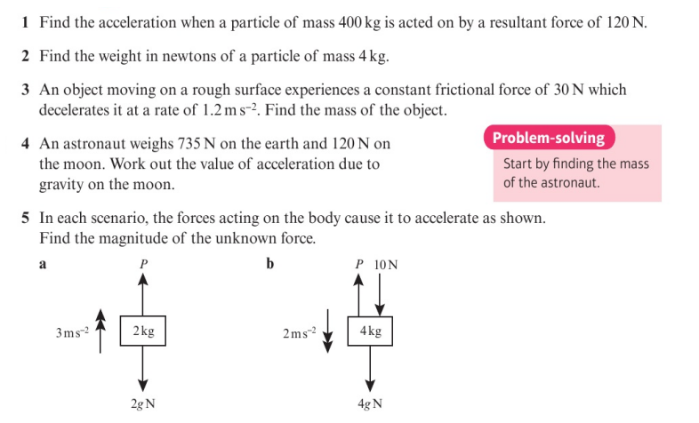
Homework Exercise

Slide 6
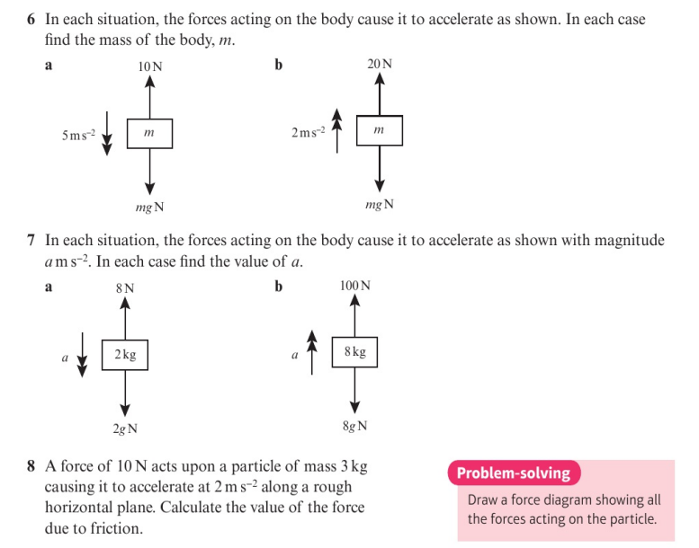
Homework Exercise

Slide 7
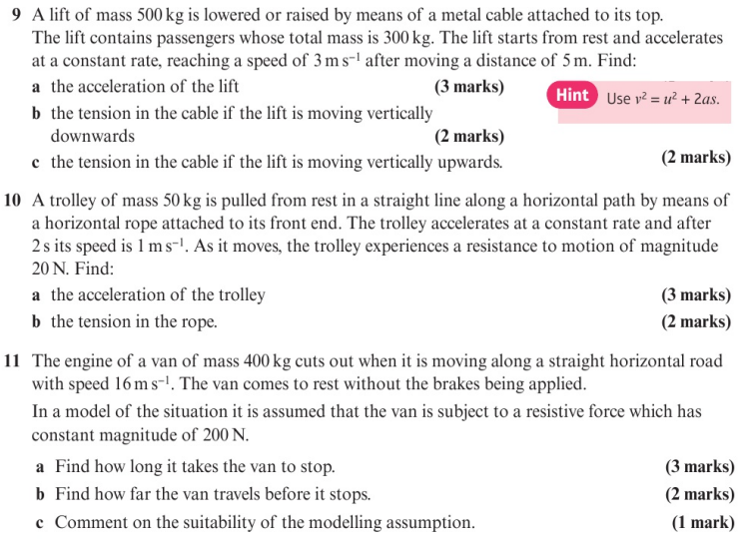
Homework Exercise

Slide 8
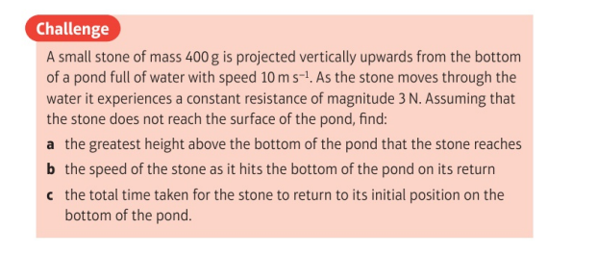
Homework Exercise

Slide 9
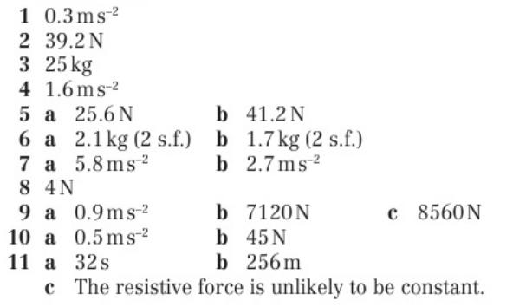
Homework Answers

