Slide 1
P1 Chapter 5: Linear Graphs Linear Equations

Slide 2

Equations using two points/point + gradient
Find the equation of the line that goes through $\left(3,5\right)$ and has gradient 2.
How would you have done this at GCSE?
?
If gradient is 2, then equation of the line is of the form:
$$y=2x+c$$
Since $\left(3,5\right)$ is on the line, it must satisfy this equation. Therefore:
$$5=2\left(3\right)+c \\ c=−1 \\ ∴y=2x−1$$

Slide 3
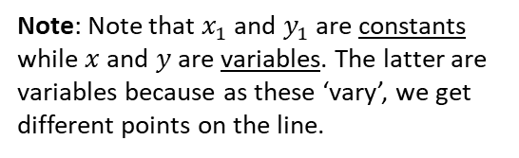

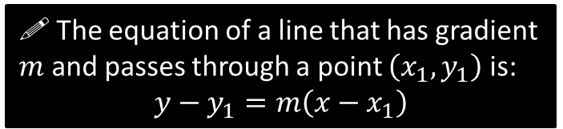

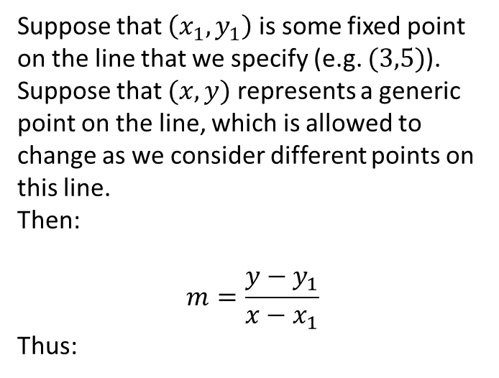
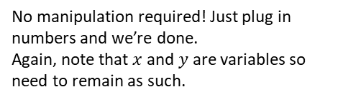



A new way…
$$y$$
Suppose that $\left(x_{1},y_{1}\right)$ is some fixed point on the line that we specify (e.g. $(3,5)$).
Suppose that $(x,y)$ represents a generic point on the line, which is allowed to change as we consider different points on this line.
Then:
$$m=\frac{y−y_{1}}{x−x_{1}}$$
Thus:
$$\left(x,y\right)$$
$$\left(x_{1},y_{1}\right)$$
$$x$$
?
Note: Note that $x_{1}$ and $y_{1}$ are constants while $x$ and $y$ are variables. The latter are variables because as these ‘vary’, we get different points on the line.
! The equation of a line that has gradient $m$ and passes through a point $\left(x_{1},y_{1}\right)$ is:
$$y−y_{1}=m\left(x−x_{1}\right)$$
Let’s revisit:
Find the equation of the line that goes through $\left(3,5\right)$ and has gradient 2.
?
$$y−5=2\left(x−3\right)$$
No manipulation required! Just plug in numbers and we’re done.
Again, note that $x$ and $y$ are variables so need to remain as such.

Slide 4
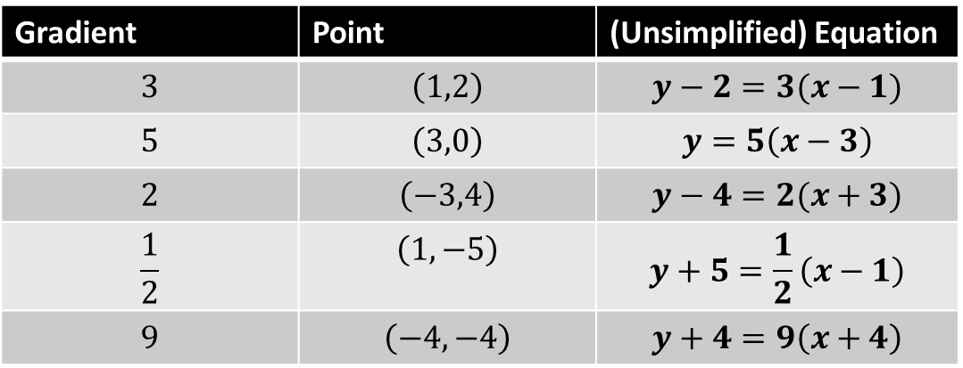
Quickfire Questions
In a nutshell: You can use this formula whenever you have (a) a gradient and (b) any point on the line.
Gradient | Point | (Unsimplified) Equation
$$3$$ | $$\left(1,2\right)$$ | $$y−2=3(x−1)$$
$$5$$ | $$\left(3,0\right)$$ | $$y=5\left(x−3\right)$$
$$2$$ | $$\left(−3,4\right)$$ | $$y−4=2(x+3)$$
$$\frac{1}{2}$$ | $$\left(1,−5\right)$$ | $$y+5=\frac{1}{2}\left(x−1\right)$$
$$9$$ | $$\left(−4,−4\right)$$ | $$y+4=9\left(x+4\right)$$
?
?
?
?
?
Important Fro Side Note: I’ve found that many students shun this formula and just use the GCSE method. Please persist with it – it’ll be much easier when fractions are involved.
Further Mathematicians, don’t even think about using the GCSE method, because you’ll encounter massive headaches when you consider algebraic points. Trust me on this one!

Slide 5

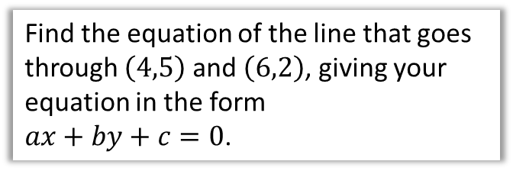

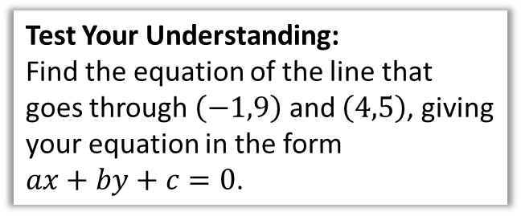
Using 2 points
Find the equation of the line that goes through $\left(4,5\right)$ and $\left(6,2\right)$, giving your equation in the form $ax+by+c=0$.
Test Your Understanding:
Find the equation of the line that goes through $\left(−1,9\right)$ and $\left(4,5\right)$, giving your equation in the form $ax+by+c=0$.
?
?
We need to work out the gradient first before we can use $y−y_{1}=m\left(x−x_{1}\right)$:
$$m=−\frac{3}{2}$$
Using $\left(4,5\right)$ (we could have also used $\left(6,2\right)$):
$$y−5=−\frac{3}{2}\left(x−4\right)$$
$$2y−10=−3\left(x−4\right) \\ 2y−10=−3x+12 \\ 3x+2y−22=0$$
$$m=−\frac{4}{5}$$
Using $\left(−1,9\right)$:
$$y−9=−\frac{4}{5}\left(x+1\right) \\ 5y−45=−4\left(x+1\right) \\ 5y−45=−4x−4 \\ 4x+5y−41=0$$

Slide 6




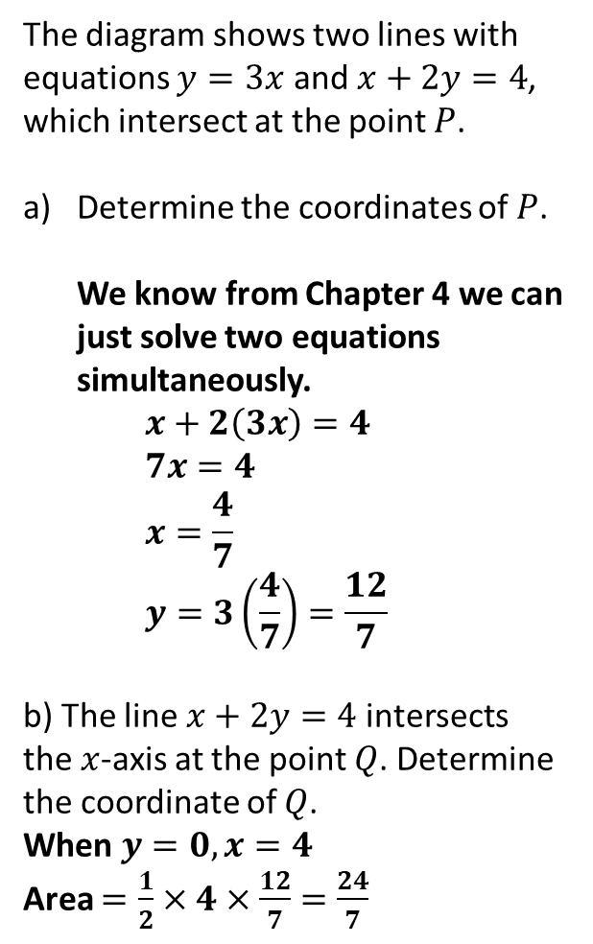



Intersection of lines
The diagram shows two lines with equations $y=3x$ and $x+2y=4$, which intersect at the point $P$.
Determine the coordinates of $P$. We know from Chapter 4 we can just solve two equations simultaneously. $x+2\left(3x\right)=4$ $7x=4$ $x=\frac{4}{7}$ $y=3\left(\frac{4}{7}\right)=\frac{12}{7}$
b) The line $x+2y=4$ intersects the $x$-axis at the point $Q$. Determine the coordinate of $Q$.
When $y=0, x=4$
Area $=\frac{1}{2}×4×\frac{12}{7}=\frac{24}{7}$
$$y$$
$$y=3x$$
$$P$$
?
$$x+2y=4$$
$$x$$
$$O$$
$$Q$$
?

Slide 7
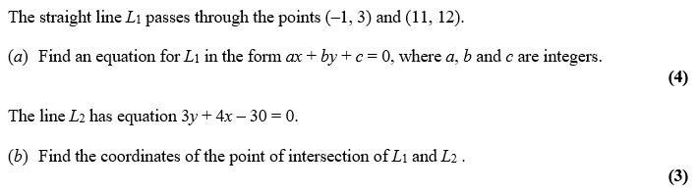
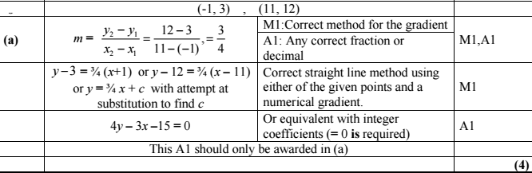
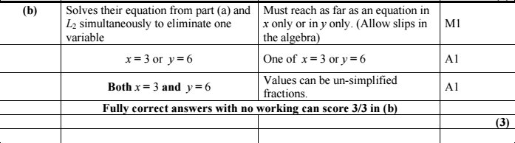
Test Your Understanding
C1 Edexcel May 2013 Q6
?
?

Slide 8
Exercise 5.2
Pearson Pure Mathematics Year 1/AS
Page 38

Slide 9
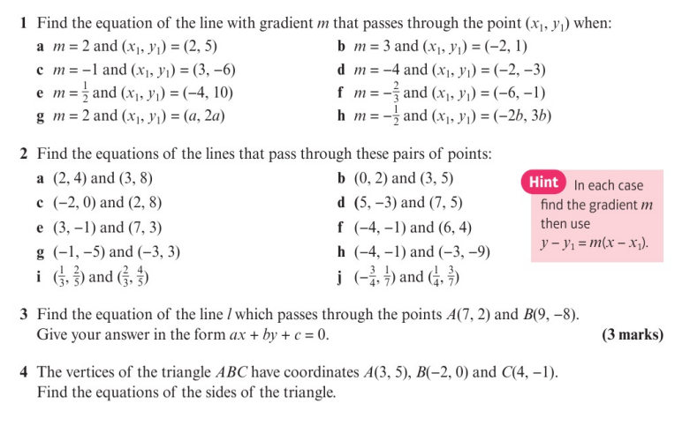
Homework Exercise

Slide 10
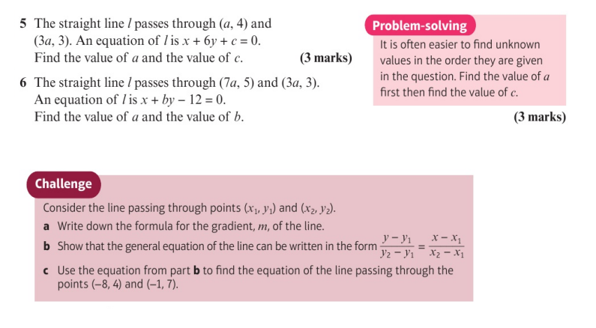
Homework Exercise

Slide 11
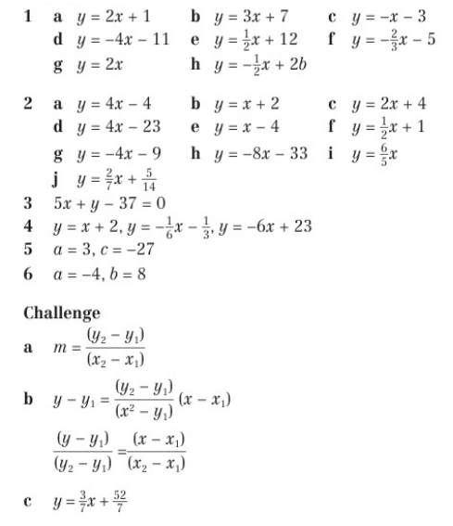
Homework Answers

Slide 12
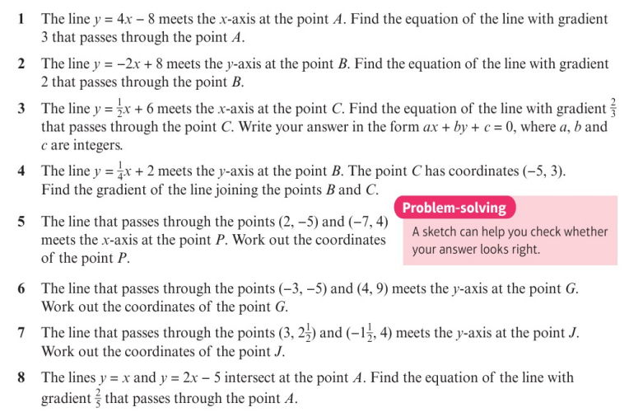
Homework Exercise

Slide 13
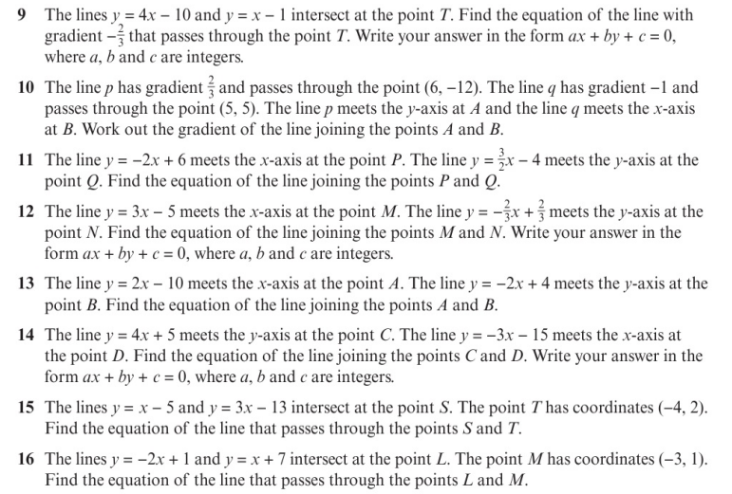
Homework Exercise

Slide 14
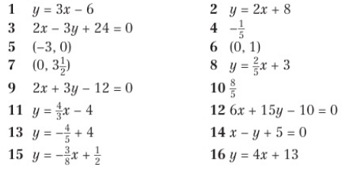
Homework Answers

