Slide 1
M1 Chapter 8: Modelling Units and Vectors

Slide 2

SI units
The SI units are a standard system of units, used internationally (“Système International”). These are the ones you will use:
Quantity | SI Unit | Symbol
Mass
Length/Displacement
Time | seconds | s
Speed/Velocity
Acceleration
Force/Weight
This unit is consistent with force being mass $×$ acceleration
The MKS units {metres, kilogram, seconds} are the mechanical base units defined in terms of the speed of light constant and Planck’s quantum constant.
All other units in mechanics are derived units that can be written as a combination of base units.

Slide 3
SI units
The SI units are a standard system of units, used internationally (“Système International”). These are the ones you will use:
Quantity | Unit | Symbol
Mass | kilogram | kg
Length/Displacement | metre | m
Time | seconds | s
Speed/Velocity | metres per second | m s⁻¹
Acceleration | metres per second per second | m s⁻²
Force/Weight | newton | N (= kg m s⁻²)
This unit is consistent with force being mass $×$ acceleration
The MKS units {metres, kilogram, seconds} are the mechanical base units defined in terms of the speed of light constant and Planck’s quantum constant.
All other units in mechanics are derived units that can be written as a combination of base units.

Slide 4

Representing Vectors
You should already be familiar that the value of a vector is the displacement in the $x$ and $y$ direction (if in 2D).
$$\left(\begin{matrix}3 \\ −2 \end{matrix}\right)$$
$$\vec{a}=\left(\begin{matrix}3 \\ −2 \end{matrix}\right), \vec{b}=\left(\begin{matrix}0 \\ −1\end{matrix}\right)$$
$$\vec{a}+\vec{b}=\left(\begin{matrix}3 \\ −3\end{matrix}\right) \\ 2\vec{a} =\left(\begin{matrix}6 \\ −4\end{matrix}\right)$$
?
?
$$j$$
$$\vec{ j}$$
$$i$$
$$\vec{ i}$$
! A unit vector is a vector of magnitude 1.
$\vec{ i}$and $\vec{ j}$ are unit vectors in the $x$-axis and $y$-axis respectively.
$$\vec{ i}=\left(\begin{matrix}1 \\ 0\end{matrix}\right) \vec{ j}=\left(\begin{matrix}0 \\ 1\end{matrix}\right)$$
e.g. $\left(\begin{matrix}4 \\ 3\end{matrix}\right)=4\left(\begin{matrix}1 \\ 0 \end{matrix}\right)+3\left(\begin{matrix}0 \\ 1\end{matrix}\right)=4\vec{ i}+3\vec{ j}$
! Bold notation is used in textbooks and exam papers but is awkward for handwriting.

Slide 5
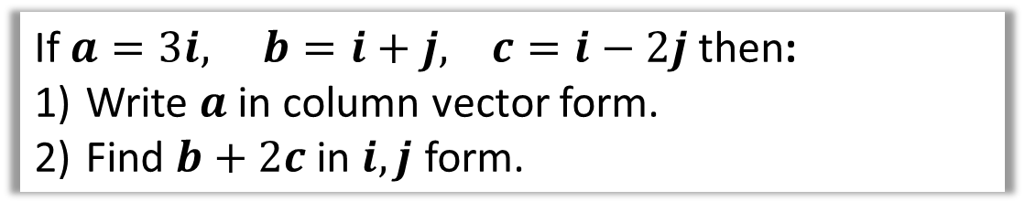
Examples
If $a=3i, b=i+j, c=i−2j$ then:
Write $a$ in column vector form.
Find $b+2c$ in $i,j$ form.
$$a=\left(\begin{matrix}3 \\ 0\end{matrix}\right)$$
$$b+2c=i+j+2\left(i−2j\right) \\ =i+j+2i−4j \\ =3i−3j$$
1
?
2
?

Slide 6





Vectors $↔$ Scalars
In Mechanics you will often need to convert between the scalar magnitude of a quantity and the vector version.
Scalar Magnitude | Vector Form
Distance | Displacement
Speed | Velocity
$$B$$
$$B$$
?
5m
$$\left(\begin{matrix}3 \\ 4\end{matrix}\right)m$$
?
Quantities which are vectors with a scalar magnitude:
force, acceleration
Quantities which are only scalars:
time, mass
$$A$$
$$A$$
?
! A scalar quantity has magnitude (i.e. size) only.
The 5m is a distance.
The value is always positive.
! A vector quantity also has direction.
The vector equivalent of distance is displacement.
?

Slide 7
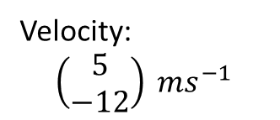
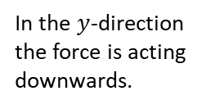


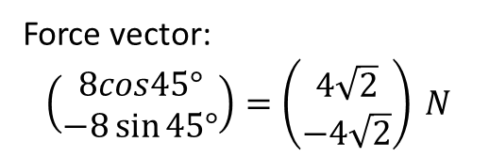
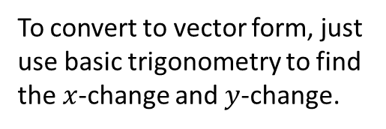





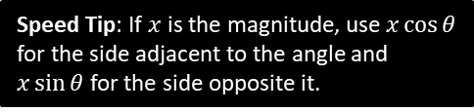
Representing Vectors
Geometric Form
Vector Form
$$B$$
?
To convert to vector form, just use basic trigonometry to find the $x$-change and $y$-change.
5m
$$\left(\begin{matrix}5\cos{60°} \\ 5\sin{60°}\end{matrix}\right)=\left(\begin{matrix}2.5 \\ 4.33\end{matrix}\right) m$$
Speed Tip: If $x$ is the magnitude, use $x\cos{θ}$ for the side adjacent to the angle and $x\sin{θ}$ for the side opposite it.
$$60°$$
$$A$$
?
Speed:
$$\sqrt{5^{2}+{\left(−12\right)}^{2}}=13 ms^{−1}$$
Velocity:
$$\left(\begin{matrix}5 \\ −12\end{matrix}\right) ms^{−1}$$
To convert scalar form, just find the magnitude of the vector using Pythagoras.
?
$$45°$$
Force vector:
$$\left(\begin{matrix}8cos45° \\ −8\sin{45°}\end{matrix}\right)=\left(\begin{matrix}4\sqrt{2} \\ −4\sqrt{2}\end{matrix}\right) N$$
In the $y$-direction the force is acting downwards.
$$8 N$$

Slide 8
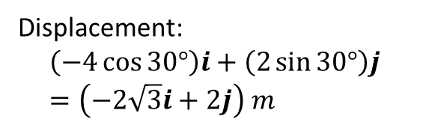
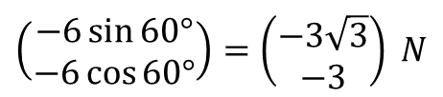




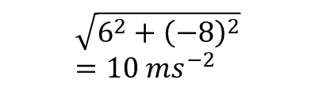

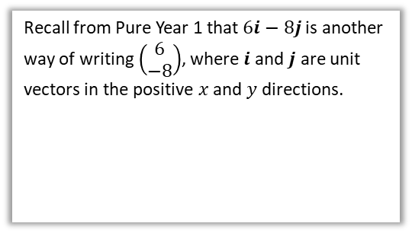
Further Examples
Geometric Form
Vector Form
?
6 N
$$\left(\begin{matrix}−6\sin{60°} \\ −6\cos{60°}\end{matrix}\right)=\left(\begin{matrix}−3\sqrt{3} \\ −3\end{matrix}\right) N$$
$$60°$$
Recall from Pure Year 1 that $6i−8j$ is another way of writing $\left(\begin{matrix}6 \\ −8\end{matrix}\right)$, where $i$ and $j$ are unit vectors in the positive $x$ and $y$ directions.
?
$$\sqrt{6^{2}+{\left(−8\right)}^{2}}=10 ms^{−2}$$
$$\left(6i−8j\right) ms^{−2}$$
$$i$$
$$j$$
?
Displacement:
$$\left(−4\cos{30°}\right)i+\left(2\sin{30°}\right)j \\ =\left(−2\sqrt{3}i+2j\right) m$$
$$30°$$
$$4 m$$

Slide 9
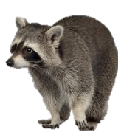





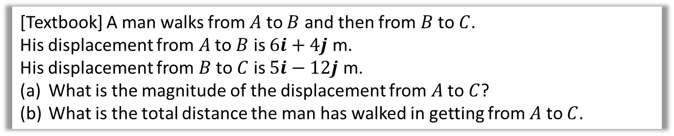



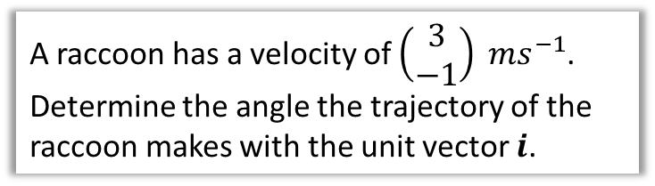
Test Your Understanding
[Textbook] A man walks from $A$ to $B$ and then from $B$ to $C$.
His displacement from $A$ to $B$ is $6i+4j$ m.
His displacement from $B$ to $C$ is $5i−12j$ m.
What is the magnitude of the displacement from $A$ to $C$?
What is the total distance the man has walked in getting from $A$ to $C$.
? Suitable Diagram
a
$$\vec{AC}=\vec{AB}+\vec{BC} \\ =11i−8j \\ \left|\vec{AC}\right|=\sqrt{{11}^{2}+8^{2}}=13.6 km$$
$$\left|\vec{AB}\right|=\sqrt{6^{2}+4^{2}}=7.21 km \\ \left|\vec{BC}\right|=\sqrt{5^{2}+{12}^{2}}=13 km$$
Total distance:
$$7.21+13=20.21 km$$
$$B$$
?
$$6i+4j$$
$$A$$
$$5i−12j$$
b
?
$$C$$
3
Raccoon
A raccoon has a velocity of $\left(\begin{matrix}3 \\ −1\end{matrix}\right) ms^{−1}$. Determine the angle the trajectory of the raccoon makes with the unit vector $i$.
?
$$θ$$
1
$$θ=\tan^{−1}\left(\frac{1}{3}\right)=18.4° \left(3sf\right)$$

Slide 10
Exercise 8C, 8D
Pearson Stats/Mechanics Year 1
Exercise 8.3 page 53
Exercise 8.4 pages 54-55

Slide 11
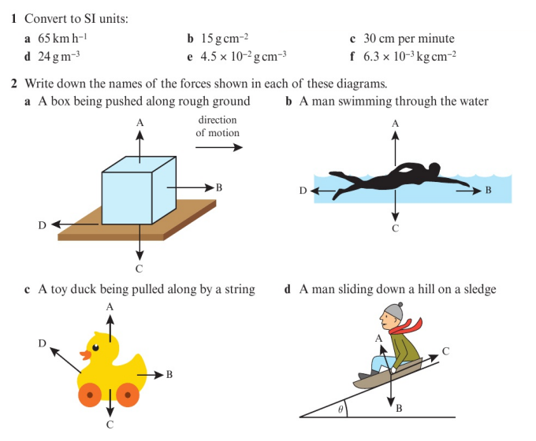
Homework Exercise

Slide 12
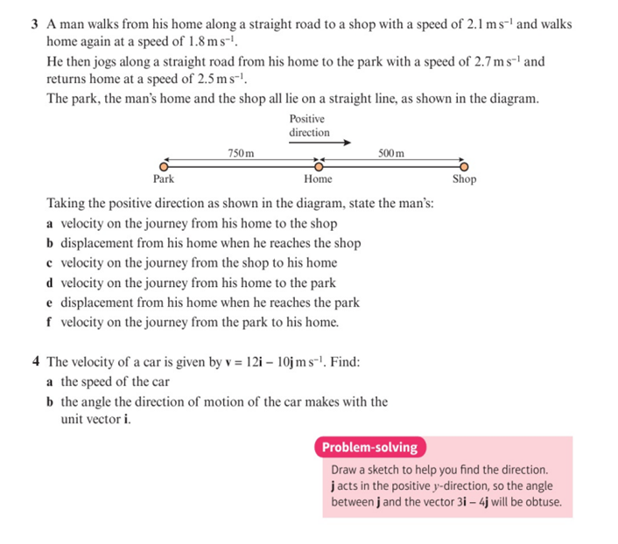
Homework Exercise

Slide 13
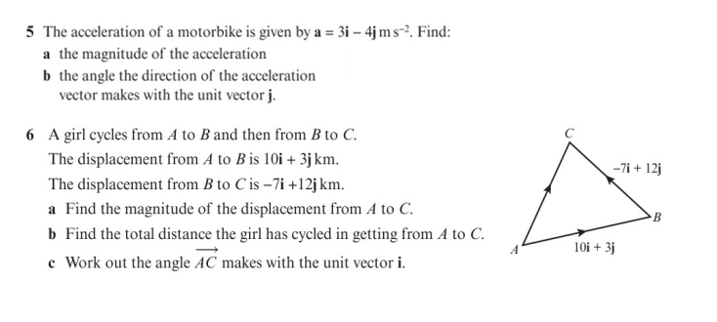
Homework Exercise

Slide 14
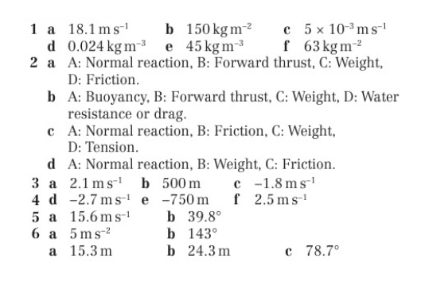
Homework Answers

