Slide 1
S1 Chapter 6: Statistical Distributions Binomial Distribution

Slide 2
On holiday in Hawaii visiting the family of a friend, we noticed that at the dinner table that out of the 8 of us, 6 of us were left-handed.
One of them commented, “The chances of that must be very low”.
“What are the odds?”.

Slide 3


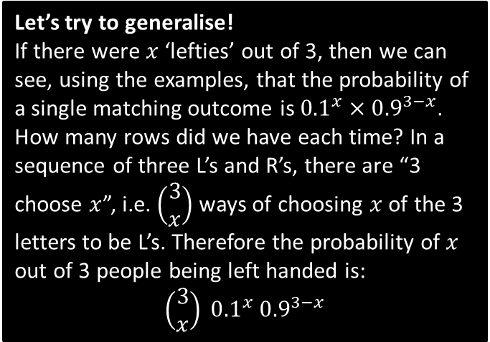


Leftie Example
Let’s simplify the problem by using just 3 people:
The probability a randomly chosen person is left-handed is 0.1. If there is a group of 3 people, what is the probability that:
All 3 are left-handed.
0 are left-handed.
1 person is left-handed.
2 people are left-handed.
d
Again, listing the possibilities:
LLR: $0.1×0.1×0.9=0.009$
RLL: $0.9×0.1×0.1=0.009$
LRL: $0.9×0.1×0.9=0.009$
$$0.009×3=0.027$$
?
$${0.1}^{3}=0.001$$
a
?
Let’s try to generalise!
If there were $x$ ‘lefties’ out of 3, then we can see, using the examples, that the probability of a single matching outcome is ${0.1}^{x}×{0.9}^{3−x}$.
How many rows did we have each time? In a sequence of three L’s and R’s, there are “3 choose $x$”, i.e. $\left(\begin{matrix}3 \\ x\end{matrix}\right)$ ways of choosing $x$ of the 3 letters to be L’s. Therefore the probability of $x$ out of 3 people being left handed is:
$$\left(\begin{matrix}3 \\ x\end{matrix}\right) {0.1}^{x} {0.9}^{3−x}$$
$${0.9}^{3}=0.729$$
b
?
c
As we would do at GCSE, we could list the possibilities than find the probability of each before adding:
LRR: $0.1×0.9×0.9=0.081$
RLR: $0.9×0.1×0.9=0.081$
RRL: $0.9×0.9×0.1=0.081$
$$0.081×3=0.243$$
?

Slide 4

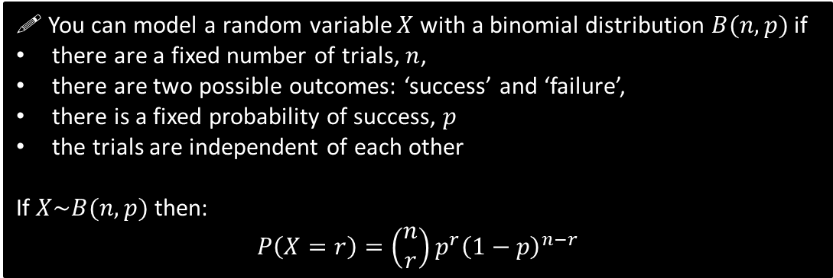
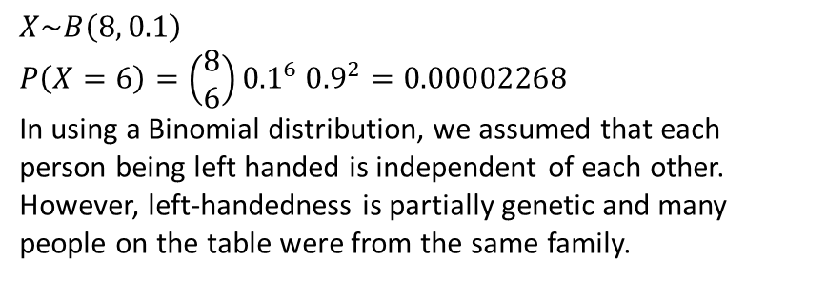
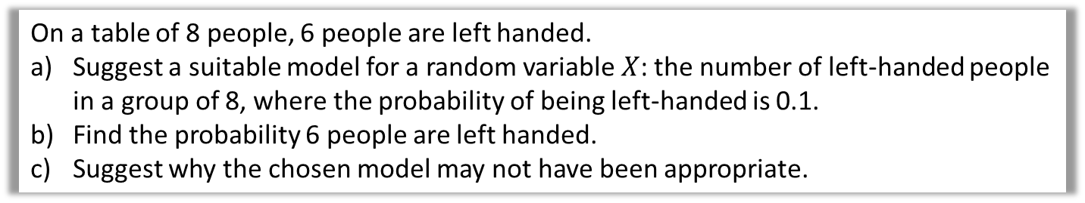

The Binomial Distribution
! You can model a random variable $X$ with a binomial distribution $B(n,p)$ if
there are a fixed number of trials, $n$,
there are two possible outcomes: ‘success’ and ‘failure’,
there is a fixed probability of success, $p$
the trials are independent of each other
If $X\sim B(n,p)$ then:
$$P\left(X=r\right)=\left(\begin{matrix}n \\ r\end{matrix}\right)p^{r}{\left(1−p\right)}^{n−r}$$
In our example, ‘success’ was ‘leftie’.
$r$ is the number of successes out of $n$.
“$\sim$” means “has the distribution”
On a table of 8 people, 6 people are left handed.
Suggest a suitable model for a random variable $X$: the number of left-handed people in a group of 8, where the probability of being left-handed is 0.1.
Find the probability 6 people are left handed.
Suggest why the chosen model may not have been appropriate.
a
$$X\sim B\left(8, 0.1\right)$$
$$P\left(X=6\right)=\left(\begin{matrix}8 \\ 6\end{matrix}\right){0.1}^{6} {0.9}^{2}=0.00002268$$
In using a Binomial distribution, we assumed that each person being left handed is independent of each other. However, left-handedness is partially genetic and many people on the table were from the same family.
?
In general, choosing a well-known model, such as a Binomial distribution, makes certain simplifying assumptions. Such assumptions simplifies the maths involved, but potentially at the expense of not adequately modelling the situation.
b
?
c
?

Slide 5


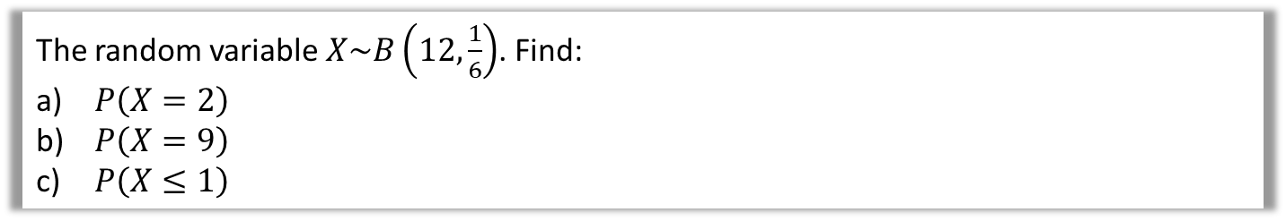
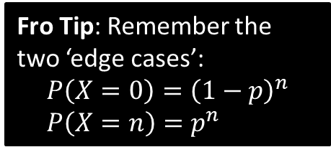

Further Examples
The random variable $X\sim B\left(12,\frac{1}{6}\right)$. Find:
$P\left(X=2\right)$
$P\left(X=9\right)$
$P\left(X≤1\right)$
$$P\left(X=2\right)=\left(\begin{matrix}12 \\ 2\end{matrix}\right) {\left(\frac{1}{6}\right)}^{2}{\left(\frac{5}{6}\right)}^{10}=0.296 \\ P\left(X=9\right)=\left(\begin{matrix}12 \\ 9\end{matrix}\right) {\left(\frac{1}{6}\right)}^{9}{\left(\frac{5}{6}\right)}^{3}=0.0000126 \\ P\left(X≤1\right)=P\left(X=0\right)+P\left(X=1\right) \\ ={\left(\frac{5}{6}\right)}^{12}+\left(\begin{matrix}12 \\ 1\end{matrix}\right) {\left(\frac{1}{6}\right)}^{1}{\left(\frac{5}{6}\right)}^{11}=0.381$$
a
?
Fro Mental Tip: The two powers add up to $n$.
b
?
Fro Tip: Remember the two ‘edge cases’:
$$P\left(X=0\right)={\left(1−p\right)}^{n} \\ P\left(X=n\right)=p^{n}$$
c
?
Edexcel S2 June 2010 Q6
A company claims that a quarter of the bolts sent to them are faulty. To test this claim the number of faulty bolts in a random sample of 50 is recorded.
(a) Give two reasons why a binomial distribution may be a suitable model for the number of faulty bolts in the sample. (2)
?

Slide 6
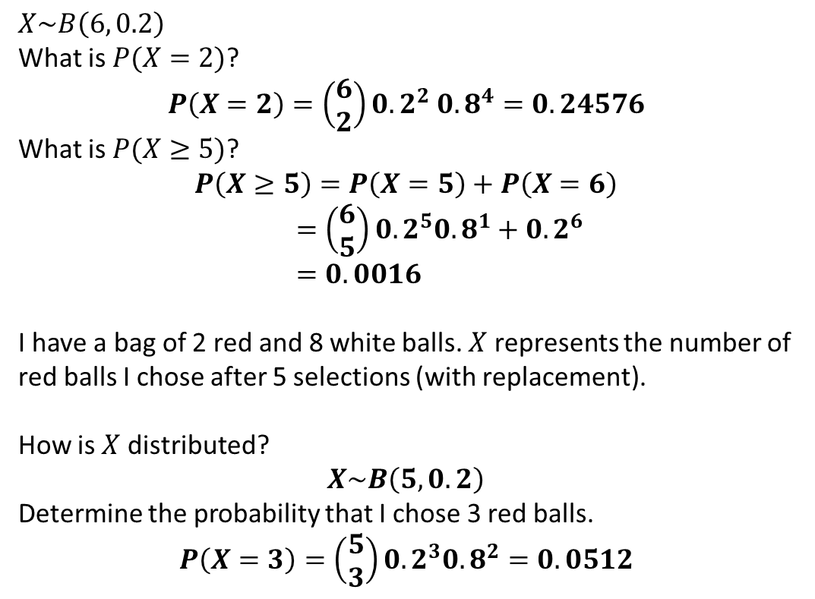
Test Your Understanding
1
$$X\sim B\left(6, 0.2\right)$$
What is $P(X=2)$?
$$P\left(X=2\right)=\left(\begin{matrix}6 \\ 2\end{matrix}\right){0.2}^{2} 0.8^{4}=0.24576$$
What is $P(X≥5)$? $$P\left(X≥5\right)=P\left(X=5\right)+P\left(X=6\right) \\ =\left(\begin{matrix}6 \\ 5\end{matrix}\right){0.2}^{5}{0.8}^{1}+0.2^{6} \\ =0.0016$$
I have a bag of 2 red and 8 white balls. $X$ represents the number of red balls I chose after 5 selections (with replacement).
How is $X$ distributed?
$$X\sim B\left(5,0.2\right)$$
Determine the probability that I chose 3 red balls.
$$P\left(X=3\right)=\left(\begin{matrix}5 \\ 3\end{matrix}\right){0.2}^{3}{0.8}^{2}=0.0512$$
?
?
2
a
?
b
?

Slide 7
Exercise 6.2
Pearson Applied Year 1/AS
Pages 40-41

Slide 8
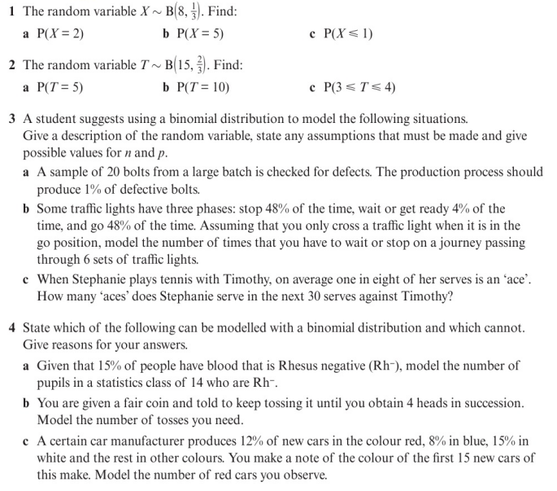
Homework Exercise

Slide 9
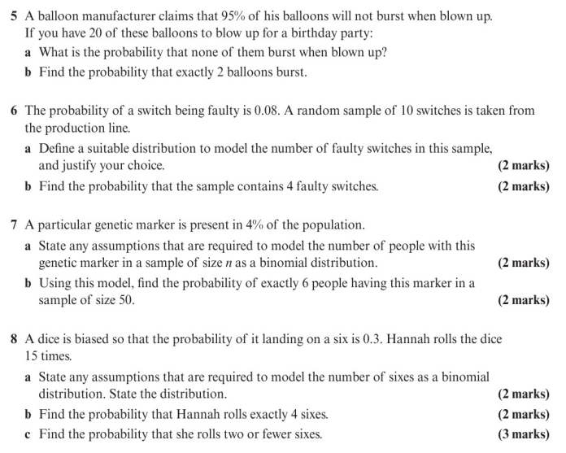
Homework Exercise

Slide 10
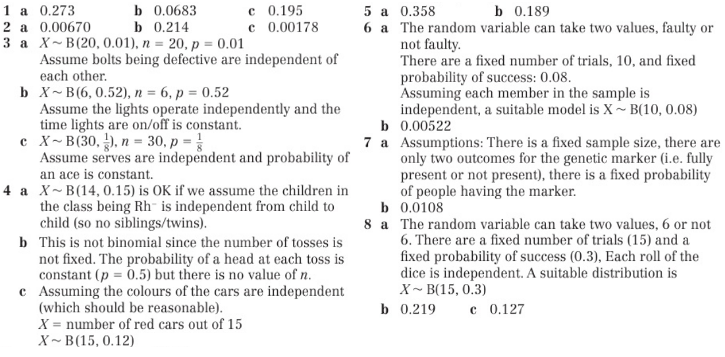
Homework Answers

