Slide 1
P2 Chapter 8: Parametric Equations Curve Sketching

Slide 2
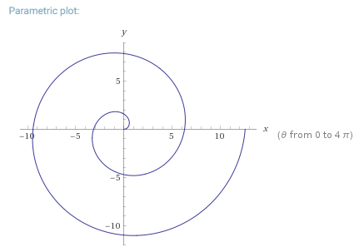
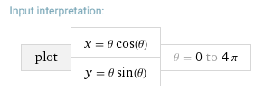
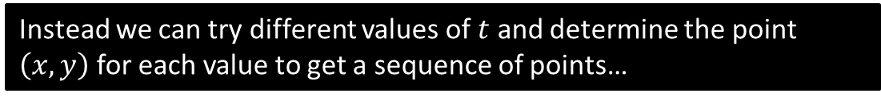
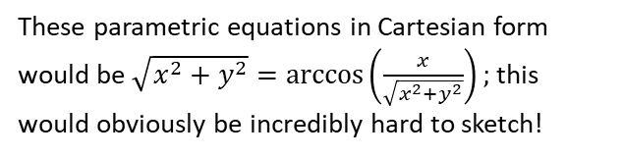
Sketching Parametric Curves
We saw that one strategy for sketching parametric curves is to convert into a Cartesian equation, and hope this is a form we recognise (e.g. quadratic or equation of circle) to appropriately sketch.
However, some parametric equations can’t easily be turned into Cartesian form:
These parametric equations in Cartesian form would be $\sqrt{x^{2}+y^{2}}=\arccos\left(\frac{x}{\sqrt{x^{2}+y^{2}}}\right);$ this would obviously be incredibly hard to sketch!
Instead we can try different values of $t$ and determine the point $\left(x,y\right)$ for each value to get a sequence of points…

Slide 3

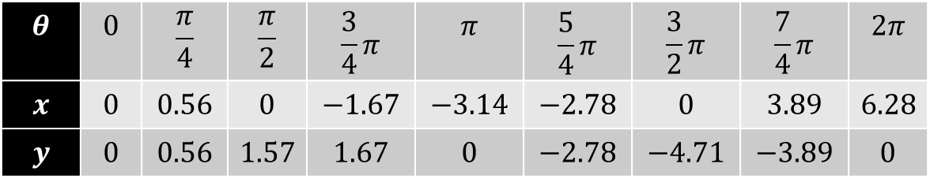








Sketching Parametric Curves
$$θ$$ | $$0$$ | $$\frac{π}{4}$$ | $$\frac{π}{2}$$ | $$\frac{3}{4}π$$ | $$π$$ | $$\frac{5}{4}π$$ | $$\frac{3}{2}π$$ | $$\frac{7}{4}π$$ | $$2π$$
$$x$$ | $$0$$ | $$0.56$$ | $$0$$ | $$−1.67$$ | $$−3.14$$ | $$−2.78$$ | $$0$$ | $$3.89$$ | $$6.28$$
$$y$$ | $$0$$ | $$0.56$$ | $$1.57$$ | $$1.67$$ | $$0$$ | $$−2.78$$ | $$−4.71$$ | $$−3.89$$ | $$0$$
?
?
?
?
?
?
?
?
?
$$y$$
$$\left(−1.67,1.57\right)$$
$$\left(0,1.57\right)$$
$$\left(0.56,0.56\right)$$
$$x$$
$$\left(−3.14,0\right)$$
$$\left(0,0\right)$$
$$\left(−2.78,−2.78\right)$$
$$\left(0, −4.71\right)$$

Slide 4
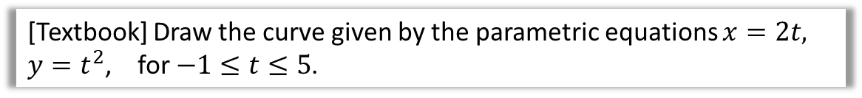
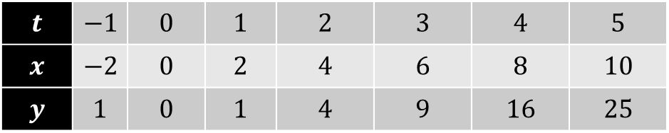


Test Your Understanding
[Textbook] Draw the curve given by the parametric equations $x=2t,$
$y=t^{2}$, for $−1≤t≤5$.
?
$$t$$ | $$−1$$ | $$0$$ | $$1$$ | $$2$$ | $$3$$ | $$4$$ | $$5$$
$$x$$ | $$−2$$ | $$0$$ | $$2$$ | $$4$$ | $$6$$ | $$8$$ | $$10$$
$$y$$ | $$1$$ | $$0$$ | $$1$$ | $$4$$ | $$9$$ | $$16$$ | $$25$$
$$y$$
25
20
15
10
5
$$x$$
-2 2 4 6 8 10

Slide 5
Exercise 8.3
Pearson Pure Mathematics Year 2/AS
Page 62

Slide 6
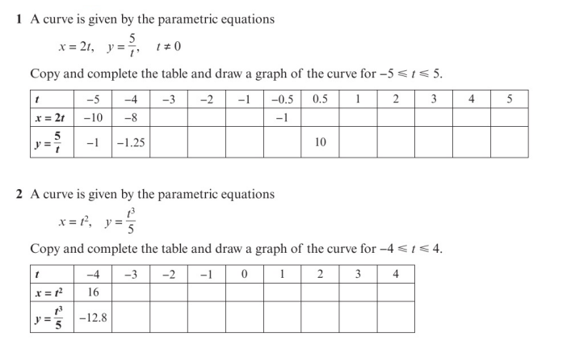
Homework Exercise

Slide 7
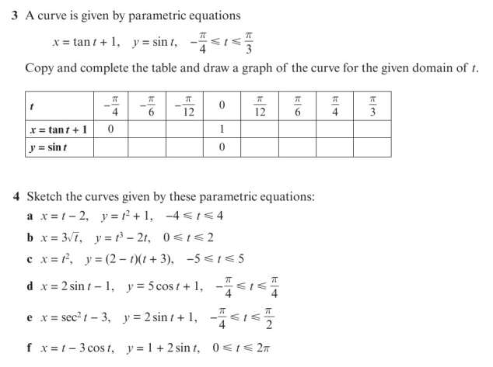
Homework Exercise

Slide 8
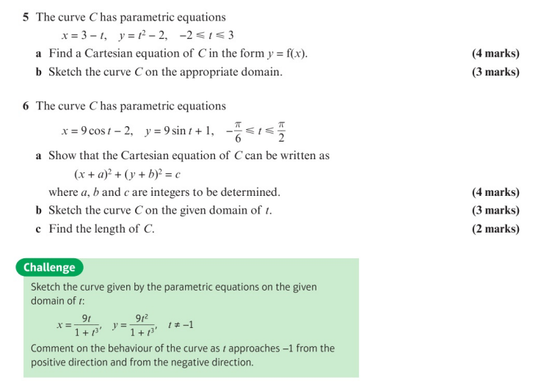
Homework Exercise

Slide 9
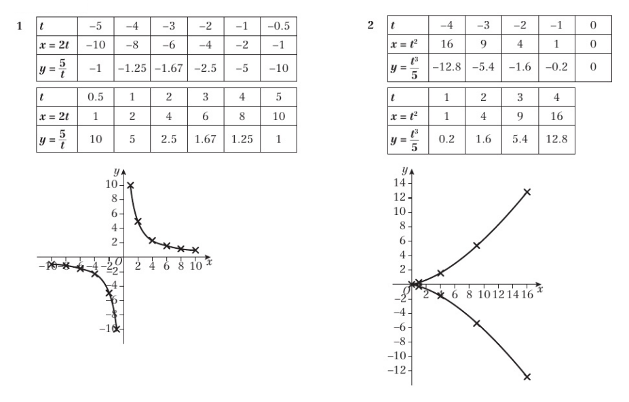
Homework Answers

Slide 10
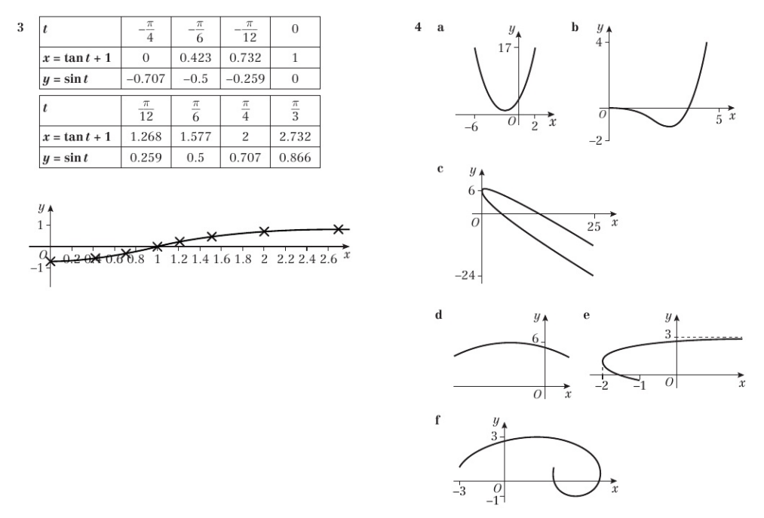
Homework Answers

Slide 11
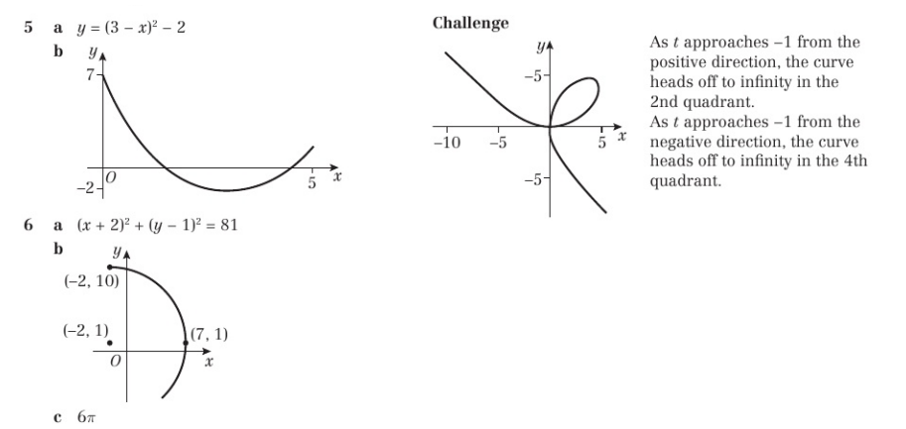
Homework Answers

