Slide 1
Stats1 Chapter 4: Correlation Linear Regression

Slide 2

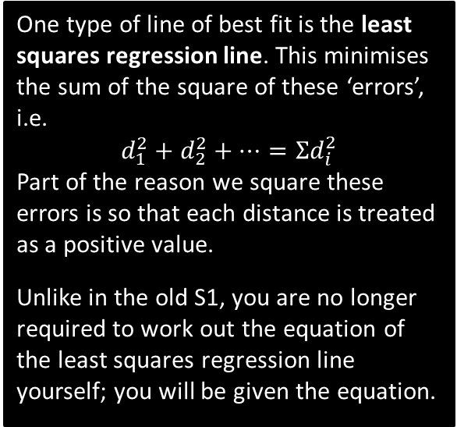






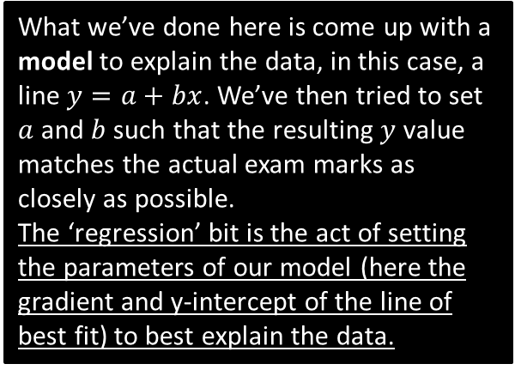



What is regression?
What we’ve done here is come up with a model to explain the data, in this case, a line $y=a+bx$. We’ve then tried to set $a$ and $b$ such that the resulting $y$ value matches the actual exam marks as closely as possible.
The ‘regression’ bit is the act of setting the parameters of our model (here the gradient and y-intercept of the line of best fit) to best explain the data.
$$d_{7}$$
$$d_{5}$$
$$d_{6}$$
Exam mark $(y)$
$$y=20+3x$$
$$d_{3}$$
$$d_{4}$$
$$d_{2}$$
$$d_{1}$$
One type of line of best fit is the least squares regression line. This minimises the sum of the square of these ‘errors’, i.e.
$$d_{1}^{2}+d_{2}^{2}+…=Σd_{i}^{2}$$
Part of the reason we square these errors is so that each distance is treated as a positive value.
Unlike in the old S1, you are no longer required to work out the equation of the least squares regression line yourself; you will be given the equation.
Time spent revising $(x)$
I record people’s exam marks as well as the time they spent revising. I want to predict how well someone will do based on the time they spent revising. How would I do this?

Slide 3
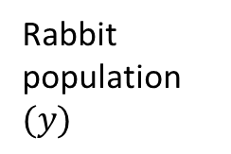


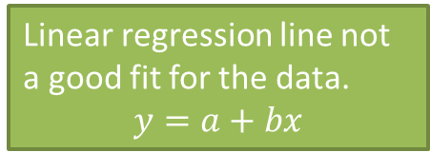
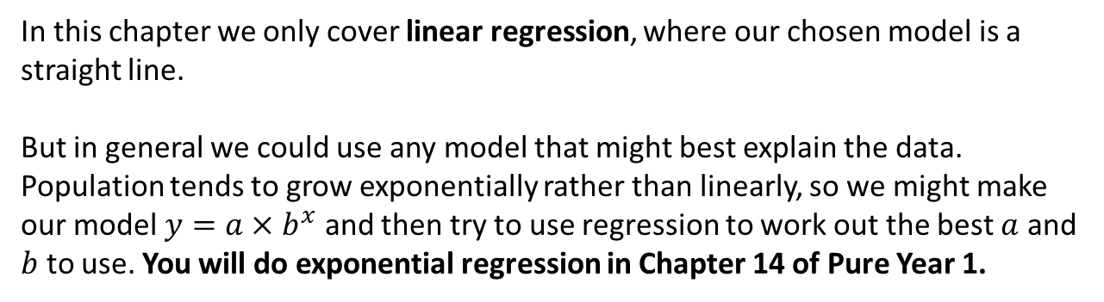
What is regression?
Linear regression line not a good fit for the data.
$$y=a+bx$$
Rabbit population $(y)$
Exponential line much better fit.
$$y=ab^{x}$$
Time$(x)$
In this chapter we only cover linear regression, where our chosen model is a straight line.
But in general we could use any model that might best explain the data. Population tends to grow exponentially rather than linearly, so we might make our model $y=a×b^{x}$ and then try to use regression to work out the best $a$ and $b$ to use. You will do exponential regression in Chapter 14 of Pure Year 1.

Slide 4
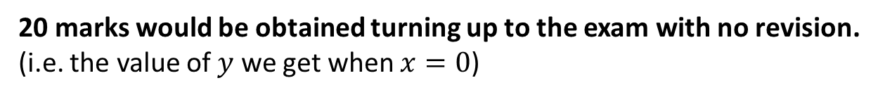
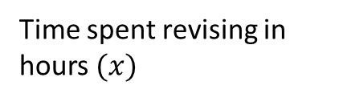
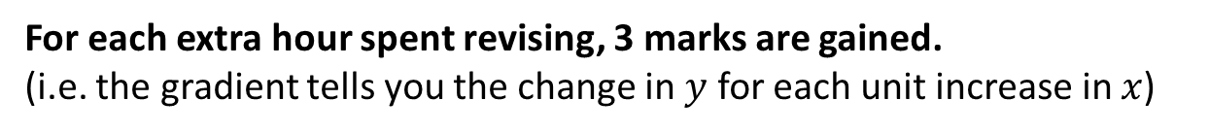

Interpreting $a$ and $b$.
$$y=20+3x$$
Exam mark $(y)$
Time spent revising in hours $(x)$
How do we interpret the gradient of 3?
?
For each extra hour spent revising, 3 marks are gained.
(i.e. the gradient tells you the change in $y$ for each unit increase in $x$)
How do we interpret the $y$-intercept of 20?
?
20 marks would be obtained turning up to the exam with no revision.
(i.e. the value of $y$ we get when $x=0$)

Slide 5
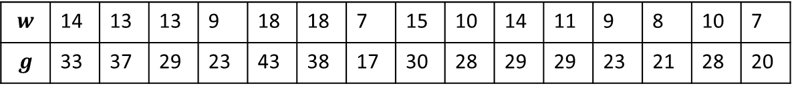

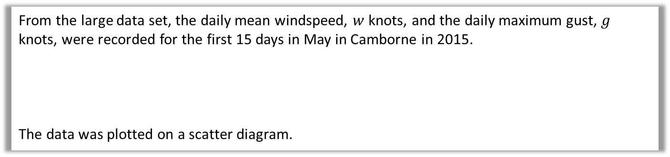
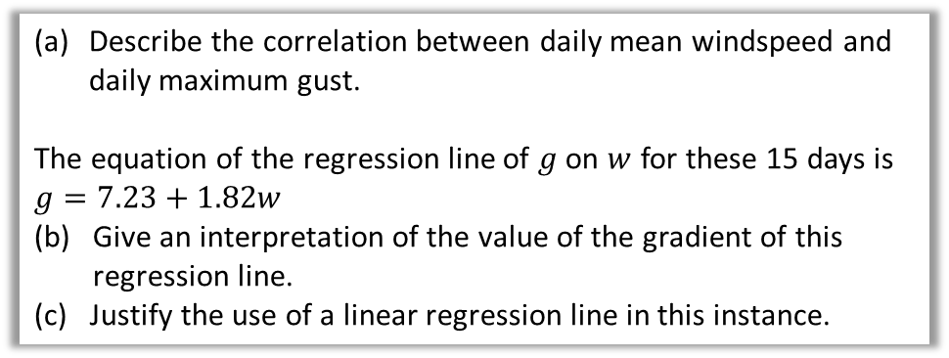


Example
From the large data set, the daily mean windspeed, $w$ knots, and the daily maximum gust, $g$ knots, were recorded for the first 15 days in May in Camborne in 2015.
The data was plotted on a scatter diagram.
$$w$$ | 14 | 13 | 13 | 9 | 18 | 18 | 7 | 15 | 10 | 14 | 11 | 9 | 8 | 10 | 7
$$g$$ | 33 | 37 | 29 | 23 | 43 | 38 | 17 | 30 | 28 | 29 | 29 | 23 | 21 | 28 | 20
© Met Office
Describe the correlation between daily mean windspeed and daily maximum gust.
The equation of the regression line of $g$ on $w$ for these 15 days is $g=7.23+1.82w$
(b) Give an interpretation of the value of the gradient of this regression line.
(c) Justify the use of a linear regression line in this instance.
50
40
30
20
10
0
Daily maximum gust, $g$ (knots)
0 5 10 15 20
Daily mean windspeed, $w$ (knots)
There is a strong positive correlation between daily mean windspeed and daily maximum gust.
If the daily mean windspeed increases by 10 knots the daily maximum gust increases by approximately 18 knots.
The correlation suggests that there is a linear relationship between $g$ and $w$ so a linear regression line is a suitable model.
a
?
b
?
The stronger the (linear) correlation, the more suitable a linear regression line is.
c
?

Slide 6
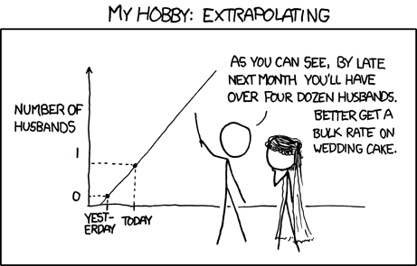
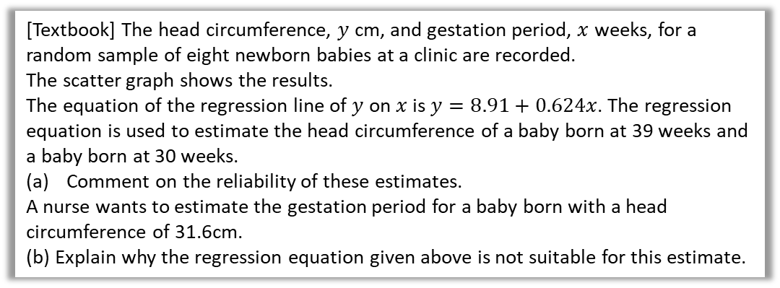
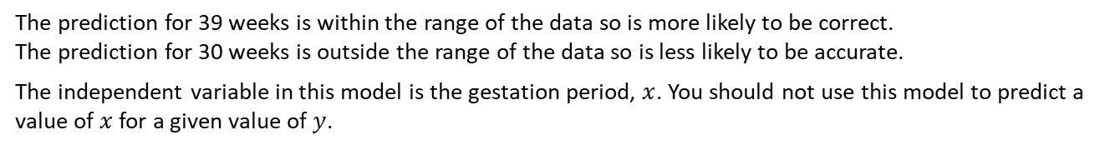
Interpolating and Extrapolating
You should only use the regression line to make predictions for values of the dependent variable that are within the range of the given data.
Estimating a value inside the data range is known as interpolating.
Estimating a value outside the data range is known as extrapolating
(as per the cartoon on the left!)
xkcd.com
[Textbook] The head circumference, $y$ cm, and gestation period, $x$ weeks, for a random sample of eight newborn babies at a clinic are recorded.
The scatter graph shows the results.
The equation of the regression line of $y$ on $x$ is $y=8.91+0.624x$. The regression equation is used to estimate the head circumference of a baby born at 39 weeks and a baby born at 30 weeks.
Comment on the reliability of these estimates.
A nurse wants to estimate the gestation period for a baby born with a head circumference of 31.6cm.
(b) Explain why the regression equation given above is not suitable for this estimate.
36
34
32
30
28
Head circumference (cm)
30 32 34 36 38 40 42x
Gestation period (weeks)
The prediction for 39 weeks is within the range of the data so is more likely to be correct.
The prediction for 30 weeks is outside the range of the data so is less likely to be accurate.
The independent variable in this model is the gestation period, $x$. You should not use this model to predict a value of $x$ for a given value of $y$.
a
?
b
?

Slide 7
Exercise 4.2
Pearson Statistics/Mechanics Year 1/AS
Pages 28-29

Slide 8
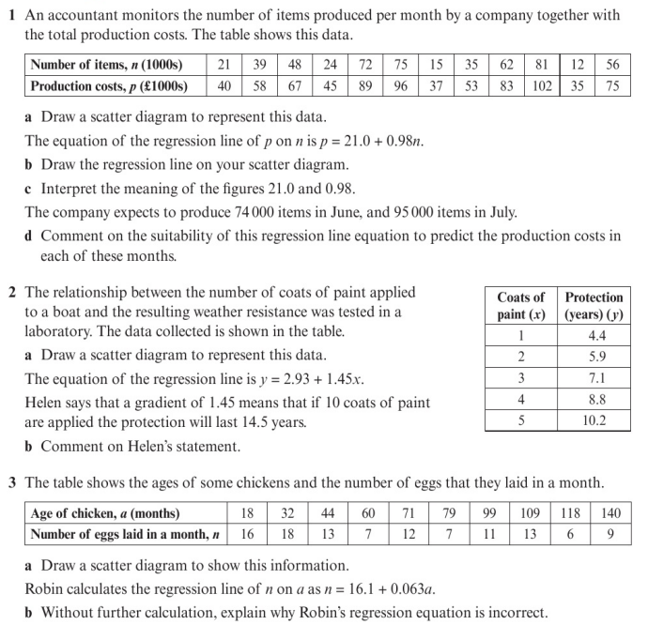
Homework Exercise

Slide 9
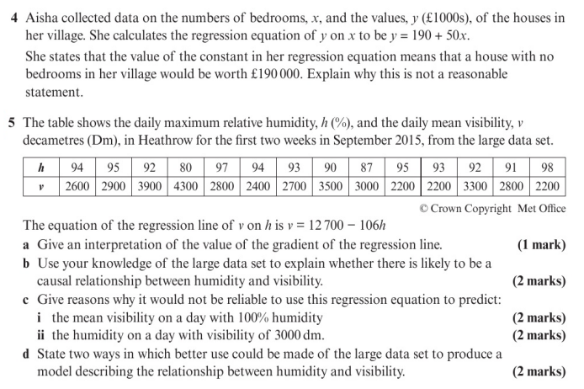
Homework Exercise

Slide 10
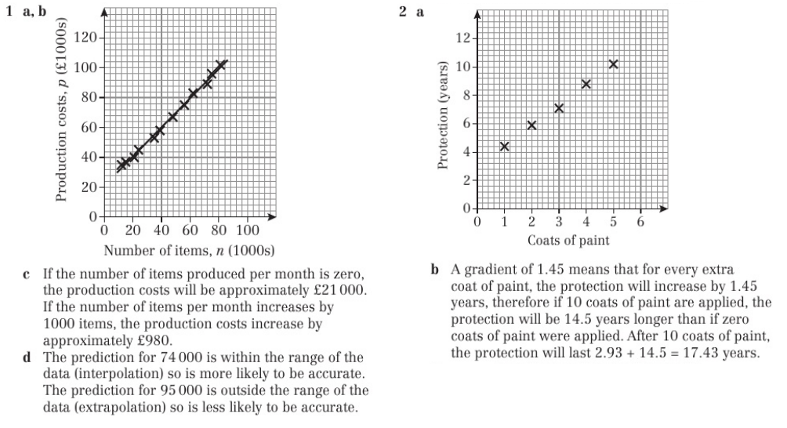
Homework Answers

Slide 11
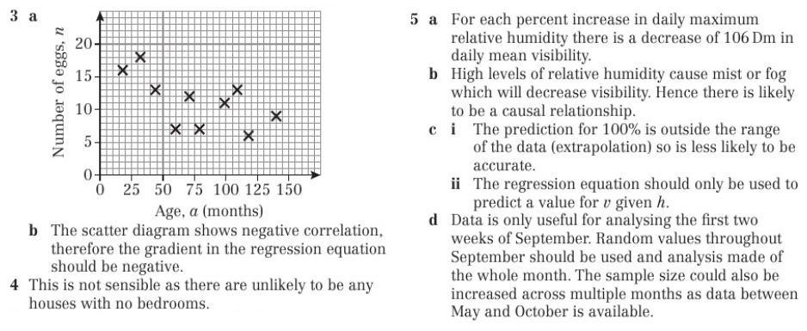
Homework Answers

