Slide 1
P1 Chapter 9: Trigonometric Ratios Circular Graphs

Slide 2
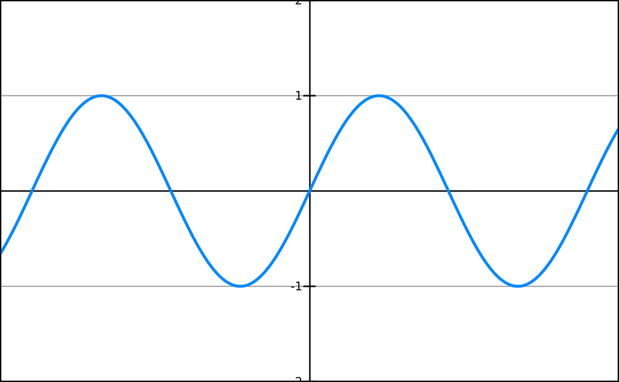
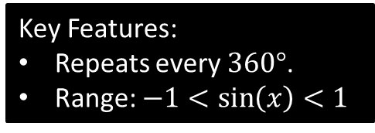
Sin Graph
What does it look like?
?
Key Features:
Repeats every $360°$.
Range: $−1<\sin\left(x\right)<1$
-360
-270
-180
-90
90
180
270
360

Slide 3
Sin Graph
What do the following graphs look like?
-360
-270
-180
-90
90
180
270
360
Suppose we know that sin(30) = 0.5. By thinking about symmetry in the graph, how could we work out:
sin(150) = 0.5
?
sin(-30) = -0.5
?
sin(210) = -0.5
?

Slide 4
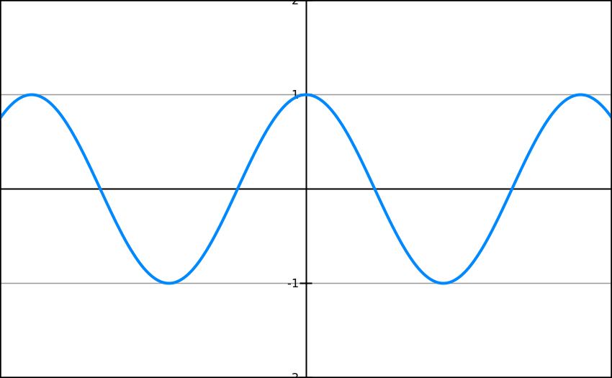

Cos Graph
What do the following graphs look like?
?
Key Features:
Repeats every $360°$.
Range: $−1<\sin\left(x\right)<1$
-360
-270
-180
-90
90
180
270
360

Slide 5
Cos Graph
What does it look like?
-360
-270
-180
-90
90
180
270
360
Suppose we know that cos(60) = 0.5. By thinking about symmetry in the graph, how could we work out:
cos(120) = -0.5
?
cos(-60) = 0.5
cos(240) = -0.5
?
?

Slide 6
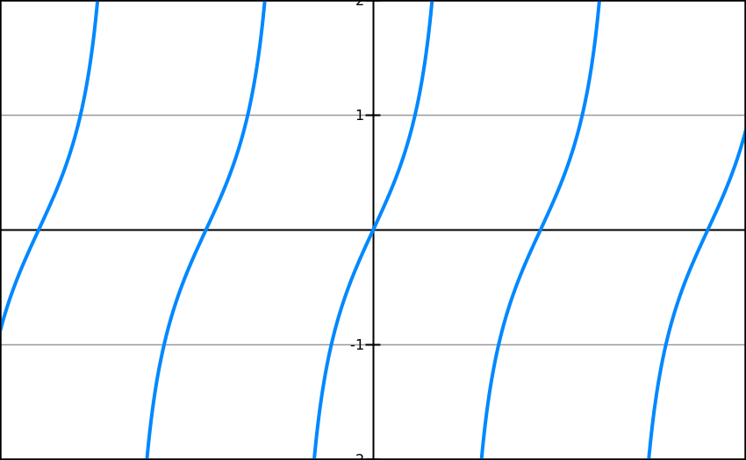
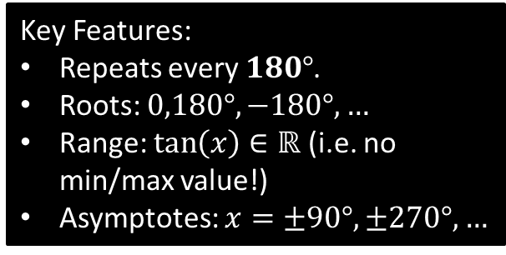
Tan Graph
What does it look like?
?
-360
-270
-180
-90
90
180
270
360
Key Features:
Repeats every $180°$.
Roots: $0,180°,−180°, …$
Range: $\tan\left(x\right)∈ℝ$ (i.e. no min/max value!)
Asymptotes: $x=±90°, ±270°,…$

Slide 7
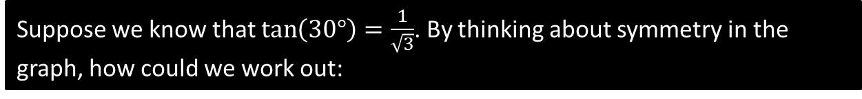

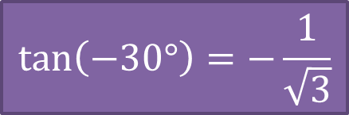
Tan Graph
What does it look like?
-360
-270
-180
-90
90
180
270
360
Suppose we know that $\tan\left(30°\right)=\frac{1}{\sqrt{3}}$. By thinking about symmetry in the graph, how could we work out:
$$\tan\left(−30°\right)=−\frac{1}{\sqrt{3}}$$
?
$$\tan\left(150°\right)=−\frac{1}{\sqrt{3}}$$
?

Slide 8
Exercise 9.5
Pearson Pure Mathematics Year 1/AS
Page 73

Slide 9
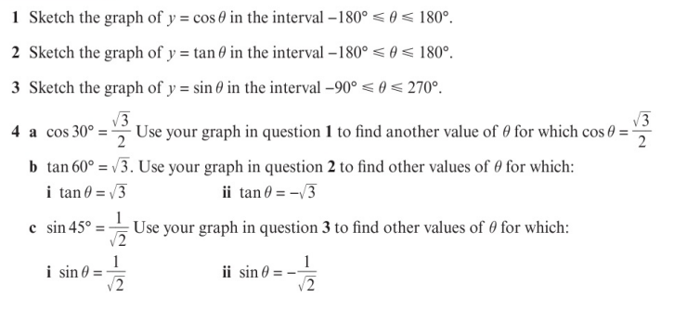
Homework Exercise

Slide 10
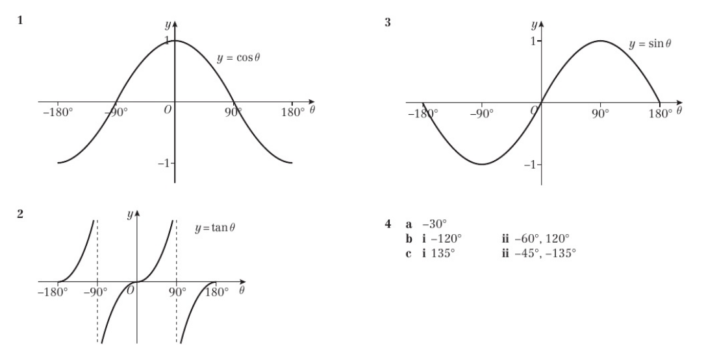
Homework Answers

