Slide 1
P2 Chapter 11: 3D Vectors Solving Geometric Problems

Slide 2



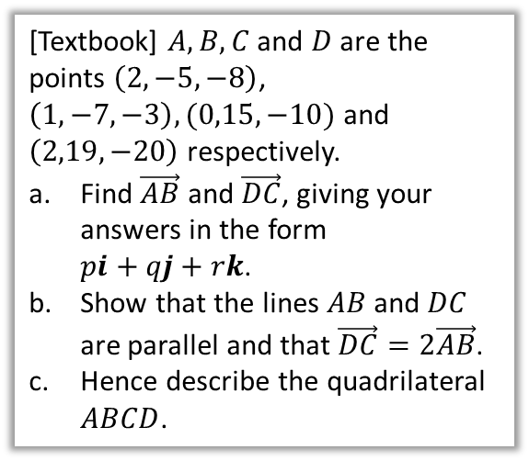


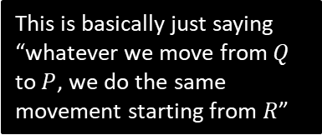
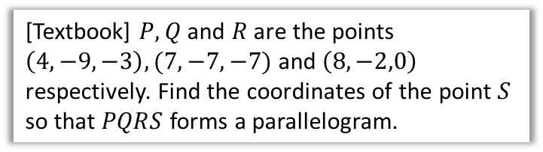

Geometric Problems
For more general problems involving vectors, often drawing a diagram helps!
[Textbook] $A, B, C$ and $D$ are the points $\left(2,−5,−8\right)$, $\left(1,−7,−3\right), (0,15,−10)$ and $\left(2,19,−20\right)$ respectively.
Find $\vec{AB}$ and $\vec{DC}$, giving your answers in the form $pi+qj+rk$.
Show that the lines $AB$ and $DC$ are parallel and that $\vec{DC}=2\vec{AB}$.
Hence describe the quadrilateral $ABCD$.
[Textbook] $P, Q$ and $R$ are the points $\left(4,−9,−3\right),(7,−7,−7)$ and $\left(8,−2,0\right)$ respectively. Find the coordinates of the point $S$ so that $PQRS$ forms a parallelogram.
?
$$S$$
$$P(4,−9,−3)$$
(Draw a diagram, recalling that the letters go in a clockwise or anticlockwise order)
$$R(8,−2,0)$$
$$\vec{AB}=−i−2j+5k \\ \vec{DC}=−2i−4j+10k$$
$$\vec{DC}=2\left(−i+2j+5k\right)=2\vec{AB}$$
They are multiples $∴$ parallel.
$AB$ and $DC$ are parallel but different in length. Therefore $ABCD$ is a trapezium.
$$Q(7,−7,−7)$$
a
?
This is basically just saying “whatever we move from $Q$ to $P$, we do the same movement starting from $R$”
$$\vec{QP}=\left(\begin{matrix}−3 \\ −2 \\ 4\end{matrix}\right) \\ ∴\vec{OS}=\vec{OR}+\vec{RS} \\ =\vec{OR}+\vec{QP} \\ =\left(\begin{matrix}8 \\ −2 \\ 0\end{matrix}\right)+\left(\begin{matrix}−3 \\ −2 \\ 4\end{matrix}\right)=\left(\begin{matrix}5 \\ −4 \\ 4\end{matrix}\right)$$
$$S\left(5,−4,4\right)$$
b
?
c
?

Slide 3



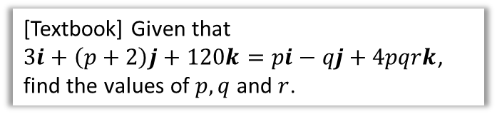



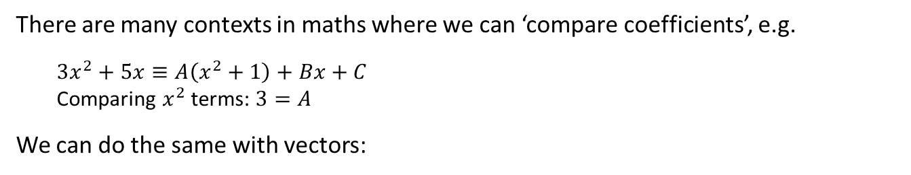






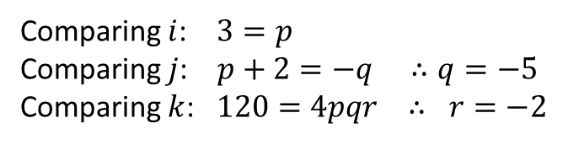


Comparing Coefficients
There are many contexts in maths where we can ‘compare coefficients’, e.g.
$3x^{2}+5x≡A\left(x^{2}+1\right)+Bx+C$
Comparing $x^{2}$ terms: $3=A$
We can do the same with vectors:
[Textbook] The diagram shows a cuboid whose vertices are $O,A,B,C,D,E,F$ and $G$. Vectors $a, b$ and $c$ are the position vectors of the vertices $A, B$ and $C$ respectively. Prove that the diagonals $OE$ and $BG$ bisect each other.
[Textbook] Given that $3i+\left(p+2\right)j+120k=pi−qj+4pqrk$, find the values of $p, q$ and $r$.
$$F$$
$$E$$
$$C$$
$$G$$
The strategy behind this type of question is to find the point of intersection in 2 ways, and compare coefficients.
$$c$$
$$H$$
$$B$$
$$D$$
?
$$b$$
$$a$$
$$A$$
Comparing $i$: $3=p$
Comparing $j$: $p+2=−q ∴q=−5$
Comparing $k$: $120=4pqr ∴ r=−2$
$$O$$
?
Suppose there is a point of intersection $H$ of $OE$ and $BG$.
We can get to $H$ in two ways:
$\vec{OH}=r \vec{OE}$ for some scalar $r$.
$\vec{OH}=\vec{OB}+\vec{BH}=\vec{OB}+s \vec{BG}$ for some scalar $s$.
$$\vec{OH}=r\left(a+b+c\right)=b+s\left(a−b+c\right) \\ ra+rb+rc=sa+\left(1−s\right)b+sc$$
Comparing coefficients, $r=s$ and $r=1−s$
Adding: $2r=1 ∴r=s=\frac{1}{2}$
Therefore lines bisect each other.

Slide 4
Exercise 12C
Pearson Pure Mathematics Year 2/AS
Pages 107-108

Slide 5
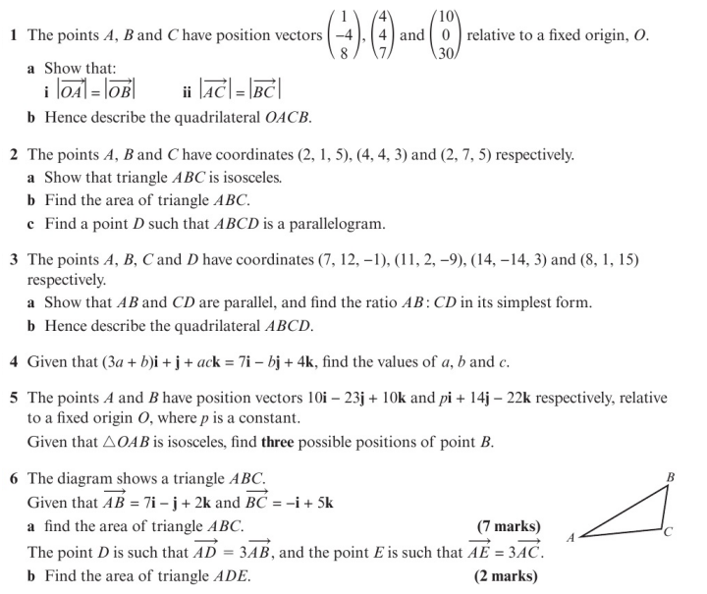
Homework Exercise

Slide 6
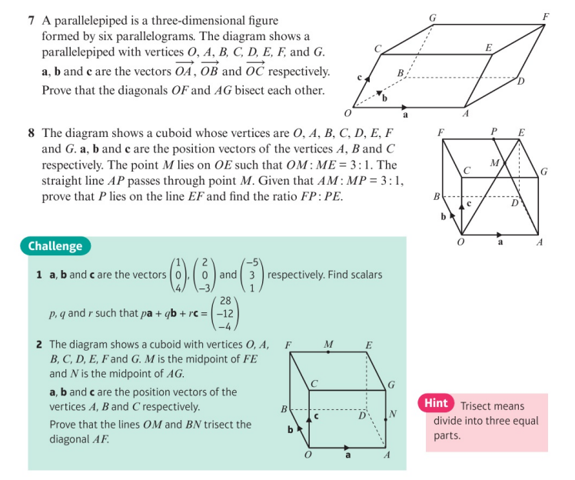
Homework Exercise

Slide 7
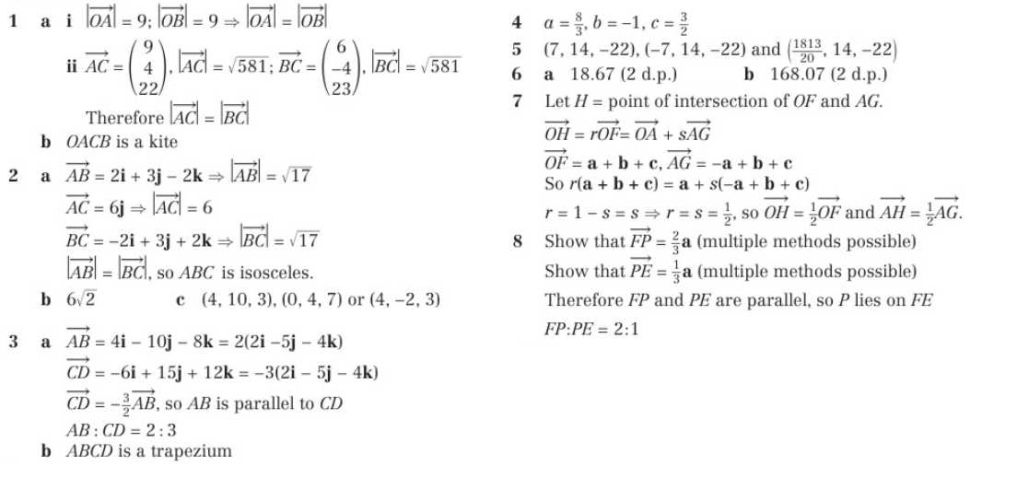
Homework Answers

Slide 8
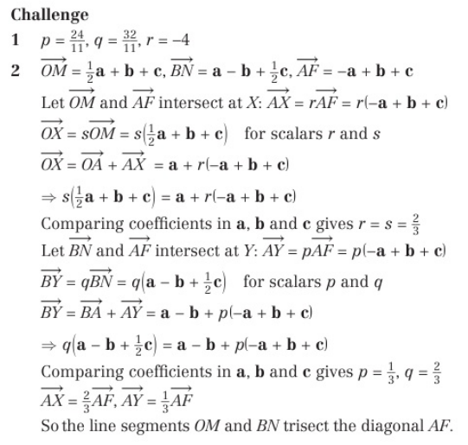
Homework Answers

