Slide 1
S1 Chapter 3: Data Representations Cumulative Frequency

Slide 2
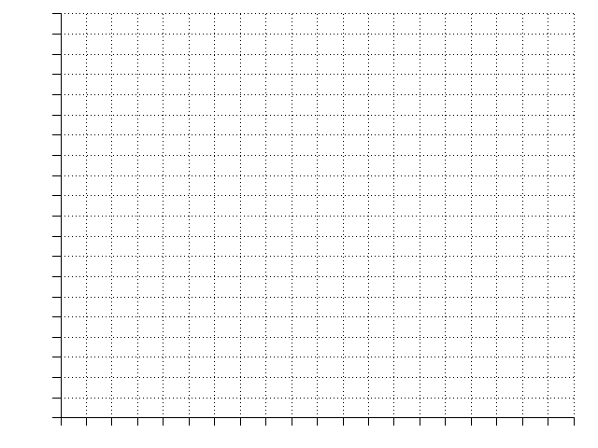
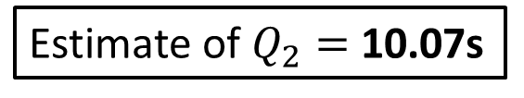
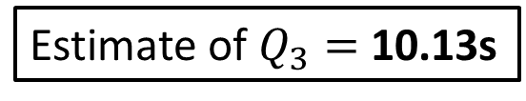
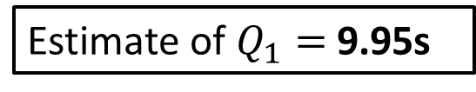
Cumulative Frequency Diagrams
Time (s) | Frequency | Cumul Freq
9.6 < t ≤ 9.7 | 1 | 1
9.7 < t ≤ 9.9 | 4 | 5
9.9 < t ≤ 10.05 | 10 | 15
10.05 < t ≤ 10.2 | 17 | 32
These graphs are intended to show the running total of people/things up to a particular value, and are particularly useful in estimating the median and quartiles.
Plot
32
28
24
20
16
12
8
4
0
Plot
Plot
Estimate of $Q_{2}=$ 10.07s
Plot
?
?
Estimate of $Q_{1}=$ 9.95s
Cumulative Frequency
?
Estimate of $Q_{3}=$ 10.13s
Interquartile Range
= 0.18s
?
9.5 9.6 9.7 9.8 9.9 10.0 10.1 10.2 10.3
Time (s)

Slide 3
Cumulative Frequency Diagrams
Estimate how many runners had a time less than 10.15s.
26 runners
Estimate how many runners had a time more than 9.95
32 – 8 = 24 runners
Estimate how many runners had a time between 9.8s and 10s
11 – 3 = 8 runners
32
28
24
20
16
12
8
4
0
?
Cumulative Frequency
?
?
9.5 9.6 9.7 9.8 9.9 10.0 10.1 10.2 10.3
Time (s)

Slide 4
Exercise 3.3
Pearson Pure Mathematics Year 1/AS
Pages 19-20

Slide 5
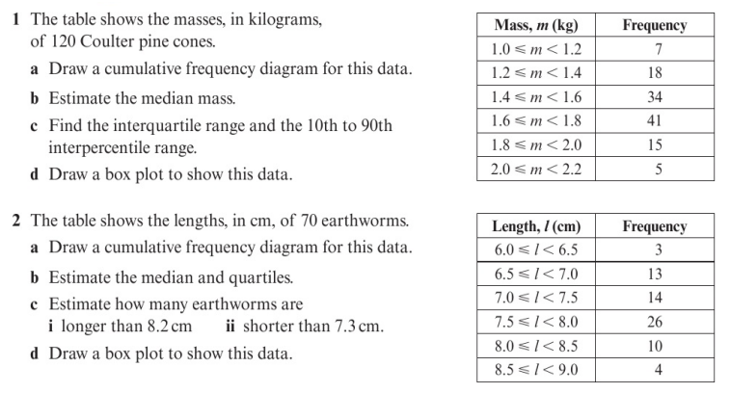
Homework Exercise

Slide 6
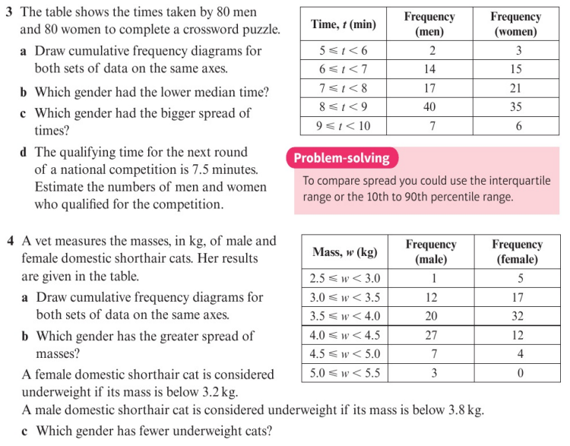
Homework Exercise

Slide 7
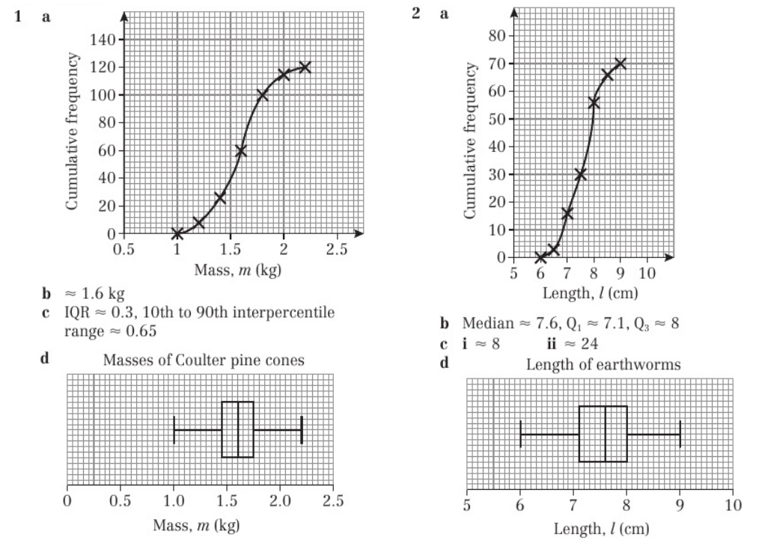
Homework Answers

Slide 8
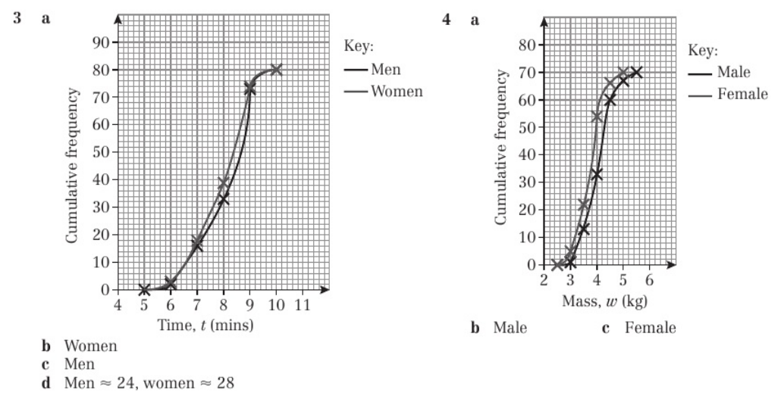
Homework Answers

