Slide 1
P2 Chapter 3: Sequences and Series
Arithmetic Series

Slide 2





Types of sequences
common difference $d$
?
+3
+3
+3
This is a:
2, 5, 8, 11, 14, …
?
Arithmetic Sequence
! An arithmetic sequence is one which has a common difference between terms.
common ratio $r$
?
$$×2$$
$$×2$$
$$×2$$
?
3, 6, 12, 24, 48, …
Geometric Sequence
(We will explore these later in the chapter)
?
This is the Fibonacci Sequence. The terms follow a recurrence relation because each term can be generated using the previous ones.
We will encounter recurrence relations later in the chapter.
1, 1, 2, 3, 5, 8, …

Slide 3
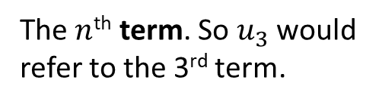

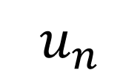

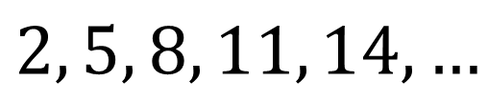
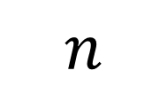
The fundamentals of sequences
$$u_{n}$$
? Meaning
The $n$^{th} term. So $u_{3}$ would refer to the 3rd term.
$$n$$
? Meaning
The position of the term in the sequence.
?
?
$$n=3$$
$$u_{3}=8$$
?
$$2, 5, 8, 11, 14, …$$

Slide 4

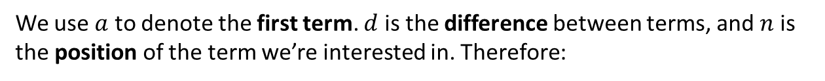



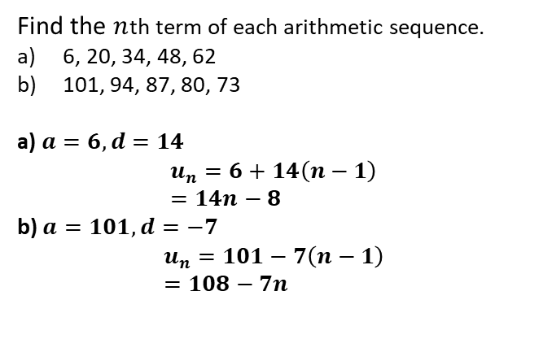

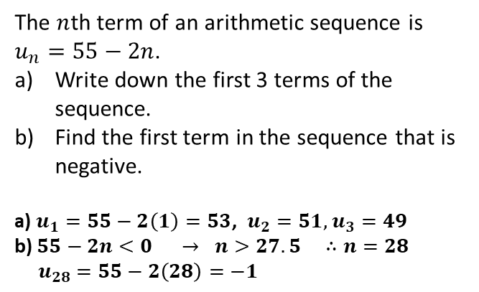

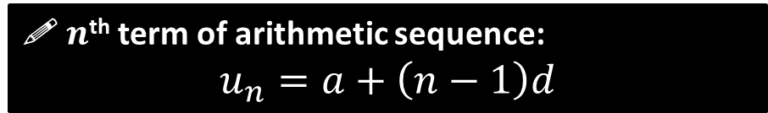
$n$^{th} term of an arithmetic sequence
We use $a$ to denote the first term. $d$ is the difference between terms, and $n$ is the position of the term we’re interested in. Therefore:
1st Term
2nd Term
3rd Term
. . .
$n$^{th} term
?
?
?
?
$$a$$
$$a+d$$
$$a+2d$$
. . .
$$a+(n−1)d$$
! $n$^{th} term of arithmetic sequence:
$$u_{n}=a+\left(n−1\right)d$$
Example 1
Example 2
The $n$th term of an arithmetic sequence is $u_{n}=55−2n$.
Write down the first 3 terms of the sequence.
Find the first term in the sequence that is negative.
a) $u_{1}=55−2\left(1\right)=53$, $u_{2}=51,$ $u_{3}=49$
b) $55−2n<0 → n>27.5 ∴n=28$
$u_{28}=55−2\left(28\right)=−1$
Find the $n$th term of each arithmetic sequence.
6, 20, 34, 48, 62
101, 94, 87, 80, 73
a) $a=6, d=14$
$$u_{n}=6+14\left(n−1\right) \\ =14n−8$$
b) $a=101, d=−7$
$$u_{n}=101−7\left(n−1\right) \\ =108−7n$$
Fro Tip: Always write out $a=, d=, n=$ first.
?
?
?
?

Slide 5
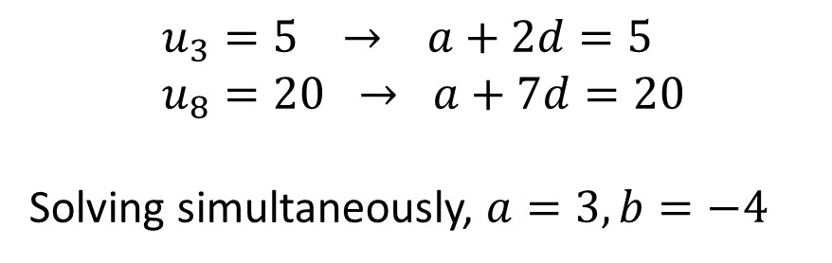
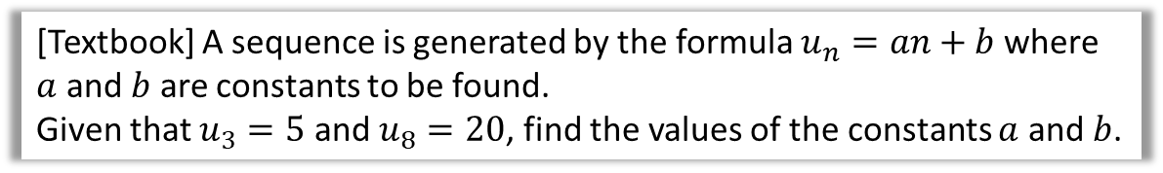
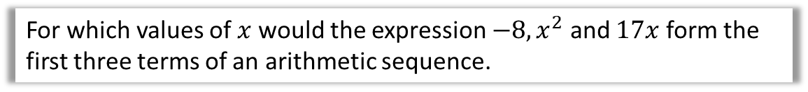
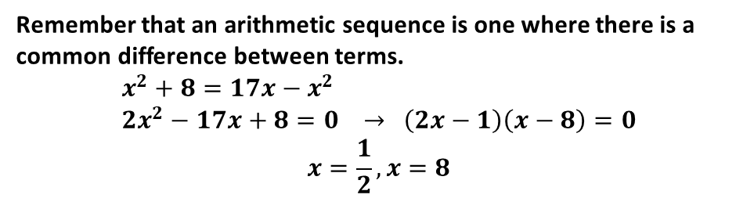
Further Examples
[Textbook] A sequence is generated by the formula $u_{n}=an+b$ where $a$ and $b$ are constants to be found.
Given that $u_{3}=5$ and $u_{8}=20$, find the values of the constants $a$ and $b$.
?
$$u_{3}=5 → a+2d=5 \\ u_{8}=20 → a+7d=20$$
Solving simultaneously, $a=3, b=−4$
For which values of $x$ would the expression $−8, x^{2}$ and $17x$ form the first three terms of an arithmetic sequence.
?
Remember that an arithmetic sequence is one where there is a common difference between terms.
$$x^{2}+8=17x−x^{2} \\ 2x^{2}−17x+8=0 → \left(2x−1\right)\left(x−8\right)=0$$
$$x=\frac{1}{2}, x=8$$

Slide 6
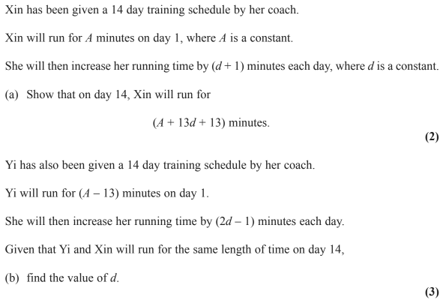
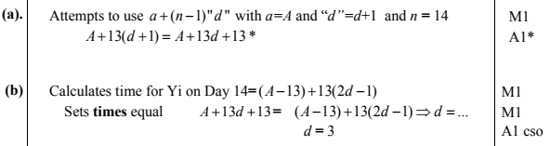
Test Your Understanding
Edexcel C1 May 2014(R) Q10
?
?

Slide 7
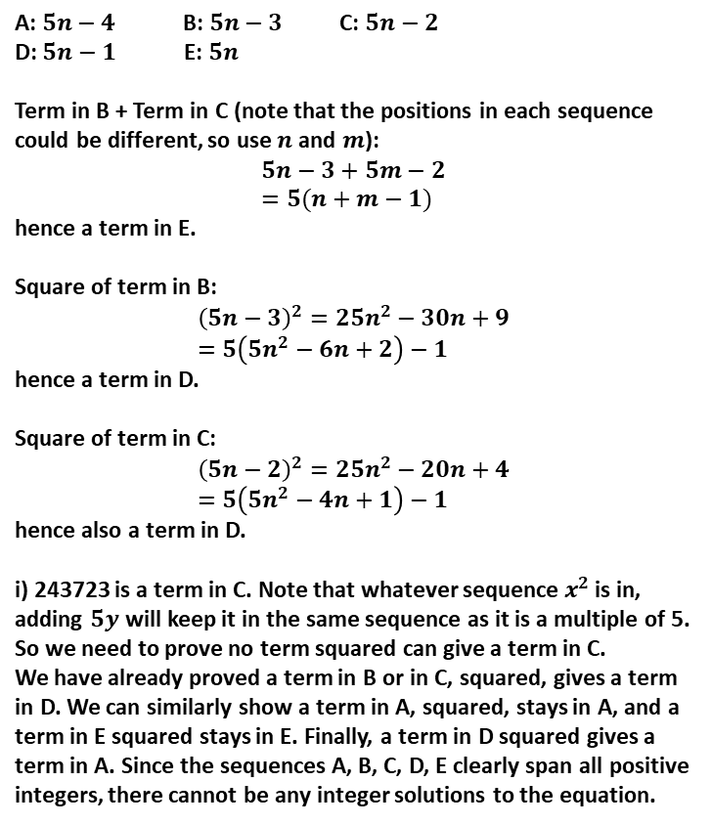
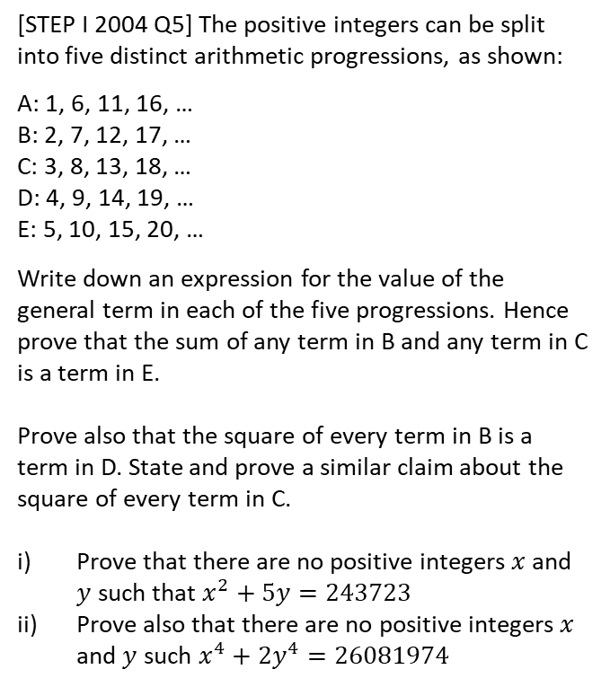
Exercise 3.1
Pearson Pure Mathematics Year 2/AS
Page 17
A: $5n−4$ B: $5n−3$ C: $5n−2$
D: $5n−1$ E: $5n$
Term in B + Term in C (note that the positions in each sequence could be different, so use $n$ and $m$):
$$5n−3+5m−2 \\ =5(n+m−1)$$
hence a term in E.
Square of term in B:
$${\left(5n−3\right)}^{2}=25n^{2}−30n+9 \\ =5\left(5n^{2}−6n+2\right)−1$$
hence a term in D.
Square of term in C:
$${\left(5n−2\right)}^{2}=25n^{2}−20n+4 \\ =5\left(5n^{2}−4n+1\right)−1$$
hence also a term in D.
i) 243723 is a term in C. Note that whatever sequence $x^{2}$ is in, adding $5y$ will keep it in the same sequence as it is a multiple of 5. So we need to prove no term squared can give a term in C.
We have already proved a term in B or in C, squared, gives a term in D. We can similarly show a term in A, squared, stays in A, and a term in E squared stays in E. Finally, a term in D squared gives a term in A. Since the sequences A, B, C, D, E clearly span all positive integers, there cannot be any integer solutions to the equation.
Extension
?
1
[STEP I 2004 Q5] The positive integers can be split into five distinct arithmetic progressions, as shown:
A: 1, 6, 11, 16, …
B: 2, 7, 12, 17, …
C: 3, 8, 13, 18, …
D: 4, 9, 14, 19, …
E: 5, 10, 15, 20, …
Write down an expression for the value of the general term in each of the five progressions. Hence prove that the sum of any term in B and any term in C is a term in E.
Prove also that the square of every term in B is a term in D. State and prove a similar claim about the square of every term in C.
Prove that there are no positive integers $x$ and $y$ such that $x^{2}+5y=243723$
Prove also that there are no positive integers $x$ and $y$ such $x^{4}+2y^{4}=26081974$

Slide 8
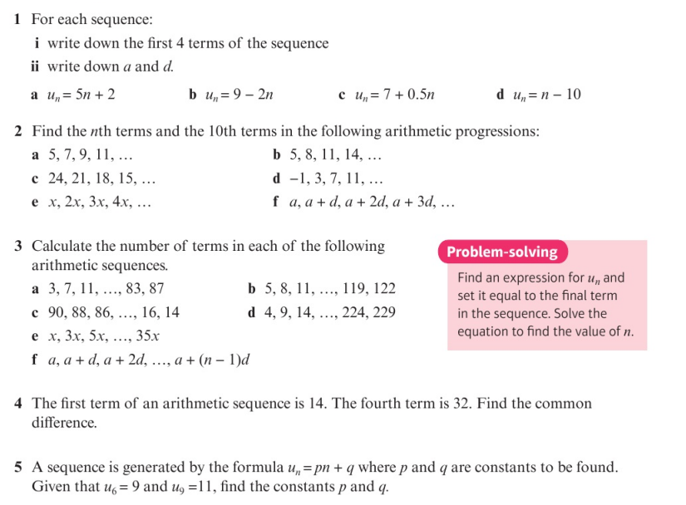
Homework Exercise

Slide 9
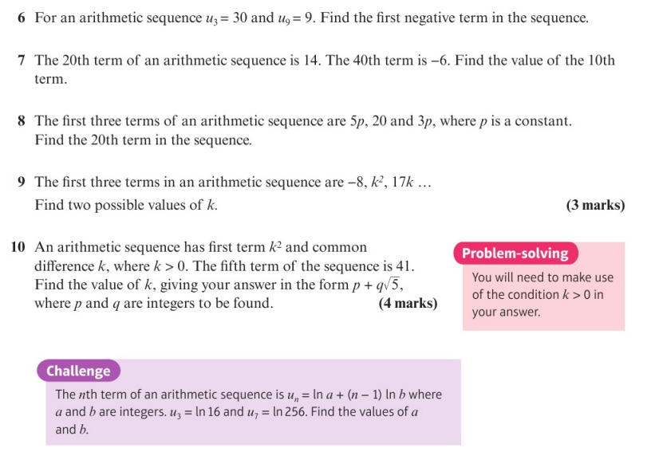
Homework Exercise

Slide 10
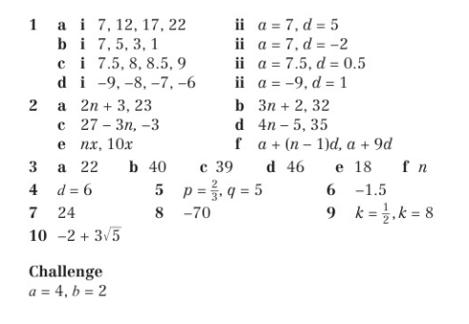
Homework Answers

