Slide 1
P2 Chapter 7: Trigonometric Equations
Double Angle Formulae

Slide 2
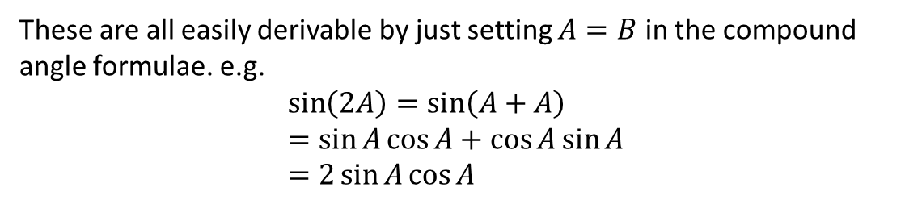
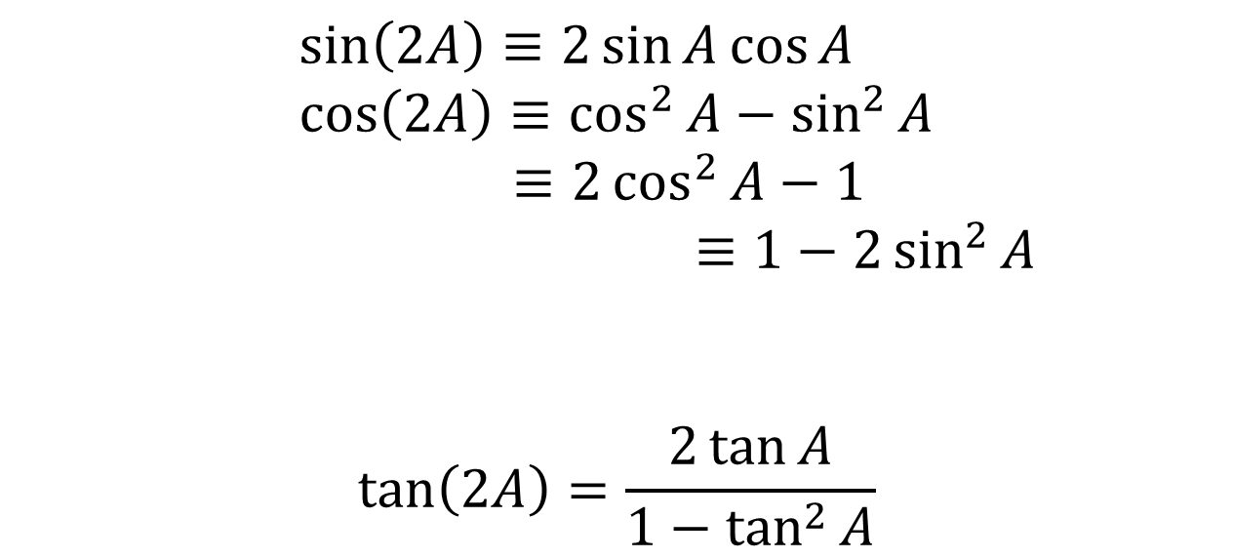
Double Angle Formulae
Double-angle formula allow you to halve the angle within a trig function.
!
This first form is relatively rare.
$$\sin\left(2A\right)≡2\sin{A}\cos{A} \\ \cos\left(2A\right)≡\cos^{2}{A}−\sin^{2}{A}$$
$≡2\cos^{2}{A}−1$
$$≡1−2\sin^{2}{A}$$
$$\tan\left(2A\right)=\frac{2\tan{A}}{1−\tan^{2}{A}}$$
Tip: Way to remember which way round these go is that the cos on the RHS is ‘attracted’ to the cos on the LHS, whereas the sin is pushed away.
These are all easily derivable by just setting $A=B$ in the compound angle formulae. e.g.
$$\sin\left(2A\right)=\sin\left(A+A\right) \\ =\sin{A}\cos{A}+\cos{A}\sin{A} \\ =2\sin{A}\cos{A}$$

Slide 3

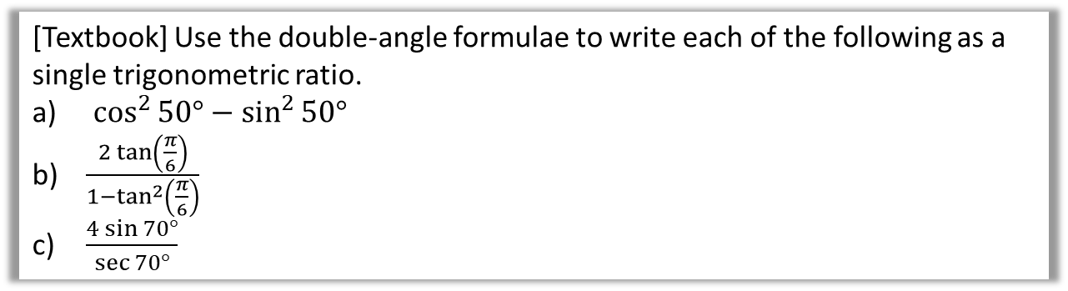

Examples
[Textbook] Use the double-angle formulae to write each of the following as a single trigonometric ratio.
$\cos^{2}{50°}−\sin^{2}{50° }$
$\frac{2\tan\left(\frac{π}{6}\right)}{1−\tan^{2}\left(\frac{π}{6}\right)}$
$\frac{4\sin{70°}}{\sec{70°}}$
$$\sin{2x}=2\sin{x}\cos{x} \\ \cos{2x}=\cos^{2}{x}−\sin^{2}{x} \\ =2\cos^{2}{x}−1 \\ =1−2\sin^{2}{x} \\ \tan{2x}=\frac{2\tan{x}}{1−\tan^{2}{x}}$$
a
This matches $\cos\left(2A\right)=\cos^{2}{A}−\sin^{2}{A}$:
$$\cos^{2}{50°}−\sin^{2}{50° }=\cos\left(100°\right)$$
This matches $\tan\left(2A\right)=\frac{2\tan{A}}{1−\tan^{2}{A}}$
$$\frac{2\tan\left(\frac{π}{6}\right)}{1−\tan^{2}\left(\frac{π}{6}\right)}=\tan\left(\frac{π}{3}\right)$$
$$\frac{4\sin{70°}}{\sec{70°}}=\frac{4\sin{70°}}{1÷\cos{70°}}=4\sin{70°}\cos{70°}$$
This matches $\sin\left(2A\right)=2\sin{A}\cos{A}$
$$4\sin{70°} cos70°=2\sin{140°}$$
?
b
?
c
?

Slide 4

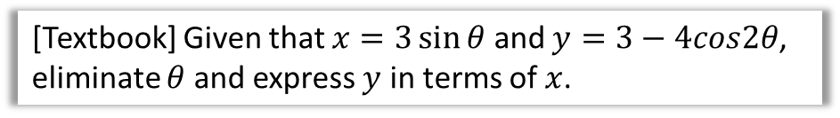

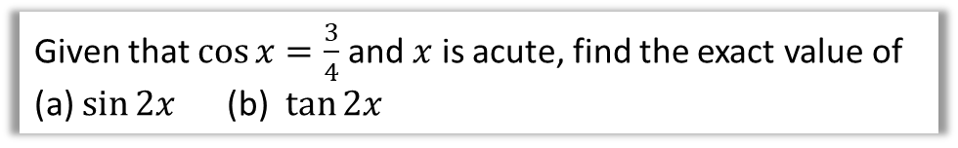

Examples
[Textbook] Given that $x=3\sin{θ}$ and $y=3−4cos2θ$, eliminate $θ$ and express $y$ in terms of $x$.
$$\sin{2x}=2\sin{x}\cos{x} \\ \cos{2x}=\cos^{2}{x}−\sin^{2}{x} \\ =2\cos^{2}{x}−1 \\ =1−2\sin^{2}{x} \\ \tan{2x}=\frac{2\tan{x}}{1−\tan^{2}{x}}$$
?
$$y=3−4\left(1−2\sin^{2}{θ}\right)$$
$$=8\sin^{2}{θ}−1$$
$$\sin{θ}=\frac{x}{3}$$
$$∴y=8{\left(\frac{x}{3}\right)}^{2}−1$$
Note: This question is an example of turning a set of parametric equations into a single Cartesian one. You will cover this in the next chapter.
Given that $\cos{x}=\frac{3}{4}$ and $x$ is acute, find the exact value of
(a) $\sin{2x}$ (b) $\tan{2x}$
?
Since $sin^{2}x+cos^{2}x=1$, $sin x=±\sqrt{1−cos^{2}x}$
$sin x=\sqrt{1−{\left(\frac{3}{4}\right)}^{2}}=\frac{\sqrt{7}}{4}$ (and is positive given $0<x<90°$)
$$∴sin 2x=2sin x cos x=2×\frac{\sqrt{7}}{4}×\frac{3}{4}=\frac{3\sqrt{7}}{8}$$
$$tan x=\frac{sin x}{cos}=\frac{3\sqrt{7}/8}{3/4}=\frac{\sqrt{7}}{3} ∴tan2x=\frac{2×\frac{\sqrt{7}}{3}}{1−{\left(\frac{\sqrt{7}}{3}\right)}^{2}}=3\sqrt{7}$$

Slide 5
Exercise 7.3
Pearson Pure Mathematics Year 2/AS
Page 50

Slide 6
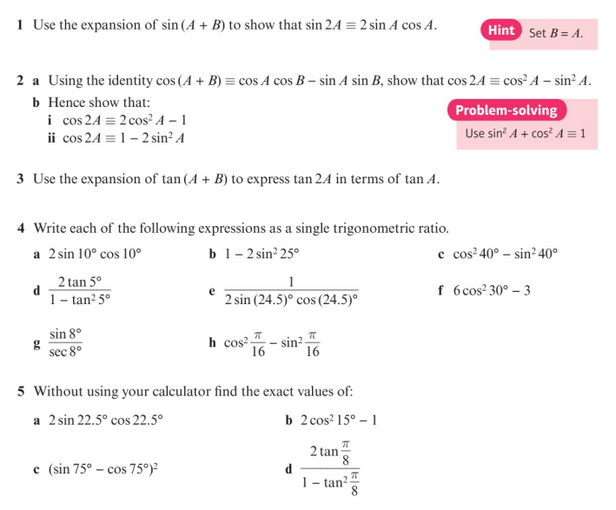
Homework Exercise

Slide 7
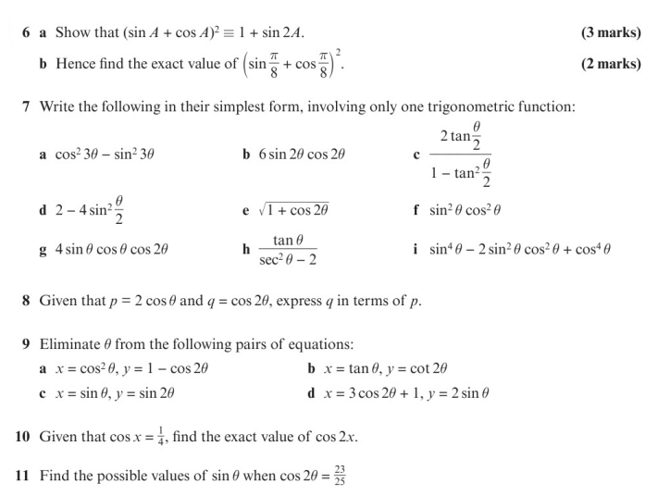
Homework Exercise

Slide 8
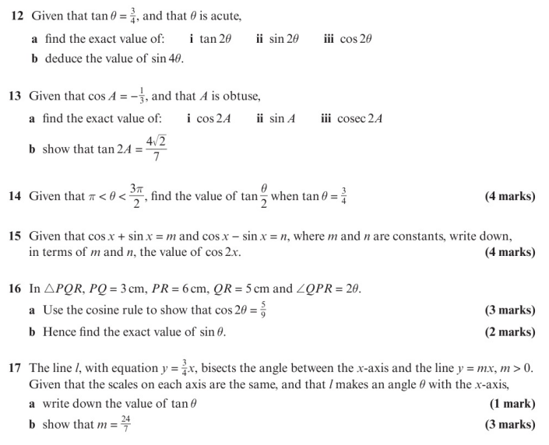
Homework Exercise

Slide 9
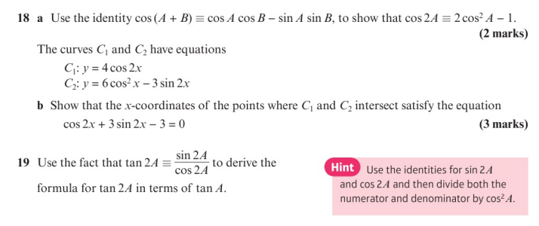
Homework Exercise

Slide 10
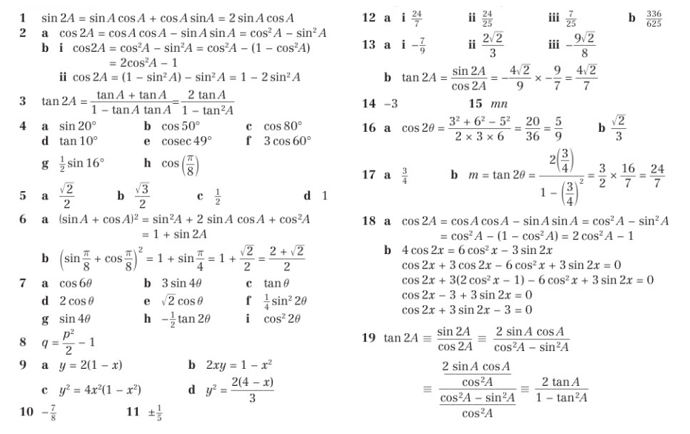
Homework Answers

