Slide 1
M2 Chapter 8: Further Kinematics Acceleration Functions

Slide 2








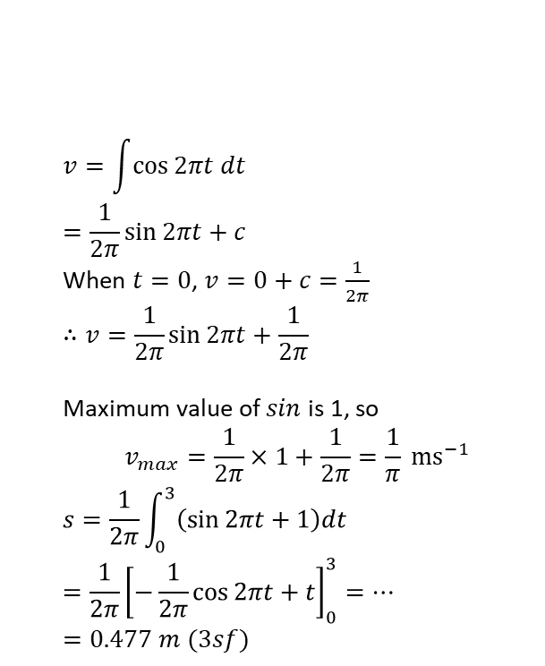


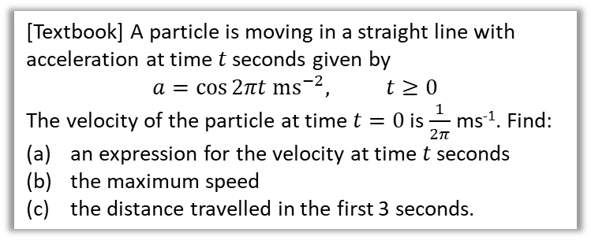

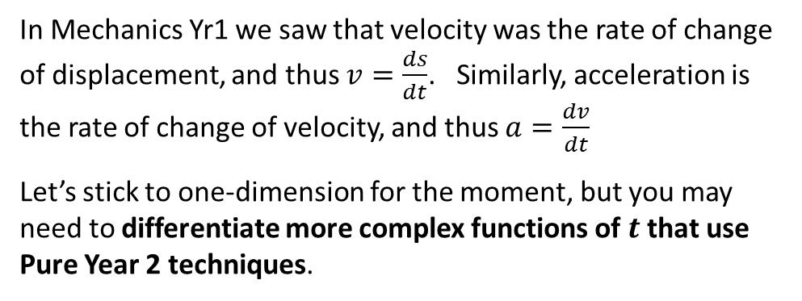

Variable Acceleration in One Dimension
In Mechanics Yr1 we saw that velocity was the rate of change of displacement, and thus $v=\frac{ds}{dt}$. Similarly, acceleration is the rate of change of velocity, and thus $a=\frac{dv}{dt}$
Let’s stick to one-dimension for the moment, but you may need to differentiate more complex functions of $t$ that use Pure Year 2 techniques.
$$s$$
$$∫v dt$$
$$\frac{d}{dt}$$
$$v$$
$$∫a dt$$
$$\frac{d}{dt}$$
$$a$$
a
$$v=\int{\cos{2πt dt}} \\ =\frac{1}{2π}\sin{2πt}+c$$
When $t=0$, $v=0+c=\frac{1}{2π}$ $$∴v=\frac{1}{2π}\sin{2πt}+\frac{1}{2π}$$
Maximum value of $sin$ is 1, so
$$v_{max}=\frac{1}{2π}×1+\frac{1}{2π}=\frac{1}{π} ms^{−1}$$
$$s=\frac{1}{2π}\int_{0}^{3}{\left(\sin{2πt}+1\right)dt} \\ =\frac{1}{2π}{\left[−\frac{1}{2π}\cos{2πt}+t\right]}_{0}^{3}=…=0.477 m (3sf)$$
?
[Textbook] A particle is moving in a straight line with acceleration at time $t$ seconds given by
$$a=\cos{2πt ms^{−2}, t≥0}$$
The velocity of the particle at time $t=0$ is $\frac{1}{2π}$ ms⁻¹. Find:
an expression for the velocity at time $t$ seconds
the maximum speed
the distance travelled in the first 3 seconds.
Remember with ‘reverse chain rule’, we divide by constant in front of variable.
b
?
$$sin⁡(πt)$$
$$\frac{d}{dt}$$
$$∫ dt$$
c
Finding area under velocity-time graph.
?
$$πcos(πt)$$
$$∫ dt$$
$$\frac{d}{dt}$$
Can tidy up integral by factorising out common factor.
$$−π^{2}sin⁡(πt)$$

Slide 3



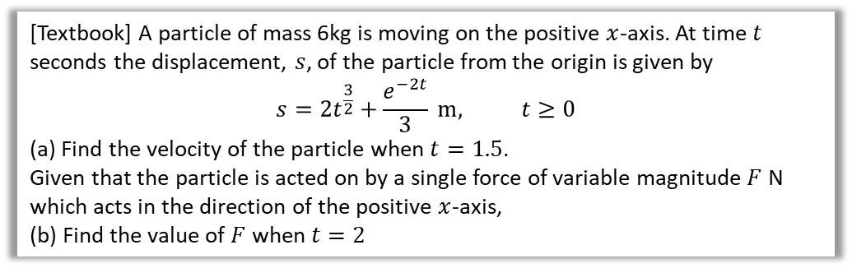



Test Your Understanding
[Textbook] A particle of mass 6kg is moving on the positive $x$-axis. At time $t$ seconds the displacement, $s$, of the particle from the origin is given by
$$s=2t^{\frac{3}{2}}+\frac{e^{−2t}}{3} m, t≥0$$
(a) Find the velocity of the particle when $t=1.5$.
Given that the particle is acted on by a single force of variable magnitude $F$ N which acts in the direction of the positive $x$-axis,
(b) Find the value of $F$ when $t=2$
a
$v=\frac{ds}{dt}=3t^{\frac{1}{2}}−\frac{2}{3}e^{−2t} ms^{−1}$
When $t=1.5$ seconds:
$$v=3×{1.5}^{0.5}−\frac{2}{3}e^{−3}=3.64 ms^{−1}$$
$$a=\frac{dv}{dt}=1.5t^{−0.5}+\frac{4}{3}e^{−4}=1.0850…ms^{−2} \\ F=ma=6×1.0850…=6.51 N$$
?
$$e^{πt}$$
$$\frac{d}{dt}$$
$$∫ dt$$
$$πe^{πt}$$
$$∫ dt$$
$$\frac{d}{dt}$$
$$−π^{2}e^{πt}$$
b
?

Slide 4
Exercise 8.3
Pearson Stats/Mechanics Year 2
Pages 71-72

Slide 5
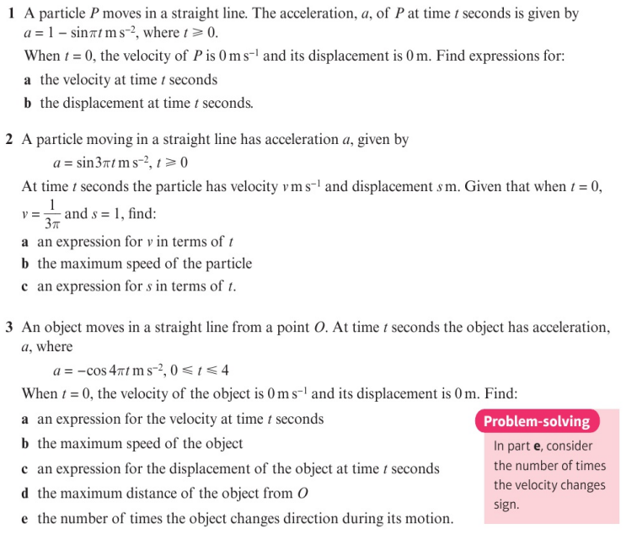
Homework Exercise

Slide 6
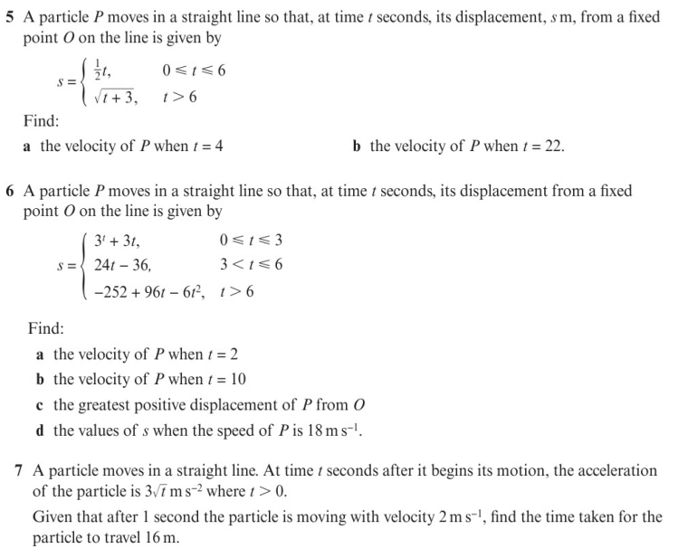
Homework Exercise

Slide 7
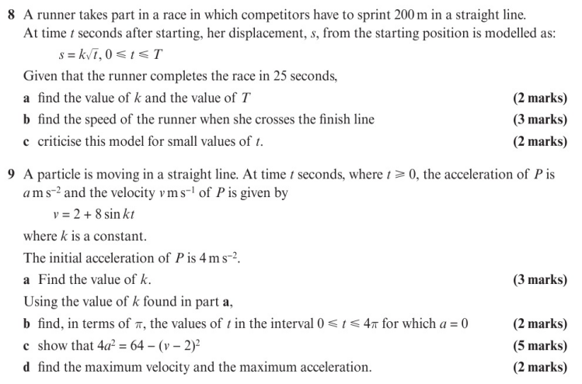
Homework Exercise

Slide 8
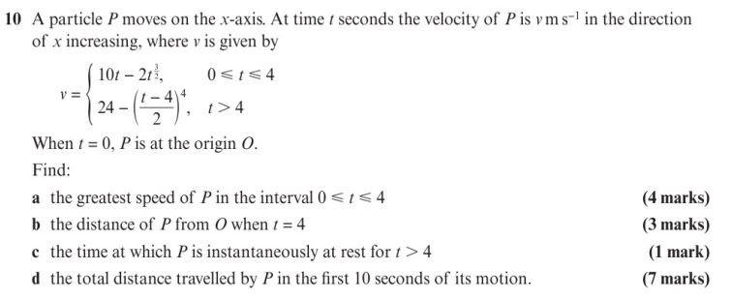
Homework Exercise

Slide 9
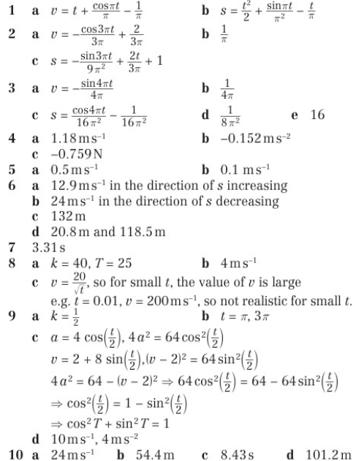
Homework Answers

