Slide 1
M2 Chapter 7: Application of Forces Static Rigid Bodies

Slide 2





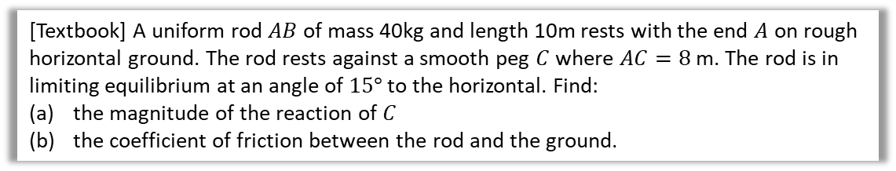









Static rigid bodies
Recall from the chapter on moments that for a stationary rigid body:
The resultant force is 0.
The resultant moment is 0.
The problems are the same as in the moments chapter, except now we may need to consider frictional forces.
[Textbook] A uniform rod $AB$ of mass 40kg and length 10m rests with the end $A$ on rough horizontal ground. The rod rests against a smooth peg $C$ where $AC=8$ m. The rod is in limiting equilibrium at an angle of $15°$ to the horizontal. Find:
the magnitude of the reaction of $C$
the coefficient of friction between the rod and the ground.
? Diagram
a
Taking moments about A:
$$40g×5\cos{15°}=P×8 \\ P=236.65$$
The normal support at $C$ has magnitude 240N (2sf).
$$R\left(→\right): μN=P\sin{15°}=61.25 \\ R\left(↑\right): N+P\cos{15°}=40g \\ ∴N=40g−P\cos{15°}=163.41 \\ ∴μ=\frac{61.25}{163.41}=0.37 (2sf)$$
$$P$$
?
$$15°$$
$$2 m$$
$$B$$
$$N$$
$$C$$
$$5 m$$
$$3 m$$
b
?
$$40g$$
This frictional force prevents the rod slides against the ground.
$$A$$
$$15°$$
$$μN$$
?
$$5\cos{15° m}$$

Slide 3



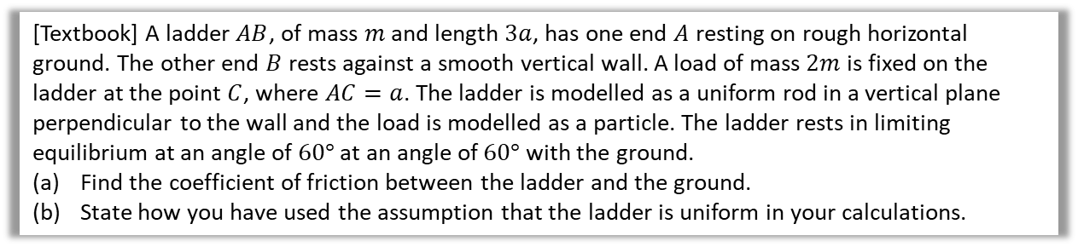







Further Example
[Textbook] A ladder $AB$, of mass $m$ and length $3a$, has one end $A$ resting on rough horizontal ground. The other end $B$ rests against a smooth vertical wall. A load of mass $2m$ is fixed on the ladder at the point $C$, where $AC=a$. The ladder is modelled as a uniform rod in a vertical plane perpendicular to the wall and the load is modelled as a particle. The ladder rests in limiting equilibrium at an angle of $60°$ at an angle of $60°$ with the ground.
Find the coefficient of friction between the ladder and the ground.
State how you have used the assumption that the ladder is uniform in your calculations.
? Diagram
?
$$P$$
$$B$$
a
$$R\left(→\right):μN=P \\ R\left(↑\right): N=2mg+mg=3mg$$
Taking moments about $B$:
$$\left(2mg×2a\cos{60°}\right)+\left(mg×1.5a\cos{60°}\right)+\left(μN×3a\sin{60°}\right)=N×3a\cos{60°}$$
$$2.75mg+\frac{3\sqrt{3}}{2}μR=1.5$$
$$2.75mg+\frac{3\sqrt{3}}{2}μ\left(3mg\right)=1.5\left(3mg\right) \\ 2.75+\frac{9\sqrt{3}}{2}μ=4.5 \\ μ=0.225 (3sf)$$
You can assume its weight acts at its midpoint.
?
$$1.5a$$
?
$$0.5a$$
$$C$$
$$mg$$
$$N$$
$$a$$
$$2mg$$
$$60°$$
$$A$$
$$μN$$
As before, two different reaction forces so need different variables.
b
?

Slide 4
Exercise 7.4
Pearson Stats/Mechanics Year 2
Pages 60-61

Slide 5
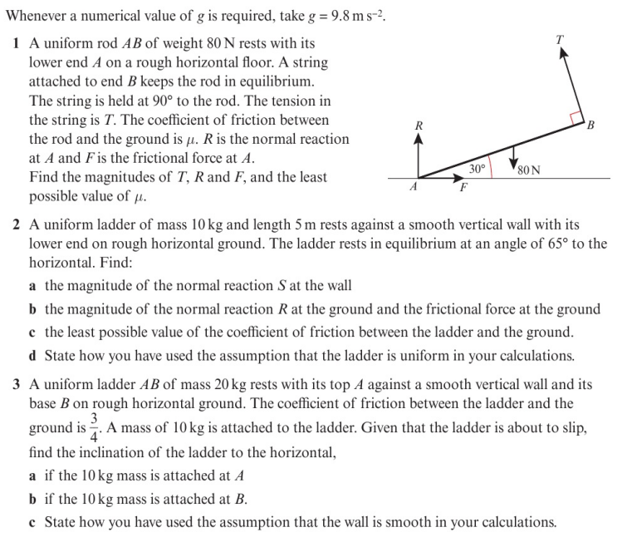
Homework Exercise

Slide 6
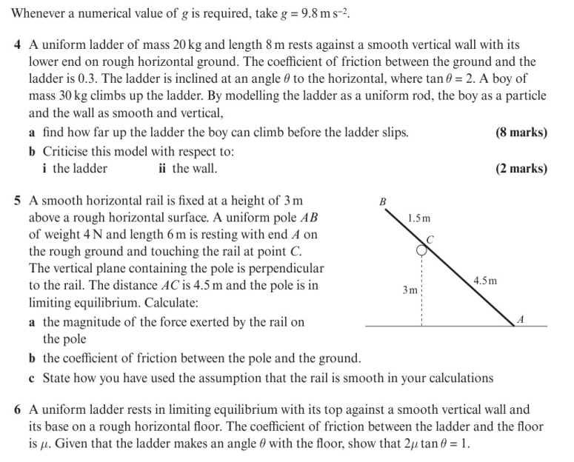
Homework Exercise

Slide 7
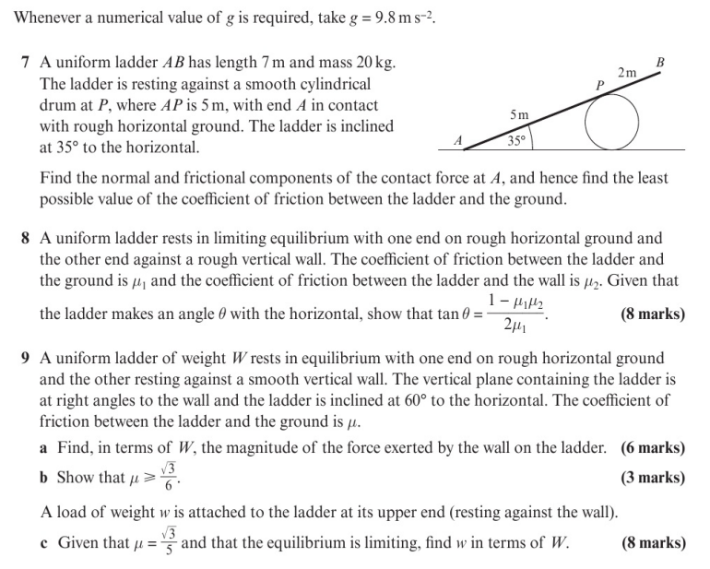
Homework Exercise

Slide 8
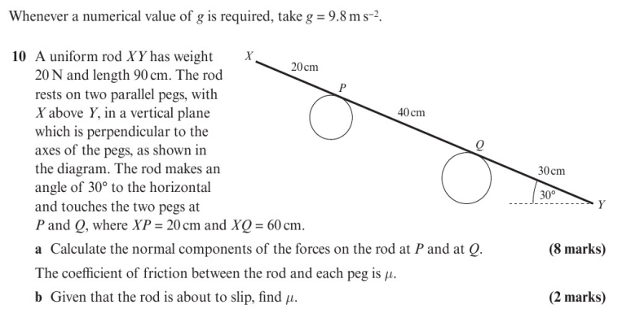
Homework Exercise

Slide 9
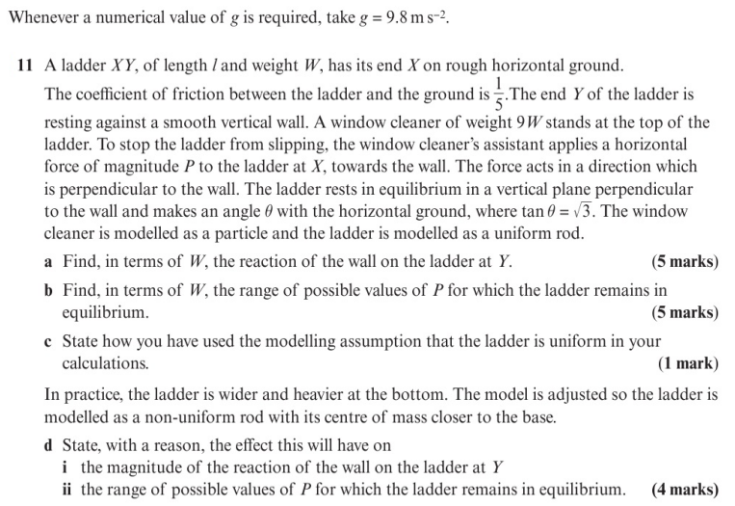
Homework Exercise

Slide 10
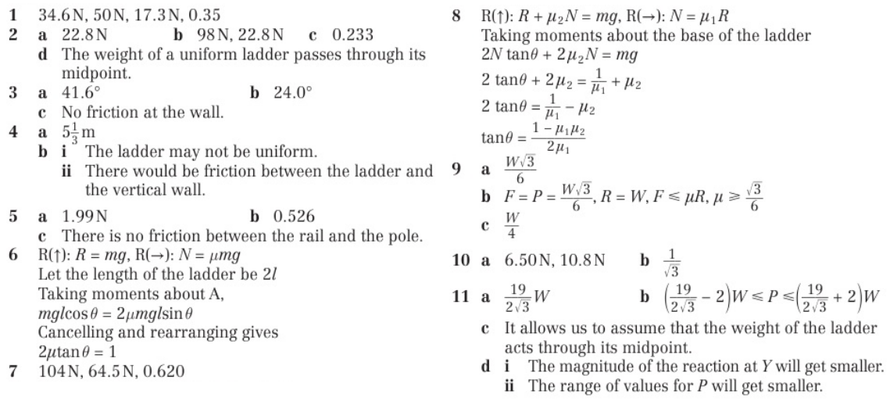
Homework Answers

