Slide 1

P1 Chapter 1 :: Algebraic Expressions
jfrost@tiffin.kingston.sch.uk
www.drfrostmaths.com @DrFrostMaths
Last modified: 7th September 2020

Slide 2




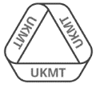
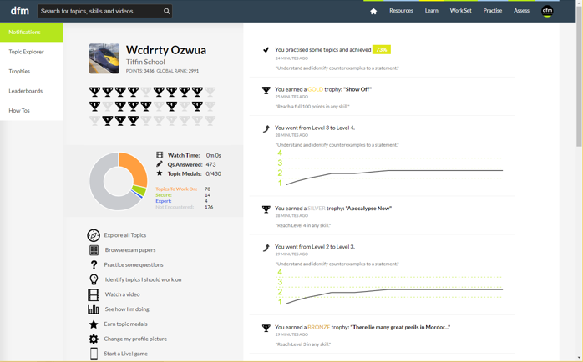
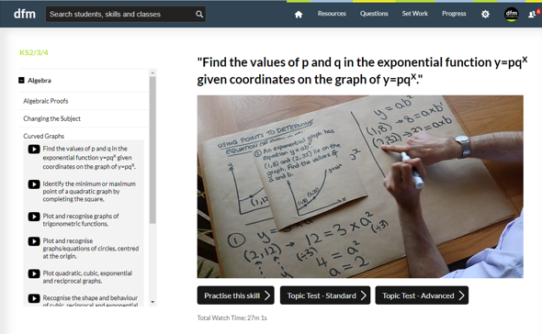
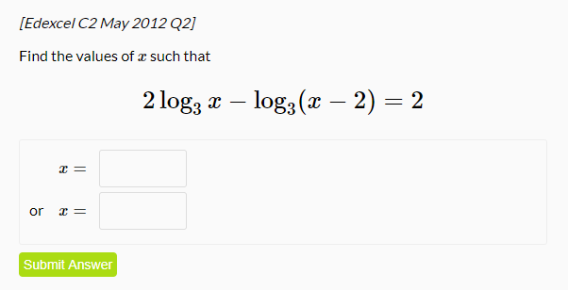
www.drfrostmaths.com
Everything is completely free.
Why not register?
Register now to interactively practise questions on this topic, including past paper questions and extension questions (including MAT + UKMT).
Teachers: you can create student accounts (or students can register themselves), to set work, monitor progress and even create worksheets.
With questions by:
Dashboard with points, trophies, notifications and student progress.
Questions organised by topic, difficulty and past paper.
Teaching videos with topic tests to check understanding.

Slide 3
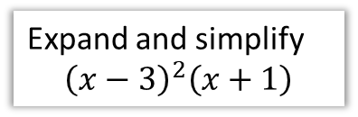
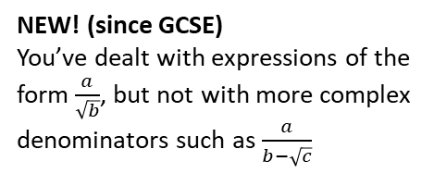
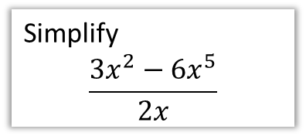
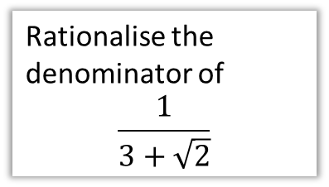
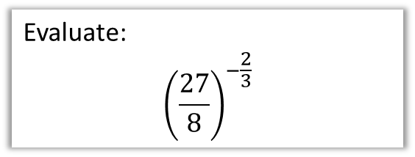
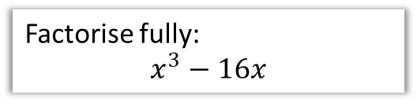
Chapter Overview
As a relatively gentle introduction to Pure, most of this chapter is a recap of core GCSE algebraic skills.
1:: Basic Index Laws
2:: Expand brackets
Simplify
$$\frac{3x^{2}−6x^{5}}{2x}$$
Expand and simplify
$${\left(x−3\right)}^{2}\left(x+1\right)$$
4:: Fractional/Negative Powers
3:: Factorise quadratics/cubics
Evaluate:
$${\left(\frac{27}{8}\right)}^{−\frac{2}{3}}$$
Factorise fully:
$$x^{3}−16x$$
NEW! (since GCSE)
You may have to combine factorisation techniques to factorise cubics.
5:: Surds
Rationalise the denominator of
$$\frac{1}{3+\sqrt{2}}$$
NEW! (since GCSE)
You’ve dealt with expressions of the form $\frac{a}{\sqrt{b}}$, but not with more complex denominators such as $\frac{a}{b−\sqrt{c}}$

Slide 4


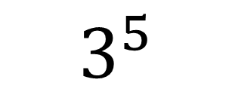


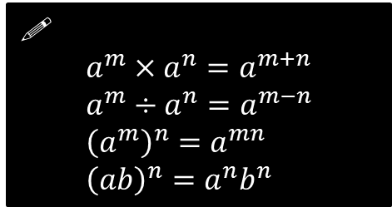



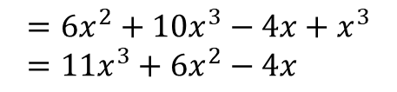

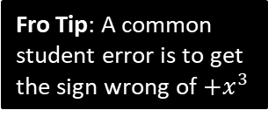
1 :: Index Laws
exponent or index (plural: indices)
base
!
$$a^{m}×a^{n}=a^{m+n} \\ a^{m}÷a^{n}=a^{m−n} \\ {\left(a^{m}\right)}^{n}=a^{mn} \\ {\left(ab\right)}^{n}=a^{n}b^{n}$$
$$3^{5}$$
power
Some also refer to the 5 as the ‘power’. But this would lead to unfortunate ambiguous phrases like “when we multiply two powers together, we add the powers” instead of “when we multiply two powers together, we add the indices”.
Simplify ${\left(a^{3}\right)}^{2}×2a^{2}$
Simplify ${\left(4x^{3}y\right)}^{3}$
?
?
$$=a^{6}×2a^{2}=2a^{8}$$
$$=64x^{9}y^{3}$$
Simplify $2x^{2}\left(3+5x\right)−x\left(4−x^{2}\right)$
Simplify $\frac{x^{3}−2x}{3x^{2}}$
?
?
$$=6x^{2}+10x^{3}−4x+x^{3} \\ =11x^{3}+6x^{2}−4x$$
$$=\frac{x^{3}}{{3x}^{2}}−\frac{2x}{3x^{2}} \\ =\frac{1}{3}x−\frac{2}{3x}$$
Fro Tip: A common student error is to get the sign wrong of $+x^{3}$
Fro Tip: While $\frac{a+b}{c}$ can be split into $\frac{a}{c}+\frac{b}{c}$, a common student error is to think that $\frac{a}{b+c}=\frac{a}{b}+\frac{a}{c}$

Slide 5

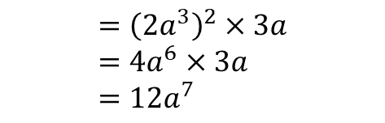




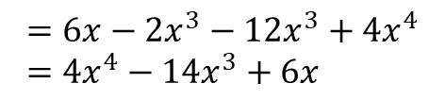

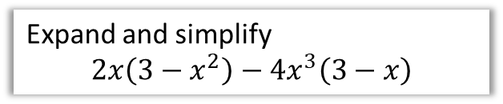
Test Your Understanding
1
Simplify ${\left(\frac{2a^{5}}{a^{2}}\right)}^{2}×3a$
2
Simplify $\frac{2x+x^{5}}{4x^{3}}$
?
?
$$={\left(2a^{3}\right)}^{2}×3a \\ =4a^{6}×3a \\ =12a^{7}$$
$$=\frac{1}{2}x^{−2}+\frac{1}{4}x^{2}$$
or $\frac{1}{2x^{2}}+\frac{x^{2}}{4}$
3
Expand and simplify
$$2x\left(3−x^{2}\right)−4x^{3}\left(3−x\right)$$
4
Simplify $2^{x}×3^{x}$
?
$$=6^{x}$$
Fro Note: This is using ${\left(ab\right)}^{n}=a^{n}b^{n}$ law backwards.
?
$$=6x−2x^{3}−12x^{3}+4x^{4} \\ =4x^{4}−14x^{3}+6x$$

Slide 6
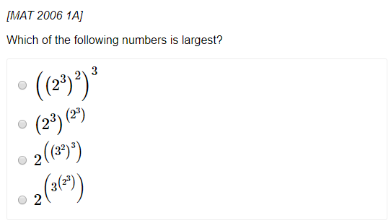
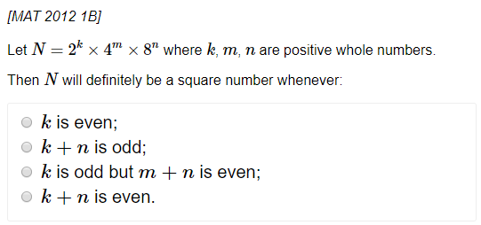
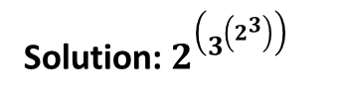
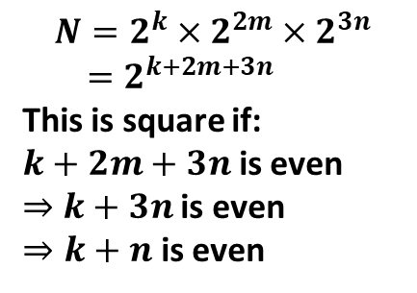
Exercise 1A
Pearson Pure Mathematics Year 1/AS
Page 3
Extension (Full Database: http://www.drfrostmaths.com/resources/resource.php?rid=268 )
1
2
?
$$N=2^{k}×2^{2m}×2^{3n} \\ =2^{k+2m+3n}$$
This is square if:
$k+2m+3n$ is even
$⇒$ $k+3n$ is even
$⇒k+n$ is even
?
Solution: $2^{\left(3^{\left(2^{3}\right)}\right)}$

Slide 7






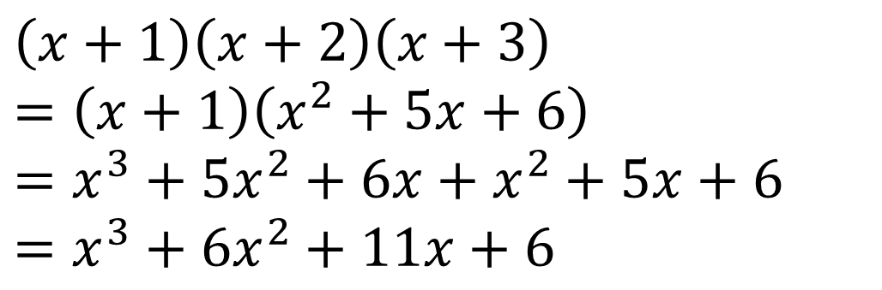


2 :: Expanding Brackets
If you have ever been taught ‘FOIL’ to multiply brackets please purge it from your mind now – instead:
Multiply each term in the first bracket by each term in the second.
$$\left(x−y\right)\left(x+y−1\right)$$
Fro Tip: My order is “first term in first brackets times each in second, then second term in first bracket times each in second, etc.”
$$=x^{2}$$
$$+xy$$
$$−x$$
$$−xy$$
$$−y^{2}$$
$$+y$$
$$=x^{2}−y^{2}−x+y$$
Fro Tip: For more than 2 brackets, multiply two out each time to reduce the number of brackets by one.
$$\left(x+1\right)\left(x+2\right)\left(x+3\right) \\ =\left(x+1\right)\left(x^{2}+5x+6\right) \\ =x^{3}+5x^{2}+6x+x^{2}+5x+6 \\ =x^{3}+6x^{2}+11x+6$$
?

Slide 8
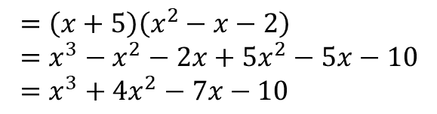
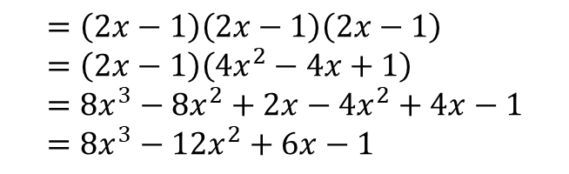
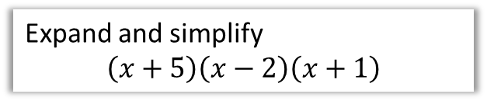
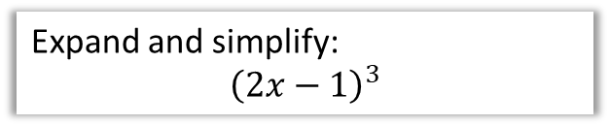
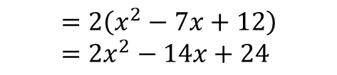
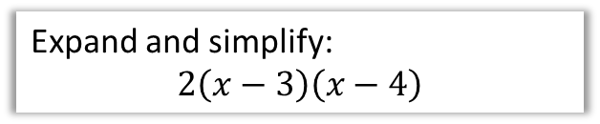
Test Your Understanding
1
Expand and simplify
$$\left(x+5\right)\left(x−2\right)\left(x+1\right)$$
2
Expand and simplify:
$$2\left(x−3\right)\left(x−4\right)$$
?
?
$$=\left(x+5\right)\left(x^{2}−x−2\right) \\ =x^{3}−x^{2}−2x+5x^{2}−5x−10 \\ =x^{3}+4x^{2}−7x−10$$
$$=2\left(x^{2}−7x+12\right) \\ =2x^{2}−14x+24$$
3
Expand and simplify:
$${\left(2x−1\right)}^{3}$$
?
$$=\left(2x−1\right)\left(2x−1\right)\left(2x−1\right) \\ =\left(2x−1\right)\left(4x^{2}−4x+1\right) \\ =8x^{3}−8x^{2}+2x−4x^{2}+4x−1 \\ =8x^{3}−12x^{2}+6x−1$$

Slide 9
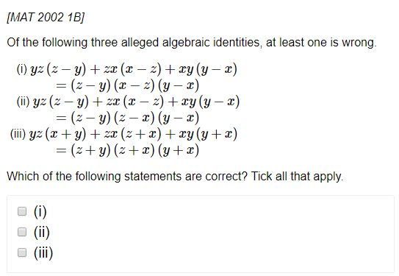
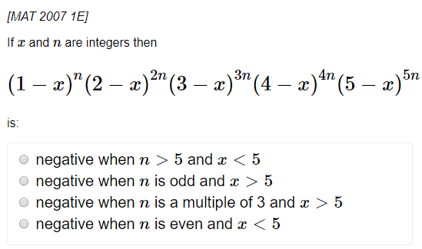

Exercise 1B
Pearson Pure Mathematics Year 1/AS
Page 5
Extension (Full Database: http://www.drfrostmaths.com/resources/resource.php?rid=268 )
1
2
?
?
Solution: (ii) only
Solution: $n$ is odd and $x>5$

Slide 10
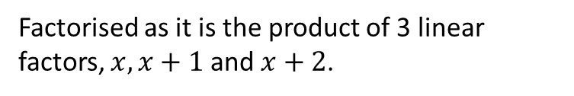

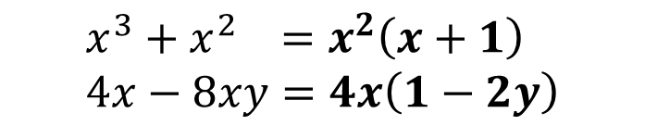

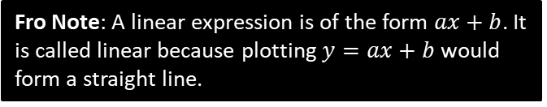
3 :: Factorising
Informally, factorising is the opposite of expanding brackets.
More formally, a factorised expression is one which is expressed as a product of expressions.
$$x(x+1)(x+2)$$
Factorised as it is the product of 3 linear factors, $x, x+1$ and $x+2$.
Fro Note: A linear expression is of the form $ax+b$. It is called linear because plotting $y=ax+b$ would form a straight line.
$$x\left(x+1\right)+\left(x−1\right)\left(x+1\right)$$
Not factorised because the outer-most operation is a sum, not a product.
Basic Examples:
?
$$x^{3}+x^{2} =x^{2}\left(x+1\right) \\ 4x−8xy=4x\left(1−2y\right)$$
?

Slide 11
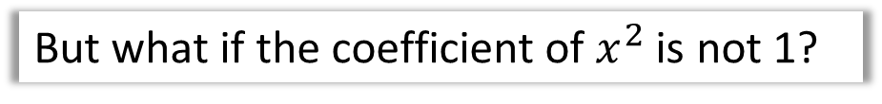



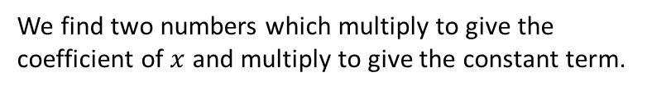


Factorising Quadratics
Recap:
We find two numbers which multiply to give the coefficient of $x$ and multiply to give the constant term.
$$⊕$$
$$⊗$$
?
$$x^{2}−5x−14=\left(x−7\right)\left(x+2\right)$$
Fro Note: The coefficient of a term is the constant on front of it, e.g. the coefficient of $4x^{2}$ is 4.
But what if the coefficient of $x^{2}$ is not 1?
$${2x}^{2}+5x−12=\left(2x−3\right)\left(x+4\right)$$
?
The easiest way is to use your common sense to guess the brackets. What multiplies to give the $2x^{2}$? What multiplies to give the constant term of $−12$?
?
Or you can ‘split the middle term’ (don’t be embarrassed if you’ve forgotten how to!)
$$⊕5 \\ ⊗−24$$
$${2x}^{2}+5x−12 \\ =2x^{2}+8x−3x−12 \\ =2x\left(x+4\right)−3\left(x+4\right) \\ =(x+4)(2x−3)$$
?
STEP 1: Find two numbers which add to give the middle number and multiply to give the first times last.
?
STEP 2: Split the middle term.
?
STEP 3: Factorise first half and second half ensuring bracket is duplicated..
?
STEP 4: Factorise out bracket.

Slide 12


Other Factorisations
Difference of two squares:
?
$$4x^{2}−9=\left(2x+3\right)\left(2x−3\right)$$
Using multiple factorisations:
$$x^{3}−x \\ =x\left(x^{2}−1\right) \\ =x(x+1)(x−1)$$
Fro Tip: Always look for a common factor first before using other factorisation techniques.
?
$$x^{3}+3x^{2}+2x \\ =x\left(x^{2}+3x+2\right) \\ =x\left(x+2\right)\left(x+1\right)$$
?

Slide 13
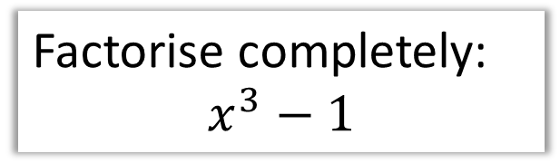

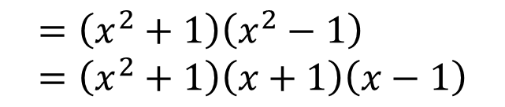
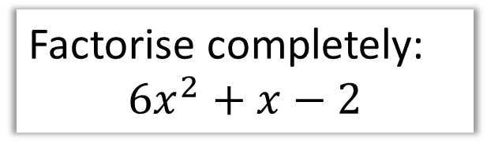

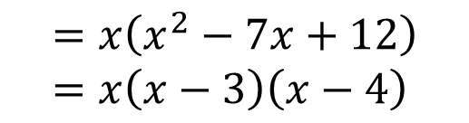
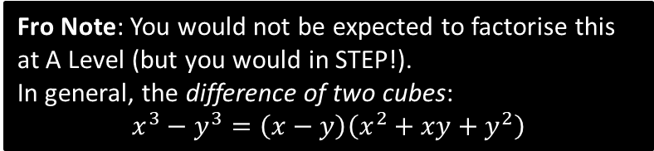
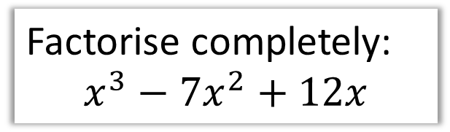

Test Your Understanding
1
Factorise completely:
$$6x^{2}+x−2$$
2
Factorise completely:
$$x^{3}−7x^{2}+12x$$
$$6x^{2}+x−2 ⊕1 ⊗−12 \\ =6x^{2}+4x−3x−2 \\ =2x\left(3x+2\right)−1\left(3x+2\right) \\ =\left(3x+2\right)\left(2x−1\right)$$
$$=x\left(x^{2}−7x+12\right) \\ =x\left(x−3\right)\left(x−4\right)$$
?
?
N
Factorise completely:
$$x^{4}−1$$
N
Factorise completely:
$$x^{3}−1$$
?
?
$$=\left(x^{2}+1\right)\left(x^{2}−1\right) \\ =\left(x^{2}+1\right)\left(x+1\right)\left(x−1\right)$$
$$=(x−1)(x^{2}+x+1)$$
Fro Note: You would not be expected to factorise this at A Level (but you would in STEP!).
In general, the difference of two cubes:
$$x^{3}−y^{3}=\left(x−y\right)\left(x^{2}+xy+y^{2}\right)$$

Slide 14
Exercise 1C
Pearson Pure Mathematics Year 1/AS
Page 8

Slide 15
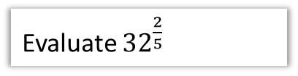













4 :: Negative and Fractional Indices
$$a^{0}=1 \\ a^{\frac{1}{m}}=\sqrt[m]{a} \\ a^{\frac{n}{m}}={\left(\sqrt[m]{a}\right)}^{n} \\ a^{−m}=\frac{1}{a^{m}}$$
Fro Note: $\sqrt{9}$ only means the positive square root of 9, i.e. 3 not -3.
Otherwise, what would be the point of the $±$ in the quadratic formula before the $\sqrt{b^{2}−4ac}$?
Prove that $x^{\frac{1}{2}}=\sqrt{x}$
Evaluate ${27}^{−\frac{1}{3}}$
Evaluate ${32}^{\frac{2}{5}}$
?
?
?
$$x^{\frac{1}{2}}×x^{\frac{1}{2}}=x^{1}$$
But $\sqrt{x}×\sqrt{x}=x$
$$∴x^{\frac{1}{2}}=\sqrt{x}$$
$$=\frac{1}{{27}^{\frac{1}{3}}}=\frac{1}{3}$$
$$=2^{2}=4$$
Simplify ${\left(\frac{1}{9}x^{6}y\right)}^{\frac{1}{2}}$
Evaluate ${\left(\frac{27}{8}\right)}^{−\frac{2}{3}}$
If $b=\frac{1}{9}a^{2}$, determine $3b^{−2}$ in the form $kb^{n}$ where $k,n$ are constants.
?
$$={\left(\frac{8}{27}\right)}^{\frac{2}{3}}={\left(\frac{2}{3}\right)}^{2}=\frac{4}{9}$$
$$=\frac{1}{3}x^{3}y^{\frac{1}{2}}$$
?
?
$$3b^{−2}=3{\left(\frac{1}{9}a^{2}\right)}^{−2} \\ =3\left(81a^{−4}\right)=243a^{−4}$$

Slide 16



Writing a surd using indices
If $9\sqrt{3}=3^{k}$, determine the value of $k$.
The key here is to write everything as powers with a consistent base, in this case, 3.
?
$$9\sqrt{3}=9×\sqrt{3} \\ =3^{2}×3^{\frac{1}{2}} \\ =3^{\frac{5}{2}}$$
$$∴k=\frac{5}{2}$$
Fro Note: In algebra we like to avoid mixed numbers. So don’t write $3^{2\frac{1}{2} }$

Slide 17




Further Examples
[Edexcel IGCSE May14-4H] Given that
$${\left(2^{\frac{1}{2}}\right)}^{n}=\frac{2^{x}}{8^{y}}$$
Express $n$ in terms of $x$ and $y$.
[Edexcel IAL C12 Jan 2019 Q2c] Given that $y=2^{x}$, express the following in terms of $y$.
$$\frac{1}{4^{2x−3}}$$
Write your expression in its simplest form.
?
?
$$2^{\frac{1}{2}n}=\frac{2^{x}}{{\left(2^{3}\right)}^{y}} \\ =\frac{2^{x}}{2^{3y}}=2^{x−3y} \\ ∴\frac{1}{2}n=x−3y \\ n=2x−6y$$
$$\frac{1}{4^{2x−3}}=4^{−(2x−3)}=4^{−2x+3} \\ ={\left(2^{2}\right)}^{−2x+3} \\ =2^{−4x+6} \\ =2^{−4x}×2^{6} \\ ={\left(2^{x}\right)}^{−4}×64 \\ =64y^{−4} or \frac{64}{y^{4}}$$
Write 8 as a power of 2 (putting a bracket around it), for consistency of base with the other powers.

Slide 18


Test Your Understanding
Edexcel Paper 2 – May 2019
?

Slide 19


Exercise 1D
Pearson Pure Mathematics Year 1/AS
Page 11
Extension (Full Database: http://www.drfrostmaths.com/resources/resource.php?rid=268 )
?
$$=\frac{2^{r+s}×3^{r+s}×2^{2r−2s}×3^{r−s}}{2^{3r}×3^{2r+4s}} \\ =2^{−s}×3^{−4s}$$
This is an integer only if $s≤0$.

Slide 20



5 :: Surds
Recap:
Fro Note: A rational number is any which can be expressed as $\frac{a}{b}$ where $a,b$ are integers. $\frac{2}{3}$ and $\frac{4}{1}=4$ are rational numbers, but $π$ and $\sqrt{2}$ are not.
A surd is a root of a number that does not simplify to a rational number.
Laws:
$$\sqrt{a}×\sqrt{b}=\sqrt{ab} \\ \frac{\sqrt{a}}{\sqrt{b}}=\sqrt{\frac{a}{b}}$$
?
$$\sqrt{3}×2 =2\sqrt{3} \\ 3\sqrt{5}×2\sqrt{5} =30 \\ \sqrt{8}=\sqrt{4}\sqrt{2} =2\sqrt{2} \\ \sqrt{12}+\sqrt{27} =2\sqrt{3}+3\sqrt{3}=5\sqrt{3} \\ \left(\sqrt{8}+1\right)\left(\sqrt{2}−3\right) =\sqrt{16}−3\sqrt{8}+\sqrt{2}−3 \\ =4−6\sqrt{2}+\sqrt{2}−3 \\ =1−5\sqrt{2}$$
?
?
?
?
?
?

Slide 21




Exercise 1E
Pearson Pure Mathematics Year 1/AS
Page 11
Extension (questions used with permission by the UKMT)
1
2
Note that:
$$10−3\sqrt{11}=\sqrt{100}−\sqrt{99}$$
The other options can similarly be written as $\sqrt{n+1}−\sqrt{n}$. The greater the $n$, the smaller the number, so the answer is $10−3\sqrt{11}$.
If $\sqrt{a+12\sqrt{2}}=x+y\sqrt{2}$, then squaring:
$$a+12\sqrt{2}=x^{2}+2y^{2}+2xy\sqrt{2}$$
Thus $2xy=12 → xy=6$
The only possibilities are $\left(x,y\right)=\left(1,6\right),\left(2,3\right),\left(3,2\right),\left(6,1\right)$ corresponding to the 5th, 2nd, 1st and 3rd options. Thus $54+12\sqrt{2}$ is the odd one out.
?
?

Slide 22


6 :: Rationalising The Denominator
Here’s a surd. What could we multiply it by such that it’s no longer an irrational number?
?
?
$$\sqrt{5}×\sqrt{5}=5$$
$$\frac{1}{\sqrt{2}}×\frac{\sqrt{2}}{\sqrt{2}}=\frac{\sqrt{2}}{2}$$
?
?
In this fraction, the denominator is irrational. ‘Rationalising the denominator’ means making the denominator a rational number.
What could we multiply this fraction by to both rationalise the denominator, but leave the value of the fraction unchanged?
Bro Side Note: There’s two reasons why we might want to do this:
For aesthetic reasons, it makes more sense to say “half of root 2” rather than “one root two-th of 1”. It’s nice to divide by something whole!
It makes it easier for us to add expressions involving surds.

Slide 23


Examples
$$\frac{3}{\sqrt{2}}=\frac{3\sqrt{2}}{2}$$
$$\frac{6}{\sqrt{3}}=\frac{6\sqrt{3}}{3}=2\sqrt{3}$$
$$\frac{7}{\sqrt{7}}=\frac{7\sqrt{7}}{7}=\sqrt{7}$$
$$\frac{15}{\sqrt{5}}+\sqrt{5}=3\sqrt{5}+\sqrt{5}=4\sqrt{5}$$
Test Your Understanding:
?
?
$$\frac{12}{\sqrt{3}}=4\sqrt{3}$$
$$\frac{2}{\sqrt{6}}=\frac{\sqrt{6}}{3}$$
$$\frac{4\sqrt{2}}{\sqrt{8}}=\frac{16}{8}=2$$
?
?
?
?
?

Slide 24


More Complex Denominators
You’ve seen ‘rationalising a denominator’, the idea being that we don’t like to divide things by an irrational number.
But what do we multiply the top and bottom by if we have a more complicated denominator?
$$\frac{1}{\sqrt{2}+1}×\frac{\sqrt{2}−1}{\sqrt{2}−1}=\frac{\sqrt{2}−1}{1}=\sqrt{2}−1$$
?
?
We basically use the same expression but with the sign reversed (this is known as the conjugate). That way, we obtain the difference of two squares. Since $\left(a+b\right)\left(a−b\right)=a^{2}−b^{2}$, any surds will be squared and thus we’ll end up with no surds in the denominator.

Slide 25




More Examples
$$\frac{3}{\sqrt{6}−2}×\frac{\sqrt{6}+2}{\sqrt{6}+2}=\frac{3\sqrt{6}+6}{2}$$
You can explicitly expand out $\left(\sqrt{6}−2\right)\left(\sqrt{6}+2\right)$ in the denominator, but remember that $\left(a−b\right)\left(a+b\right)=a^{2}−b^{2}$ so we can mentally obtain $6−4=2$
Just remember: ‘difference of two squares’!
?
?
$$\frac{4}{\sqrt{3}+1}×\frac{\sqrt{3}−1}{\sqrt{3}−1}=\frac{4\sqrt{3}−4}{2}=2\sqrt{3}−2$$
?
?
?
?
?
$$\frac{3\sqrt{2}+4}{5\sqrt{2}−7}×\frac{5\sqrt{2}+7}{5\sqrt{2}+7}=\frac{30+21\sqrt{2}+20\sqrt{2}+28}{1} \\ =58+41\sqrt{2}$$

Slide 26






Test Your Understanding
Rationalise the denominator and simplify
$$\frac{4}{\sqrt{5}−2}$$
?
$$8+4\sqrt{5}$$
Rationalise the denominator and simplify
$$\frac{2\sqrt{3}−1}{3\sqrt{3}+1}$$
AQA IGCSE FM June 2013 Paper 1
Solve $y\left(\sqrt{3}−1\right)=8$
Give your answer in the form $a+b\sqrt{3}$ where $a$ and $b$ are integers.
?
$$\frac{2\sqrt{3}−1}{3\sqrt{3}+1}×\frac{3\sqrt{3}−1}{3\sqrt{3}−1} \\ =\frac{18−2\sqrt{3}−3\sqrt{3}+1}{27−1} \\ =\frac{19−5\sqrt{3}}{26}$$
?
$$y=\frac{8}{\sqrt{3}−1}×\frac{\sqrt{3}+1}{\sqrt{3}+1} \\ =\frac{8\sqrt{3}+8}{2}=4+4\sqrt{3}$$

Slide 27





Writing surd expressions in power form
This is not in the textbook, but a common type of question in exams, often asked in conjunction with differentiation (a later chapter).
Express $\frac{{\left(2+\sqrt{x}\right)}^{2}}{x}$ as powers of $x$.
Test Your Understanding
Express $\frac{{\left(x+\sqrt{x}\right)}^{2}}{2\sqrt{x}}$ as powers of $x$.
?
$$\frac{4+4\sqrt{x}+x}{x}=\frac{4+4x^{\frac{1}{2}}+x}{x^{1}} \\ =\frac{4}{x^{1}}+\frac{4x^{\frac{1}{2}}}{x^{1}}+\frac{x}{x} \\ =4x^{−1}+4x^{−\frac{1}{2}}+1$$
Expand.
?
$$\frac{x^{2}+2x\sqrt{x}+x}{2\sqrt{x}} \\ =\frac{x^{2}+2x^{\frac{3}{2}}+x}{2x^{\frac{1}{2}}} \\ =\frac{1}{2}x^{\frac{3}{2}}+x+\frac{1}{2}x^{\frac{1}{2}}$$
Write any roots as powers of $x$.
Split fraction (some may wish to do this step mentally)

Slide 28


Exercise 1F (Page 15)
or alternatively: (not in textbook)
1
Rationalise the denominator and simplify the following:
$$\frac{1}{\sqrt{5}+2}=\sqrt{5}−2$$
$$\frac{\sqrt{3}}{\sqrt{3}−1}=\frac{3+\sqrt{3}}{2}$$
$$\frac{\sqrt{5}+1}{\sqrt{5}−2}=7+3\sqrt{5}$$
$$\frac{2\sqrt{3}−1}{3\sqrt{3}+4}=2−\sqrt{3}$$
$$\frac{5\sqrt{5}−2}{2\sqrt{5}−3}=4+\sqrt{5}$$
2
Expand and simplify:
$$\left(\sqrt{5}+3\right)\left(\sqrt{5}−2\right)\left(\sqrt{5}+1\right)=4$$
Rationalise the denominator, giving your answer in the form $a+b\sqrt{3}$.
$$\frac{3\sqrt{3}+7}{3\sqrt{3}−5}=31+18\sqrt{3}$$
Solve $x\left(4−\sqrt{6}\right)=10$ giving your answer in the form $a+b\sqrt{6}$.
$$x=\frac{10}{4−\sqrt{6}}=4+\sqrt{6}$$
Solve $y\left(1+\sqrt{2}\right)−\sqrt{2}=3$
$$y=\frac{3+\sqrt{2}}{1+\sqrt{2}}=2\sqrt{2}−1$$
Simplify:
$$\frac{\sqrt{a+1}−\sqrt{a}}{\sqrt{a+1}+\sqrt{a}}=2a+1−2\sqrt{a}\sqrt{a+1}$$
?
?
a
3
?
b
?
c
?
4
?
?
d
?
5
e
?
6
?

Slide 29


A final super hard puzzle
Solve $\frac{\sqrt[4]{9}}{\sqrt[5]{27}}=\sqrt[x]{3}$
N
$$\frac{\sqrt[4]{3^{2}}}{\sqrt[5]{3^{3}}}=\frac{{\left(3^{2}\right)}^{\frac{1}{4}}}{{\left(3^{3}\right)}^{\frac{1}{5}}}=\frac{3^{\frac{1}{2}}}{3^{\frac{3}{5}}}=3^{−\frac{1}{10}}$$
But $\sqrt[x]{3}=3^{\frac{1}{x}}$
$$∴\frac{1}{x}=−\frac{1}{10} → x=−10$$
?

