Slide 1
P1 Chapter 12: Differentiation
Tangents and Normals

Slide 2

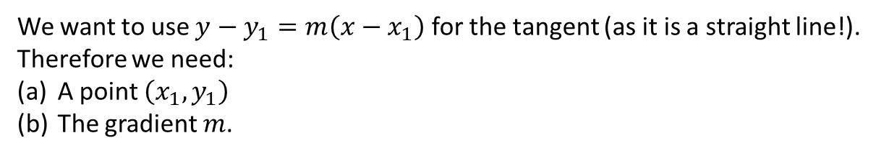
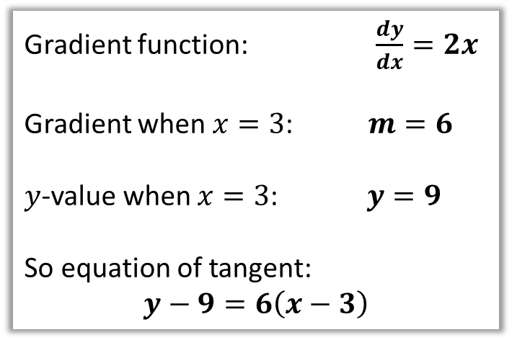
Finding equations of tangents
Find the equation of the tangent to the curve $y=x^{2}$ when $x=3$.
We want to use $y−y_{1}=m\left(x−x_{1}\right)$ for the tangent (as it is a straight line!). Therefore we need:
A point $\left(x_{1},y_{1}\right)$
The gradient $m$.
Gradient function: $\frac{dy}{dx}=2x$
Gradient when $x=3$: $m=6$
$y$-value when $x=3$: $y=9$
So equation of tangent:
$$y−9=6\left(x−3\right)$$
?
?
?
tangent
$$(3,?)$$
?

Slide 3


Finding equations of normals
Find the equation of the normal to the curve $y=x^{2}$ when $x=3$.
The normal to a curve is the line perpendicular to the tangent.
Equation of tangent (from earlier):
$$y−9=6(x−3)$$
Therefore equation of normal:
$$y−9=−\frac{1}{6}\left(x−3\right)$$
normal
tangent
?
$$(3,9)$$
Fro Exam Tip: A very common error is for students to accidentally forget whether the question is asking for the tangent or for the normal.

Slide 4


Test Your Understanding
Find the equation of the normal to the curve $y=x+3\sqrt{x}$ when $x=9$.
? y
When $x=9$, $y=9+3\sqrt{9}=18$
$$y=x+3x^{\frac{1}{2}}$$
$$∴\frac{dy}{dx}=1+\frac{3}{2}x^{−\frac{1}{2}}$$
$$m_{T}=1+\frac{3}{2}\left(9^{−\frac{1}{2}}\right)=\frac{3}{2} \\ ∴m_{N}=−\frac{2}{3}$$
Equation of normal: $y−18=−\frac{2}{3}\left(x−9\right)$
? gradient
Fro Tip: I like to use $m_{T}$ and $m_{N}$ to make clear to the examiner (and myself) what gradient I’ve found.
? Final equation

Slide 5
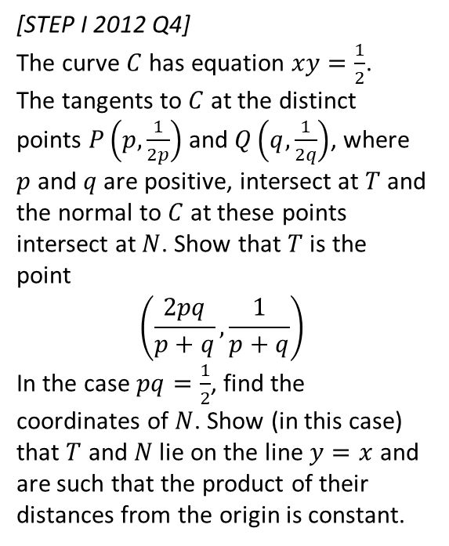
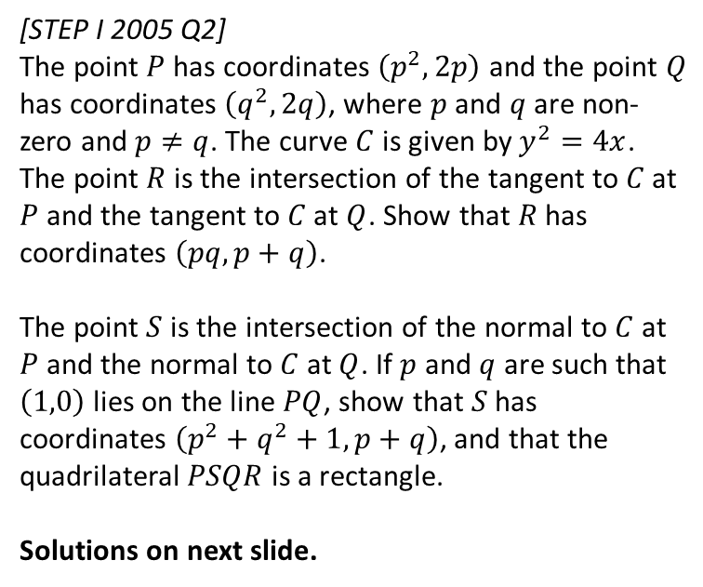
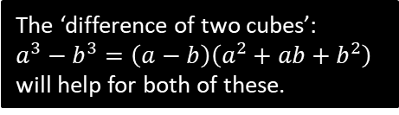
Exercise 12.6
Pearson Pure Mathematics Year 1/AS
Page 96
The ‘difference of two cubes’:
$a^{3}−b^{3}=\left(a−b\right)\left(a^{2}+ab+b^{2}\right)$
will help for both of these.
Extension
[STEP I 2012 Q4]
The curve $C$ has equation $xy=\frac{1}{2}$.
The tangents to $C$ at the distinct points $P\left(p,\frac{1}{2p}\right)$ and $Q\left(q,\frac{1}{2q}\right)$, where $p$ and $q$ are positive, intersect at $T$ and the normal to $C$ at these points intersect at $N$. Show that $T$ is the point
$$\left(\frac{2pq}{p+q},\frac{1}{p+q}\right)$$
In the case $pq=\frac{1}{2}$, find the coordinates of $N$. Show (in this case) that $T$ and $N$ lie on the line $y=x$ and are such that the product of their distances from the origin is constant.
2
1
[STEP I 2005 Q2]
The point $P$ has coordinates $\left(p^{2},2p\right)$ and the point $Q$ has coordinates $\left(q^{2},2q\right)$, where $p$ and $q$ are non-zero and $p≠q$. The curve $C$ is given by $y^{2}=4x$. The point $R$ is the intersection of the tangent to $C$ at $P$ and the tangent to $C$ at $Q$. Show that $R$ has coordinates $\left(pq,p+q\right)$.
The point $S$ is the intersection of the normal to $C$ at $P$ and the normal to $C$ at $Q$. If $p$ and $q$ are such that $\left(1,0\right)$ lies on the line $PQ$, show that $S$ has coordinates $\left(p^{2}+q^{2}+1,p+q\right)$, and that the quadrilateral $PSQR$ is a rectangle.
Solutions on next slide.

Slide 6
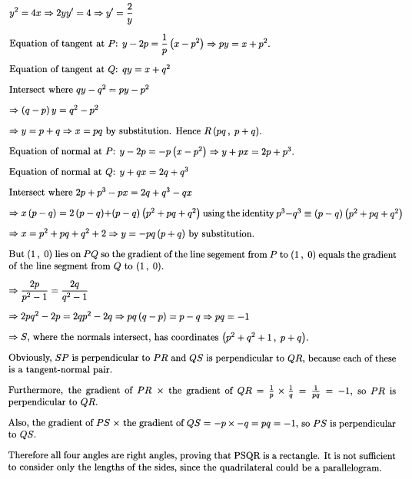

Solutions to Extension Question 1
This is using something called ‘implicit differentiation’ (Year 2), but you could easily do:
$$y^{2}=4x →y=2x^{\frac{1}{2}} \\ \frac{dy}{dx}=x^{−\frac{1}{2}}=\frac{1}{\sqrt{x}}=\frac{2}{y}$$

Slide 7
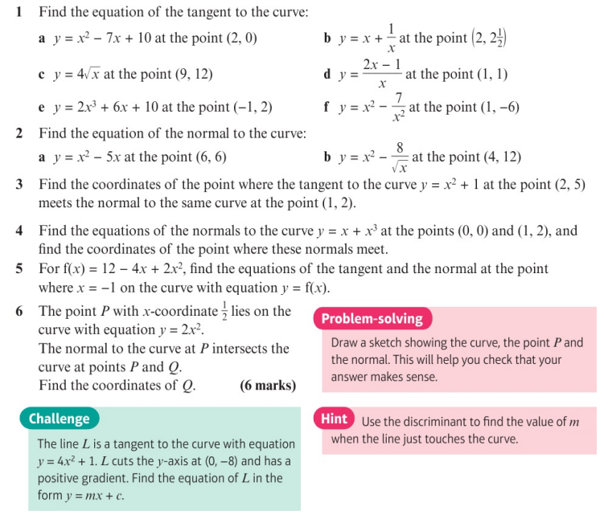
Homework Exercise

Slide 8
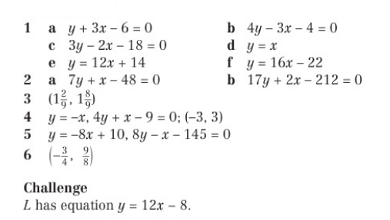
Homework Answers

