Slide 1
P1 Chapter 11: Vectors Position Vectors

Slide 2




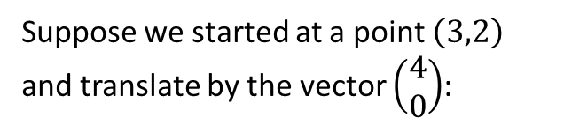


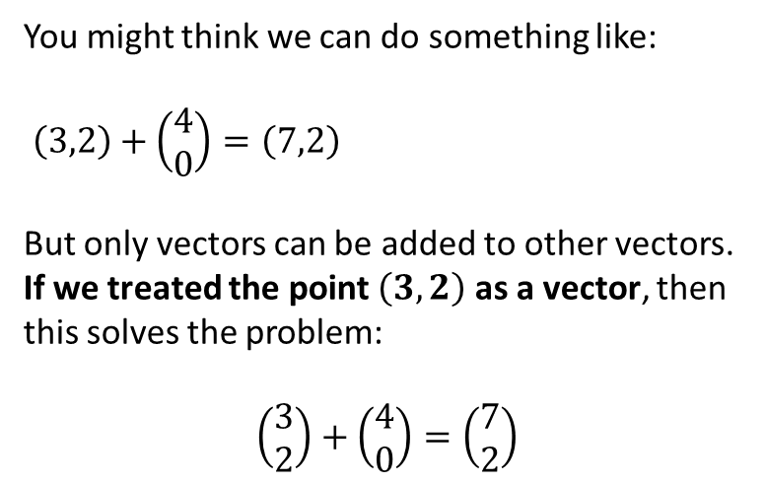
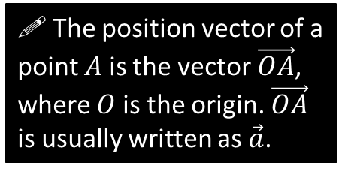


Position Vectors
$$y$$
Suppose we started at a point $\left(3,2\right)$ and translate by the vector $\left(\begin{matrix}4 \\ 0\end{matrix}\right)$:
$$\vec{OA}=\left(\begin{matrix}3 \\ 2\end{matrix}\right)$$
$$A\left(3,2\right)$$
$$\left(\begin{matrix}4 \\ 0\end{matrix}\right)$$
$$O$$
$$x$$
$$A\left(3,2\right)$$
$$?$$
A vector used to represent a position is unsurprisingly known as a position vector.
A position can be thought of as a translation from the origin, as per above. It enables us to use positions in all sorts of vector (and matrix!) calculations.
You might think we can do something like:
$\left(3,2\right)+\left(\begin{matrix}4 \\ 0\end{matrix}\right)=\left(7,2\right)$
But only vectors can be added to other vectors.
If we treated the point $\left(3,2\right)$ as a vector, then this solves the problem:
$$\left(\begin{matrix}3 \\ 2\end{matrix}\right)+\left(\begin{matrix}4 \\ 0\end{matrix}\right)=\left(\begin{matrix}7 \\ 2\end{matrix}\right)$$
! The position vector of a point $A$ is the vector$\vec{OA}$, where $O$ is the origin. $\vec{OA}$ is usually written as $\vec{a}$.

Slide 3

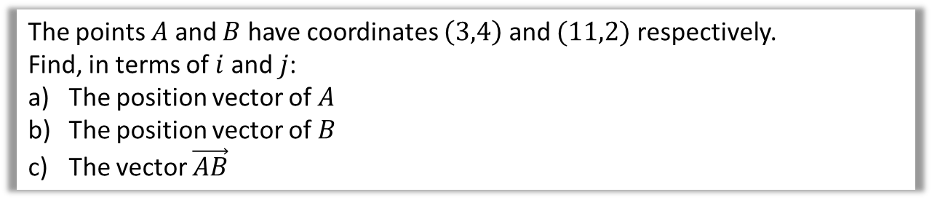


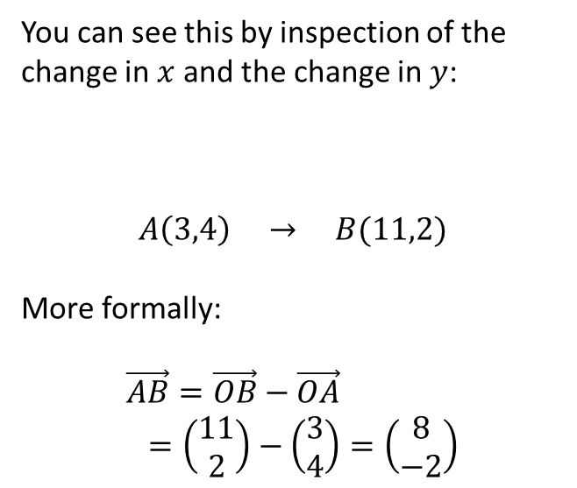
Example
The points $A$ and $B$ have coordinates $\left(3,4\right)$ and $(11,2)$ respectively.
Find, in terms of $i$ and $j$:
The position vector of $A$
The position vector of $B$
The vector $\vec{AB}$
?
You can see this by inspection of the change in $x$ and the change in $y$:
$$A\left(3,4\right) → B(11,2)$$
More formally:
$$\vec{AB}=\vec{OB}−\vec{OA} \\ =\left(\begin{matrix}11 \\ 2\end{matrix}\right)−\left(\begin{matrix}3 \\ 4\end{matrix}\right)=\left(\begin{matrix}8 \\ −2\end{matrix}\right)$$
a
$$\vec{OA}=3i+4j$$
$$\vec{OB}=11i+2j$$
$$\vec{AB}=8i−2j$$
b
?
$$+8$$
$$−2$$
c
?

Slide 4
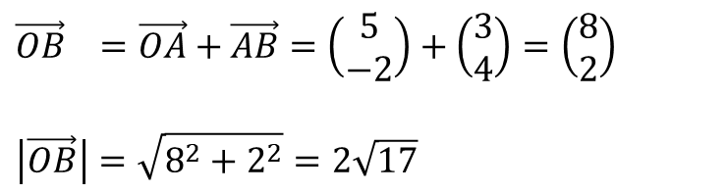
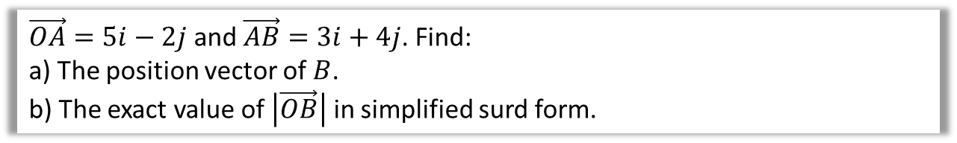
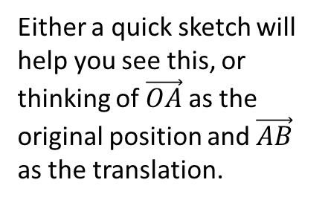
Further Example
$\vec{OA}=5i−2j$ and $\vec{AB}=3i+4j$. Find:
a) The position vector of $B$.
b) The exact value of $\left|\vec{OB}\right|$ in simplified surd form.
Either a quick sketch will help you see this, or thinking of $\vec{OA}$ as the original position and $\vec{AB}$ as the translation.
?
a
$$\vec{OB} =\vec{OA}+\vec{AB}=\left(\begin{matrix}5 \\ −2\end{matrix}\right)+\left(\begin{matrix}3 \\ 4\end{matrix}\right)=\left(\begin{matrix}8 \\ 2\end{matrix}\right)$$
$$\left|\vec{OB}\right|=\sqrt{8^{2}+2^{2}}=2\sqrt{17}$$
?
b

Slide 5
Exercise 11.4
Pearson Pure Mathematics Year 1/AS
Pages 88-89

Slide 6
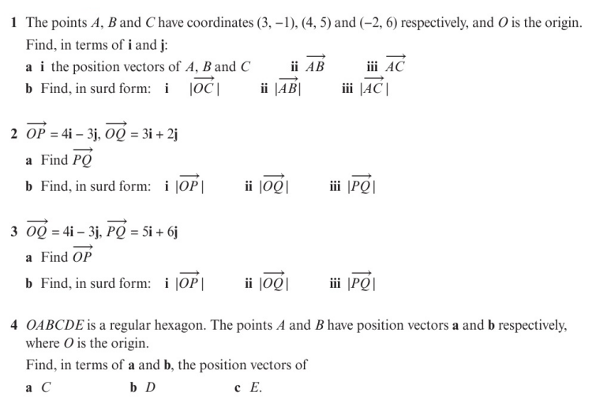
Homework Exercise

Slide 7
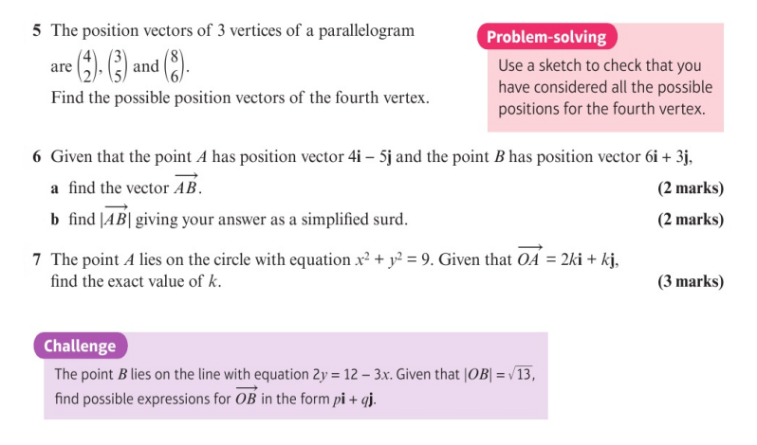
Homework Exercise

Slide 8
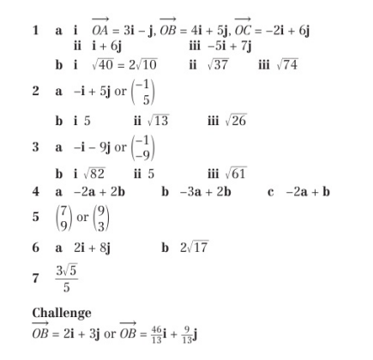
Homework Answers

