Slide 1
M2 Chapter 5: Inclined Planes Friction

Slide 2









Friction
Scenario 1: A block is on a horizontal rough surface with no forces (other than gravity) acting on it.
$$N$$
Comment regarding friction:
No frictional force.
?
$$mg$$
Scenario 2: A cable is attached to the block and a force applied. The block doesn’t move.
Comment regarding friction:
There must be a force left (i.e. friction, which acts parallel to the plane) to counteract the tension force acting right. Note that as the tension increases but the block doesn’t move, the frictional force increases.
?
$$N$$
$$T$$
$$F$$
$$mg$$
Scenario 3: The tension is increased until the block starts to move.
Comment regarding friction:
The friction reaches a maximum. Therefore if the tension increases further, there will be an overall force right and therefore the block accelerates. The friction is in the opposite direction to motion.
$$N$$
?
$$T$$
$$F$$
$$mg$$

Slide 3
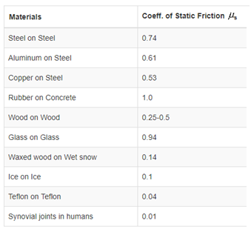
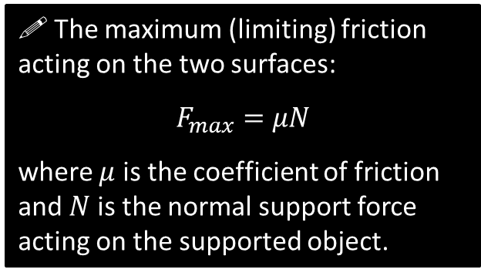

Friction
This ‘maximum friction’ depends on two things:
How rough the surface is (i.e. the rougher the surface, the more force required before the block starts moving).
How much the block is pressing into the surface.
?
?
Example $μ$: (source physlink.com)
! The maximum (limiting) friction acting on the two surfaces:
$$F_{max}=μN$$
where $μ$ is the coefficient of friction and $N$ is the normal support force acting on the supported object.

Slide 4
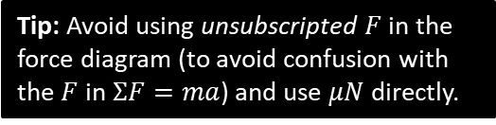


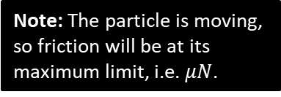

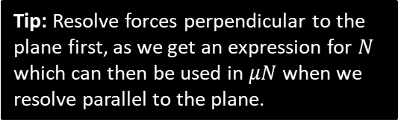


Example
[Textbook] A particle of mass 5kg is pulled along a rough horizontal surface by a horizontal force of magnitude 20N. The coefficient of friction between the particle and the floor is 0.2. Calculate:
the magnitude of frictional force
the acceleration of the particle.
Note: The particle is moving, so friction will be at its maximum limit, i.e. $μN$.
? Diagram
? Working
$$a$$
Tip: Resolve forces perpendicular to the plane first, as we get an expression for $N$ which can then be used in $μN$ when we resolve parallel to the plane.
$$N$$
$$μN$$
$$20$$
$R\left(↑\right): N=5g$
$R\left(→\right): 20−μN=5a$ $20−0.2\left(5g\right)=5a$ $a=2.0 ms^{−2}$
$$5g$$
Tip: Avoid using unsubscripted $F$ in the force diagram (to avoid confusion with the $F$ in $ΣF=ma$) and use $μN$ directly.

Slide 5





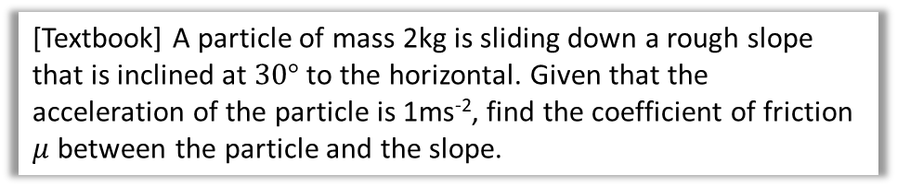






Inclined Plane with Friction Example
[Textbook] A particle of mass 2kg is sliding down a rough slope that is inclined at $30°$ to the horizontal. Given that the acceleration of the particle is 1ms⁻², find the coefficient of friction $μ$ between the particle and the slope.
? Diagram
? Working
Recall that friction always acts in opposite direction to motion.
$R\left(↖\right): N=2g\cos{30°}$
$$R\left(↙\right): 2g\sin{30°}−μN=2a \\ g−2μg\cos{30°}=2a \\ …$$ $μ=\frac{7.8}{16.974…}=0.46$
$$N$$
$$1 ms^{−2}$$
$$μN$$
$$5g$$
$2$ kg
$$2g\cos{30}$$
$$2g$$
$$30°$$
$$30°$$
$$2g\sin{30}$$

Slide 6
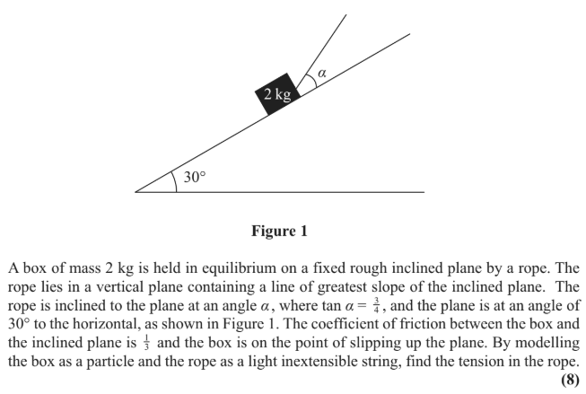
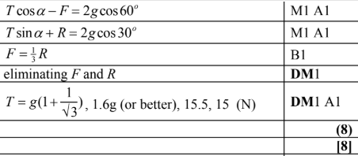
Test Your Understanding
Edexcel M1(Old) May 2013 Q3
?

Slide 7
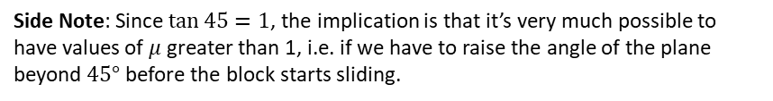

Exercise 5.3
Pearson Stats/Mechanics Year 2
Pages 46-47
Additional question:
1
A block lies on a rough plane at an incline of $θ$. The coefficient of friction between the block and plane is $μ$. If the block is on the verge of sliding down the plane, prove that $μ=\tan{θ}$.
Let mass of block be $m$.
$$R\left(↖\right): N=mg\cos{θ} \\ R\left(↙\right): mg\sin{θ}=μN \\ mg\sin{θ}=μmg\cos{θ} \\ μ=\frac{mg\sin{θ}}{mg\cos{θ}}=\tan{θ}$$
?
Side Note: Since $\tan{45}=1$, the implication is that it’s very much possible to have values of $μ$ greater than 1, i.e. if we have to raise the angle of the plane beyond $45°$ before the block starts sliding.

Slide 8
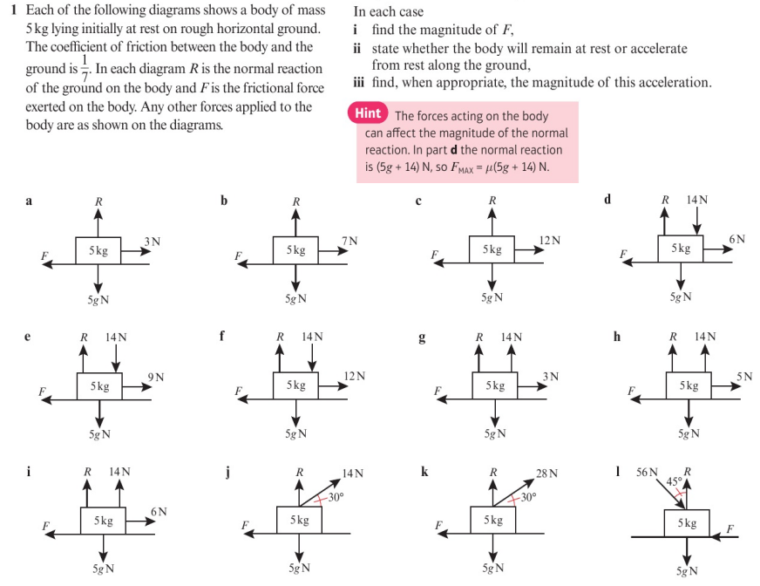
Homework Exercise

Slide 9
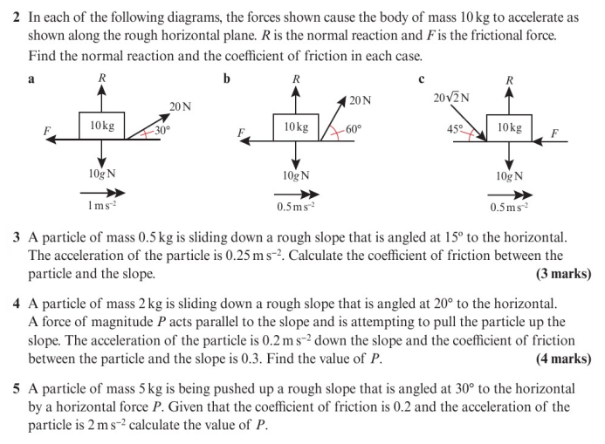
Homework Exercise

Slide 10
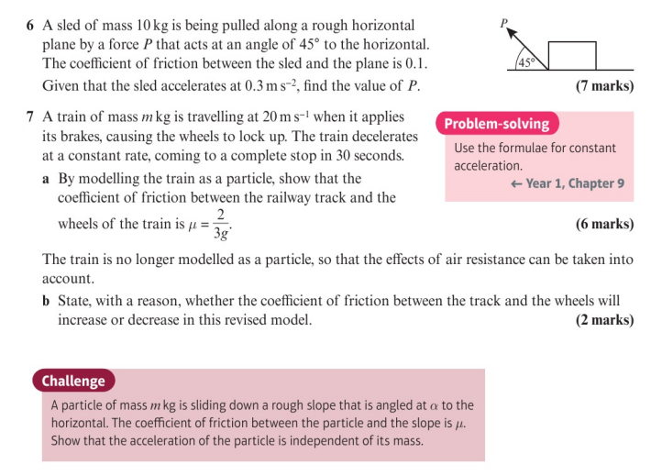
Homework Exercise

Slide 11
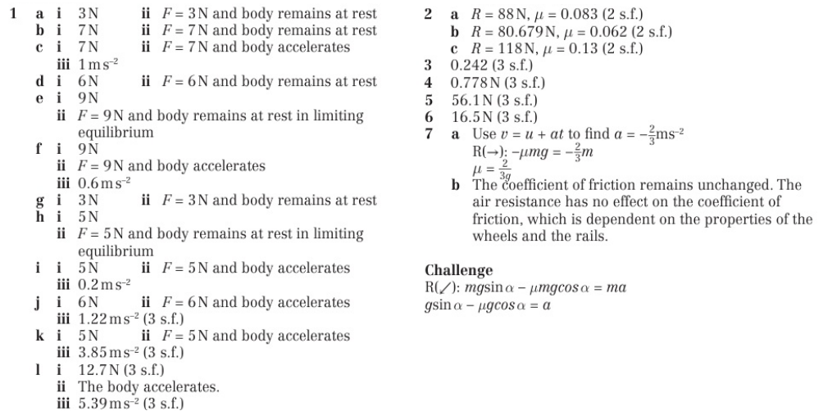
Homework Answers

