Slide 1
P2 Chapter 10: Numerical Methods Locating Roots

Slide 2
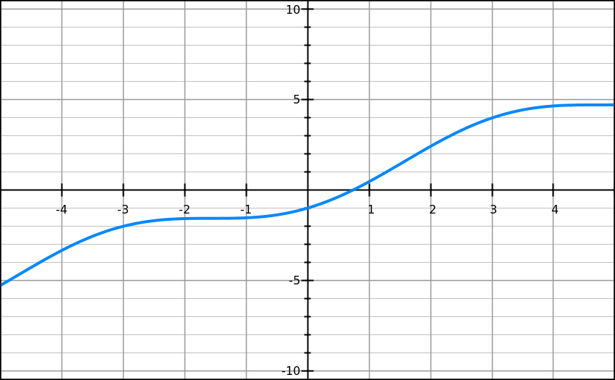
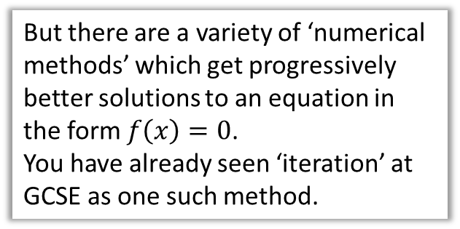

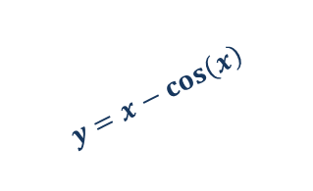
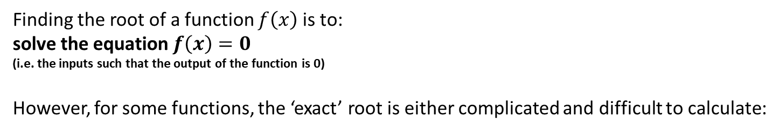

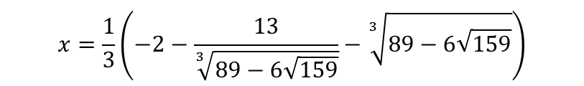
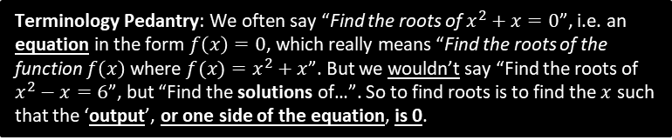
Why do we need numerical methods?
Terminology Pedantry: We often say “Find the roots of $x^{2}+x=0$”, i.e. an equation in the form $f\left(x\right)=0$, which really means “Find the roots of the function $f\left(x\right)$ where $f(x)=x^{2}+x$”. But we wouldn’t say “Find the roots of $x^{2}−x=6$”, but “Find the solutions of…”. So to find roots is to find the $x$ such that the ‘output’, or one side of the equation, is 0.
Finding the root of a function $f\left(x\right)$ is to:
solve the equation $f\left(x\right)=0$
(i.e. the inputs such that the output of the function is 0)
However, for some functions, the ‘exact’ root is either complicated and difficult to calculate:
?
$$x=\frac{1}{3}\left(−2−\frac{13}{\sqrt[3]{89−6\sqrt{159}}}−\sqrt[3]{89−6\sqrt{159}}\right)$$
$$x^{3}+2x^{2}−3x+4=0$$
?
or there’s no ‘algebraic’ expression at all! (involving roots, logs, sin, cos, etc.)
?
$$x−\cos\left(x\right)=0$$
Exact solution not expressible ☹
But there are a variety of ‘numerical methods’ which get progressively better solutions to an equation in the form $f\left(x\right)=0$.
You have already seen ‘iteration’ at GCSE as one such method.
$$y=x−\cos\left(x\right)$$
Root

Slide 3
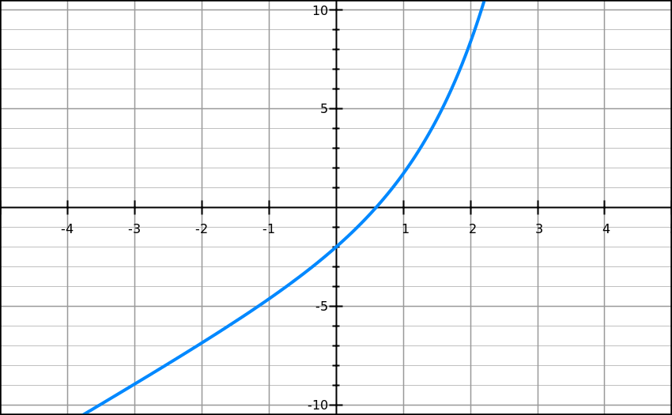
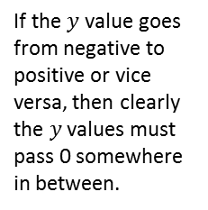


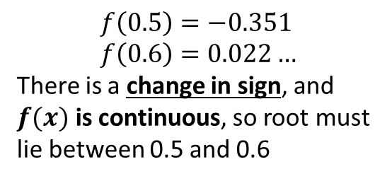
Proving a solution lies in a range
Show that ${f\left(x\right)=e}^{x}+2x−3$ has a root between $x=0.5$ and $x=0.6$
?
$$f\left(0.5\right)=−0.351 \\ f\left(0.6\right)=0.022…$$
There is a change in sign, and $f(x)$ is continuous, so root must lie between 0.5 and 0.6
Exam Tip: The mark scheme lookings for:
Finding the function output for the two values.
Referring to a ‘change in sign’.
$$\left(0.6, 0.022\right)$$
If the $y$ value goes from negative to positive or vice versa, then clearly the $y$ values must pass 0 somewhere in between.
$$\left(0.5,−0.351\right)$$

Slide 4


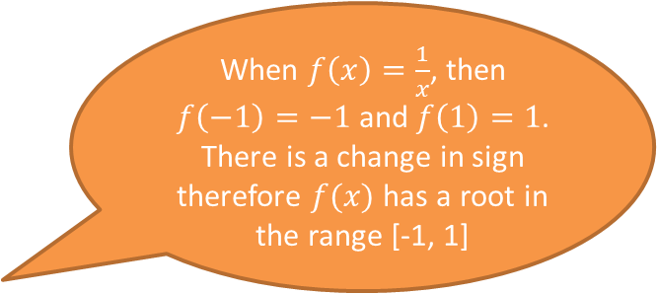



…but only if the function is continuous
Stupid Steve says:
When $f\left(x\right)=\frac{1}{x}$, then $f\left(−1\right)=−1$ and $f\left(1\right)=1$. There is a change in sign therefore $f(x)$ has a root in the range [-1, 1]
Why is Steve wrong?
$$y$$
A function is continuous if the line does not ‘jump’. A root is only guaranteed with a sign change if the function is continuous, as otherwise the line can skip past 0 (in this case due to a vertical asymptote.
$$(1,1)$$
$$x$$
$$(−1,−1)$$

Slide 5


…and no sign change doesn’t mean there isn’t a root
$$y$$
Beware! Just because there isn’t a sign change, doesn’t mean there’s no root in that interval.
root
root
$$x$$
The sign change method fails to detect a root if there were an even number of roots in that interval.

Slide 6
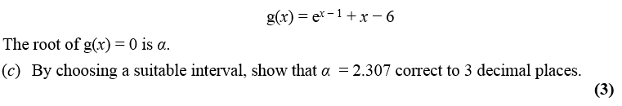

Proving a solution to a given accuracy
Edexcel C3 Jan 2013
Thinking back to lower school, if the root $2.307$ is correct to 3dp, what’s the smallest and greatest value it could be?
Smallest: $2.3065$
Greatest: $2.3075$
If there was a sign change between $x=2.3065$ and $x=2.3075$, then we know $2.3065<α<2.3075$. But if the value is in this range, then we know it is 2.307 to 3 decimal places!
$$f\left(2.3065\right)=−0.000275 \\ f\left(2.3075\right)=0.00442$$
There is a change in sign in the interval $(2.3065, 2.3075)$
$$∴2.3065<α<2.3075 \\ ∴α=2.307 to 3dp$$
?
?
? What do we write in exam…

Slide 7


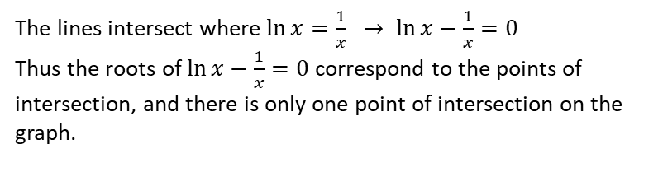
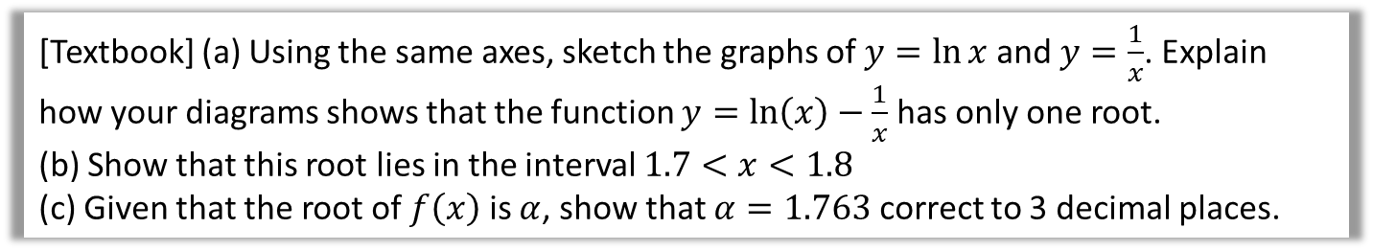



Example
[Textbook] (a) Using the same axes, sketch the graphs of $y=\ln{x}$ and $y=\frac{1}{x}$. Explain how your diagrams shows that the function $y=\ln\left(x\right)−\frac{1}{x}$ has only one root.
(b) Show that this root lies in the interval $1.7<x<1.8$
(c) Given that the root of $f\left(x\right)$ is $α$, show that $α=1.763$ correct to 3 decimal places.
a
$$y$$
?
b
$$f\left(x\right)=\ln{x}−\frac{1}{x} \\ f\left(1.7\right)=−0.0576… \\ f\left(1.8\right)=0.0322…$$
There is a change of sign between 1.7 and 1.8, so there is a root in the interval $1.7<x<1.8$
$$f\left(1.17625\right)=−0.00064<0 \\ f\left(1.7635\right)=0.00024>0$$
There is a change of sign in the interval $(1.7625, 1.7635)$ so $1.7625<α<1.7635$, so $α=1.763$ correct to 3dp.
$$y=\frac{1}{x}$$
?
$$y=\ln{x}$$
$$x$$
c
?
The lines intersect where $\ln{x}=\frac{1}{x} → \ln{x}−\frac{1}{x}=0$
Thus the roots of $\ln{x}−\frac{1}{x}=0$ correspond to the points of intersection, and there is only one point of intersection on the graph.

Slide 8
Exercise 10.1
Pearson Pure Mathematics Year 2/AS
Page 81

Slide 9
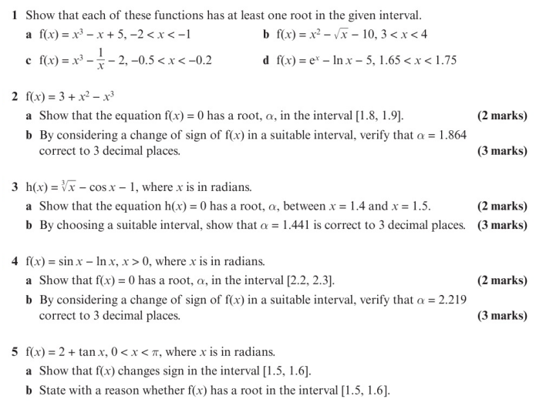
Homework Exercise

Slide 10
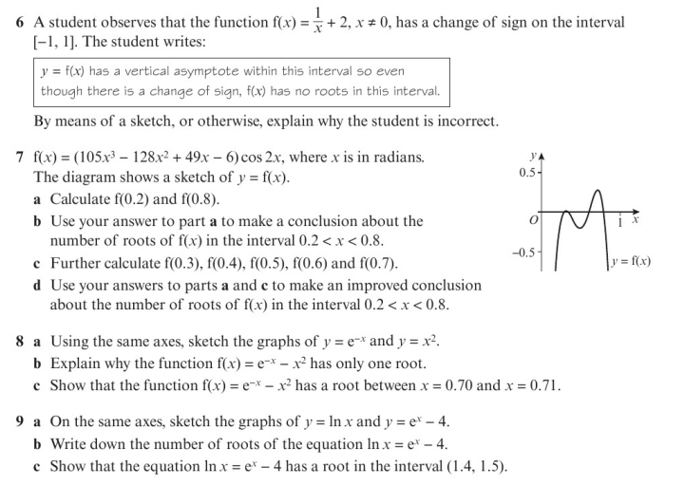
Homework Exercise

Slide 11
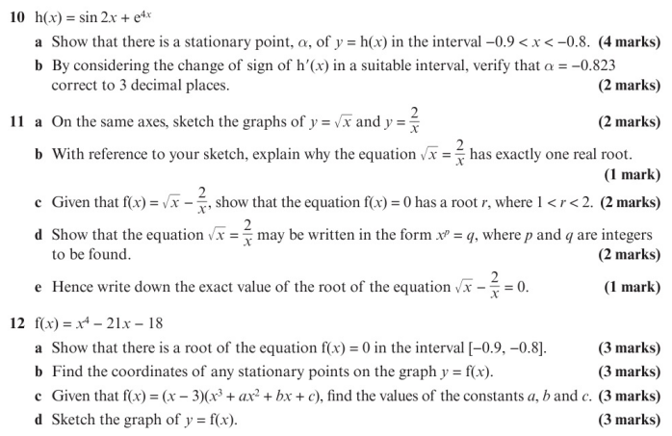
Homework Exercise

Slide 12
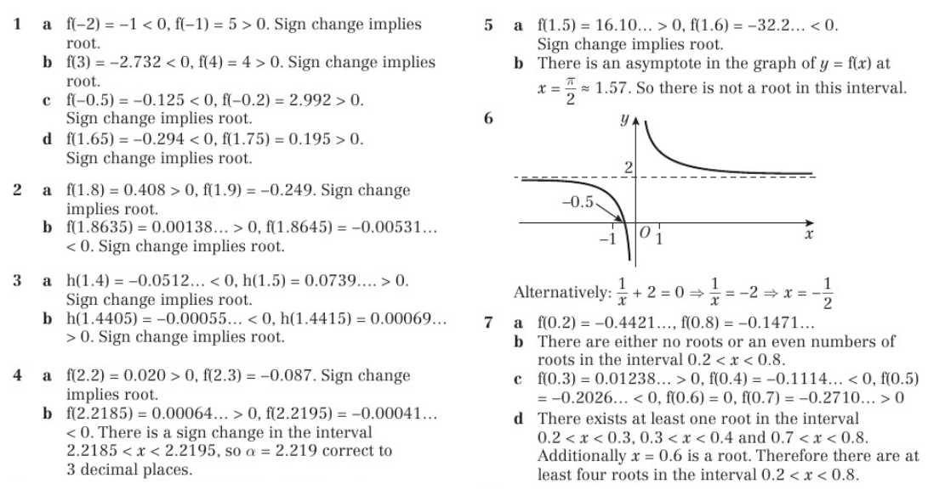
Homework Answers

Slide 13
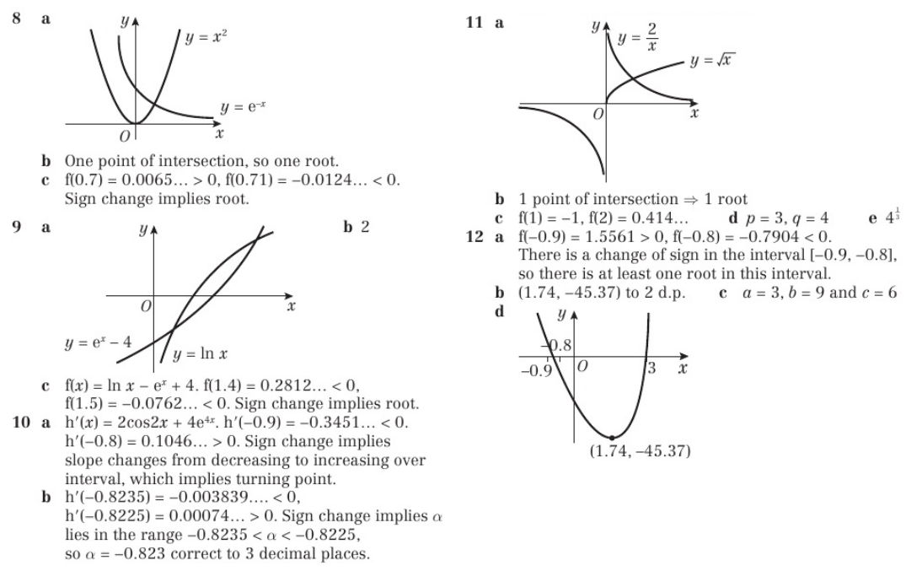
Homework Answers

