Slide 1
P1 Chapter 2: Quadratics Discriminants

Slide 2
Starter
How many distinct real solutions do each of the following have?
?
$x^{2}−12x+36=0$ $x=6$ (1 distinct solution)
$x^{2}+x+3=0$ $x=\frac{−1±\sqrt{−11}}{2}$ We can’t square root -11, Therefore no real solutions.
$x^{2}−2x−1=0$ $x=1±\sqrt{2}$ (2 distinct solutions)
?
?

Slide 3
The Discriminant
Fro Note: Roots of a function $f$ are the values of $x$ such that $f\left(x\right)=0$.
Similarly the roots of an equation are solutions to an equation in the form $f\left(x\right)=0$
$$ax^{2}+bx+c=0$$
$$x=\frac{−b±\sqrt{b^{2}−4ac}}{2a}$$
Looking at this formula, when in general do you think we have:
No real roots? $b^{2}−4ac<0$
Equal roots? $b^{2}−4ac=0$
Two distinct roots? $b^{2}−4ac>0$
?
?
!
?
Because adding 0 or subtracting 0 in the quadratic formula gives the same value.
$b2 – 4ac$is known as the discriminant.

Slide 4
Discriminant Types
$$y$$
$$y$$
We say the graph “touches” the axis.
$$x$$
$$x$$
$$y$$
Distinct real roots
Equal roots
$$b^{2}−4ac>0$$
$$b^{2}−4ac=0$$
$$x$$
No real roots
$$b^{2}−4ac<0$$

Slide 5

Just for your interest…
Why do we say “Equal Roots” not “One root”?
$$x^{2}−12x+36=0$$
It is due to the Fundamental Theorem of Algebra:
Using the quadratic formula gives us the same value in both $+$ and $−$ cases: $x=6$.
You might wonder why we say “it has one repeated root” or “it has equal roots”, i.e. indicating we have 2 roots (but with the same value). Why not say it has 1 root?
“Every polynomial of order $n$ has exactly $n$ roots.”
A polynomial is an expression with non-negative integer powers of $x$, i.e.
$$a+bx+cx^{2}+dx^{3}+…$$
All linear, quadratic and cubic expressions are examples of polynomials.
These roots might be repeated or might not be ‘real’ roots. $\sqrt{−1}$ is known as a complex number, which you will encounter if you do FM. But it is still a value!
The theorem means that a quadratic (order 2) will always have 2 roots. This is why you should say “no real roots” when $b^{2}−4ac<0$ rather than “no roots”, because there are still roots – it’s just they’re not ‘real’! Similarly we must say “equal roots” because there are still 2 roots.
Despite the theorem being a simple statement, it was only until 1806 that it was first proven by Argand. Clearly by using the quadratic formula we can show a quadratic equation has 2 roots. We can use similar formulas to show that a cubic has 3 roots and a quartic 4 roots. But there is provably no such formulae for order 5 (quintics) and beyond. So we have to prove for example that 5 roots exist for a quintic, despite us having no way to find these exact roots!
One side result of the Fundamental Theorem of Algebra is that every polynomial can be written as a product of linear and/or quadratic expressions.
Leibniz claimed in 1702 that a polynomial of the form $x^{4}+a^{4}$ cannot be written in this way. He then got completely burned by Euler in 1742 who managed to do so:
$$x^{4}+a^{4}=\left(x^{2}+a\sqrt{2} x+a^{2}\right)\left(x^{2}−a\sqrt{2} x+a^{2}\right)$$
The order of a polynomial is its highest power of $x$. So the order of a quadratic is 2, and a cubic 3.
There are various other ‘Fundamental Laws’. The ‘FL of Arithmetic’ you encountered at KS3, which states that “every positive integer $>1$ can be written as a product of primes in one way only”. You will encounter the ‘FL of Calculus’ in Chapter 13.

Slide 6
Quickfire Questions
Number of Distinct Real Roots
Equation
Discriminant
?
?
$$x^{2}+3x+4=0$$
$$−7$$
$$0$$
?
?
$$x^{2}−4x+1=0$$
$$12$$
$$2$$
?
?
$$x^{2}−4x+4=0$$
$$0$$
$$1$$
?
?
$$2x^{2}−6x−3=0$$
$$60$$
$$2$$
?
?
$$x−4−3x^{2}=0$$
$$−47$$
$$0$$
?
?
$$1−x^{2}=0$$
$$4$$
$$2$$

Slide 7
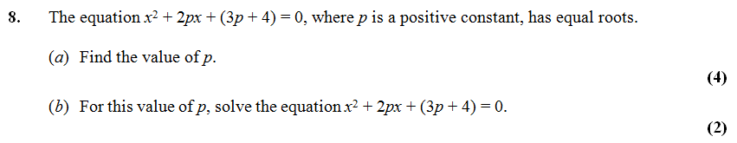

Problems involving the discriminant
?
?
?
a) $a=1, b=2p, c=3p+4$ $${\left(2p\right)}^{2}−4\left(1\right)\left(3p+4\right)=0 \\ 4p^{2}−12p−16=0 \\ p^{2}−3p−4=0 \\ \left(p+1\right)\left(p−4\right)=0 \\ p=4$$
Tip: Always start by writing out $a, b$ and $c$ explicitly.
?
b) When $p=4$: $x^{2}+8x+16=0$ $${\left(x+4\right)}^{2}=0, x=−4$$
?

Slide 8
Test Your Understanding
$$x^{2}+5kx+\left(10k+5\right)=0$$
where $k$ is a constant.
Given that this equation has equal roots, determine the value of $k$.
$$a=1, b=5k, c=10k+5 \\ {\left(5k\right)}^{2}−4\left(1\right)\left(10k+5\right)=0 \\ 25k^{2}−40k−20=0 \\ 5k^{2}−8k−4=0 \\ \left(5k+2\right)\left(k−2\right)=0 \\ k=2$$
?
Find the range of values of $k$ for which $x^{2}+6x+k=0$ has two distinct real solutions.
$$a=1, b=6, c=k \\ 36−4\left(1\right)\left(k\right)=36−4k>0 \\ 36>4k \\ k<9$$
?

Slide 9
Exercise 2.5
Pearson Pure Mathematics Year 1/AS
Page 10
Extension Questions:
1
[MAT 2009 1C] Given a real constant $c$, the equation
$$x^{4}={\left(x−c\right)}^{2}$$
Has four real solutions (including possible repeated roots) for:
$c≤\frac{1}{4}$
$−\frac{1}{4}≤c≤\frac{1}{4}$
$c≤−\frac{1}{4}$
all values of $c$
Square rooting: $x^{2}=±(x−c)$
Case 1:
$$x^{2}−x+c=0$$
Discriminant: $1−4c≥0∴c≤\frac{1}{4}$
Case 2:
$$x^{2}+x−c=0$$
Discriminant: $1+4c≥0∴c≥−\frac{1}{4}$
Answer is B.
[MAT 2006 1B] The equation ${\left(2+x−x^{2}\right)}^{2}=16$ has how many real root(s)?
$$2+x−x^{2}=±4$$
First case:
$$2+x−x^{2}=4 \\ x^{2}−x+2=0$$
As $b^{2}−4ac<0$ no real roots.
Second case:
$$2+x−x^{2}=−4 \\ x^{2}−x−6=0 \\ \left(x+2\right)\left(x−3\right)=0 \\ x=−2 or x=3$$
So 2 distinct real roots.
[MAT 2011 1B] A rectangle has perimeter $P$ and area $A$. The values $P$ and $A$ must satisfy:
$P^{3}>A$
$A^{2}>2P+1$
$P^{2}≥16A$
$PA>A+P$
Let $x$ and $y$ be the width and height. Then $A=xy, P=2x+2y$. Substituting:
$$P=2x+2\left(\frac{A}{x}\right) \\ Px=2x^{2}+2A \\ 2x^{2}−Px+2A=0$$
Discriminant: $a=2, b=−P, c=2A$
$${\left(−P\right)}^{2}−4\left(2\right)\left(2A\right)≥0 \\ P^{2}−16A≥0 \\ P^{2}≥16A$$
2
3
?
?
?

Slide 10
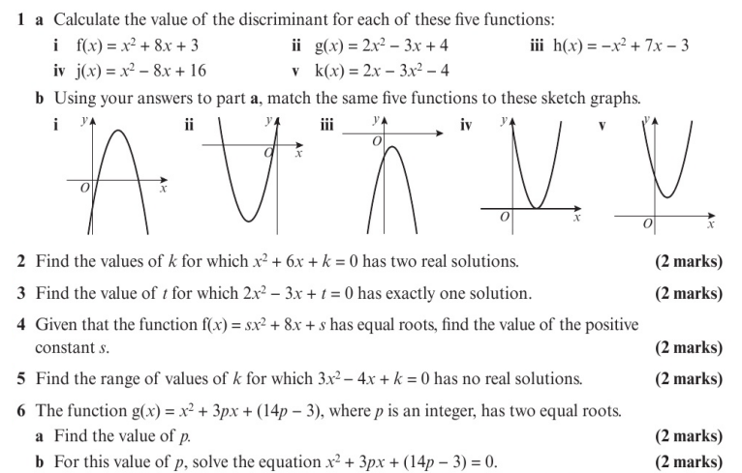
Homework Exercise

Slide 11
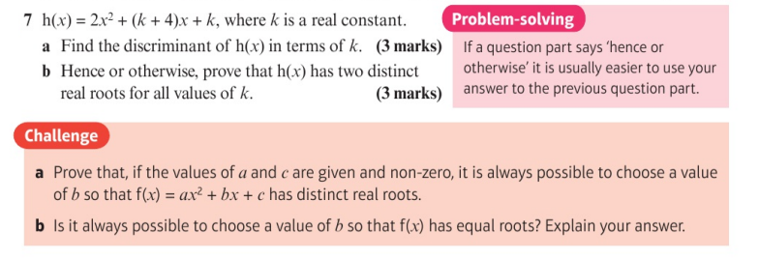
Homework Exercise

Slide 12
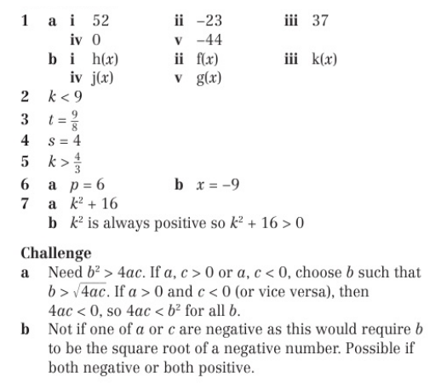
Homework Answers

