Slide 1
Stats1 Chapter 2: Measures of Data Measures of Spread

Slide 2
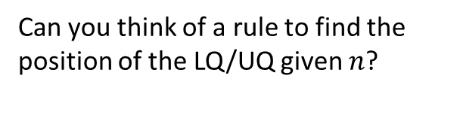
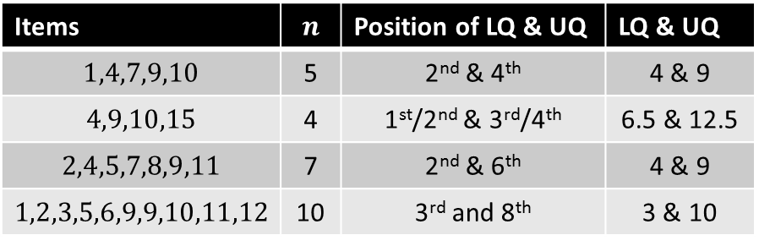

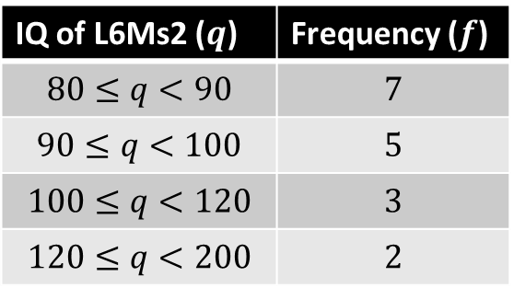
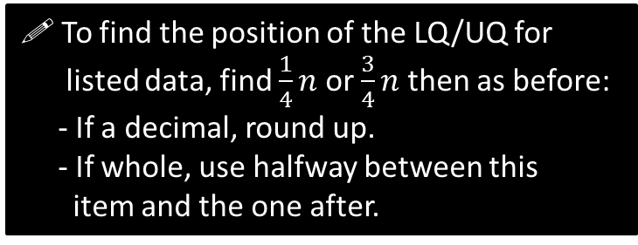
Quartiles – which item?
You need to be able to find the quartiles of both listed data and of grouped data. The rule is exactly the same as for the median.
Grouped data
Listed data
IQ of L6Ms2 ($q$) | Frequency ($f$)
$$80≤q<90$$ | $$7$$
$$90≤q<100$$ | $$5$$
$$100≤q<120$$ | $$3$$
$$120≤q<200$$ | $$2$$
Items | $$n$$ | Position of LQ & UQ | LQ & UQ
$$1,4,7,9,10$$ | 5 | 2nd & 4th | 4 & 9
$$4,9,10,15$$ | 4 | 1st/2nd & 3rd/4th | 6.5 & 12.5
$$2,4,5,7,8,9,11$$ | 7 | 2nd & 6th | 4 & 9
$$1,2,3,5,6,9,9,10,11,12$$ | 10 | 3rd and 8th | 3 & 10
?
?
?
?
?
?
?
?
Can you think of a rule to find the position of the LQ/UQ given $n$?
Position to use for LQ:
4.25
?
! To find the position of the LQ/UQ for listed data, find $\frac{1}{4}n$ or $\frac{3}{4}n$ then as before:
- If a decimal, round up.
- If whole, use halfway between this item and the one after.
! To find the LQ and UQ of grouped data, find $\frac{1}{4}n$ and $\frac{3}{4}n$, then use linear interpolation.
?
Again, DO NOT round this value.

Slide 3


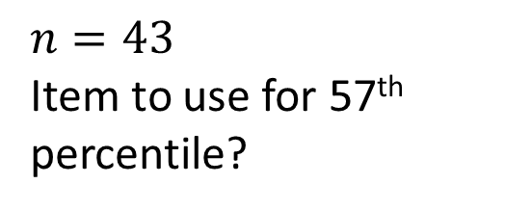



Percentiles
The LQ, median and UQ give you 25%, 50% and 75% along the data respectively.
But we can have any percentage you like!
$$n=43$$
Item to use for 57th percentile?
?
$$43×0.57=24.51$$
You will always find these for grouped data in an exam, so never round this position.
Notation:
$$Q_{2}$$
$$Q_{1}$$
?
Lower Quartile:
?
Median:
$$Q_{3}$$
$$P_{57}$$
Upper Quartile:
?
57th Percentile:
?

Slide 4
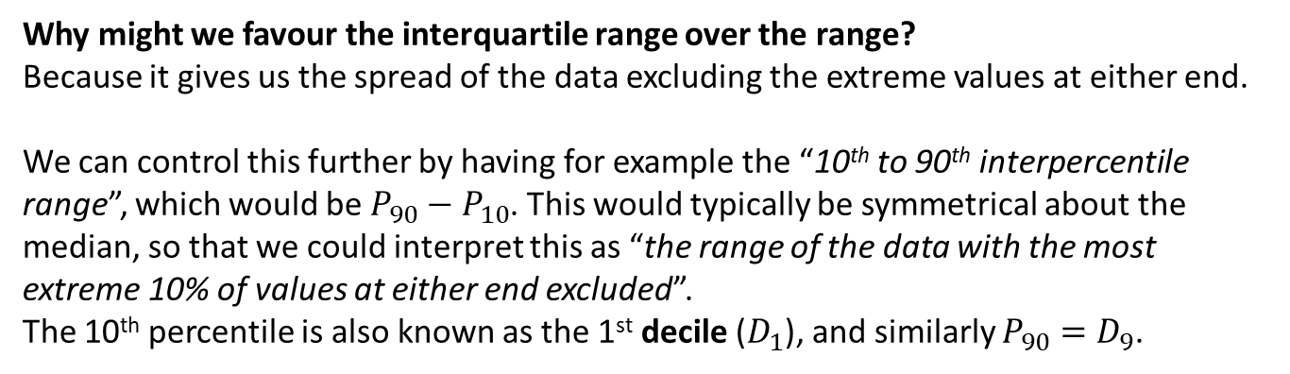


Measures of Spread
The interquartile range and interpercentile range are examples of measures of spread.
Range
Interquartile Range
Min
$$Q_{1}$$
$$Q_{3}$$
Max
Bottom 25% of data
Middle 50% of data
Top 25% of data
Interquartile Range = Upper Quartile $−$ Lower Quartile
Why might we favour the interquartile range over the range?
Because it gives us the spread of the data excluding the extreme values at either end.
We can control this further by having for example the “10th to 90th interpercentile range”, which would be $P_{90}−P_{10}$. This would typically be symmetrical about the median, so that we could interpret this as “the range of the data with the most extreme 10% of values at either end excluded”.
The 10th percentile is also known as the 1st decile ($D_{1}$), and similarly $P_{90}=D_{9}$.
?

Slide 5

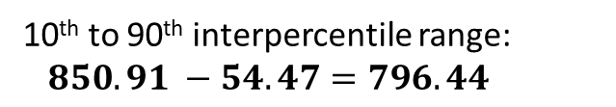

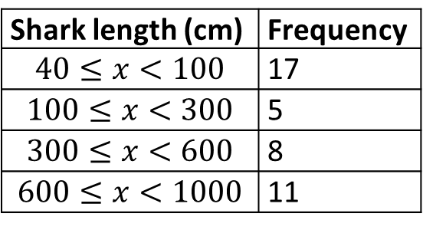
Test Your Understanding
These are the same as the ‘Test Your Understanding’ questions on your supplementary sheet from before.
Age of relic (years) | Frequency
0-1000 | 24
1001-1500 | 29
1501-1700 | 12
1701-2000 | 35
Shark length (cm) | Frequency
$$40≤x<100$$ | 17
$$100≤x<300$$ | 5
$$300≤x<600$$ | 8
$$600≤x<1000$$ | 11
Item for $Q_{1}$:
25th
$$Q_{1}=1000.5+\left(\frac{1}{29}×500\right)$$ $=1017.74$ years
$$Q_{3}=1700.5+\left(\frac{10}{35}×300\right)$$ $=1786.21$ years
$IQR=768.47$
?
Item to use for $P_{10}$: $41×0.1=4.1$
$$P_{10}=40+\left(\frac{4.1}{17}×60\right)=54.47$$
$$P_{90}=600+\left(\frac{6.9}{11}×400\right)=850.91$$
?
?
?
?
?
10th to 90th interpercentile range:
$850.91 −54.47=796.44$
?
?
Notes:
There’s a slip to print out here.

Slide 6
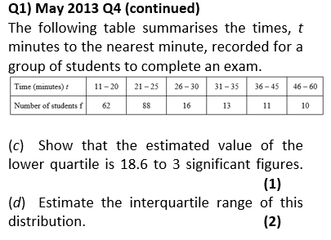
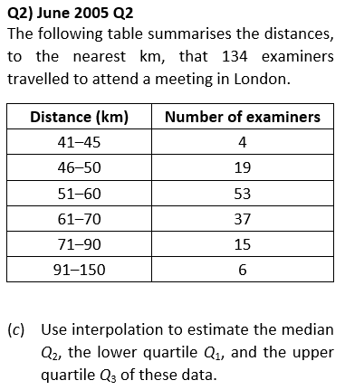
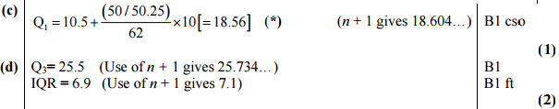
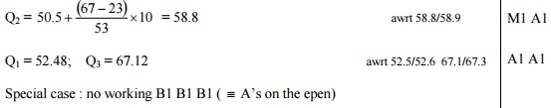
Supplementary Exercise 2
?
?

Slide 7
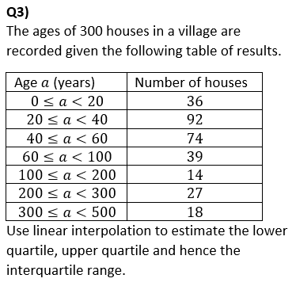
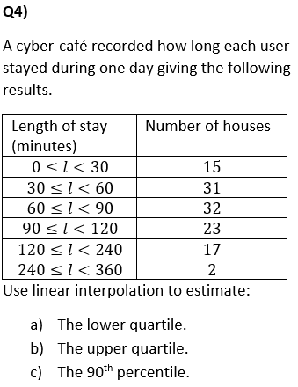
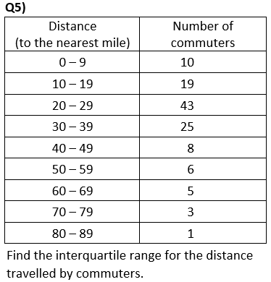



Supplementary Exercise 2
$$Q_{1}=19.5+\left(\frac{1}{43}×10\right)=19.7 \\ Q_{3}=29.5+\left(\frac{18}{25}×10\right)=36.7 \\ IQR=17.0$$
?
?
$$Q_{1}=20+\left(\frac{39}{92}×20\right)=28.5 \\ Q_{3}=60+\left(\frac{23}{39}×40\right)=83.6$$
$$IQR=55.1$$
$$Q_{1}=30+\left(\frac{15}{31}×30\right)=44.5 \\ Q_{3}=90+\left(\frac{12}{23}×30\right)=105.7 \\ P_{90}=120+\left(\frac{7}{17}×120\right)=169.4$$
?

Slide 8
Exercises 2.3
Pearson Statistics & Mechanics Year 1/AS
Pages 10-11

Slide 9
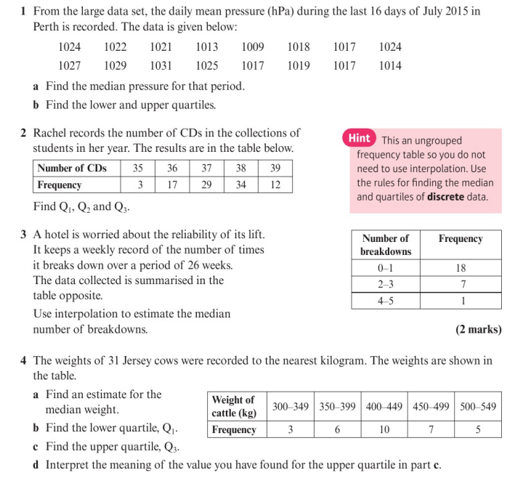
Homework Exercise

Slide 10
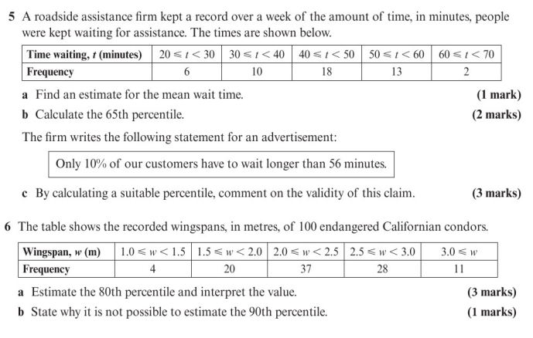
Homework Exercise

Slide 11
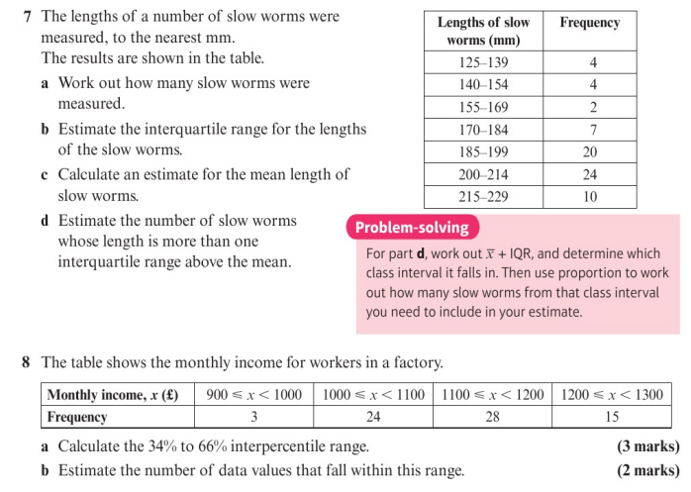
Homework Exercise

Slide 12
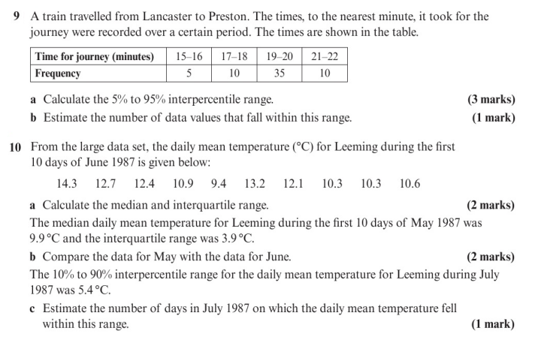
Homework Exercise

Slide 13
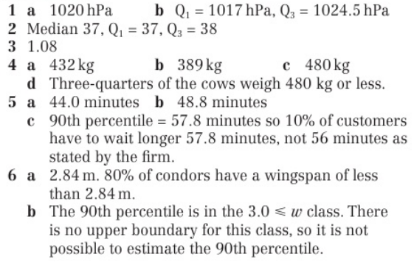
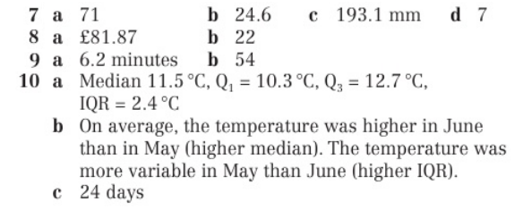
Homework Answers

