Slide 1
P2 Chapter 7: Trigonometric Equations
Using Addition Formulae

Slide 2
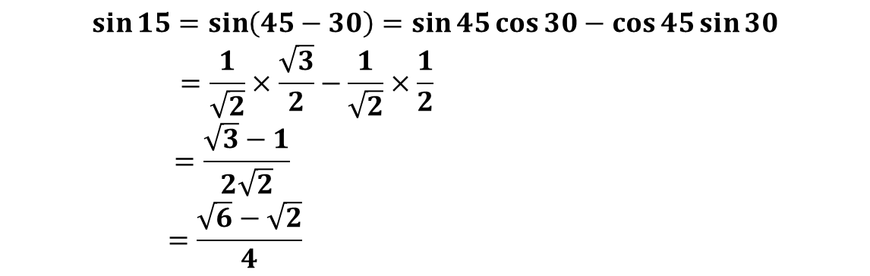
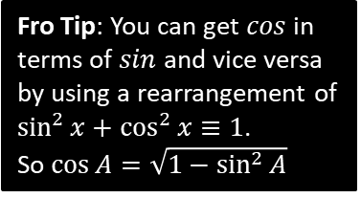
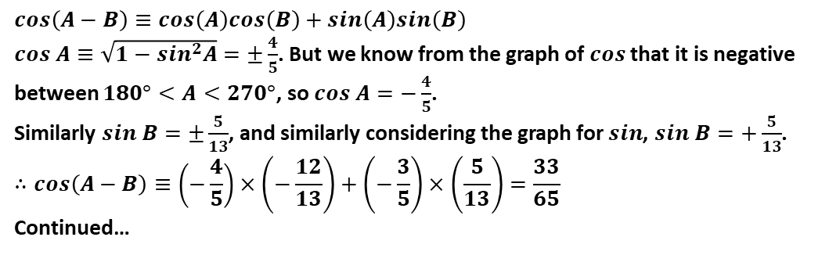
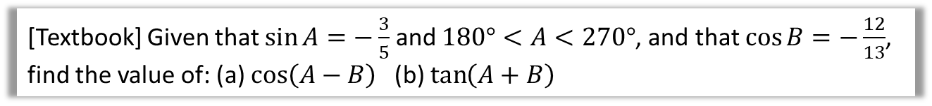
Uses of Addition Formulae
Q
[Textbook] Using a suitable angle formulae, show that $\sin{15°}=\frac{\sqrt{6}−\sqrt{2}}{4}$.
?
$$\sin{15}=\sin\left(45−30\right)=\sin{45}\cos{30}−\cos{45}\sin{30} \\ =\frac{1}{\sqrt{2}}×\frac{\sqrt{3}}{2}−\frac{1}{\sqrt{2}}×\frac{1}{2} \\ =\frac{\sqrt{3}−1}{2\sqrt{2}} \\ =\frac{\sqrt{6}−\sqrt{2}}{4}$$
Q
[Textbook] Given that $\sin{A}=−\frac{3}{5}$ and $180°<A<270°$, and that $\cos{B}=−\frac{12}{13}$, find the value of: (a) $\cos\left(A−B\right)$ (b) $\tan\left(A+B\right)$
$$cos\left(A−B\right)≡cos\left(A\right)cos\left(B\right)+sin\left(A\right)sin\left(B\right)$$
$cos A≡\sqrt{1−sin^{2}A}=±\frac{4}{5}$. But we know from the graph of $cos$ that it is negative between $180°<A<270°$, so $cos A=−\frac{4}{5}$.
Similarly $sin B=±\frac{5}{13}$, and similarly considering the graph for $sin$, $sin B=+\frac{5}{13}$.
$$∴cos\left(A−B\right)≡\left(−\frac{4}{5}\right)×\left(−\frac{12}{13}\right)+\left(−\frac{3}{5}\right)×\left(\frac{5}{13}\right)=\frac{33}{65}$$
Continued…
?
Fro Tip: You can get $cos$ in terms of $sin$ and vice versa by using a rearrangement of
$\sin^{2}{x}+\cos^{2}{x}≡1$.
So $\cos{A}=\sqrt{1−\sin^{2}{A}}$

Slide 3

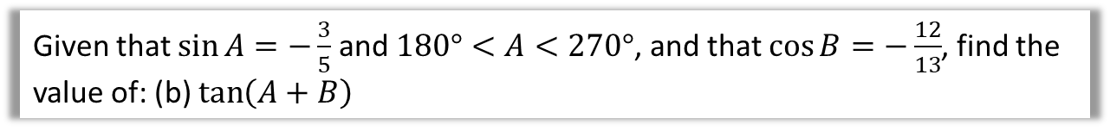
Continued…
Q
Given that $\sin{A}=−\frac{3}{5}$ and $180°<A<270°$, and that $\cos{B}=−\frac{12}{13}$, find the value of: (b) $\tan\left(A+B\right)$
?
$$\tan\left(A+B\right)=\frac{\tan\left(A\right)+tan⁡(B)}{1−\tan{A}\tan{B}}$$
We earlier found $\sin{A}=−\frac{3}{5},\sin{B}=\frac{5}{13},\cos{A}=−\frac{4}{5},\cos{B}=−\frac{12}{13}$
$∴\tan{A}=\left(−\frac{3}{5}\right)÷\left(−\frac{4}{5}\right)=\frac{3}{4}$ and $\tan{B}=\frac{5}{13}÷\left(−\frac{12}{13}\right)=−\frac{5}{12}$
By substitution:
$$\tan\left(A+B\right)=\frac{16}{63}$$

Slide 4

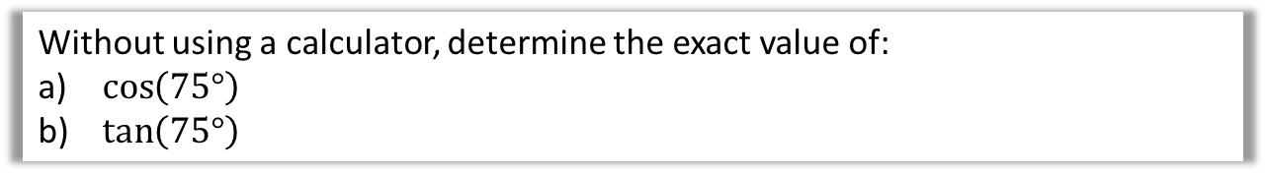
Test Your Understanding
Without using a calculator, determine the exact value of:
$\cos\left(75°\right)$
$\tan\left(75°\right)$
?
$$\cos\left(75°\right)=\cos\left(45°+30°\right)=\cos\left(45°\right)\cos\left(30°\right)−\sin\left(45°\right)\sin\left(30°\right) \\ =\frac{1}{\sqrt{2}}×\frac{\sqrt{3}}{2}−\frac{1}{\sqrt{2}}×\frac{1}{2} \\ =\frac{\sqrt{3}−1}{2\sqrt{2}}=\frac{\sqrt{6}−\sqrt{2}}{4}$$
$$\tan\left(75°\right)=\frac{\sin\left(75°\right)}{\cos\left(75°\right)}$$
$$\sin\left(75°\right)=\sin\left(45°+30°\right)=\sin\left(45°\right)\cos\left(30°\right)+\cos\left(45°\right)\sin\left(30°\right) \\ =\frac{1}{\sqrt{2}}×\frac{\sqrt{3}}{2}+\frac{1}{\sqrt{2}}×\frac{1}{2}=\frac{\sqrt{6}+\sqrt{2}}{4}$$
$$∴\tan\left(75°\right)=\left(\frac{\sqrt{6}+\sqrt{2}}{4}\right)÷\left(\frac{\sqrt{6}−\sqrt{2}}{4}\right)=\frac{\sqrt{6}+\sqrt{2}}{\sqrt{6}−\sqrt{2}}=2+\sqrt{3}$$
?

Slide 5
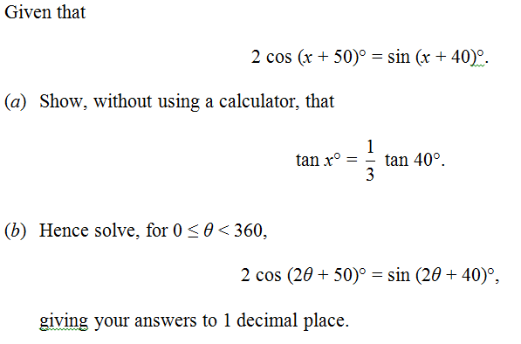

Challenging question
Edexcel June 2013 Q3
a
?
‘Expanding’ both sides:
$$2\cos{x}\cos{50}−2\sin{x}\sin{50} \\ =\sin{x}\cos{40}+\cos{x}\sin{40}$$
Since thing to prove only has 40 in it, use $\cos{50}=\sin{40}$ and $\sin{50}=\cos{40 }.$
$$2\cos{x}\sin{40}−2\sin{x}\cos{40 } \\ =\sin{x}\cos{40}+\cos{x}\sin{40}$$
As per usual, when we want tans, divide by $\cos{x}\cos{40}$:
$$2\tan{40}−2\tan{x}=\tan{x}+\tan{40} \\ \tan{40}=3\tan{x} \\ \frac{1}{3}\tan{40}=\tan{x}$$

Slide 6
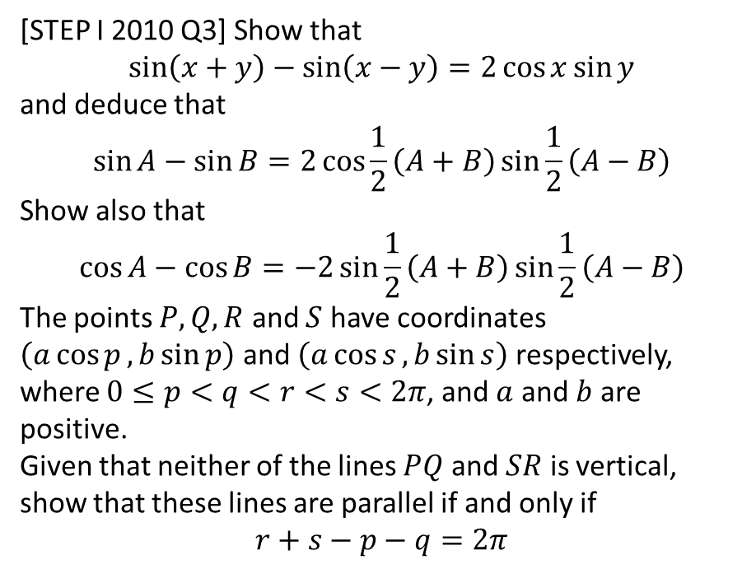
Exercise 7.2
Pearson Pure Mathematics Year 2/AS
Page 49
Extension
[STEP I 2010 Q3] Show that
$$\sin\left(x+y\right)−\sin\left(x−y\right)=2\cos{x}\sin{y}$$
and deduce that
$$\sin{A}−\sin{B}=2\cos{\frac{1}{2}\left(A+B\right)}\sin{\frac{1}{2}\left(A−B\right)}$$
Show also that
$$\cos{A}−\cos{B}=−2\sin{\frac{1}{2}\left(A+B\right)}\sin{\frac{1}{2}\left(A−B\right)}$$
The points $P, Q, R$ and $S$ have coordinates $\left(a\cos{p},b\sin{p}\right)$ and $\left(a\cos{s}, b\sin{s}\right)$ respectively, where $0≤p<q<r<s<2π$, and $a$ and $b$ are positive.
Given that neither of the lines $PQ$ and $SR$ is vertical, show that these lines are parallel if and only if
$$r+s−p−q=2π$$

Slide 7
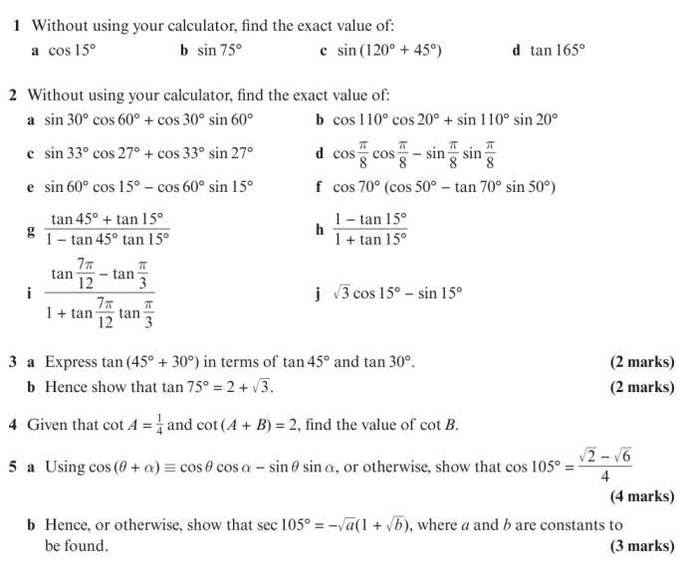
Homework Exercise

Slide 8
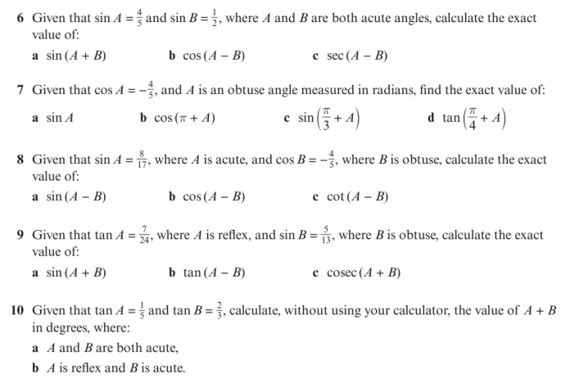
Homework Exercise

Slide 9
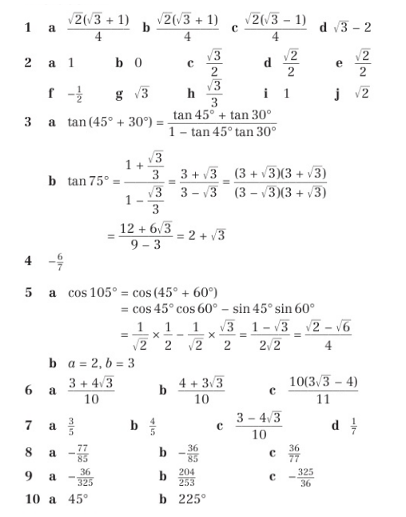
Homework Answers

