Slide 1
Stats Yr2 Chapter 3: Distribution-N Mean and Variance

Slide 2
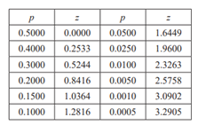

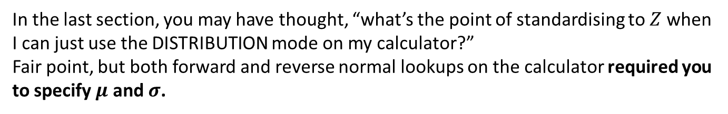






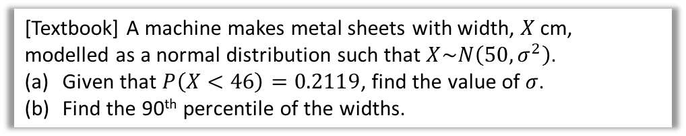
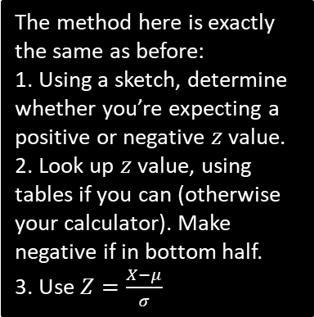

Missing $μ$ and $σ$
In the last section, you may have thought, “what’s the point of standardising to $Z$ when I can just use the DISTRIBUTION mode on my calculator?”
Fair point, but both forward and reverse normal lookups on the calculator required you to specify $μ$ and $σ$.
[Textbook] $X\sim N\left(μ,3^{2}\right)$. Given that $P\left(X>20\right)=0.2$, find the value of $μ$.
?
$$P\left(X>20\right)=0.2 \\ 0.8416=\frac{20−μ}{3} \\ μ=17.5 (3sf)$$
0.2
$$μ$$
$$20$$
The method here is exactly the same as before:
1. Using a sketch, determine whether you’re expecting a positive or negative $z$ value.
2. Look up $z$ value, using tables if you can (otherwise your calculator). Make negative if in bottom half.
3. Use $Z=\frac{X−μ}{σ}$
[Textbook] A machine makes metal sheets with width, $X$ cm, modelled as a normal distribution such that $X\sim N\left(50,σ^{2}\right)$.
Given that $P\left(X<46\right)=0.2119$, find the value of $σ$.
Find the 90th percentile of the widths.
?
$$P\left(X<46\right)=0.2119 \\ −0.80=\frac{46−50}{σ} \\ σ=5$$
$$X\sim N\left({50,5}^{2}\right) \\ P\left(X<a\right)=0.9 \\ a=56.4 cm (1dp)$$
0.2
0.2
To use inverse normal distribution on calculator, note that $Z\sim N\left({0,1}^{2}\right)$, so use $μ=0$ and $σ=1$.
$$46$$
$$50$$

Slide 3
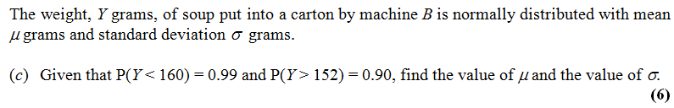
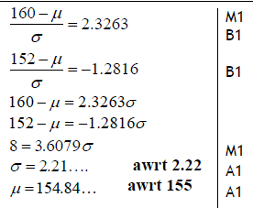
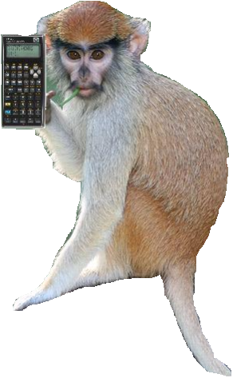
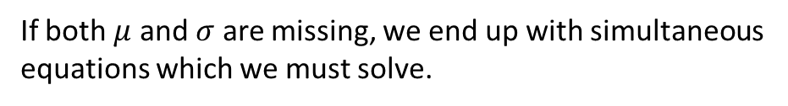
When both are missing
If both $μ$ and $σ$ are missing, we end up with simultaneous equations which we must solve.
Edexcel S1 Jan 2011
?
“Use of Technology” Monkey says:
Your Classwiz solves simultaneous equations. Look under the EQUATIONS mode.

Slide 4
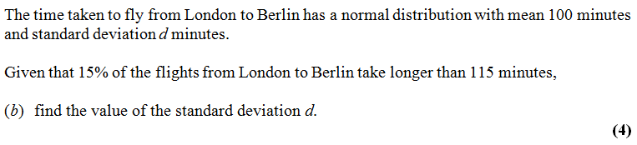

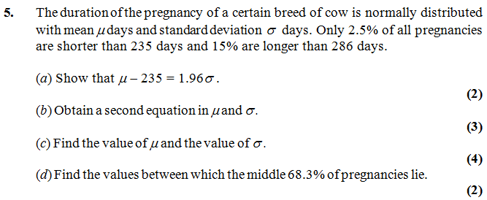
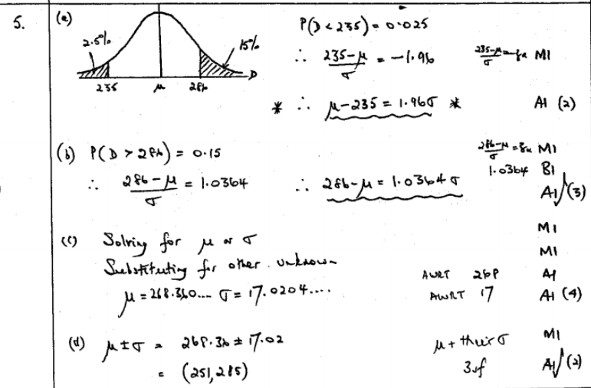
Test Your Understanding
Edexcel S1 May 2013 (R)
?
Edexcel S1 Jan 2002
?
?
?
?

Slide 5
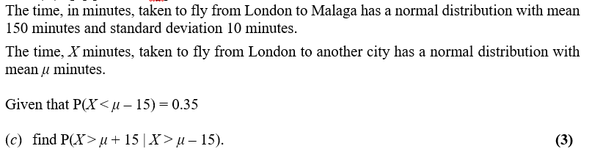


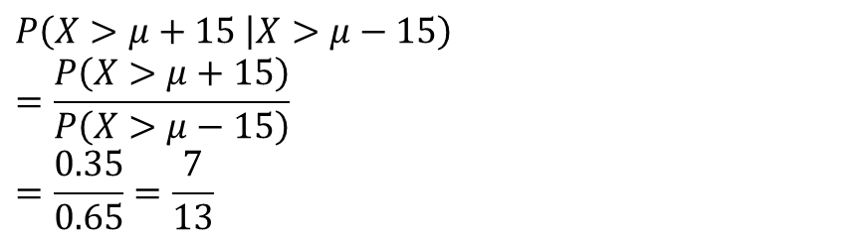


Conditional Probabilities
This is not in the textbook. But given the recent Chapter 2 on Conditional Probabilities and the fact that the type of question below occurred frequently in S1 papers, it seems worthwhile to cover!
Edexcel S1 May 2014(R) Q4
?
$$P\left(X>μ+15 | X>μ−15\right) \\ =\frac{P\left(X>μ+15\right)}{P\left(X>μ−15\right)} \\ =\frac{0.35}{0.65}=\frac{7}{13}$$
The intersection of “above $μ+15$” and “above $μ−15$” is just “above $μ+15$” because the stronger statements takes precedent. If I said “my age is above 20, and above 30”, this is equivalent to saying just “my age is above 30”.
0.35
$$μ−15$$
$$μ$$
$$μ+15$$

Slide 6
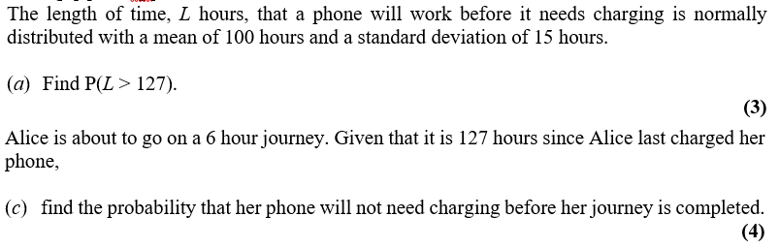
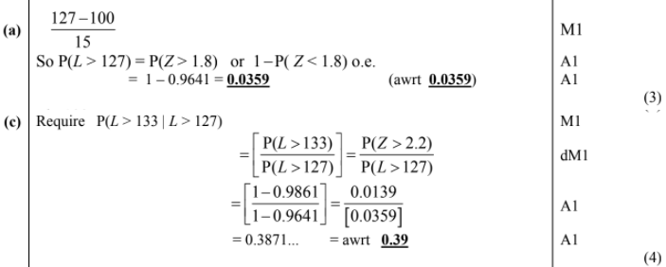
Test Your Understanding
Edexcel S1 Jan 2013 Q4a,c
?
?

Slide 7
Exercise 3.5
Pearson Stats/Mechanics Year 2
Pages 26-27

Slide 8
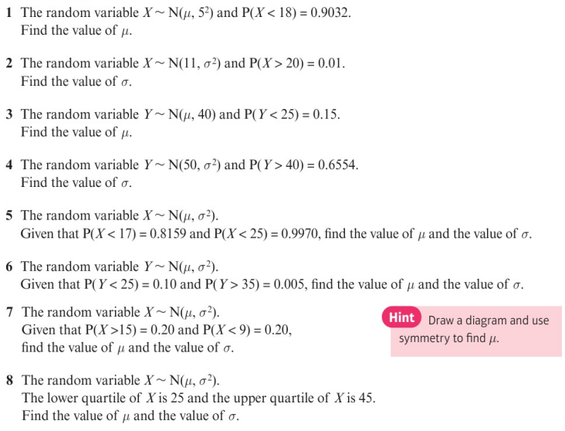
Homework Exercise

Slide 9
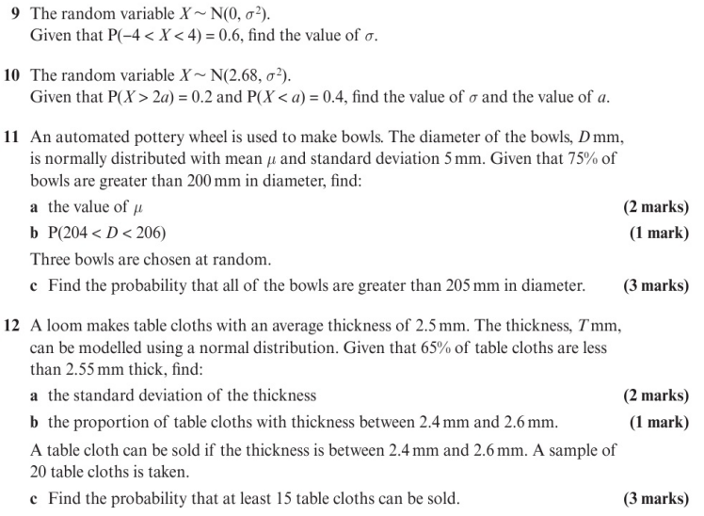
Homework Exercise

Slide 10
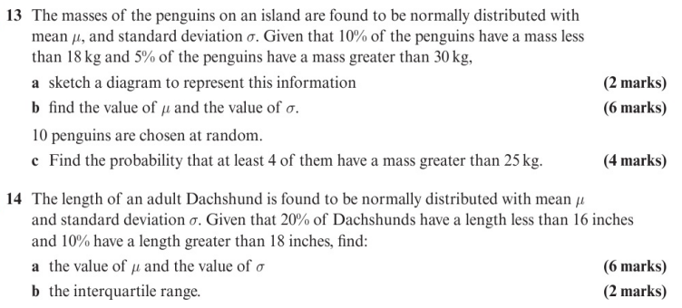
Homework Exercise

Slide 11
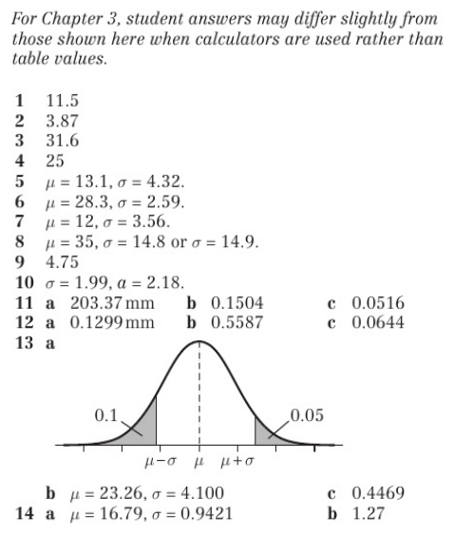
Homework Answers

