Slide 1
Stats1 Chapter 1: Data Collection 1.5 The Large Data Set

Slide 2
Name That Sampling Method!
Simple Random Sampling
Systematic Sampling
Stratified Sampling
Quota
Sampling
Opportunity
Sampling
Suggest a suitable sampling method.
Probably systematic sampling, as the method of choosing items is simpler than simple random sampling (where it would be time-consuming to find specifically chosen random light bulbs). Sampling frame is known.
“You wish to test lightbulbs produced by a factory in a daily batch.”
?
“You wish to survey consumer opinion on your new drink FizzGuzz released in the UK.”
Quota sampling or opportunity sampling. We’d realistically not have access to the sampling frame (i.e. a list of all UK residents).
?
Stratified sampling. We (probably) have access to the sampling frame (i.e. a list of all students). Stratified sampling ensures that each stratum (year group) is proportionately represented.
“You wish to determine students’ favourite TV programmes in your school, that is fairly representative of each year group.”
?

Slide 3
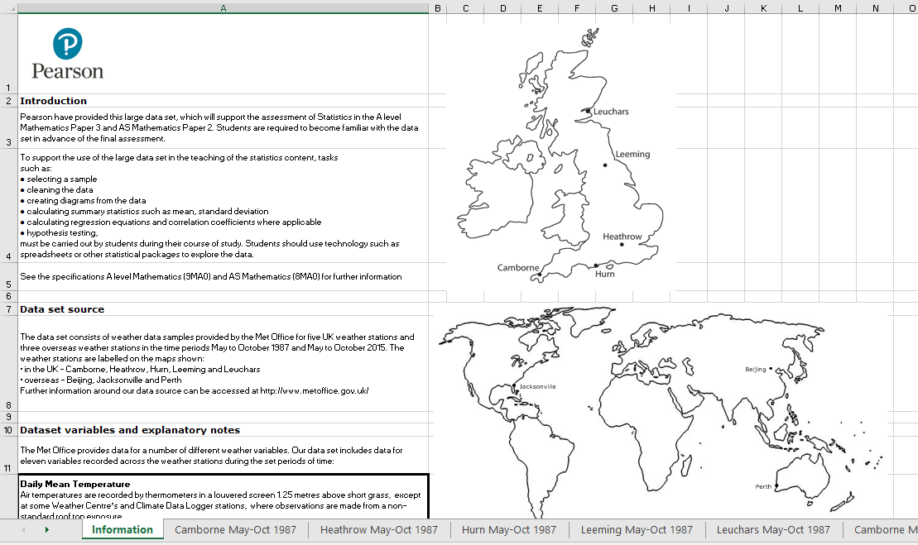
Large Data Set
All A Level exam boards are obligated to provide a ‘large data set’. Data in exam questions will often be from this set, and you are encouraged to explore this data (which is publicly available) in Microsoft Excel.
It is important to note that you are expected to be familiar with this data set before you go into your exam, including some basic geographic knowledge!
Edexcel’s data set concerns weather data from a number of weather stations.
Let’s explore what you might be expected to know…
https://qualifications.pearson.com/content/dam/pdf/A%20Level/Mathematics/2017/specification-and-sample-assesment/Pearson%20Edexcel%20GCE%20AS%20and%20AL%20Mathematics%20data%20set%20-%20Issue%201%20(1).xls

Slide 4
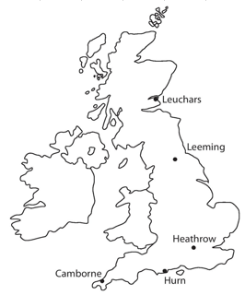
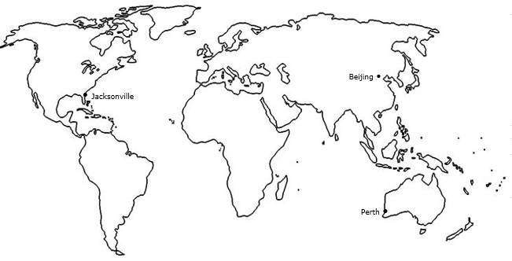
What You Need To Be Familiar With…
Northern Hemisphere
Southern Hemisphere
1
You should know the names and rough locations of the 5 UK weather stations, as well as the 3 international weather stations.
The data was recorded for:
May-Oct 1987
May-Oct 2015

Slide 5
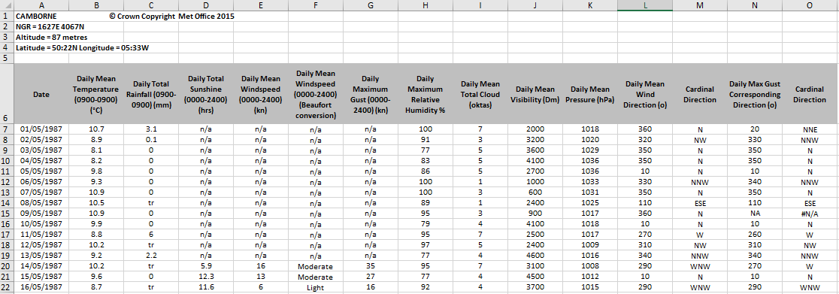
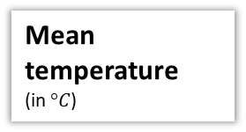
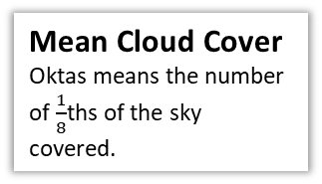
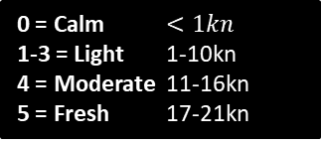
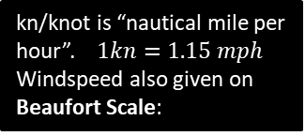
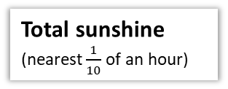
All the following are daily…
2
You should be familiar with the variables involved and their respective units.
Total rainfall
(in mm)
Mean Windspeed
Mean Visibility
How far (in metres) can be seen into the horizon during daylight hours.
kn/knot is “nautical mile per hour”. $1kn=1.15 mph$
Windspeed also given on Beaufort Scale:
0 = Calm $<1kn$
1-3 = Light 1-10kn
4 = Moderate 11-16kn
5 = Fresh 17-21kn
tr/trace means less than 0.05mm
Wind Direction
Mean Pressure
In hectopascals (hPa)
Mean temperature
(in $°C$)
Maximum Gust (in kn) is highest instantaneous wind speed.
Humidity
is the % of air saturation with water vapour. 100% is the maximum % water content air can contain.
Mean Cloud Cover
Oktas means the number of $\frac{1}{8}$ths of the sky covered.
Textbook claims this is max temp for UK, but it is mean temp for all locations.
Total sunshine
(nearest $\frac{1}{10}$ of an hour)

Slide 6
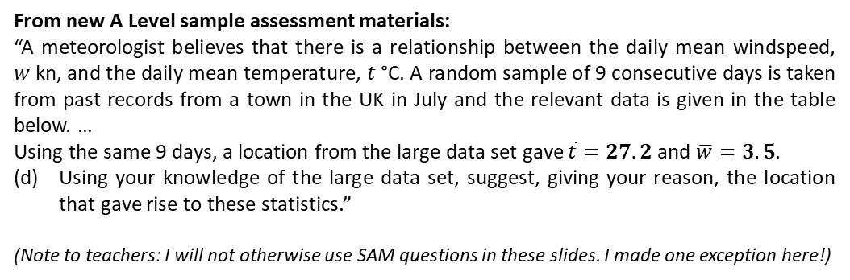
3
You should have a vague idea of the range of values for each location.
UK Location (2015) | Temp Range | Wind Speed Range
Camborne | 10-20 | 3-18
Heathrow | 8-29 | 3-19
Hurn | 6-24 | 2-19
Leeming | 4-23 | 3-17
Leuchars | 4-19 | 3-23
World Location (2015) | Temp Range | Wind Speed Range
Beijing | 8-33 | 2-9
Jacksonville | 15-31 | 1-12
Perth | 8-25 | 4-14
Beijing temp range relatively large.
Min Jacksonville temp high.
Perth similar to UK.
From new A Level sample assessment materials:
“A meteorologist believes that there is a relationship between the daily mean windspeed, $w$ kn, and the daily mean temperature, $t$ °C. A random sample of 9 consecutive days is taken from past records from a town in the UK in July and the relevant data is given in the table below. …
Using the same 9 days, a location from the large data set gave $\overline{t}=27.2$ and $\overline{w}=3.5$.
Using your knowledge of the large data set, suggest, giving your reason, the location that gave rise to these statistics.”
(Note to teachers: I will not otherwise use SAM questions in these slides. I made one exception here!)
Mean wind speed in UK across full period was roughly 9 nm. But 4 nm in Beijing (i.e. lower), 5 in Jacksonville (again lower), 8 in Perth (similar to UK).

Slide 7
4
You should have a vague idea of the range of values for each variable for the data set as a whole.
Variable | Typical value(s)
Gust (UK only) | 8 – 52 nm
Rainfall | 0 – 60 mm in UK, but more extreme maximums elsewhere (e.g. 102mm in Perth)
Pressure | 988 – 1038 hPa
Wind Speed on Beaufort scale | Max is ‘fresh’ (5). Most Light or Moderate.
Sunshine (UK only) | 0 – 16 hrs
Cloud Cover | 0 – 8 ocktas (i.e. full spread)

Slide 8
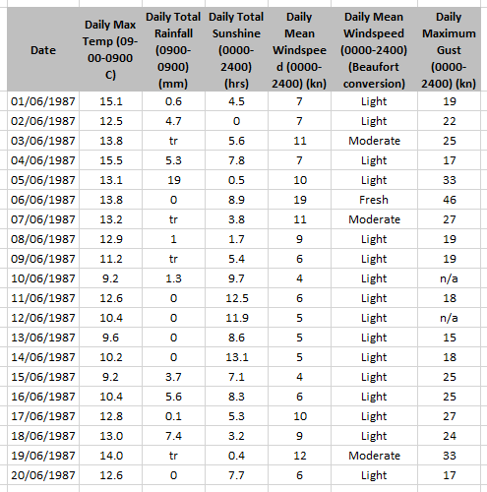
Example Questions
Hurn
© Crown Copyright Met Office 1987
[Textbook]
(a) Describe the type of data represented by daily total rainfall.
Alison is investigating daily maximum gust. She wants to select a sample of size 5 from the first 20 days in Hurn in June 1987. She uses the first two digits of the date as a sampling frame and generates five random numbers between 1 and 20.
b) State the type of sample selected by Alison.
c) Explain why Alison’s process might not generate a sample of size 5.
a
Continuous quantitative data.
Simple random sample.
Some of the data values are not available (n/a).
?
b
?
As previously noted, the actual data set has mean temperature for all locations. I changed to maximum temperature for this example for consistency with the textbook.
c
?

Slide 9

Example Questions
Hurn
© Crown Copyright Met Office 1987
[Textbook] Calculate:
The mean daily maximum temperature for the first five days of June in Hurn in 1987.
The median daily total rainfall for the week of 14th June to 20th June inclusive.
The median daily total rainfall for the same week in Perth was 19.00mm. Karl states that more southerly countries experience higher rainfall during June. State with a reason whether your answer to part (b) supports this statement.
$$70.0÷5=14.0 °C (1dp)$$
Values in ascending order: 0, 0, tr, 0.1, 3.7, 5.6, 7.4.
$∴$ Median is 0.1mm.
Perth is in Australia, which is south of the UK, and the median rainfall was higher. However, this is a very small sample from a single location in each country so does not provide enough evidence to support Karl’s statement.
a
?
b
?
c
?

Slide 10
Exercise 1.5
Pearson Statistics & Mechanics Year 1/AS
Page 5

Slide 11
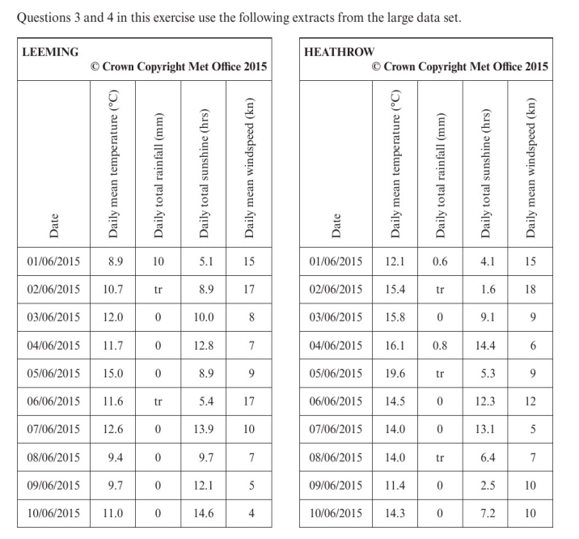
Homework Exercise

Slide 12
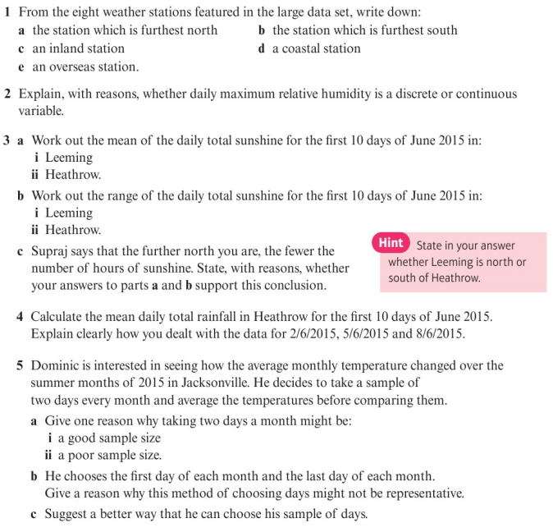
Homework Exercise

Slide 13
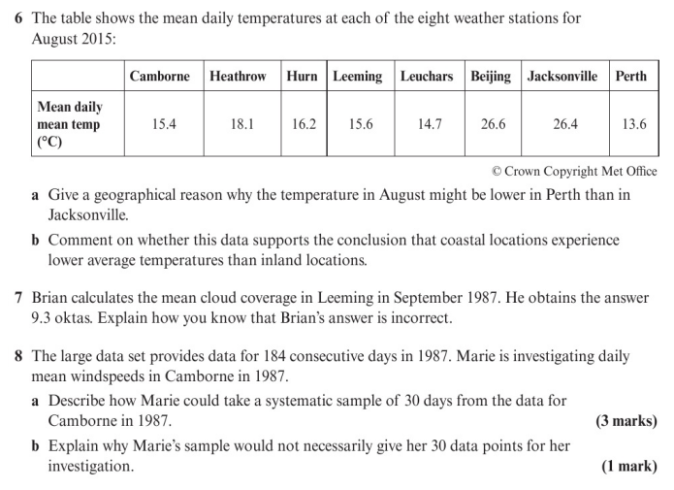
Homework Exercise

Slide 14
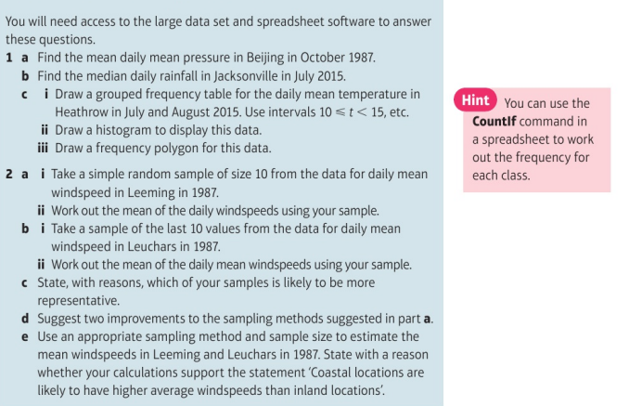
Homework Exercise

Slide 15
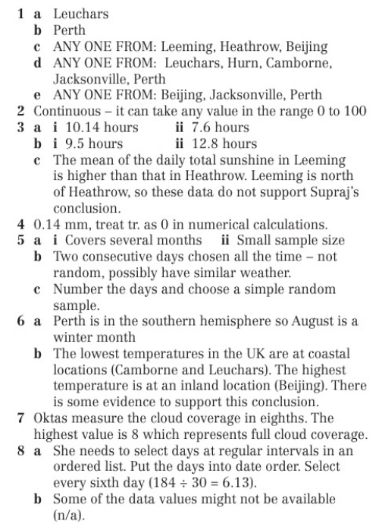
Homework Answers

Slide 16
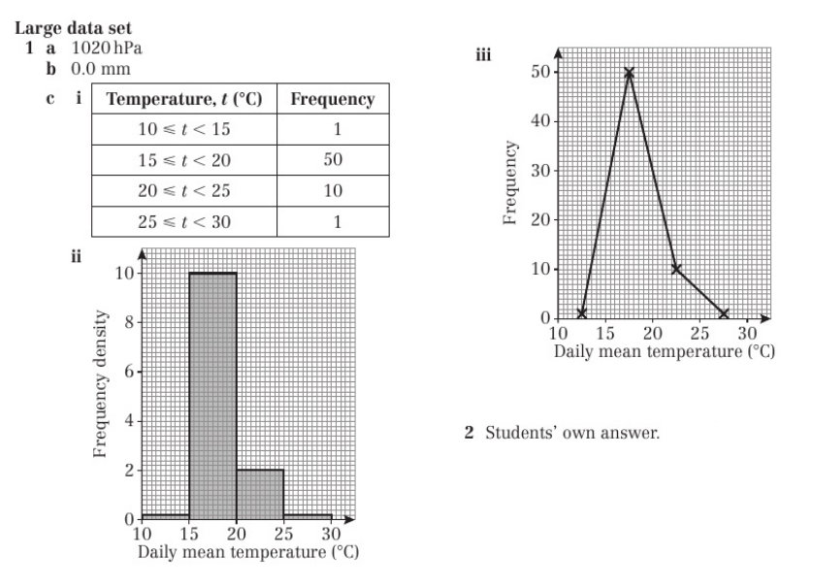
Homework Answers

