Slide 1
P1 Chapter 7: Algebraic Methods Polynominal Fractions

Slide 2
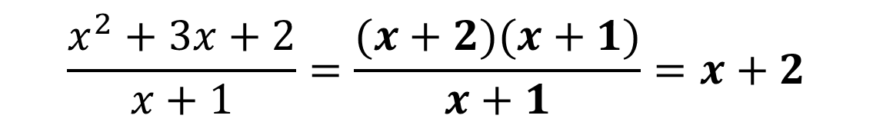
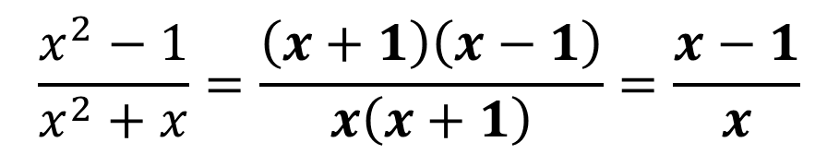
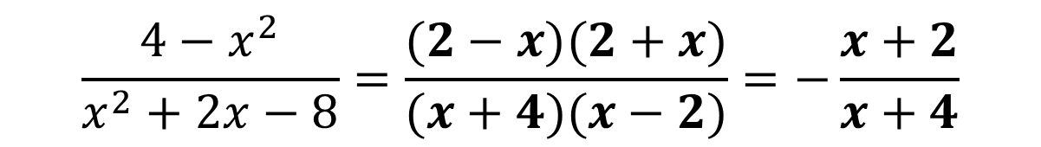
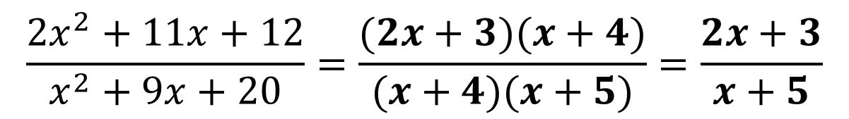
1 :: Simplifying Algebraic Fractions
Recall that you can simplify fractions by dividing the numerator and denominator by a common factor.
Hint: To identify common factors we need to factorise first.
$$\frac{x^{2}−1}{x^{2}+x}=\frac{\left(x+1\right)\left(x−1\right)}{x\left(x+1\right)}=\frac{x−1}{x}$$
?
$$\frac{x^{2}+3x+2}{x+1}=\frac{(x+2)(x+1)}{x+1}=x+2$$
Note: Do not leave 1 in the denominator!
?
Tip: Factorise the easier one first because it provides clues to the factorisation of the other.
$$\frac{2x^{2}+11x+12}{x^{2}+9x+20}=\frac{(2x+3)(x+4)}{(x+4)(x+5)}=\frac{2x+3}{x+5}$$
?
$$\frac{4−x^{2}}{x^{2}+2x−8}=\frac{(2−x)(2+x)}{(x+4)(x−2)}=−\frac{x+2}{x+4}$$
?
Tip: $\frac{a−b}{b−a}=−1$

Slide 3
Exercise 7.1
Pearson Pure Mathematics Year 1/AS
Page 55

Slide 4
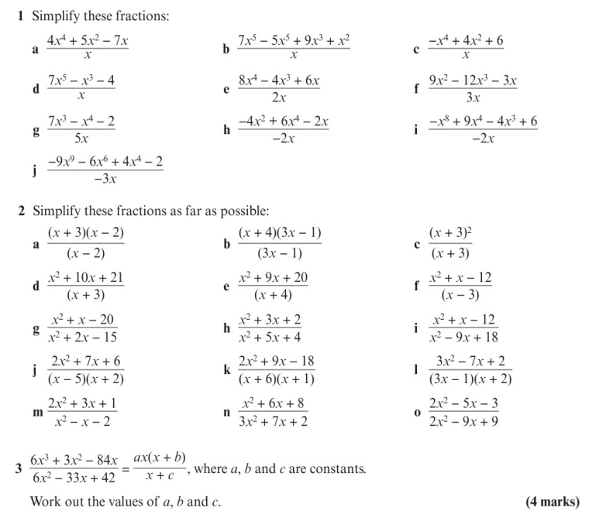
Homework Exercise

Slide 5
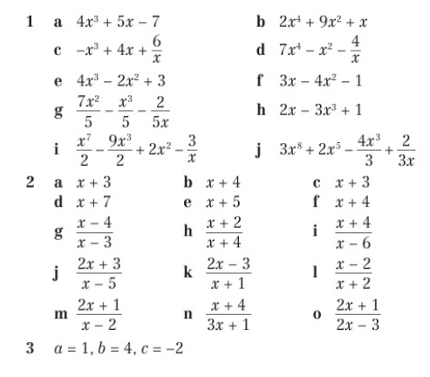
Homework Answers

