Slide 1
M2 Chapter 8: Further Kinematics Vectors in Kinematics

Slide 2
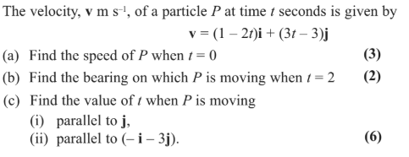
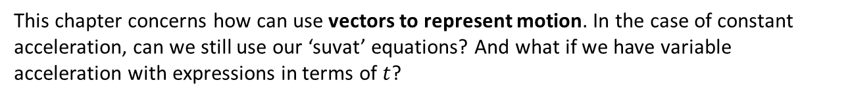
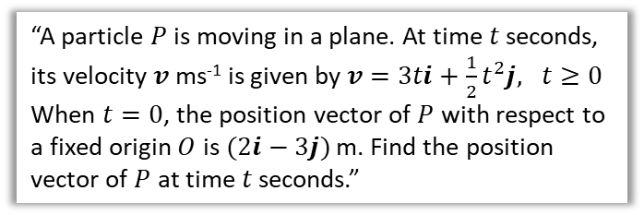
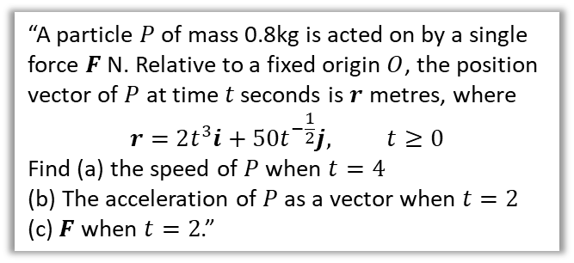
Overview
This chapter concerns how can use vectors to represent motion. In the case of constant acceleration, can we still use our ‘suvat’ equations? And what if we have variable acceleration with expressions in terms of $t$?
1:: Vector equations for motion.
2:: Variable acceleration with vectors.
“A particle $P$ of mass 0.8kg is acted on by a single force $F$ N. Relative to a fixed origin $O$, the position vector of $P$ at time $t$ seconds is $r$ metres, where
$$r=2t^{3}i+50t^{−\frac{1}{2}}j, t≥0$$
Find (a) the speed of $P$ when $t=4$
(b) The acceleration of $P$ as a vector when $t=2$
(c) $F$ when $t=2$.”
3:: Integration with vectors to find velocity/displacement
“A particle $P$ is moving in a plane. At time $t$ seconds, its velocity $v$ ms⁻¹ is given by $v=3ti+\frac{1}{2}t^{2}j, t≥0$
When $t=0$, the position vector of $P$ with respect to a fixed origin $O$ is $(2i−3j)$ m. Find the position vector of $P$ at time $t$ seconds.”

Slide 3





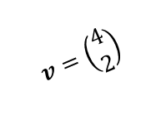
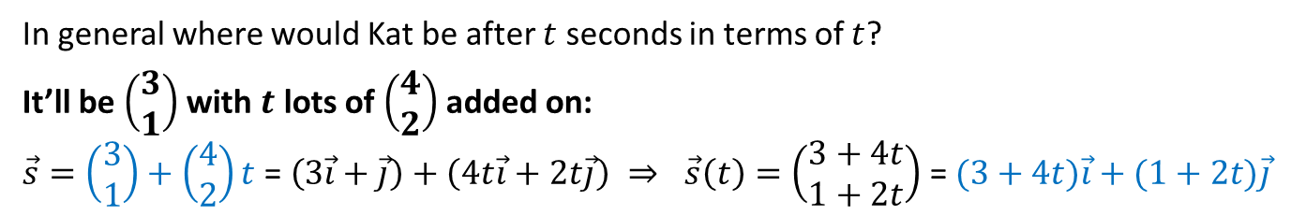
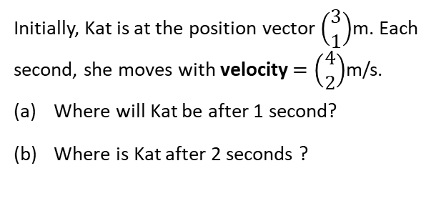

Vector motion
Initially, Kat is at the position vector $\left(\begin{matrix}3 \\ 1\end{matrix}\right)$m. Each second, she moves with velocity $=\left(\begin{matrix}4 \\ 2\end{matrix}\right)$m/s.
Where will Kat be after 1 second?
Where is Kat after 2 seconds ?
(b) $t=2⇒ \vec{s}=\left(\begin{aligned}11 \\ 5\end{aligned}\right)≡11\vec{i}+5\vec{j}$
?
$$t=0$$
?
$$v=\left(\begin{matrix}4 \\ 2\end{matrix}\right)$$
(a) $t=1⇒ \vec{s}=\left(\begin{matrix}7 \\ 3\end{matrix}\right)≡7\vec{i}+3\vec{j}$
$$\left(\begin{matrix}3 \\ 1\end{matrix}\right)$$
In general where would Kat be after $t$ seconds in terms of $t$?
It’ll be $\left(\begin{matrix}3 \\ 1\end{matrix}\right)$ with $t$ lots of $\left(\begin{matrix}4 \\ 2\end{matrix}\right)$ added on:
$\vec{s}=\left(\begin{matrix}3 \\ 1\end{matrix}\right)+\left(\begin{matrix}4 \\ 2\end{matrix}\right)t \text{= }\left(3\vec{i}+\vec{j}\right)+\left(4t\vec{i}+2t\vec{j}\right) ⇒ \vec{s}\left(t\right)=\left(\begin{matrix}3+4t \\ 1+2t\end{matrix}\right)$ = $(3+4t)\vec{i}+(1+2t)\vec{j}$
?
! Position vector $r$ of particle:
$$r=r_{0}+vt$$
where $r_{0}$ is initial position and $v$ is velocity.
Note: The formula comes from ‘common sense’ using the reasoning above.
Note II: Further Mathematicians who have finished Vectors in Core Pure Yr1 may see the similarities with vector equations of straight lines.

Slide 4

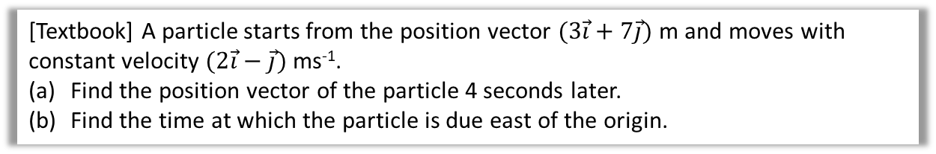
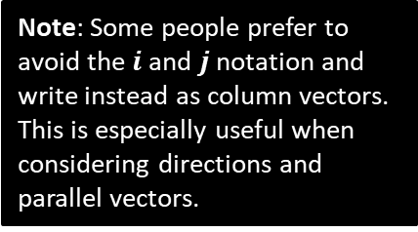
Example
[Textbook] A particle starts from the position vector $(3\vec{i}+7\vec{j})$ m and moves with constant velocity $(2\vec{i}−\vec{j})$ ms⁻¹.
Find the position vector of the particle 4 seconds later.
Find the time at which the particle is due east of the origin.
a
$$r=\left(\begin{matrix}3 \\ 7\end{matrix}\right)+4\left(\begin{matrix}2 \\ −1\end{matrix}\right)=\left(\begin{matrix}11 \\ 3\end{matrix}\right) \\ =\left(\begin{matrix}11 \\ 3\end{matrix}\right) m$$
If due East, then the $j$ component is 0:
$$r=\left(\begin{matrix}3 \\ 7\end{matrix}\right)+t\left(\begin{matrix}2 \\ −1\end{matrix}\right)=\left(\begin{matrix}3+2t \\ 7−t\end{matrix}\right)$$
$7−t=0 → t=7$ seconds
?
Note: Some people prefer to avoid the $i$ and $j$ notation and write instead as column vectors. This is especially useful when considering directions and parallel vectors.
b
?

Slide 5

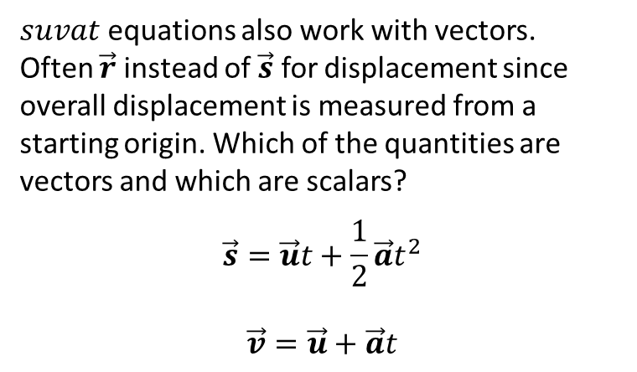
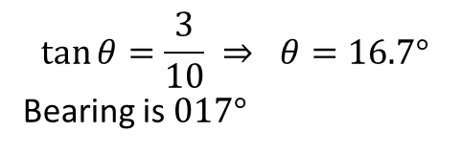
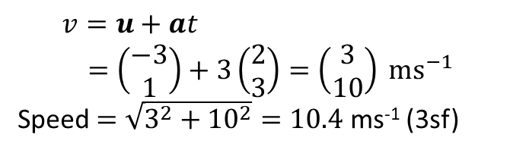
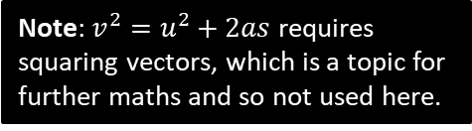
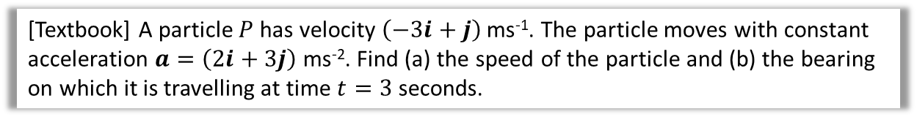



$suvat$… but with vectors!
Which of the quantities are vectors and which are scalars?
$suvat$ equations also work with vectors. Often $\vec{r}$ instead of $\vec{s}$ for displacement since overall displacement is measured from a starting origin. Which of the quantities are vectors and which are scalars?
$$\vec{s}=\vec{u}t+\frac{1}{2}\vec{a}t^{2}$$
$$\vec{v}=\vec{u}+\vec{a}t$$
$s=$ vector
$u=$ vector
$v=$ vector
$a=$ vector
$t=$ scalar
?
?
?
?
Note: $v^{2}=u^{2}+2as$ requires squaring vectors, which is a topic for further maths and so not used here.
[Textbook] A particle $P$ has velocity $\left(−3i+j\right)$ ms⁻¹. The particle moves with constant acceleration $a=\left(2i+3j\right)$ ms⁻². Find (a) the speed of the particle and (b) the bearing on which it is travelling at time $t=3$ seconds.
a
?
b
$$3$$
?
$$\tan{θ}=\frac{3}{10} ⇒ θ=16.7°$$
Bearing is $017°$
$$v=u+at \\ =\left(\begin{matrix}−3 \\ 1\end{matrix}\right)+3\left(\begin{matrix}2 \\ 3\end{matrix}\right)=\left(\begin{matrix}3 \\ 10\end{matrix}\right) ms^{−1}$$
Speed $=\sqrt{3^{2}+{10}^{2}}=10.4$ ms⁻¹ (3sf)
$$10$$
$$θ$$
The velocity vector gives the direction of motion. Just draw it out to establish angles.
Remember that speed is the scalar for of velocity, so find magnitude of the vector.

Slide 6

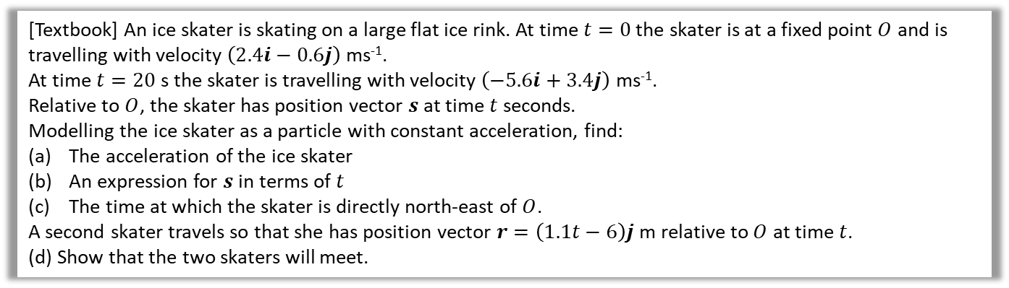


Further Example
[Textbook] An ice skater is skating on a large flat ice rink. At time $t=0$ the skater is at a fixed point $O$ and is travelling with velocity $\left(2.4i−0.6j\right)$ ms⁻¹.
At time $t=20$ s the skater is travelling with velocity $\left(−5.6i+3.4j\right)$ ms⁻¹.
Relative to $O$, the skater has position vector $s$ at time $t$ seconds.
Modelling the ice skater as a particle with constant acceleration, find:
The acceleration of the ice skater
An expression for $s$ in terms of $t$
The time at which the skater is directly north-east of $O$.
A second skater travels so that she has position vector $r=\left(1.1t−6\right)j$ m relative to $O$ at time $t$.
(d) Show that the two skaters will meet.
When north-east of $O$, the $i$ component will be the same as the $j$ component.
$$2.4t−0.2t^{2}=−0.6t+0.1t^{2} \\ 3t\left(1−0.1t\right)=0 \\ t=0 or t=10$$
When they meet, two position vectors will be the same:
$$\left(\begin{matrix}2.4t−0.2t^{2} \\ −0.6t+0.1t^{2}\end{matrix}\right)=\left(\begin{matrix}0 \\ 1.1t−6\end{matrix}\right)$$
$$2.4t−0.2t^{2}=0 → 2t\left(12−t\right)=0 \\ t=0 or t=12$$
When $t=0$, $−0.6\left(0\right)+0.1\left(0^{2}\right)=0$
But $1.1\left(0\right)−6=−6$ so do not meet when $t=0$
When $t=12$, $−0.6\left(12\right)+0.1\left({12}^{2}\right)=7.2$ and $1.1\left(12\right)−6=7.2$ so skaters meet when $t=12$ seconds.
c
$$s$$
a
Using $v=u+at$,
$$\left(\begin{matrix}−5.6 \\ 3.4\end{matrix}\right)=\left(\begin{matrix}2.4 \\ −0.6\end{matrix}\right)+20a \\ 20a=\left(\begin{matrix}−8 \\ 4\end{matrix}\right) \\ a=\left(\begin{matrix}−0.4 \\ 0.2\end{matrix}\right) ms^{−2}$$
Using $s=ut+\frac{1}{2}at^{2}$,
$$s=\left(\begin{matrix}2.4 \\ −0.6\end{matrix}\right)t+\frac{1}{2}\left(\begin{matrix}−0.4 \\ 0.2\end{matrix}\right)t^{2} \\ =\left(\begin{matrix}2.4t−0.2t^{2} \\ −0.6t+0.1t^{2}\end{matrix}\right) m$$
?
?
d
?
b
?

Slide 7
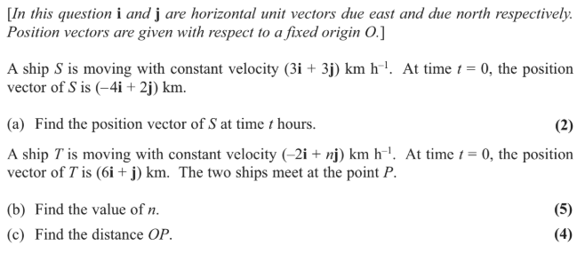
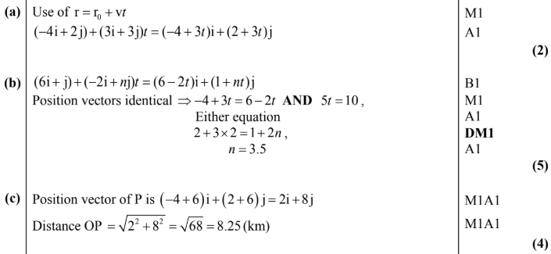
Test Your Understanding
Edexcel M1(Old) May 2013(R) Q6
?
?
?

Slide 8
Exercise 8.1
Pearson Stats/Mechanics Year 2
Pages 68-69

Slide 9
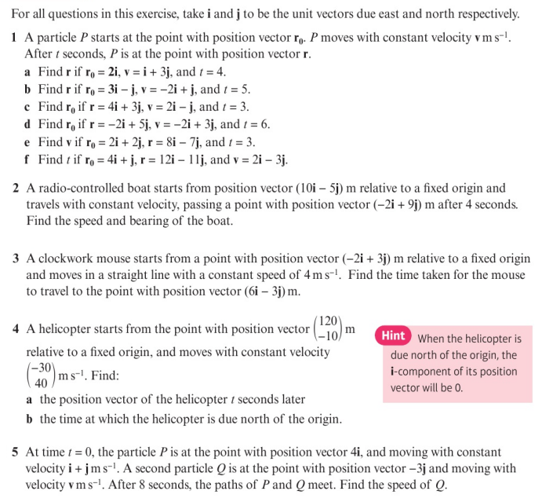
Homework Exercise

Slide 10
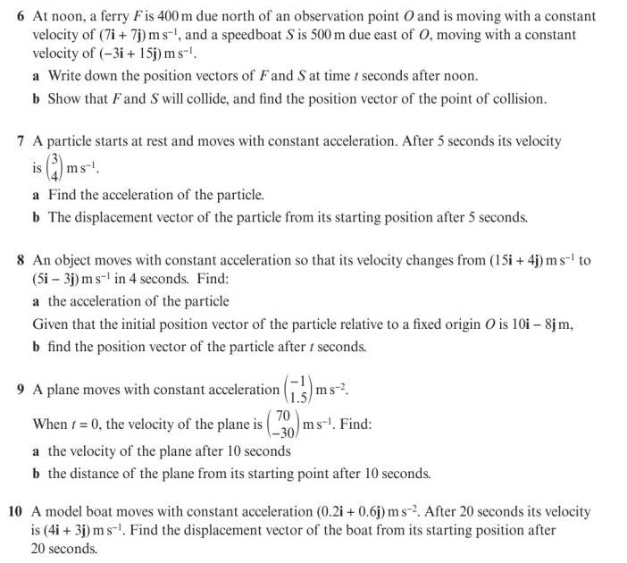
Homework Exercise

Slide 11
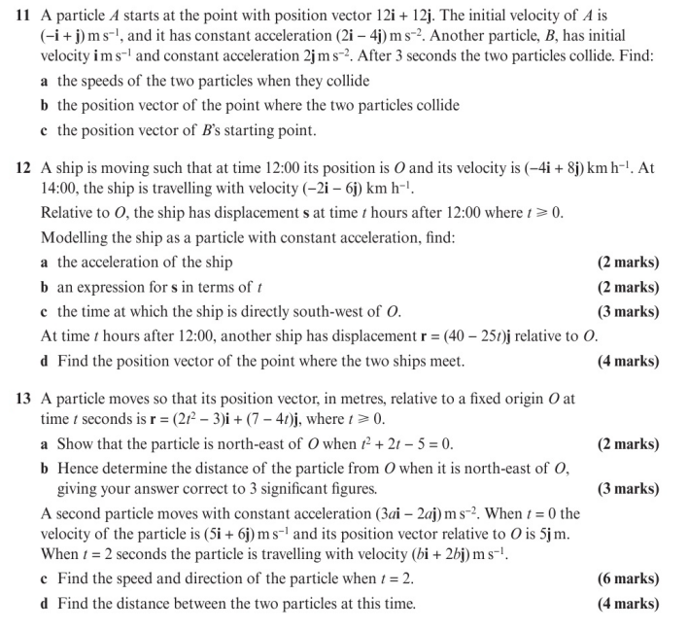
Homework Exercise

Slide 12
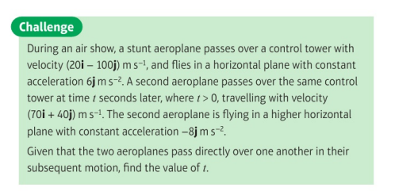
Homework Exercise

Slide 13
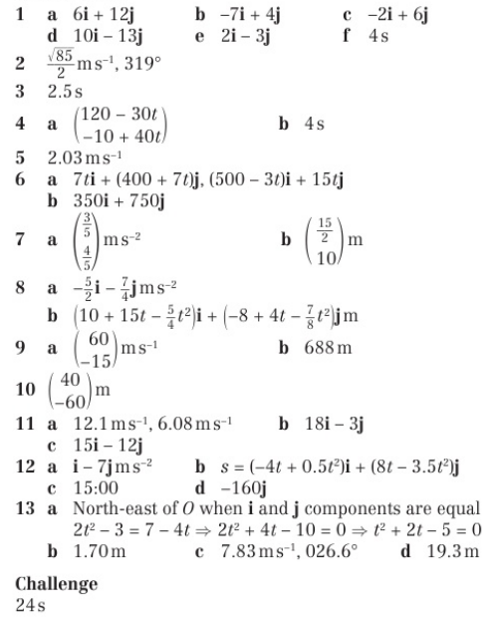
Homework Answers

