Slide 1
Stats1 Chapter 7: Hypothesis Tests Null and Alternative Hypothesis

Slide 2
Experimental
i.e. Dealing with collected data.
Chp2: Measures of Location/Spread
Chp3: Representation of Data
Chp1: Data Collection
Statistics used to summarise data, including mean, standard deviation, quartiles, percentiles. Use of linear interpolation for estimating medians/quartiles.
Producing and interpreting visual representations of data, including box plots and histograms.
Methods of sampling, types of data, and populations vs samples.
Chp4: Correlation
Measuring how related two variables are, and using linear regression to predict values.
Theoretical
Deal with probabilities and modelling to make inferences about what we ‘expect’ to see or make predictions, often using this to reason about/contrast with experimentally collected data.
Chp5: Probability
Chp6: Statistical Distributions
Chp7: Hypothesis Testing
Venn Diagrams, mutually exclusive + independent events, tree diagrams.
Common distributions used to easily find probabilities under certain modelling conditions, e.g. binomial distribution.
Determining how likely observed data would have happened ‘by chance’, and making subsequent deductions.

Slide 3
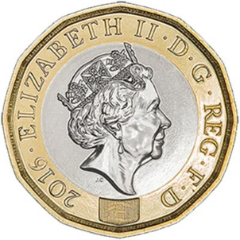


What is Hypothesis Testing?
I throw a coin 10 times. For what numbers of heads might you conclude that the coin is biased towards heads? Why?
Our intuition is that the further away we are from the ‘expected’ number of heads (i.e. 5 heads out of 10), the more unlikely it is.
$$p(x)$$
8 Heads still moderately likely to happen ‘by chance’.
Unlikely to happen ‘by chance’.
0 1 2 3 4 5 6 7 8 9 10
Number of heads ($x$)

Slide 4
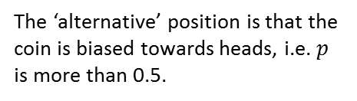

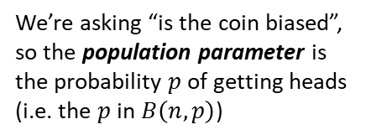
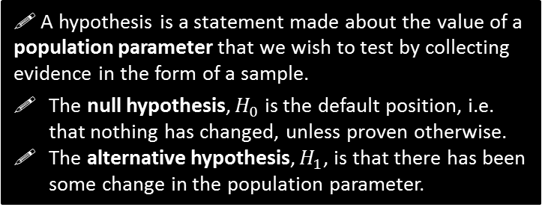
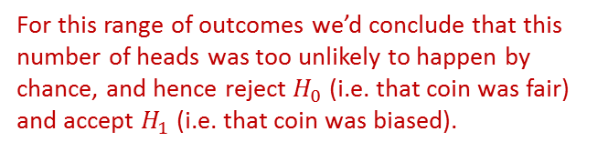

What is Hypothesis Testing?
I throw a coin 10 times. For what numbers of heads might you conclude that the coin is biased towards heads? Why?
! A hypothesis is a statement made about the value of a population parameter that we wish to test by collecting evidence in the form of a sample.
The null hypothesis, $H_{0}$ is the default position, i.e. that nothing has changed, unless proven otherwise.
The alternative hypothesis, $H_{1}$, is that there has been some change in the population parameter.
In this context…
We’re asking “is the coin biased”, so the population parameter is the probability $p$ of getting heads (i.e. the $p$ in $B\left(n,p\right)$)
?
The ‘default position’ is that the coin is fair, i.e. $p=0.5$.
?
$$p(x)$$
For this range of outcomes we wouldn’t conclude the coin is biased, i.e. we’d “accept $H_{0}$”
The ‘alternative’ position is that the coin is biased towards heads, i.e. $p$ is more than 0.5.
?
For this range of outcomes we’d conclude that this number of heads was too unlikely to happen by chance, and hence reject $H_{0}$ (i.e. that coin was fair) and accept $H_{1}$ (i.e. that coin was biased).
0 1 2 3 4 5 6 7 8 9 10
Number of heads ($x$)

Slide 5

What is Hypothesis Testing?
I throw a coin 10 times. For what numbers of heads might you conclude that the coin is biased towards heads? Why?
In this context…
! In a hypothesis test, the evidence from the sample is a test statistic.
?
The test statistic $X$ is what we observed, in this case, $X$ is the number of heads seen in 10 throws.
Note that the test statistic is a distribution (i.e. across the possible things we might observe).
$$X\sim B(10,p)$$
noting that $p$ is not known until we start making assumptions.
$$p(x)$$
0 1 2 3 4 5 6 7 8 9 10
Number of heads ($x$)

Slide 6
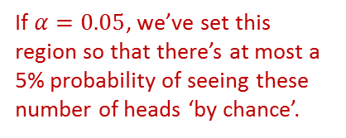
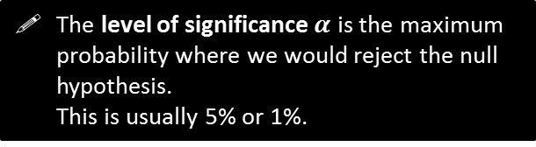

What is Hypothesis Testing?
I throw a coin 10 times. For what numbers of heads might you conclude that the coin is biased towards heads? Why?
In this context…
The level of significance $α$ is the maximum probability where we would reject the null hypothesis. This is usually 5% or 1%.
?
We said that if we saw a number of heads within ranges of outcomes that were sufficiently unlikely, then we’d rule out that the coin is fair and conclude it was in fact biased.
But how unlikely is ‘sufficiently unlikely’? If $α=5\%$, then we’d find a region of outcomes where there’s (at most) a 5% chance of one of these extreme values happening ‘by chance’ (i.e. if the coin was fair).
$$p(x)$$
If $α=0.05$, we’ve set this region so that there’s at most a 5% probability of seeing these number of heads ‘by chance’.
0 1 2 3 4 5 6 7 8 9 10
Number of heads ($x$)

Slide 7
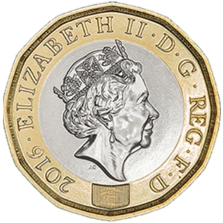
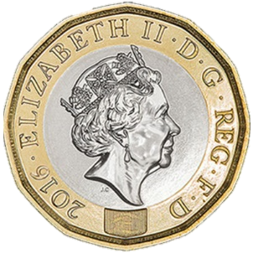
What is Hypothesis Testing?
!
Hypothesis testing in a nutshell then is:
We have some hypothesis we wish to see if true (e.g. coin is biased towards heads), so…
We collect some sample data by throwing the coin (giving us our ‘test statistic’) and…
If that number of heads (or more) is sufficiently unlikely to have emerged ‘just by chance’, then we conclude that our (alternative) hypothesis is correct, i.e. the coin is biased.

Slide 8
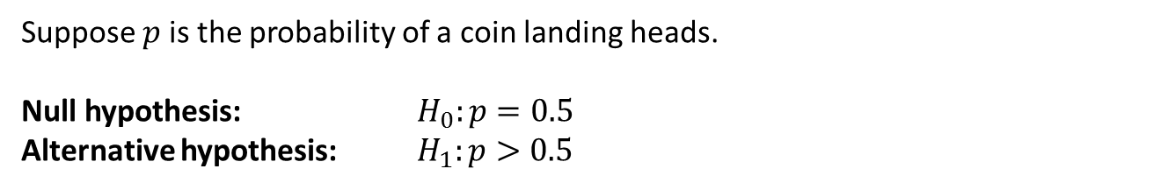
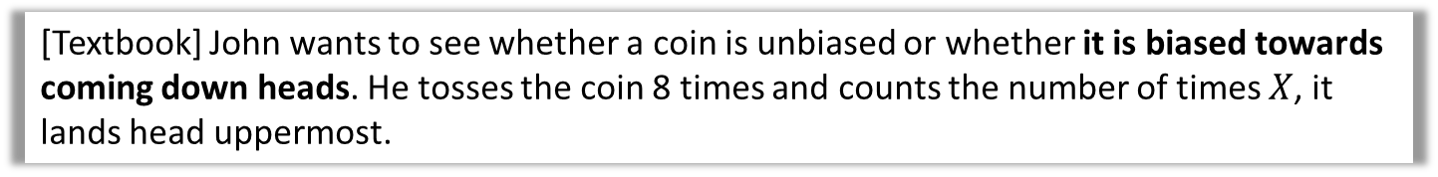
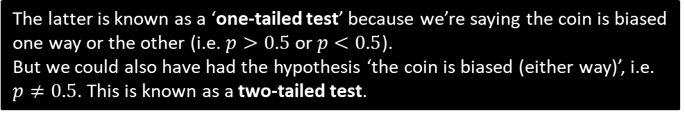
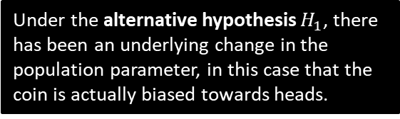
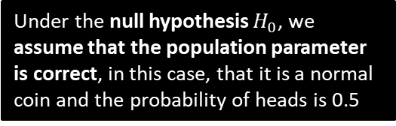
Null Hypothesis and Alternative Hypothesis
[Textbook] John wants to see whether a coin is unbiased or whether it is biased towards coming down heads. He tosses the coin 8 times and counts the number of times $X$, it lands head uppermost.
We said that our two hypotheses are about the population parameter.
Suppose $p$ is the probability of a coin landing heads.
Null hypothesis: $H_{0}:p=0.5$
Alternative hypothesis: $H_{1}:p>0.5$
?
Under the null hypothesis $H_{0}$, we assume that the population parameter is correct, in this case, that it is a normal coin and the probability of heads is 0.5
?
Under the alternative hypothesis $H_{1}$, there has been an underlying change in the population parameter, in this case that the coin is actually biased towards heads.
The latter is known as a ‘one-tailed test’ because we’re saying the coin is biased one way or the other (i.e. $p>0.5$ or $p<0.5$).
But we could also have had the hypothesis ‘the coin is biased (either way)’, i.e. $p≠0.5$. This is known as a two-tailed test.

Slide 9
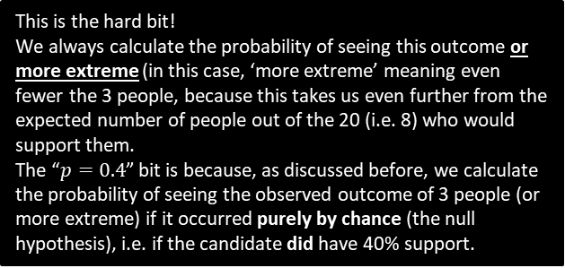

Further Example
[Textbook] An election candidate believes she has the support of 40% of the residents in a particular town. A researcher wants to test, at the 5% significance level, whether the candidate is over-estimating her support. The researcher asks 20 people whether they support the candidate or not. 3 people say they do.
Write down a suitable test statistic.
Write down two suitable hypotheses.
Explain the condition under which the null hypothesis would be rejected.
The number of people who say they support the candidate.
$$H_{0}:p=0.4 \\ H_{1}:p<0.4$$
Null hypothesis would be rejected if the probability of 3 or fewer people supporting the candidate is less than 5%, given that $p=0.4$
For a hypothesis test involving the binomial distribution, the test statistic is always the count of successes.
a
?
The alternative hypothesis is that the candidate is overestimating her support, so we’re interested where less than 40% support them (more than 40% would not undermine the candidate’s claim).
b
?
c
?
This is the hard bit!
We always calculate the probability of seeing this outcome or more extreme (in this case, ‘more extreme’ meaning even fewer the 3 people, because this takes us even further from the expected number of people out of the 20 (i.e. 8) who would support them.
The “$p=0.4$” bit is because, as discussed before, we calculate the probability of seeing the observed outcome of 3 people (or more extreme) if it occurred purely by chance (the null hypothesis), i.e. if the candidate did have 40% support.

Slide 10
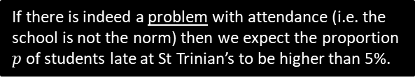

Test Your Understanding
In the UK, 5% of students turn up late to school each day. Mr Hameed wishes to determine, to a 10% significance level if St Trinian’s School has a problem with attendance. He stands at the front gate one day and finds that 6 of the 40 students who pass him are late.
Write down a suitable test statistic.
Write down two suitable hypotheses.
Explain the condition under which the null hypothesis would be rejected.
a
The number of students who are late to school that day.
$$H_{0}:p=0.05 \\ H_{1}:p>0.05$$
Null hypothesis would be rejected if the probability of 6 or more students being late to school is less than 10%, given that $p=0.05$
?
If there is indeed a problem with attendance (i.e. the school is not the norm) then we expect the proportion $p$ of students late at St Trinian’s to be higher than 5%.
b
?
c
?
Just to reiterate again what’s going on here:
We assume that the school is the norm (i.e. 5% of students are late), and calculate the probability that 6 or more students would be late under this assumption.
If the probability of this happening by chance is sufficiently unlikely (less than the 10% significance level), we conclude that it probably isn’t just by chance, and the school’s lateness rate is worse than 5%.

Slide 11
Exercise 7.1
Pearson Applied Year 1/AS
Pages 45

Slide 12
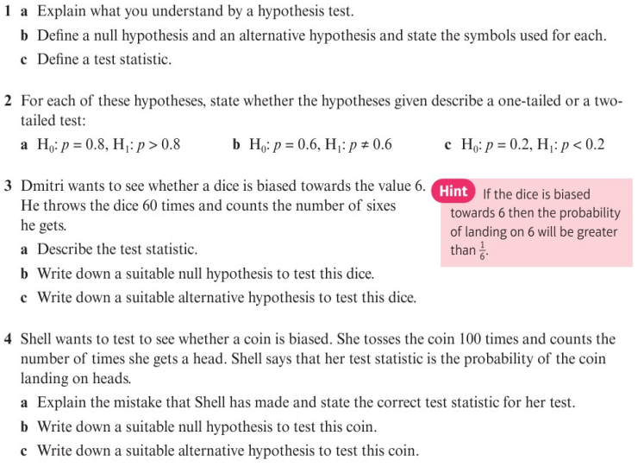
Homework Exercise

Slide 13
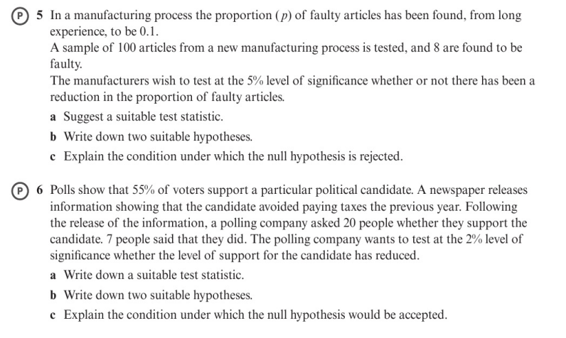
Homework Exercise

Slide 14
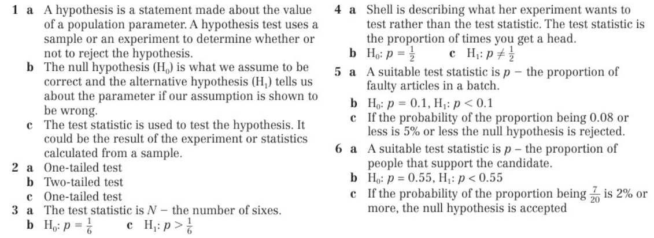
Homework Answers

