Slide 1
P1 Chapter 13: Integration
Areas Under Curves

Slide 2




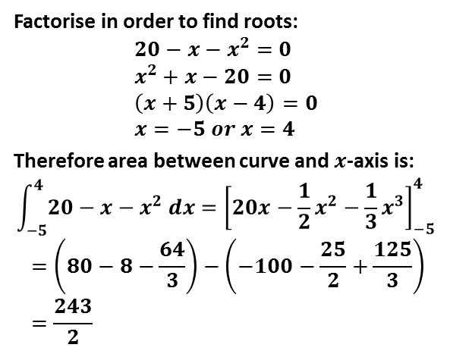
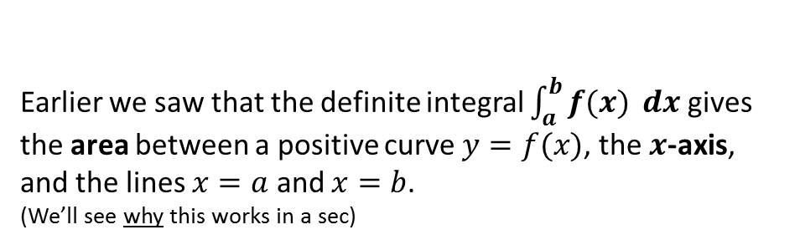







Areas under curves
$$y$$
$$y=f(x)$$
Earlier we saw that the definite integral $\int_{a}^{b}{f(x)} dx$ gives the area between a positive curve $y=f(x)$, the $x$-axis, and the lines $x=a$ and $x=b$.
(We’ll see why this works in a sec)
$$Area$$
$$Area=distance$$
$$x$$
$$a$$
$$b$$
Find the area of the finite region between the curve with equation $y=20−x−x^{2}$ and the $x$-axis.
?
Factorise in order to find roots:
$$20−x−x^{2}=0 \\ x^{2}+x−20=0 \\ \left(x+5\right)\left(x−4\right)=0 \\ x=−5 or x=4$$
Therefore area between curve and $x$-axis is:
$$\int_{−5}^{4}{20−x−x^{2} dx}={\left[20x−\frac{1}{2}x^{2}−\frac{1}{3}x^{3}\right]}_{−5}^{4} \\ =\left(80−8−\frac{64}{3}\right)−\left(−100−\frac{25}{2}+\frac{125}{3}\right) \\ =\frac{243}{2}$$
$$y$$
$$x$$
$$−5$$
$$4$$

Slide 3
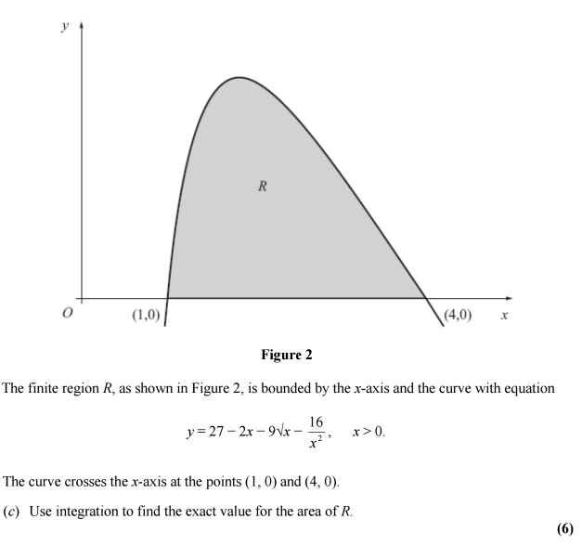
Test Your Understanding
Edexcel C2 Jan 2013 Q9c
?
Solution: 12

Slide 4




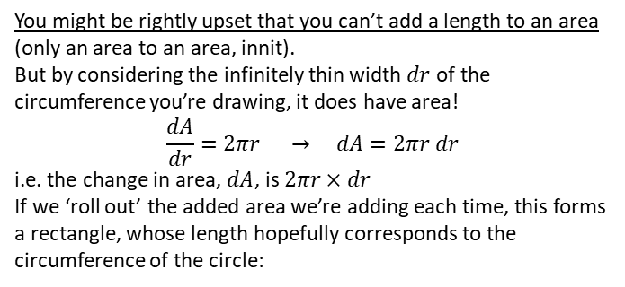


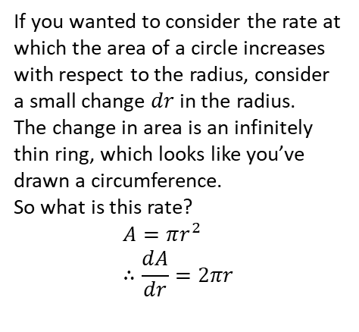

Just for your interest…
Why does integrating a function give you the area under the graph?
Part 1:
You’re already familiar with the idea that gradient is the rate at which a quantity changes, and we consider an infinitesimally small change in the variable.
You could consider the gradient as the little bit you’re adding on each time.
Here’s some practical examples using formulae you covered in your younger years!
So to draw a shaded circle (which has area!), it’s a bit like repeatedly drawing the circumference of a circle with gradually increasing radius.
Since the circumference is what the area is increasing by each time, the circumference is the gradient of the area of the circle, and conversely (by the definition of integration being the opposite of differentiation), the area is the integral of the circumference.
You might be rightly upset that you can’t add a length to an area (only an area to an area, innit).
But by considering the infinitely thin width $dr$ of the circumference you’re drawing, it does have area!
$$\frac{dA}{dr}=2πr → dA=2πr dr$$
i.e. the change in area, $dA$, is $2πr×dr$
If we ‘roll out’ the added area we’re adding each time, this forms a rectangle, whose length hopefully corresponds to the circumference of the circle:
$$dr$$
If you wanted to consider the rate at which the area of a circle increases with respect to the radius, consider a small change $dr$ in the radius.
The change in area is an infinitely thin ring, which looks like you’ve drawn a circumference.
So what is this rate?
$$A=πr^{2} \\ ∴\frac{dA}{dr}=2πr$$
$$r$$
$$?$$
$$dr$$
If the added area is $2πr dr$ and the thickness is $dr$, then the length is $\frac{2πr dr}{dr}=2πr$ as expected.
OMG THAT IS THE CIRCUMFERENCE

Slide 5
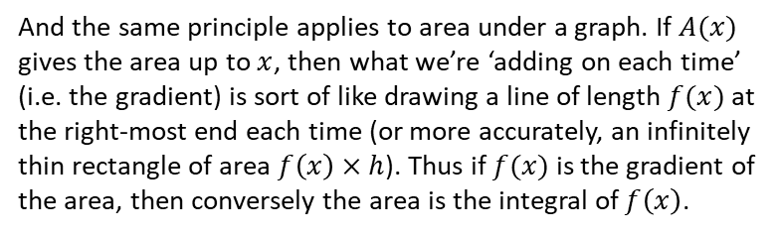

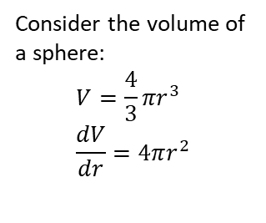

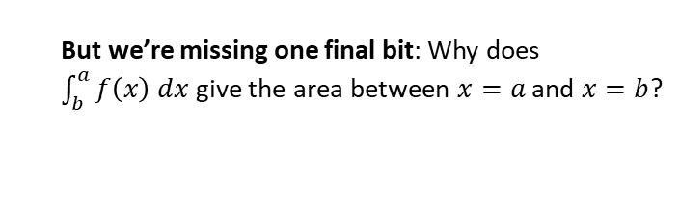
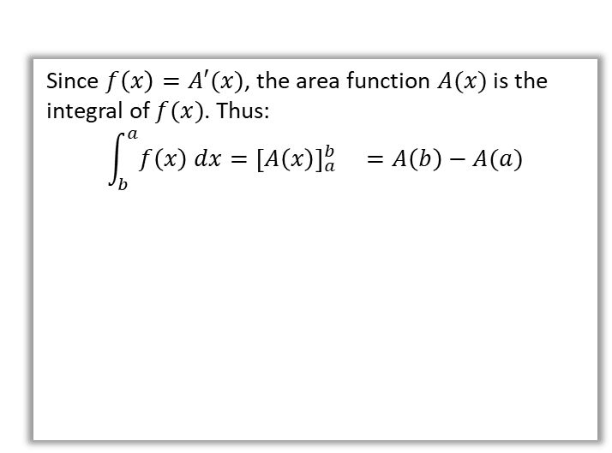

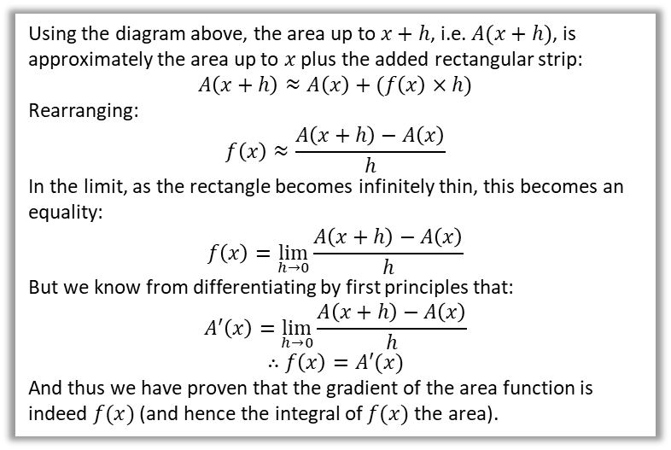





Part 2:
It gets better!
Consider the volume of a sphere:
$$V=\frac{4}{3}πr^{3} \\ \frac{dV}{dr}=4πr^{2}$$
$$f(x)$$
$$A(x)$$
$$h$$
$$x$$
$$x+h$$
And the same principle applies to area under a graph. If $A(x)$ gives the area up to $x$, then what we’re ‘adding on each time’ (i.e. the gradient) is sort of like drawing a line of length $f(x)$ at the right-most end each time (or more accurately, an infinitely thin rectangle of area $f\left(x\right)×h$). Thus if $f(x)$ is the gradient of the area, then conversely the area is the integral of $f\left(x\right)$.
OMG THAT’S THE SURFACE AREA
This works for a similar reason to before.
This gives us an intuitive sense of why it works, but we need a formal proof:
But we’re missing one final bit: Why does $\int_{b}^{a}{f\left(x\right) dx}$ give the area between $x=a$ and $x=b$?
Using the diagram above, the area up to $x+h$, i.e. $A(x+h)$, is approximately the area up to $x$ plus the added rectangular strip:
$$A\left(x+h\right)≈A\left(x\right)+(f\left(x\right)×h)$$
Rearranging:
$$f\left(x\right)≈\frac{A\left(x+h\right)−A\left(x\right)}{h}$$
In the limit, as the rectangle becomes infinitely thin, this becomes an equality:
$$f\left(x\right)=\lim_{h→0}{\frac{A\left(x+h\right)−A\left(x\right)}{h}}$$
But we know from differentiating by first principles that:
$$A^{′}\left(x\right)=\lim_{h→0}{\frac{A\left(x+h\right)−A\left(x\right)}{h}}$$
$$∴f\left(x\right)=A′(x)$$
And thus we have proven that the gradient of the area function is indeed $f(x)$ (and hence the integral of $f(x)$ the area).
Since $f\left(x\right)=A′(x)$, the area function $A(x)$ is the integral of $f(x)$. Thus:
$$\int_{b}^{a}{f\left(x\right) dx}={\left[A\left(x\right)\right]}_{a}^{b} =A\left(b\right)−A(a)$$
The area between $a$ and $b$ is the area up to $b$, i.e. $A(b)$, with the area up to $a$, i.e. $A\left(a\right)$, cut out. This gives $A\left(b\right)−A\left(a\right)$ as expected.
Because we obtained $A(x)$ by an integration, we have a constant of integration $+c$. But because of the subtraction $A\left(b\right)−A(a)$, these constants in each of $A(b)$ and $A\left(a\right)$ cancel, which explains why the constant is not present in definite integration.
$$a$$
$$b$$
This is known as the Fundamental Theorem of Calculus.

Slide 6
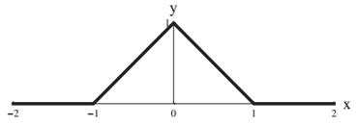

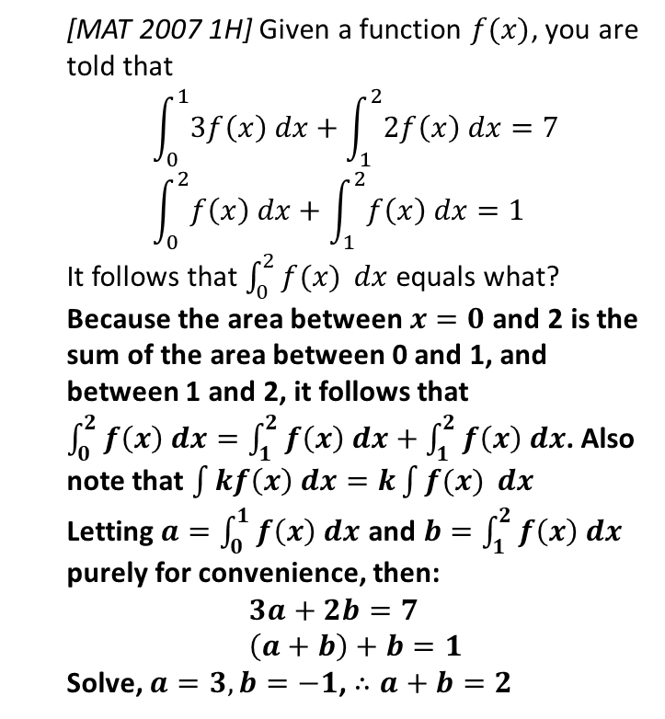
Exercise 13.5
Pearson Pure Mathematics Year 1/AS
Page 107
Extension
2
[MAT 2011 1G]
A graph of the function $y=f\left(x\right)$ is sketched on the axes below:
What is the value of $\int_{−1}^{1}{f(x^{2}−1)} dx$?
We first need to reflect on what part of the function $f$ we’re actually using. $x$ in the integral varies between -1 and 1, thus $x^{2}−1$, i.e. the input of $f$, varies between -1 and 0.
We’re therefore only using the left half of the graph, and thus $f\left(x\right)=x+1$
$$∴\int_{−1}^{1}{f(x^{2}−1)} dx=\int_{−1}^{1}{\left(x^{2}−1\right)+1 dx} \\ ={\left[\frac{1}{3}x^{3}\right]}_{−1}^{1}=\left(\frac{1}{3}\right)−\left(−\frac{1}{3}\right)=\frac{2}{3}$$
1
[MAT 2007 1H] Given a function $f(x)$, you are told that
$$\int_{0}^{1}{3f\left(x\right) dx}+\int_{1}^{2}{2f\left(x\right) dx}=7 \\ \int_{0}^{2}{f\left(x\right) dx}+\int_{1}^{2}{f\left(x\right) dx}=1$$
It follows that $\int_{0}^{2}{f(x)} dx$ equals what?
Because the area between $x=0$ and 2 is the sum of the area between 0 and 1, and between 1 and 2, it follows that $\int_{0}^{2}{f\left(x\right) dx}=\int_{1}^{2}{f\left(x\right) dx}+\int_{1}^{2}{f\left(x\right) dx}$. Also note that $\int{kf\left(x\right) dx}=k\int{f(x)} dx$
Letting $a=\int_{0}^{1}{f\left(x\right) dx}$ and $b=\int_{1}^{2}{f\left(x\right) dx}$ purely for convenience, then:
$$3a+2b=7 \\ \left(a+b\right)+b=1$$
Solve, $a=3, b=−1$, $∴a+b=2$
?
?

Slide 7
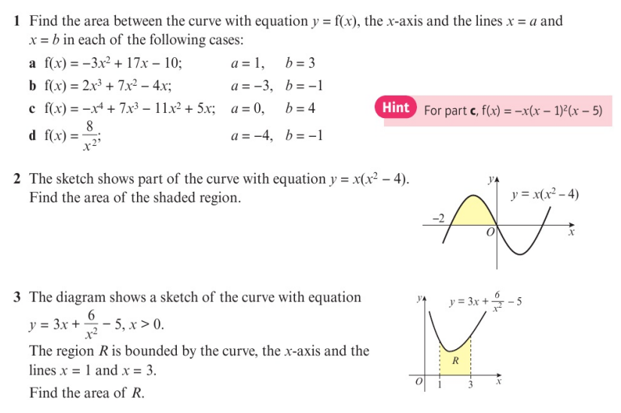
Homework Exercise

Slide 8
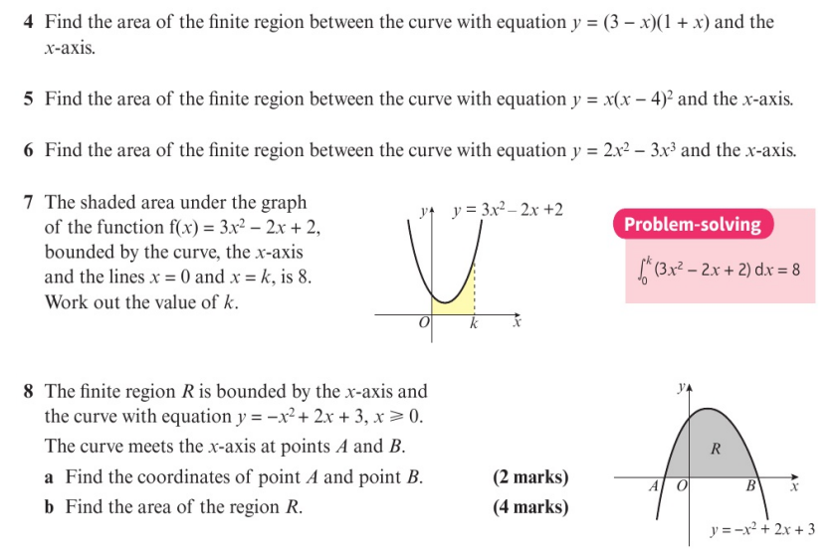
Homework Exercise

Slide 9
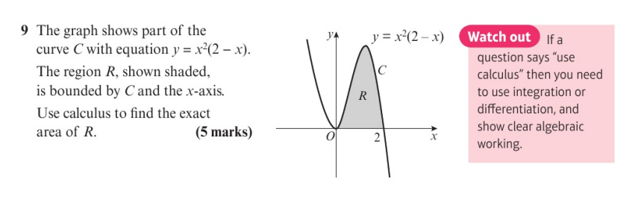
Homework Exercise

Slide 10
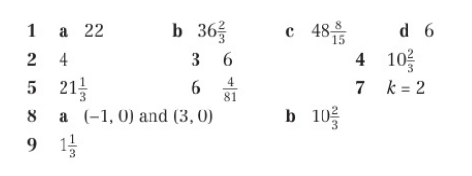
Homework Answers

