Slide 1
P2 Chapter 9: Differentiation Differentiating Sin and Cos

Slide 2
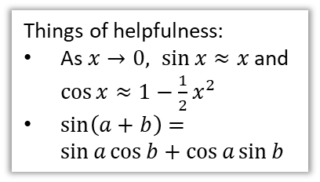
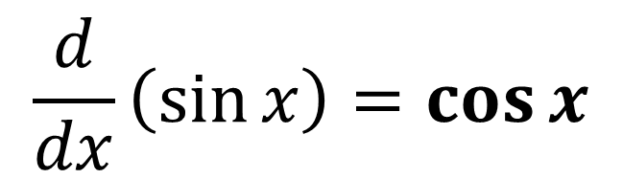



Differentiating trigonometric functions
$$\frac{d}{dx}\left(\sin{x}\right)=\cos{x}$$
?
Things of helpfulness:
As $x→0, \sin{x}≈x$ and $\cos{x}≈1−\frac{1}{2}x^{2}$
$\sin\left(a+b\right)=\sin{a}\cos{b}+\cos{a}\sin{b}$
Yes, you could be tested on this!
Proof
If $y=f(x)$ then $\frac{dy}{dx}=\lim_{h→0}{\frac{f\left(x+h\right)−f\left(x\right)}{h}}$
$$=\lim_{h→0}{\frac{\sin\left(x+h\right)−\sin\left(x\right)}{h}} \\ =\lim_{h→0}{\frac{\sin\left(x\right)\cos\left(h\right)+\cos\left(x\right)\sin\left(h\right)−\sin\left(x\right)}{h}} \\ =\lim_{h→0}\left(\left(\frac{\cos{h}−1}{h}\right)\sin{x}+\left(\frac{\sin{h}}{h}\right)\cos{x}\right)$$
Since $\lim_{h→0}{\sin{h}}≈h$, $∴$ $\lim_{h→0}{\frac{\sin{h}}{h}}≈\lim_{h→0}{\frac{h}{h}}=1$
Similarly, $\lim_{h→0}{\frac{\cos{h}−1}{h}}≈\lim_{h→0}{\frac{1−\frac{1}{2}h^{2}−1}{h}}=\lim_{h→0}{(−\frac{1}{2}h}) →0$
$$∴\frac{dy}{dx}=\lim_{h→0}\left(0\sin{x}+1\cos{x}\right)=\cos{x}$$
?
?
Use addition formula.
?
Collect $\sin{x}$ terms and $\cos{x}$ terms together.
?
Use small angle approximations to consider what the expressions in terms of $h$ will become.
?

Slide 3
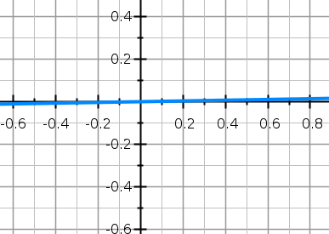
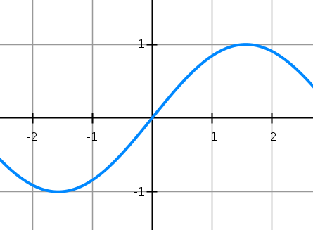

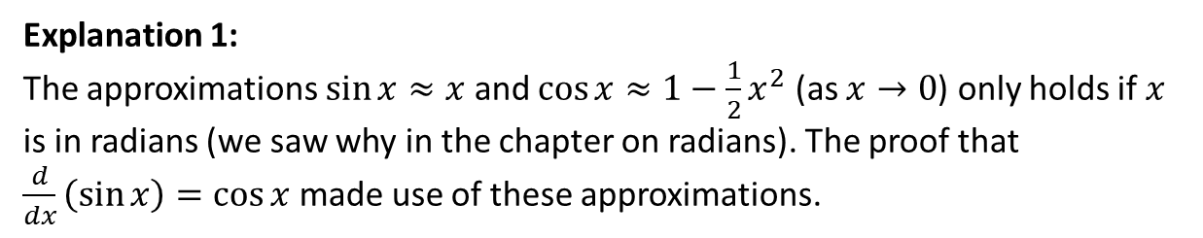



Why does this result only hold in radians?
Explanation 1:
The approximations $\sin{x}≈x$ and $\cos{x}≈1−\frac{1}{2}x^{2}$ (as $x→0$) only holds if $x$ is in radians (we saw why in the chapter on radians). The proof that $\frac{d}{dx}\left(\sin{x}\right)=\cos{x}$ made use of these approximations.
Explanation 2:
We can see by observation if we look at the graph of $\sin{x}$ in radians and in degrees.
$$y=\sin{x}$$
using radians
$$y=\sin{x}$$
using degrees
However when $x$ is in degrees, and again using the same scale for both axes, we can clearly see the gradient is much lower than 1.
If $\frac{d}{dx}\left(\sin{x}\right)=\cos{x}$ then the gradient when $x=0$ is $\cos{0}=1$. This looks right from the graph.

Slide 4

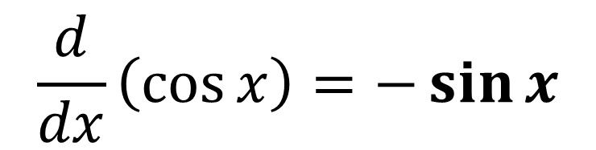

Differentiating trigonometric functions
$$\frac{d}{dx}\left(\cos{x}\right)=−\sin{x}$$
?
Memory Tip: The way I picture this in my head is this:
where moving ‘down’ is differentiating and moving up is integrating. If it’s the ‘wrong’ function (differentiating cos or integrating sin) the sign changes.
$$\sin{x}$$
$$\cos{x}$$

Slide 5
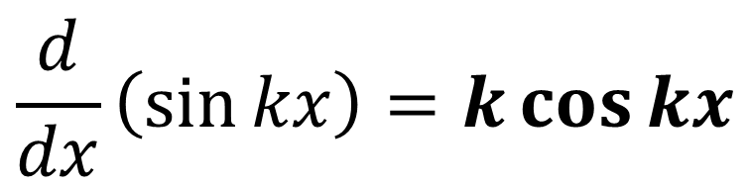
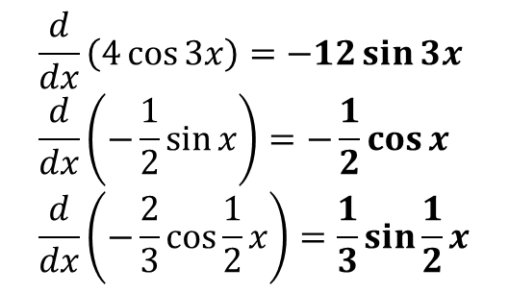
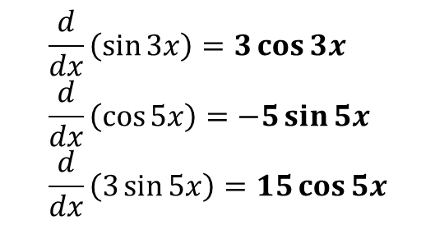
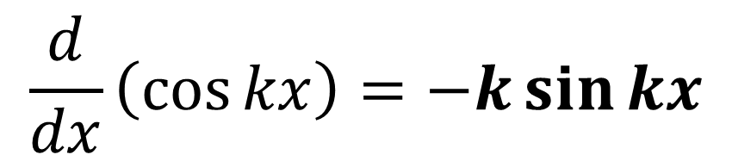
Differentiating $\sin{kx}$ and $\cos{kx}$
?
$$\frac{d}{dx}\left(\sin{kx}\right)=k\cos{kx}$$
$$\frac{d}{dx}\left(\cos{kx}\right)=−k\sin{kx}$$
?
Note: This is not a rule in itself but a specific case of the ‘chain rule’ which we’ll see later this chapter.
Quickfire Questions:
$$\frac{d}{dx}\left(\sin{3x}\right)=3\cos{3x} \\ \frac{d}{dx}\left(\cos{5x}\right)=−5\sin{5x} \\ \frac{d}{dx}\left(3\sin{5x}\right)=15\cos{5x}$$
$$\frac{d}{dx}\left(4\cos{3x}\right)=−12\sin{3x} \\ \frac{d}{dx}\left(−\frac{1}{2}\sin{x}\right)=−\frac{1}{2}\cos{x} \\ \frac{d}{dx}\left(−\frac{2}{3}\cos{\frac{1}{2}x}\right)=\frac{1}{3}\sin{\frac{1}{2}x}$$
?
?
?
?
?
?

Slide 6


Example
[Textbook] A curve has equation $y=\frac{1}{2}x−\cos{2x}$. Find the stationary points on the curve in the interval $0≤x≤π$.
?
$$\frac{dy}{dx}=\frac{1}{2}+2\sin{2x}=0 \\ 2\sin{2x}=−\frac{1}{2} \\ \sin{2x}=−\frac{1}{4} \\ 2x=−0.2527, 3.3943, 6.0305 \\ x=1.697, 3.015$$
When $x=1.697, y=\frac{1}{2}\left(1.697\right)−\cos\left(2×1.697\right)=1.82$
When $x=3.015, y=0.539$

Slide 7

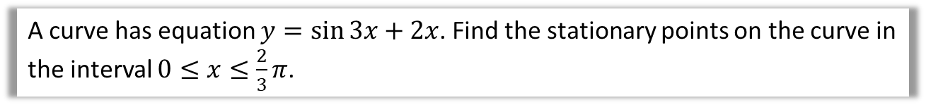
Test Your Understanding
A curve has equation $y=\sin{3x}+2x$. Find the stationary points on the curve in the interval $0≤x≤\frac{2}{3}π$.
?
$$\frac{dy}{dx}=3cos 3x+2=0 \\ 3\cos{3x}=−2 \\ \cos{3x}=−\frac{2}{3} \\ 3x=2.3005, 3.9827 \\ x=0.7668, 1.3276$$
When $x=0.7668, y=2.279$
When $x=1.3276, y=1.910$

Slide 8
Exercise 9.1
Pearson Pure Year 2
Page 70

Slide 9
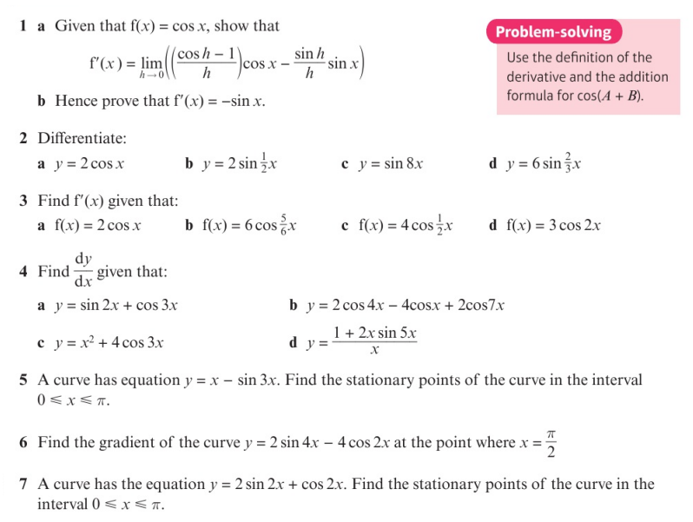
Homework Exercise

Slide 10
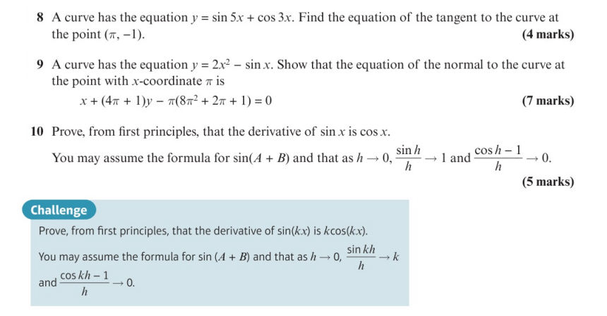
Homework Exercise

Slide 11
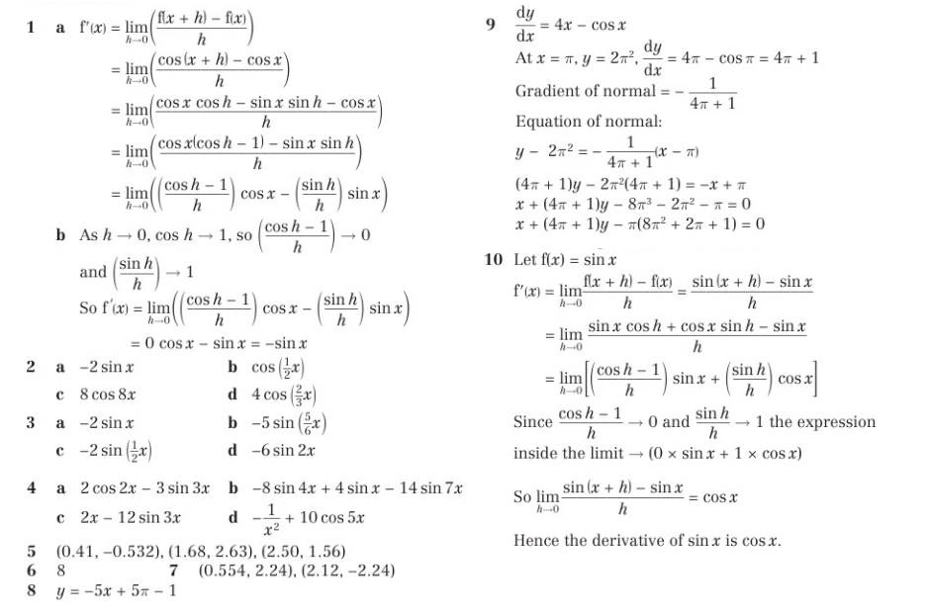
Homework Answers

Slide 12
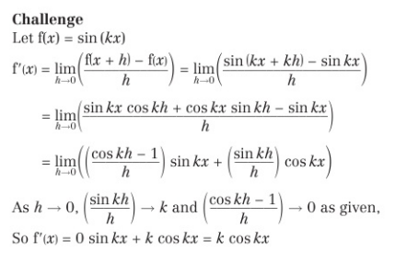
Homework Answers

